Slide 1


Image Segmentation

Slide 2
What is Image Segmentation?
Segmentation:
  Split or separate an image into regions (hopefully meaningful)
  To facilitate recognition, understanding, and region of interests (ROI) processing
Ill-defined problem
  The definition of a region is context-dependent. Do you split by color or texture or shape or content?

Slide 3
More…
Complete segmentation
  Each part corresponds to a real object
  No overlapping parts
Partial segmentation
  Regions of homogeneous brightness, texture, color, etc.
  Overlapping parts, needs further processing
Problem: Totally correct and complete segmentation of complex scenes usually cannot be achieved
Resolution: A reasonable aim is to use partial segmentation as an input to higher level processing.

Slide 4
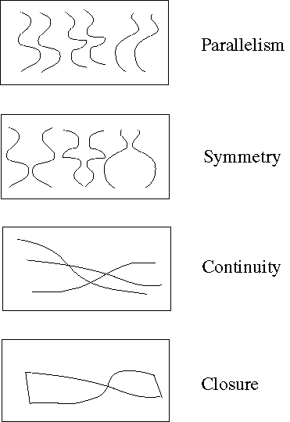
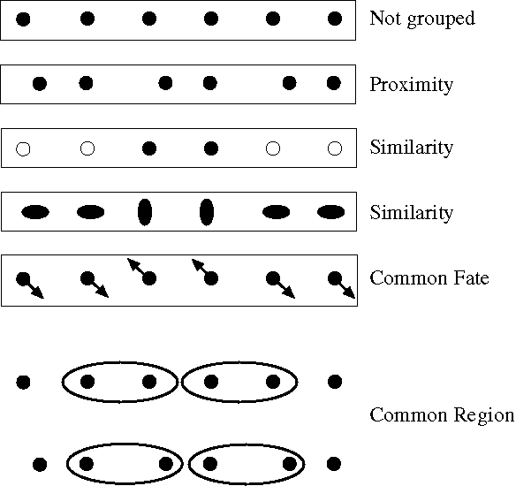
Some Human Ideas
We use different visual clues to “group” or segment together regions: Color, Texture and ….

Slide 5
Principal approaches
Segmentation algorithms generally are based on one of 2 basis properties of intensity values
  discontinuity:
  to partition an image based on abrupt changes in criteria (such as intensity - edges)
  similarity :
  to partition an image into regions that are similar according to a set of predefined criteria.

Slide 6
Segmentation Methods
Thresholding
Edge based segmentation
Region based segmentation
Motion segmentation
Segmentation through “learning”
NOTE: Segmentations resulting from different methods are not usually exactly the same.

Slide 7
Segmentation via Thresholding

Slide 8
Segmentation via Thresholding
Gray level or Color thresholding is the simplest segmentation process.
Many objects or image regions are characterized by constant reflectivity or light absorption of their surface.
It is computationally inexpensive and fast.
It can easily be done in real time using specialized hardware.
Complete segmentation can result from thresholding in simple scenes.

Slide 9
Algorithm for Threshold Segmentation using 1 global threshold for entire image
for(each pixel f(i,j) of image)
if f(i,j) >= T
is an object pixel (Group 1)
else
is a background pixel (Group 0)

Slide 10
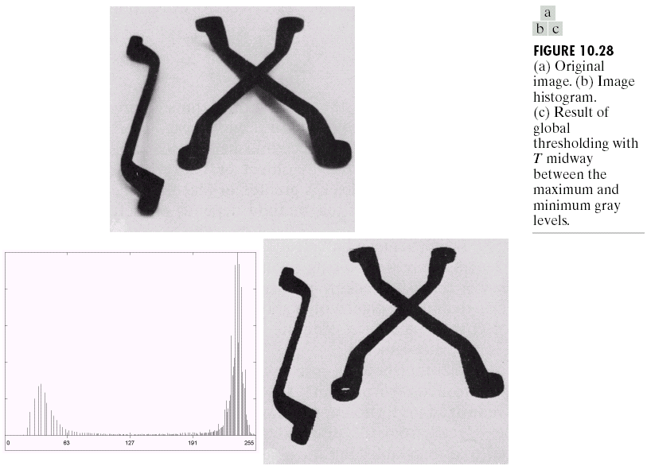
Threshold Example

Slide 11
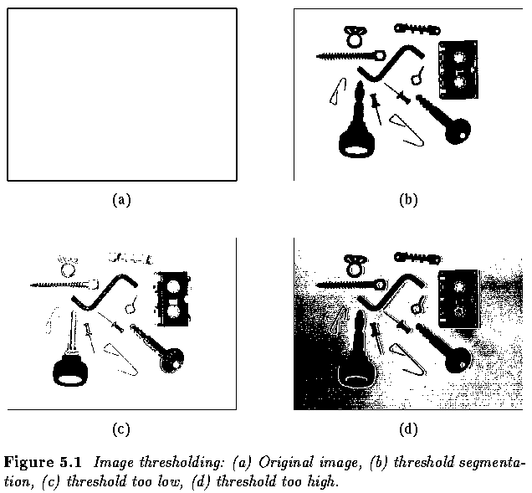

Threshold Selection is Important

Slide 12
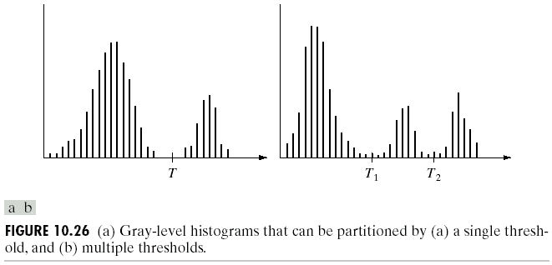


Threshold Selection using Histogram
Here Histogram tells us to use 1 threshold
to create 2 segments/groups, labeled
below as 0 or 1
This histograms suggest
we use more than 1 threshold

Slide 13
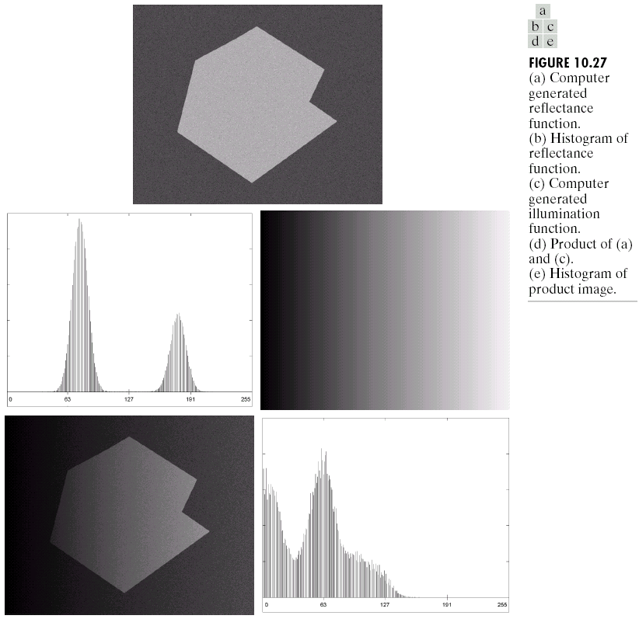
Effect of Illumination on Thresholding
easily use global thresholding
object and background are separated
(a)
(b)
difficult to segment
……But, its hard for
humans to segment the
left hand side of the
object in (d)
(c)
(e)
(d)

Slide 14
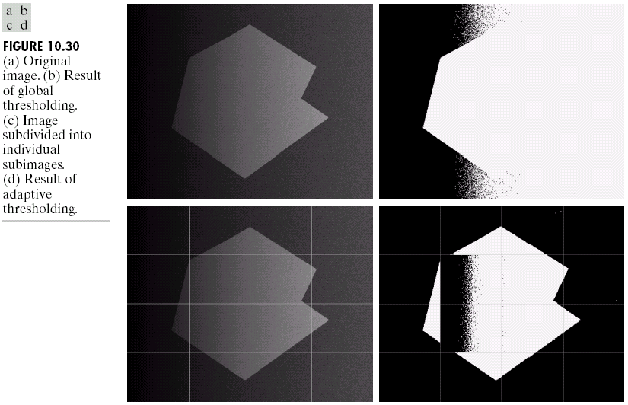
Adaptive (variable) Threshold
Threshold varies over the image as a function of local image characteristics, can produce the solution in these cases.
image f is divided into subimages fc
a threshold is determined independently in each subimage
if a threshold cannot be determined in some subimage, it can be interpolated from thresholds determined in neighboring subimages.
each subimage is then processed with respect to its local threshold.
f = entire image
fc = current sub-image

Slide 15
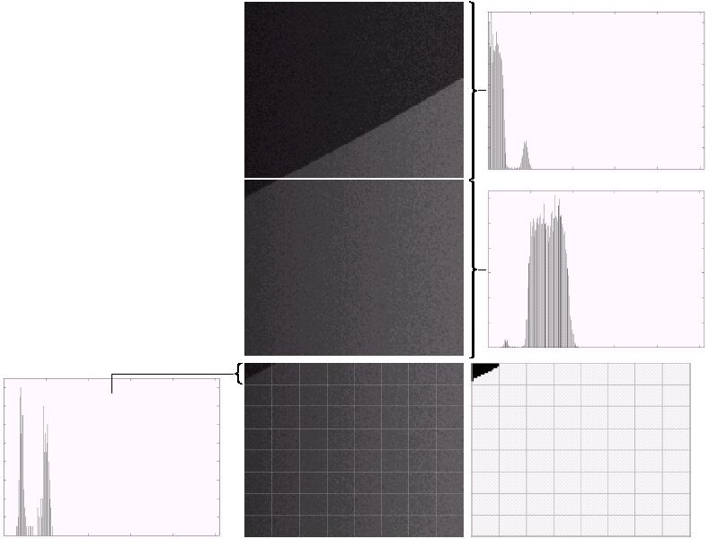
Needs of Local Threshold
Properly and improperly segmented subimages
Further division of the sub-image, and result of adaptive thresholding

Slide 16
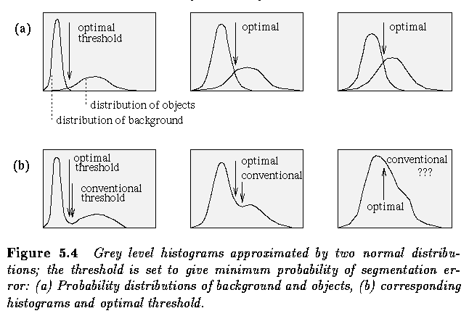
Optimal Thresholding
based on approximation of the histogram of an image using a weighted sum of two or more probability densities with normal distribution
The threshold is set as the closest gray level corresponding to the minimum probability between the maxima of two or more normal distributions, which results in minimum error segmentation

Slide 17
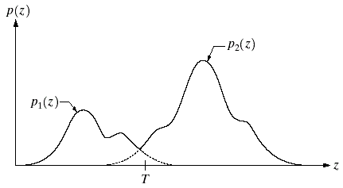
Threshold: Hypothesis Testing
Question:
  Does this pixel with intensity z belong to a region (edge) or not?
Hypothesis
  H₀: Null. It does not
  H₁: Alt. It does
Likelihood
  p(z|z∈H₀) = p₁(z)
  p(z| z∈ H₁) = p₂(z)
Prior
  P₁ = p(z∈H₀) ,
  P₂ = p(z∈H₁)
Maximum likelihood:
  Pixel z belongs to a region if p(z|H₁) > p(z|H₀)
Bayesian:
P₂ p(z|H₁) > P₁ p(z|H₀)
Sufficient statistic:
  z > T

Slide 18
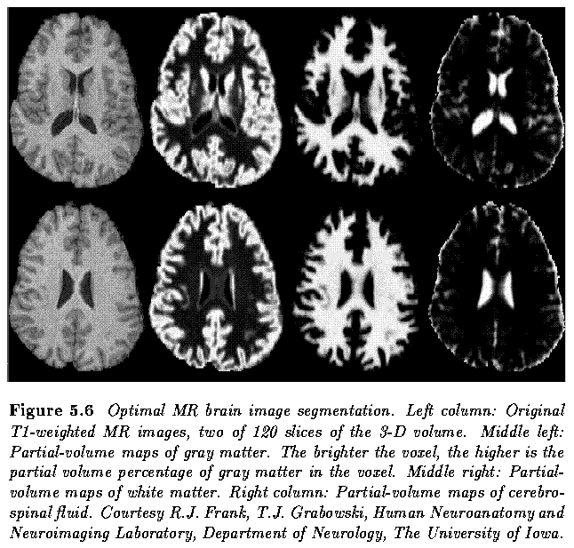
Thresholding Example – Magnetic Resonance Images
Original Image
Segment 1
Segment 2
Segment 3
Original Image
Segment 1
Segment 2
Segment 3

Slide 19
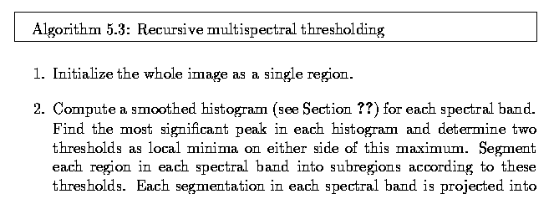
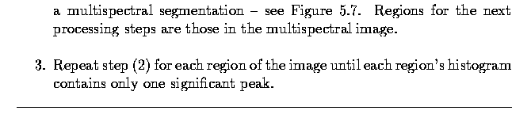
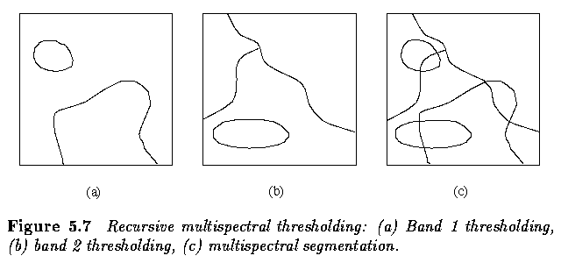
Color (multi-spectral) Thresholding
Determine thresholds independently in each spectral band and combines them into a single segmented image.

Slide 20



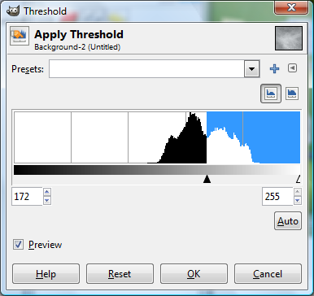
Another example – breast cancer mass detection
Here thresholding can create binary image that has (white) pixels belonging to blob
Original
image
Thresholded
image
Note: we have more than one “blob” segmented need to group (see previous lecture on blob detection in binary images) and eliminate too small blobs/segments
Gimp SW dialog box lets
us pick the best threshold
visualizing the histogram

Slide 21
Edge based Segmentation

Slide 22
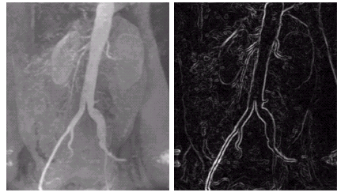
Edge based Segmentation
Edge Detect Image
    these edges mark image locations of discontinuities in gray level, color, texture, etc.
Combine edges into edge chains that correspond better with borders in the image.
Segments are regions contained in edge chains/borders.
Recall: the common way to detect edges is to run a mask through the image. We discuss in detail edge detection in a previous module.

Slide 23
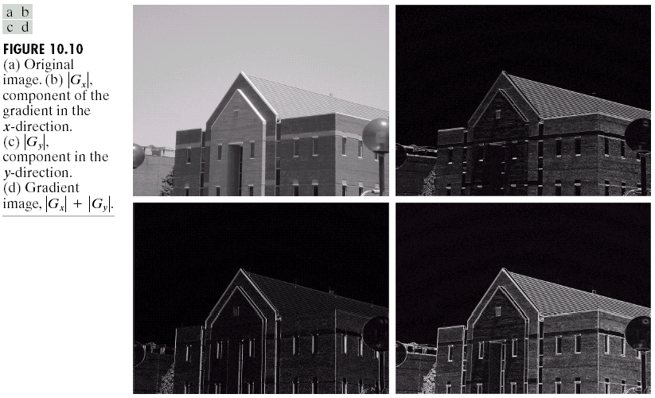
Approximate Gradient with L1 Norm

Slide 24
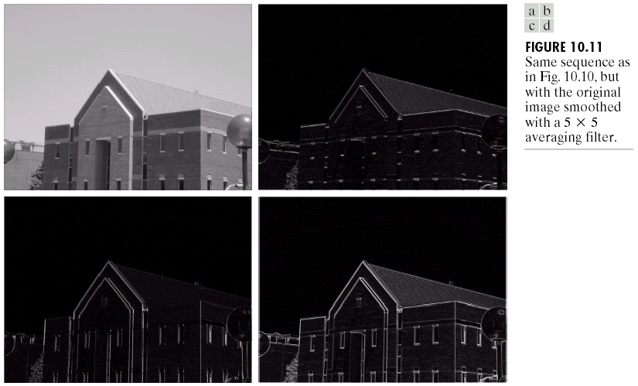
Effects of Smoothing

Slide 25
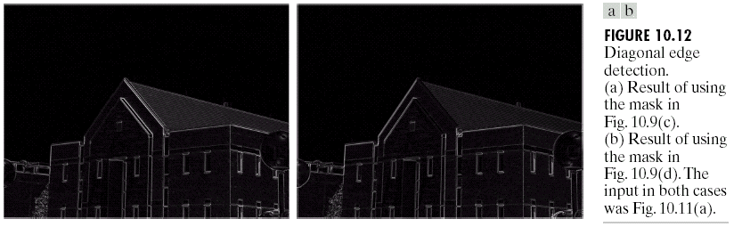
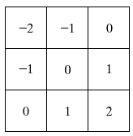
Emphasizing Diagonal Edges
Use diagonal Sobel operator shown in figure 10.9(d)

Slide 26
Comparison of Edge Detection
original
Sobel
LoG
Threshold LoG
Zero-crossing
Gradient method:
  suitable for abrupt gray level transition, sensitive to noise
2nd order derivative:
  good for smooth edges
Gaussian smooth operator
Laplacian operator

Slide 27
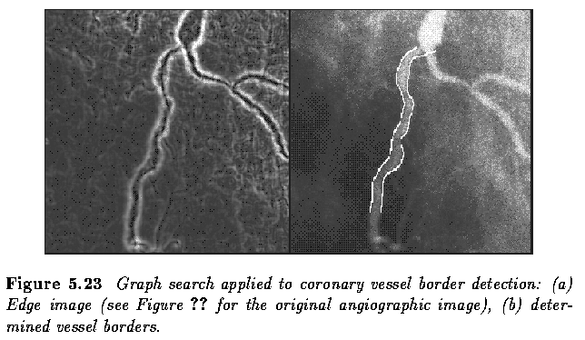
Edge Linking: Boundary Extraction
Adjacent or connected edge pixels should be linked together to form boundary of regions that segment the image.
Edge linking methods:
  Local processing
  Hough transform
  Graphic theoretic method
  Dynamic programming

Slide 28
Local Edge Linking
analyze the characteristics of pixels in a small neighborhood (say, 3x3, 5x5) about every edge pixels (x,y) in an image.
all points that are similar according to a set of predefined criteria are linked, forming an edge of pixels that share those criteria.

Slide 29
Criteria 1
the strength of the response of the gradient operator used to produce the edge pixel
  an edge pixel with coordinates (x₀,y₀) in a predefined neighborhood of (x,y) is similar in magnitude to the pixel at (x,y) if
  |∇f(x,y) - ∇f (x₀,y₀) | ≤ E

Slide 30
Criteria 2
the direction of the gradient vector
  an edge pixel with coordinates (x₀,y₀) in a predefined neighborhood of (x,y) is similar in angle to the pixel at (x,y) if
  |α(x,y) - α (x₀,y₀) | < A

Slide 31
Criteria
A point in the predefined neighborhood of (x,y) is linked to the pixel at (x,y) if both magnitude and direction criteria are satified.
the process is repeated at every location in the image
a record must be kept
simply by assigning a different gray level to each set of linked edge pixels.

Slide 32
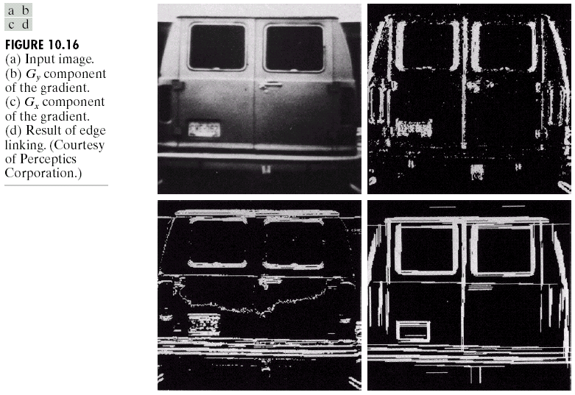
Local Edge Linking Results
An edge pixel will be linked to another edge pixel within its own neighborhood if they meet two criteria:

Slide 33
Region based Segmentation

Slide 34
Region based Segmentation
Three basic approaches:
  Region Merging
  Region Splitting
  Split and Merge Together

Slide 35
Region Merging Segmentation
Region merging/growing techniques are generally better in noisy images where edges are extremely difficult to detect.
Homogeneity of regions is used as the main segmentation criterion in region growing.
Possible criteria for homogeneity:
  gray level
  color, texture
  shape
  model

Slide 36
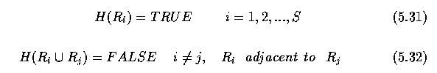
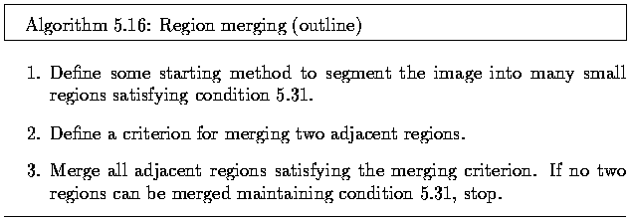
Region Merging Algorithm
Regions are defined such that Resulting regions of the segmented image must be both homogeneous (H) and maximal and non-overlapping.
Specific methods differ in the definition of the starting segmentation and in the criterion for merging.
The result of region merging usually depends on the order in which regions are merged.
The simplest methods begin merging by starting the segmentation using regions of 2x2, 4x4 or 8x8 pixels.

Slide 37
Region Merging Heuristics
Merging heuristics:
  Two adjacent regions are merged if a significant part of their common boundary consists of weak edges
  Two adjacent regions are also merged if a significant part of their common boundary consists of weak edges, but in this case not considering the total length of the region borders.
Of the two given heuristics, the first is more general and the second cannot be used alone because it does not consider the influence of different region sizes.

Slide 38
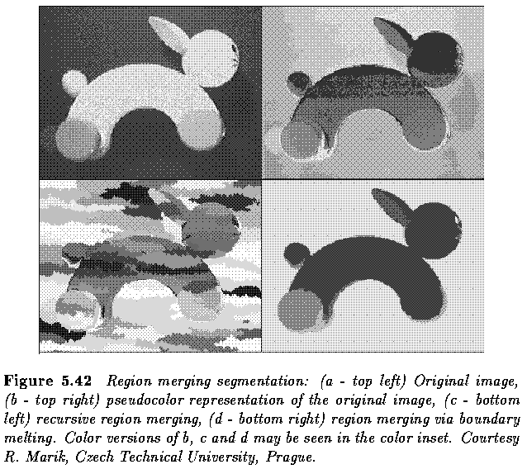
Region Merging Results

Slide 39
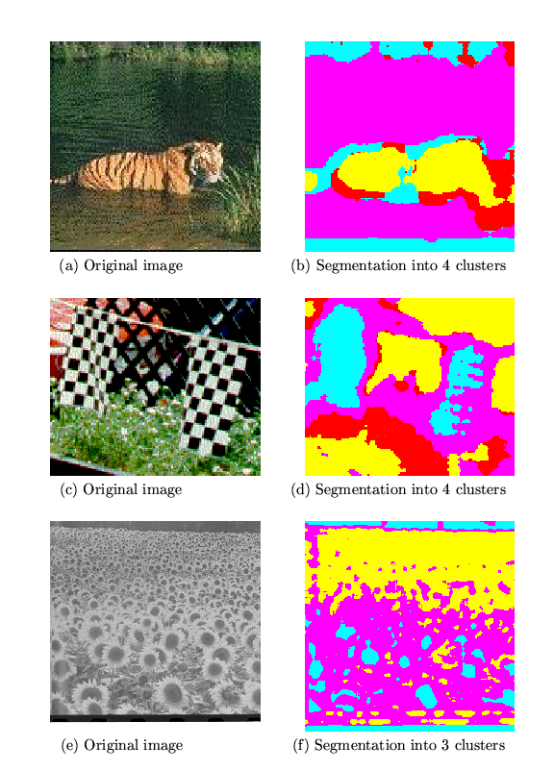
Another Region Merging Sample
Here merge if
texture is similar

Slide 40
Region Merging – Post processing?
Region growing often results in undergrowing or overgrowing as a result of non-optimal parameter setting.
A variety of post-processors has been developed.
Some of them combine segmentation information obtained from region growing (next slide) and edge-based segmentation.
Simpler post-processors are based on general heuristics and decrease the number of small regions in the segmented image that cannot be merged with any adjacent region according to the originally applied homogeneity criteria.

Slide 41
Region Merging –Simple Algorithm
The simplest algorithm initializes by breaking up the image into NxN adjacent non-overlapping segments/regions.
N may be as small as 2

Slide 42
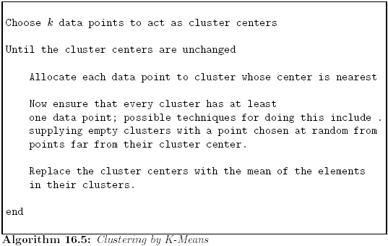
Region Merging –K Means – a more complex starting point?
Choose a fixed number of regions (called clusters in this algorithm)
Choose cluster/region centers and point-cluster allocations to minimize error
Note: distance
is NOT spatial
distance, but,
distance in one or
more feature values
-like texture, color,
grey value

Slide 43
K-Means clustering
Select a value of K (how this is a tricky part)
Select a feature vector for every pixel (color, texture, position, or combination of these etc.)
Define a similarity measure between feature vectors (Usually Euclidean Distance IN feature space).
Apply K-Means Algorithm.
Apply Connected Components Algorithm.
Merge any components of size less than some threshold to an adjacent component that is most similar to it.

Slide 44
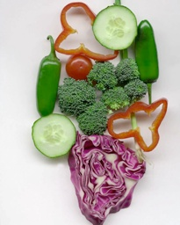
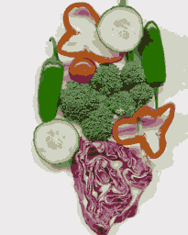
K Means Clustering Results
Here is done with K=11, and cluster based on color
Original
K Means Cluster Results
(this is a psuedo colored Label map)

Slide 45
K Means Clustering – What is K???
Option A: Use a prior knowledge about image.
    Maybe you have manufacturing environment where you know there are 2 different objects and one homogenous background
Option B: Try different values of K and test for goodness of clusters and take best.
    There are many versions of this technique proposed.
    One idea of goodness is that the sum of the variance of the feature(s) for each cluster is minimum. The smaller this value, the more homogenous, in terms of this feature(s), are the clusters.
Option C: Analyze Image Histograms.
Option D-*: there are many others proposed in literature.
Difficult Part of this Algorithm

Slide 46
Region Splitting Segmentation
Region splitting is the opposite of region merging.
It begins with the whole image represented as a single region which does not usually satisfy the condition of homogeneity.
The existing image regions are sequentially split to satisfy all the above given conditions of homogeneity.
Region splitting methods generally use similar criteria of homogeneity as region merging methods, and only differ in the direction of their application.

Slide 47
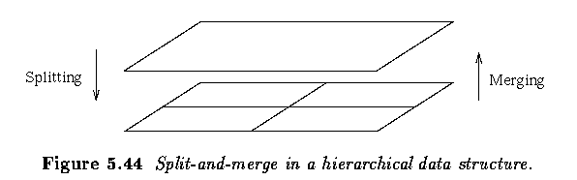
Split and Merge Algorithms
A combination of splitting and merging may result in a method with the advantages of both approaches.
Split-and-merge approaches work using pyramid image representations; regions are square-shaped and correspond to elements of the appropriate pyramid level. (uses quadtree data structure to split image into different levels of smaller and smaller regions)

Slide 48
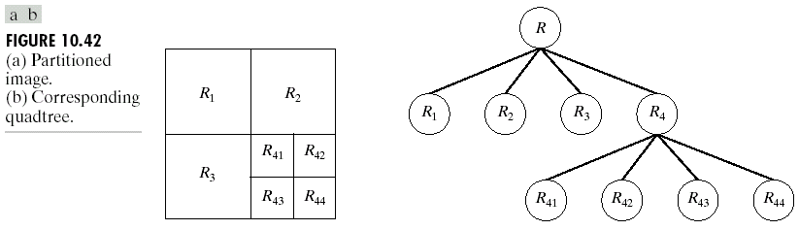
Split and Merge Algorithm
Quadtree
Using Quadtree structure viewed above to do image splitting and merging
Split into 4 disjoint quadrants any region R_{i} for which
Homogeneous(R_{i}) = FALSE
Merge any adjacent region R_{j} and R_{k} for which
Homogeneous(R_{j} ∪ R_{k} ) = TRUE
Stop when no further merging or splitting is possible.

Slide 49
Split …
1
1
1
2
3
2
3
2
3
4
4
4
1
1
2
3
2
3
4
4

Slide 50
Merge …
1
1
1
2
2
3
2
3
3
4
4
4

Slide 51
Quadtree Representation
1
1
1
2
3
2
3
2
3
4
4
4
Not uniform
uniform

Slide 52
Split and Merge Explained
Can sometimes find free/cheap implementations on the web….
If any region in any pyramid level is not homogeneous (excluding the lowest level), it is split into four subregions -- these are elements of higher resolution at the level below.
If four regions exist at any pyramid level with approximately the same value of homogeneity measure, they are merged into a single region in an upper pyramid level.
The segmentation process can be understood as the construction of a segmentation quadtree where each leaf node represents a homogeneous region.
Splitting and merging corresponds to removing or building parts of the segmentation quadtree.
Split-and-merge methods usually store the adjacency information in region adjacency graphs (or similar data structures).
Using segmentation trees, in which regions do not have to be contiguous, is both implementationally and computationally easier.
An unpleasant drawback of segmentation quadtrees is the square region shape assumption
  merging of regions which are not part of the same branch of the segmentation tree
Because both split-and-merge processing options are available, the starting segmentation does not have to satisfy any of the homogeneity conditions.

Slide 53
Video Segmentation

Slide 54
Video Segmentation
Can do same kind of segmentation on each image frame separately, but, can also use motion and between frame differences to help.

Slide 55
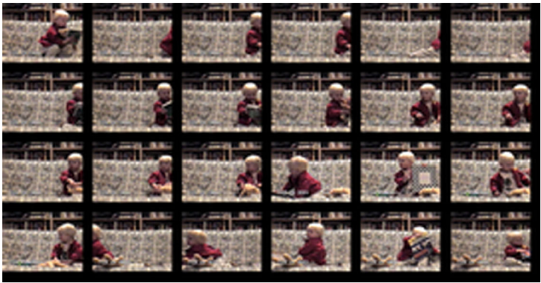

Slide 56
Technique: Background Subtraction
If we know what the background looks like, it is easy to identify “interesting bits”
Applications
  Person in an office
  Tracking cars on a road
  surveillance
Approach:
  use a moving average to estimate background image
  subtract from current frame
  large absolute values are interesting pixels
    trick: use morphological operations to clean up pixels

Slide 57
Technique: Shot Boundary Detection
Find the shots in a sequence of video
  shot boundaries usually result in big differences between succeeding frames
Strategy:
  compute interframe distances
  declare a boundary where these are big
Possible distances
  frame differences
  histogram differences
  block comparisons
  edge differences
Applications:
  representation for movies, or video sequences
    find shot boundaries
    obtain “most representative” frame
  supports search

Slide 58
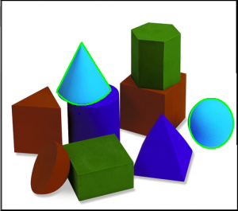
OpenCV Contour deteciton
Detect boundaries (contours) of already segmented labeled image
See http://www.cuelogic.com/blog/opencv-contour-detection-in-android-2/

Slide 59
OpenCV
Has method to find contours / boundaries of segmented image –can be useful

Slide 60
OpenCV example
//”segment” image by making binary image of
//pixels in a certain color range –like finding the
// orange in the shopping cart
Core.inRange(rgbaImage, mLowerBound, mUpperBound, segmentImage_binary);
//dilate to fill in some potential holes in binary blobs
Imgproc.dilate(segmentImage_binary, dilated_segmentImage_binary, new Mat());

Slide 61

OpenCV example
//detect contours given binary image
List<MatOfPoint> contours = new ArrayList<MatOfPoint>();
Imgproc.findContours(dilated_segmentImage_binary, contours, mHierarchy, Imgproc.RETR_EXTERNAL, Imgproc.CHAIN_APPROX_SIMPLE);
//draws all the contours in red with thickness of 2
// on top of original rgbaImage
Imgproc.drawContours(rgbaImage, contours, -1, new Scalar(255, 0, 0), 2);

Slide 62
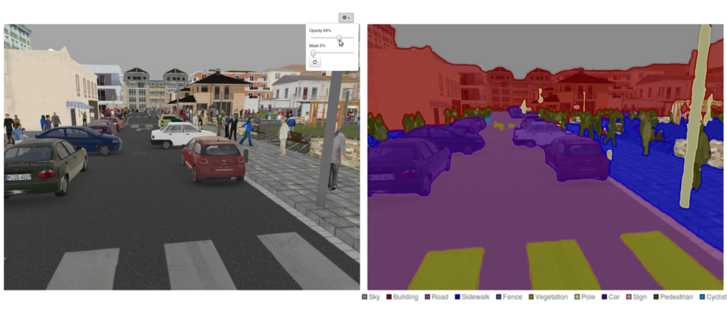
More on Segmentation
Scene or Semantic Segmentation

Slide 63
Up to now
We have been focused on directly looking for “connected” regions
There is something called scene or semantic segmentation → it is focused on object recognition

Slide 64
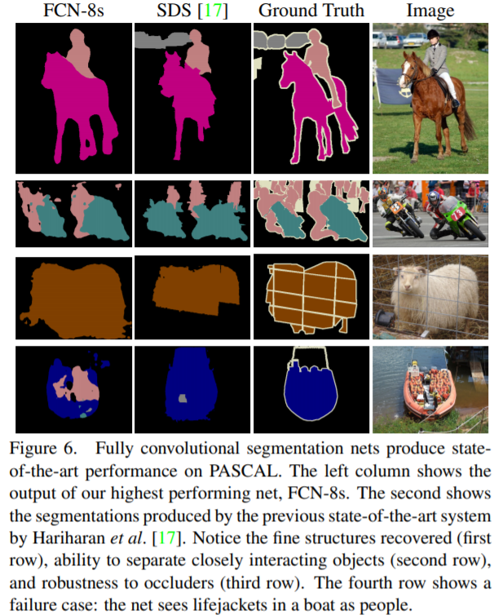
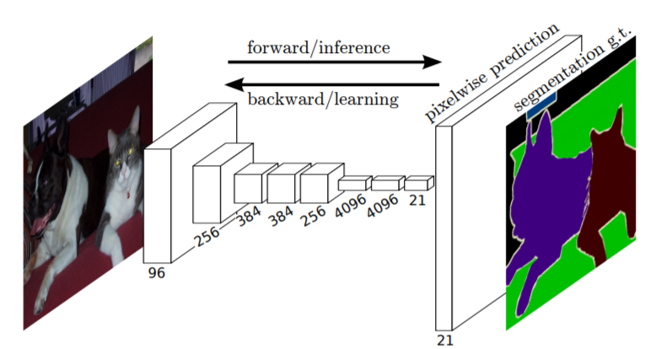
Idea: use deep learning networks to identify objects and pixels used in decision become grouped together into “object segment
Introduced in https://people.eecs.berkeley.edu/~jonlong/long_shelhamer_fcn.pdf
First we must learn about recognition → future lecture!!! More to come!

