Slide 1

Feature Detection – the beginning

Slide 2

RECALL: Example structure of a general Computer Vision problem
Knowledge Base
Problem
Image
Acquisition
Pre-processing
Feature
Extraction
Analysis
Interpretation
Sensor
Illumination
Noise
Img enhancement
Transform
Lines
Corners
Contours
Regions
Optical flow
In many vision systems, feature extraction is a “mid-level” stage in the
system.

Slide 3
The beginning?
We have already looked at some “features” when we discussed Binary Images
We are going to look for features now in any kind of image (color, grey scale or binary).

Slide 4
What is a Feature?
That is an inserting question…and really depends on the “objects” and data you are dealing with.
In general, features are distinguishing pieces of information for the “object(s)” in the scene or image itself.

Slide 5
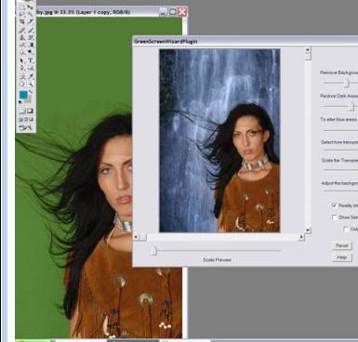
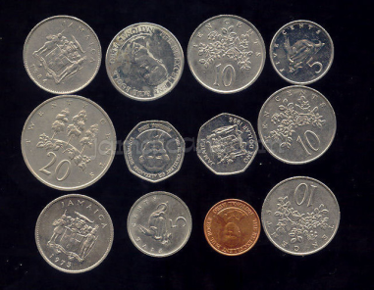
What do you mean “object” or image?
features are distinguishing pieces of information for the “object” or image
Image BASED: Some tasks we might only be thinking of the image (or part of it) in our task.
  Example: Find the green in a “green screen system ” to remove background and create a new composed background
Object BASED: Some tasks we think about objects in our image.
  Example: the coins in the image are our objects.
  Most vision systems are “Object-based”.
Taken from
http://image.wareseeker.com/software/Graphic-Apps/Editors/details_green-screen-wizard-photoshop-plugin-1.5.jpg

Slide 6
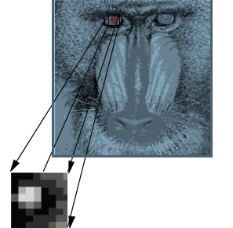
Some Image-based Features (not object-based) for vision systems
Average Color or Greyscale (of area of image) …or other statistics like median, variance.
Texture
Transformed Image Values
(i.e. frequency values)
WE ALREADY looked at these in previous lectures. The decision left is do you to it for an entire image or be block-based, breaking up image into smaller MxM regions?

Slide 7
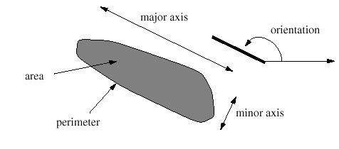
Object-Based Features
Lets move on to the (possibly) more complex idea of Object –based features.
We saw the beginning of this with our lecture on Binary Image Processing and Blob (our objects) features.

Slide 8
Object-Based Features…First the Object
This is really a hard set of questions:
    What are the objects we care about?
    Where are they in the image?
    Will we always see the same view of our (3D) object? Or is it a 2D object (a character in OCR)?
    Will we always see the entire object or can it be occluded by others or only partially in a scene?
    Will the properties (i.e. color, shape, etc) of the object change (i.e. someone’s face-makeup, expressions?
    Will the scale of the object change (close by, far away)?
    THERE ARE MANY MORE questions…..and figuring out what the right questions are for your computer vision task is part of the discovery (problem).

Slide 9
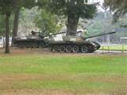
Examples of some questions
What are the objects?
    In this image we care about the tanks and not the trees, grass, sky and other items in the scene.
    Understanding what objects you care about is really IMPORTANT and not always trivial. Sometimes we have a category of “other” to signify other objects.

Slide 10
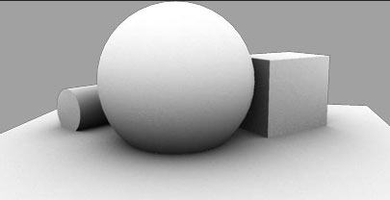
Examples of some questions
Occlusion ?-
    Here the cube and cylinder are occluded by the sphere.

Slide 11
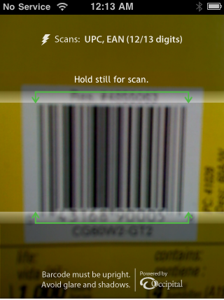
Examples of some questions
  Will we always see the same view of our (3D) object? Or is it a 2D object (a character in OCR)?
In this example – RedLaser iPhone
App the user is expected to take a
Picture of the barcode inside the
“green” indicated image area.
This is an example of a very constrained
view. In this usage, it is not a
bad constraint and certainly makes the
vision problem easier.

Slide 12
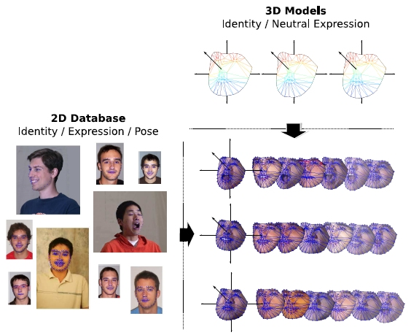
Examples of some questions
  Will the properties (i.e. color, shape, etc) of the object change (i.e. face detection - someone’s face chages with makeup, expressions, hair)?
Taken from
http://humansensing.cs.cmu.edu/projects/oprml.html

Slide 13
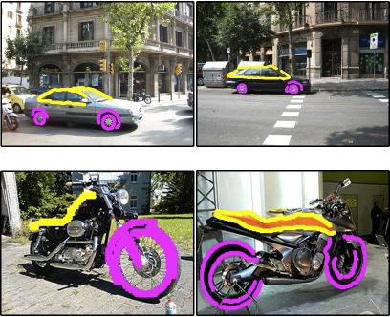
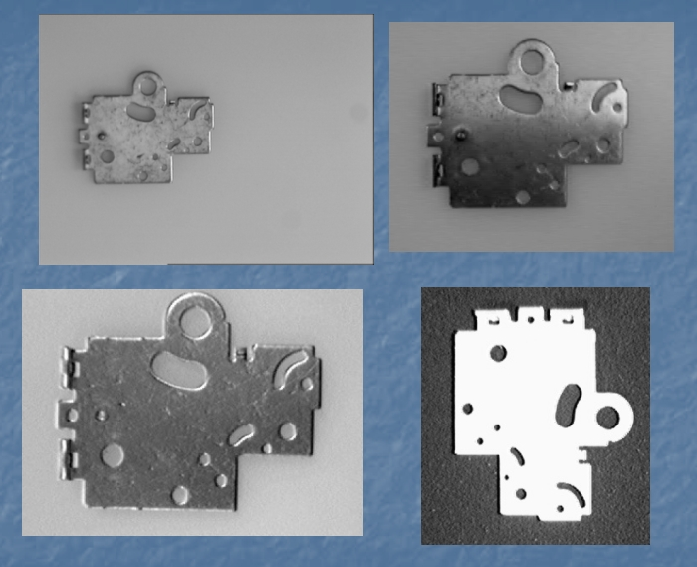
Examples of some questions
  Will the scale of the object change (close by, far away)? …
      what is the range and how does the object change.
Objects and different
scales
Taken from http://web.engr.oregonstate.edu/~sinisa/
Taken from
http://vpa.sabanciuniv.edu/projects/festo/

Slide 14
Examples of some questions
  THERE ARE MANY MORE questions…..and figuring out what the right questions are for your computer vision task is part of the discovery (solving the problem).
  Finding out the questions ….leads to what features about the object are useful in recognition!!!
      Example: If scale varies so greatly the object does not retain similar geometric properties or parts…maybe we have to break it down into different systems for different scales…or maybe we look at non-geometric properties like color and texture instead!!

Slide 15
Geometric based Object Features
Edges
Boundaries
Lines, Curves
Corners and points of inflection
Surfaces

Slide 16
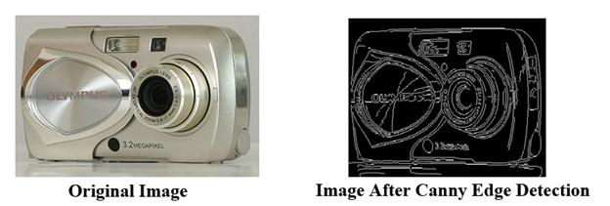
Geometric based Object Features
Edges
Taken from
http://www.odec.ca/projects/2008/niel8c2/

Slide 17
Edges as Features
What Edges Detection Algorithm?
Which Edges?

Slide 18
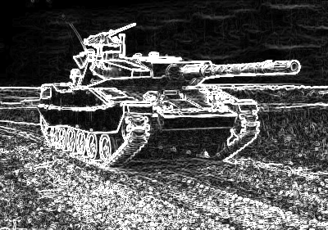
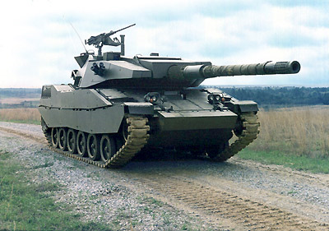
Edges as Features
What Edges Detection Algorithm?
  There are many.
Sobel
Edge
Detector
Original Image f
H_{v}
H_{h}
log[ (f*H_{v})² + (f*H_{h})² ]
Too many edges?

Slide 19
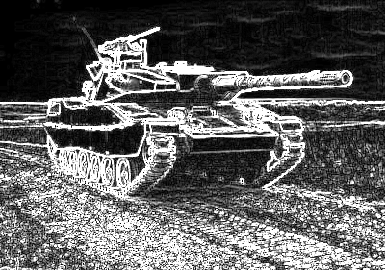
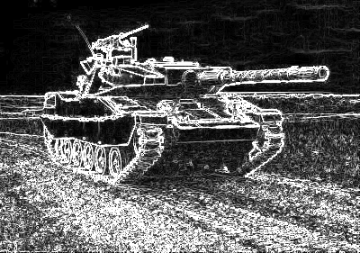
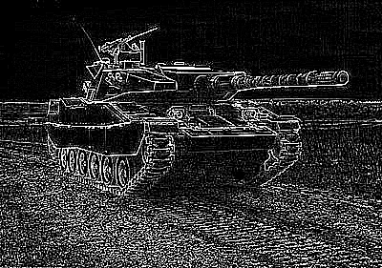
How to select an Edge Detection Algorithm
Idea 1: run on test data and “
see” (by observation or measurement) which gives best results.
    Below are some common edge detectors
Sobel | Prewitt | Roberts | Laplacian

Slide 20
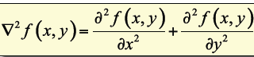
How to select an Edge Detection Algorithm
Idea 2: There is some theory behind the use of the Laplacian (2nd derivative) that the zero crossings are continuous ….theoretically solves problem of edges disconnectivity.
Edge points are the zero crossings of the Laplacian
Note how these
Edges look different than
Other edge detectors on previous slide….are more connected….look at the ground

Slide 21
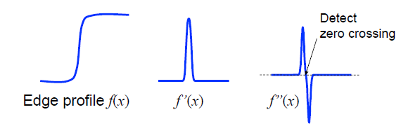
Laplacian
Why edges = zero crossings of 2nd derivative
Across an edge
in the image
the grey values
go from lower value
to higher value at
the point of an edge
First Derivative of
this location is a
peak
2nd Derivative of
this location results in
an up peak followed by
a down peak…at the ZERO
CROSSING is the edge point
Image from Bernd Girod: EE368 Digital Image Processing,
http://www.stanford.edu/class/ee368/

Slide 22
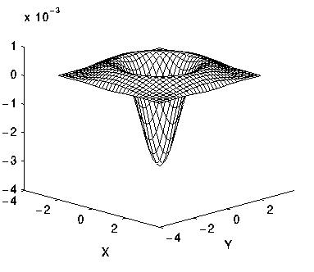
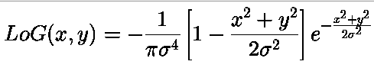
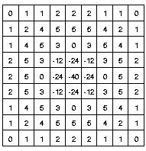
One Problem with Laplacian Edge Detector
Results in typically too MANY edge points
  Solution: Smooth image first with Gaussian (or another smoothing) function to reduce noise (and their edges)
  Called Laplacian of Gaussian (LoG), edge points are the zero crossings of image convolved with LoG
  Parameter σ increases width of trough of the curve
Discrete LoG
with σ=1.4
Taken from http://homepages.inf.ed.ac.uk/rbf/HIPR2/log.htm

Slide 23
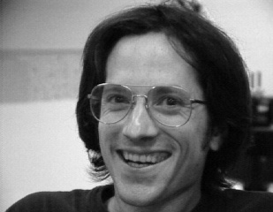
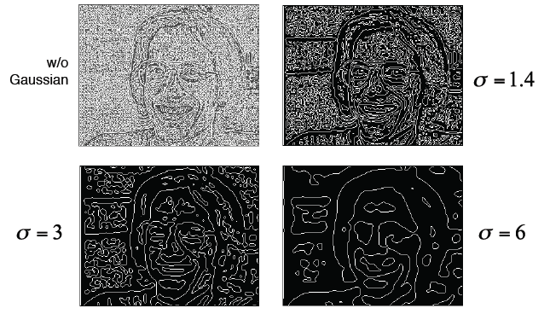
LoG as an Edge Detector
With changing σ get different results.
As you increase σ
you get wider Gaussian
and more smoothing.
This is like saying only
keep edges that correspond
to boundaries of larger
grey (or color) change
Taken from Bernd Girod: EE368 Digital Image Processing,
http://www.stanford.edu/class/ee368/

Slide 24
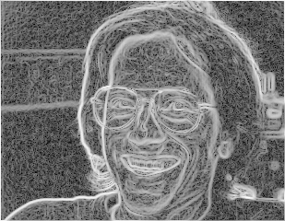
Edges as Features
Which Edges?
    Often too many
Sobel
Edge
Detector
Original Image f
H_{v}
H_{h}
log[ (f*H_{v})² + (f*H_{h})² ]
Too many edges?

Slide 25
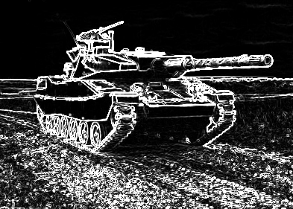
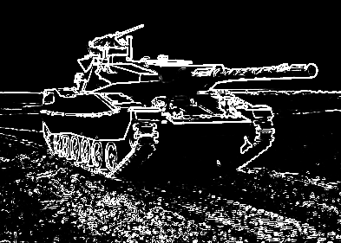
Edges as Features
Too many Edges → Threshold
g= log[ (f*H_{v})² + (f*H_{h})² ]
Original Image f
Sobel
Edge
Detector
Lower Threshold
Mid Threshold
If g < Threshold
g= 0 //get rid of it

Slide 26
Thresholded Edges
New question – what should the threshold be?
    Answer 1: test….look at the results with as much test data as you have and time allows and hand select a good threshold
    Answer 2: could instead of picking a set number, take the top X% of edge points.
    Answer 3: Use histogram of edge values to help you determine threshold (see previous lecture on histograms)
Lower Threshold
Mid Threshold

Slide 27
Too Many Edges – another Idea
Use the Canny Edge Detector.
  Canny who developed this edge detector so that image noise should not create false edges.
  To satisfy these requirements Canny used the calculus of variations .
  The optimal function in Canny's detector is described by the sum of four exponential terms, but can be approximated by the first derivative of a Gaussian.

Slide 28
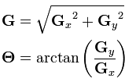
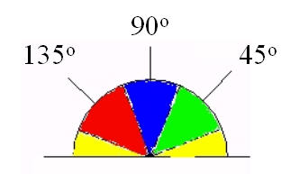
Canny Edge Algorithm
Step 1) Like LoG to reduce edges from noise, does a Gaussian first.
Step 2) Unlike LoG, does then a first (not second) derivative.
the Canny algorithm uses filters to detect horizontal, vertical and diagonal edges in the blurred image. The edge detection operator (Roberts, Prewitt, Sobel for example) returns a value for the first derivative in the horizontal direction (Gy) and the vertical direction (Gx).
From this the edge gradient and direction can be determined: - Θ is rounded to 4 directions
NOTE: get direction by
Calculating Θ AND rounding
it to one of the values of 0 (horizontal
edge) , 45 (diagonal), 90 (vertical)
and 135 degrees (diagonal)

Slide 29
Canny Edge Detector continued
Step 3) IMPORTANT Stage that reduces noise edges is called, “Non-Maximum Suppression”
a search is then carried out to determine if the gradient magnitude assumes a local maximum in the gradient direction. ONLY these local maximum are kept as edge points, others are left at zero.
      For every pixel G(x,y)
      { //apply Non-maximum Suppression
      if G(x,y) is the maximum in a 3x3 neighborhood //note 3x3 can change
      { do nothing; }
      else
      {G(x,y) =0; } //suppress-eliminate this edge
      }
This will give a thin line in the output image.

Slide 30
Canny Edge Detector continued
Step4) Last stage which further eliminates weak edges is called “Hysteresis Thresholding”
    We know it is difficulty often to pick a threshold .
    Canny uses thresholding with hysteresis.
    requires two thresholds – high and low.
    Begin by applying a high threshold. This marks out the edges we can be fairly sure are genuine. Starting from these, using the directional information derived earlier, edges can be traced through the image. While tracing an edge, we apply the lower threshold, allowing us to trace faint sections of edges as long as we find a starting point.
      For every pixel G(x,y)
      { //apply maximum threshold
      if( G(x,y) < high_Threshold)
      G₁ (x,y) = 0;
      else
      G₁ (x,y) = 1;
      }
      //trace the edges in G₁ and use low_threshold
      For every pixel G₁ (x,y) = 1
      { LOOP: starting at point G₁ (x,y) go in direction of Θ(x,y) – to new location x’,y’
      { if(G (x’ ,y’) > low_threshold)
      G₁ (x’ ,y’) = 1 //set as an edge point
      x=x’;
      y=y’’;
      go to LOOP;
      }
      }
Takes edge points we know for sure and from that traces out looking for connected weaker (low_threshold) edge points

Slide 31
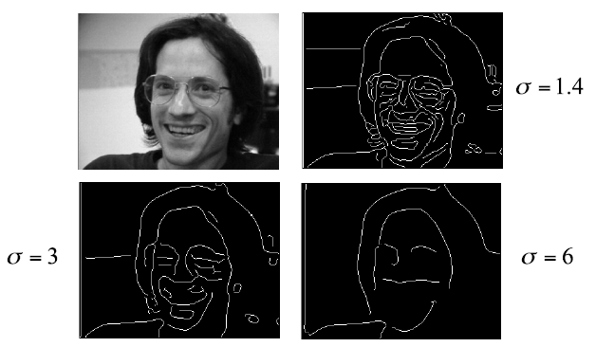
Some Canny Edge Detection Results
Note: σ is the Gaussian Parameter
Image taken from Bernd Girod: EE368 Digital Image Processing,
http://www.stanford.edu/class/ee368/

Slide 32
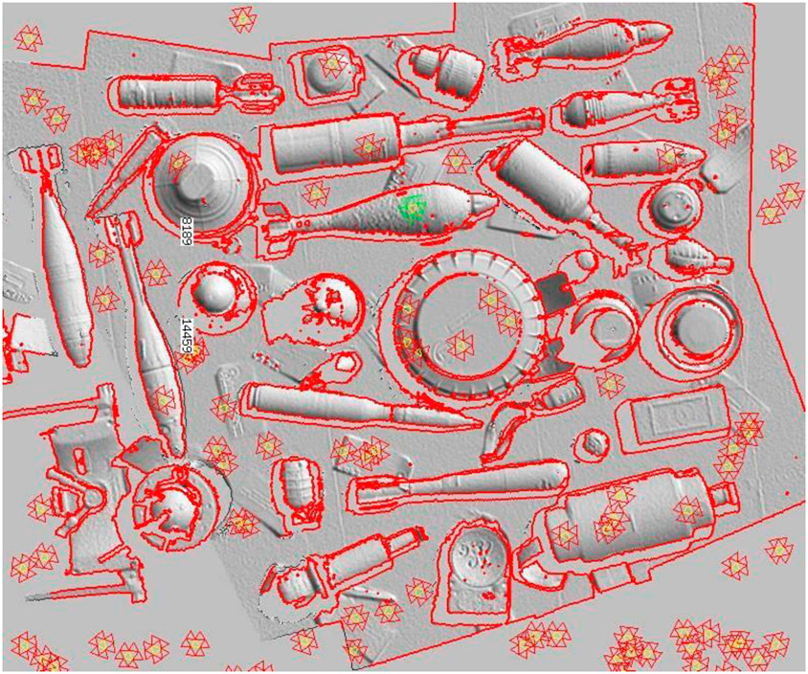
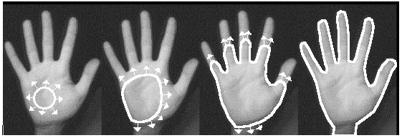
Geometric based Object Features
Boundaries
Taken from
http://spie.org/x40762.xml?ArticleID=x40762
Taken from
http://www.bmva.ac.uk/bmvc/1997/papers/013/paper.html

Slide 33
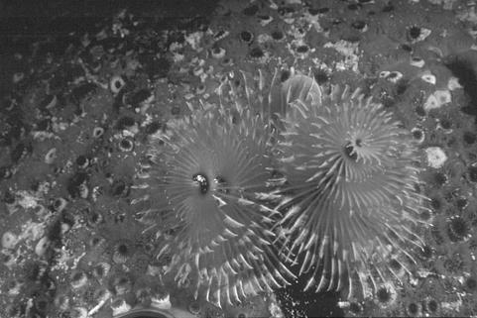
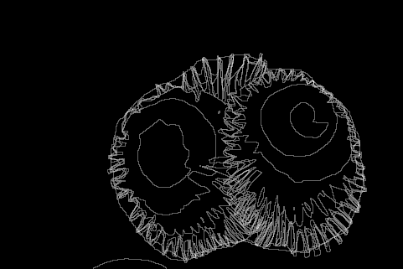
Boundary Detection
Sometimes easy for humans and sometimes not.
HUMAN drawn boundaries
Images from
http://www.eecs.berkeley.edu/Research/Projects/CS/vision/grouping/segbench/bench/html/images.html

Slide 34
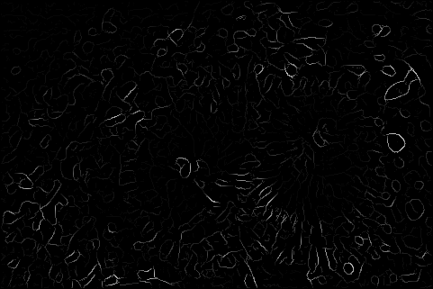
Boundary Detection
Idea 1: Use Edges
  What edge detection? (see discussion before)
  Edges are broken, not continuous as you may want. (see discussion before)
      Can we connect the edges somehow?
  Edge images often have more detail that what humans select as boundaries
      Can we filter and somehow only choose the best edges?
Original | Machine Edge Detection | Human Drawn Boundaries

Slide 35
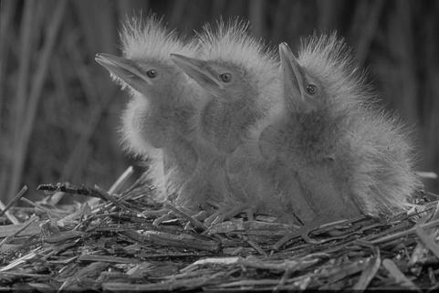
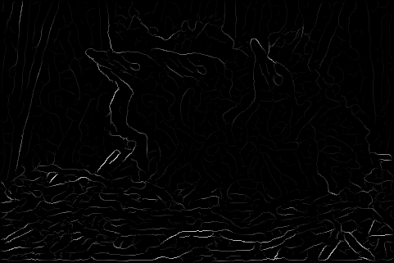
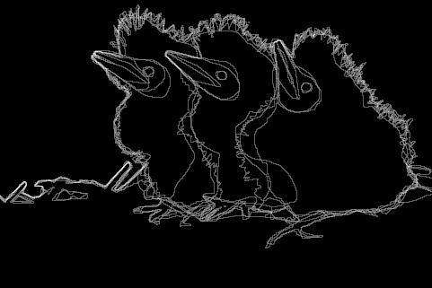
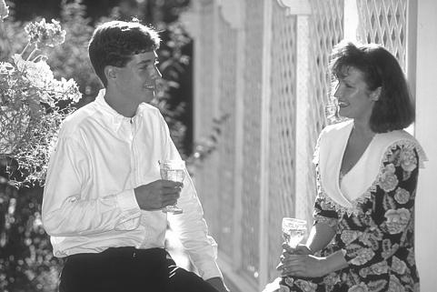
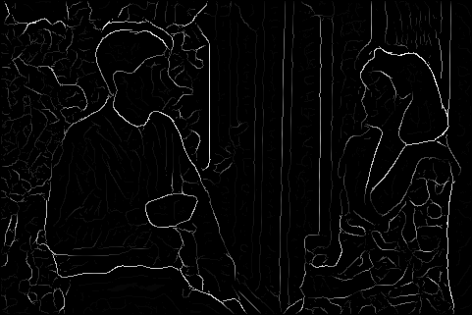
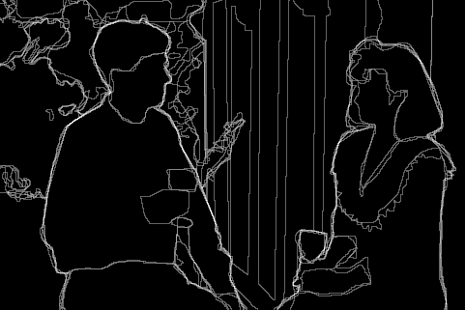
Boundary Detection
Edge images do not always match what humans select as boundaries.
Original | Machine Edge Detection | Human Drawn Boundaries
Is the human
our ideal?
Why?
Images from
http://www.eecs.berkeley.edu/Research/Projects/CS/vision/grouping/segbench/bench/html/images.html

Slide 36
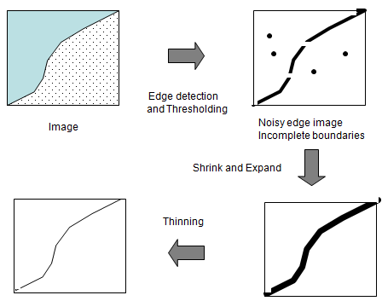
Boundary Detection with Edges
Can clean up our edge images by trying to connect broken edges via Morphology
Shrink,
then expand
then thin
Please see previous
Lecture on Morphology.
Note can apply to color,
greyscale or binary
images.

Slide 37
Another Boundary Detection Idea
Try Edge Tracking / Following.
We saw some of this with the Canny Edge Operator but, there are many algorithms for this.

Slide 38
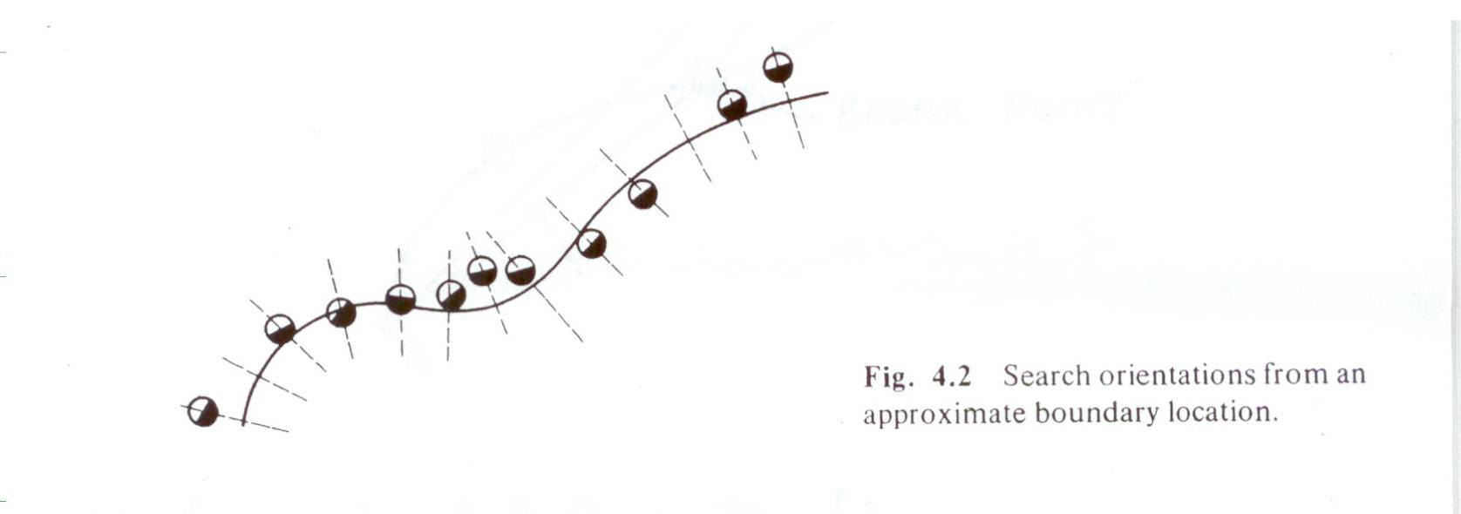
Boundaries via Edge Tracking Methods
1) Approximate Location of Boundary determined through Edge Detection or Some other technique
Find Accurate Location of Boundary
    Search for STRONG EDGES along normals to approximate boundary.
    Fit curve (eg., polynomials) to strong edges.

Slide 39
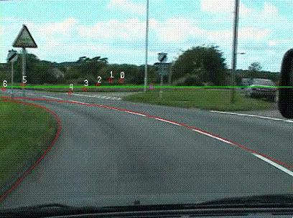
Geometric based Object Features
Curves/Lines
Taken from
http://www.cs.nott.ac.uk/~bai/vision.html

Slide 40
Curves / Lines
Here we are assume that the data contains either lines or curves that we can fit our data to.

Slide 41
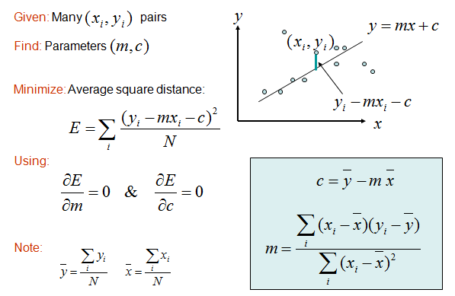
Line Detection through data fitting
Brute force method to take data and from it calculate the best line that runs through it.
Problem: You
Need to know what
data belongs to
a single line.
This is not trivial.

Slide 42
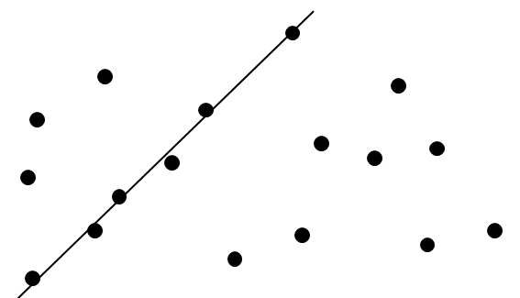
Line Detection through fitting
Problem: what happens when data does not fit a line?
This data does
not fit a line,
Although our
method will find
a best line. But,
it is non-sense…
Have you heard
the phrase “Garbage
in, Garbage out”.
Here the Garbage in
is assuming all these
points belong to 1 line

Slide 43
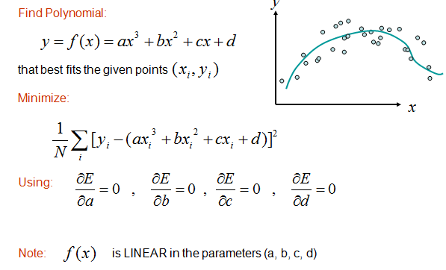
Curve Detection through data fitting
Again brute force where we solve an optimization problem…minimizing error (distance) from curve.
Problem: You
Need to know what
data belongs to
a single line.
This is not trivial.

Slide 44
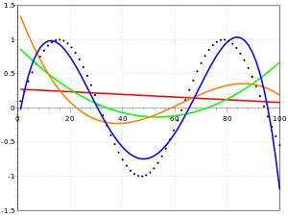
Curve Detection
4 points will determine one unique set of a,b,c,d in y=ax^3 + bx^2 + cx + d
If more points minimize error.
Many algorithms to find “best or good” parameters a,b,c,d
See http://en.wikipedia.org/wiki/Curve_fitting
SW: GNU Scientific Library, MATLAB, SciPy and OpenOpt
Red =1st order, line
Green = 2nd order
Orange = 3rd order
Blue = 4th order

Slide 45
Curve Detection
Still have the problem….how do we group points in an image saying they should belong to the same single curve….rather than a set of different curves?
One idea: we can look for places where 2 edge lines intersect and “intersection points” and stop our curves there A = ᴧ + _ + / + \
Answer: How to do this is VERY data/task dependent. Sometimes there is no answer which is why this is a difficult problem
A

Slide 46
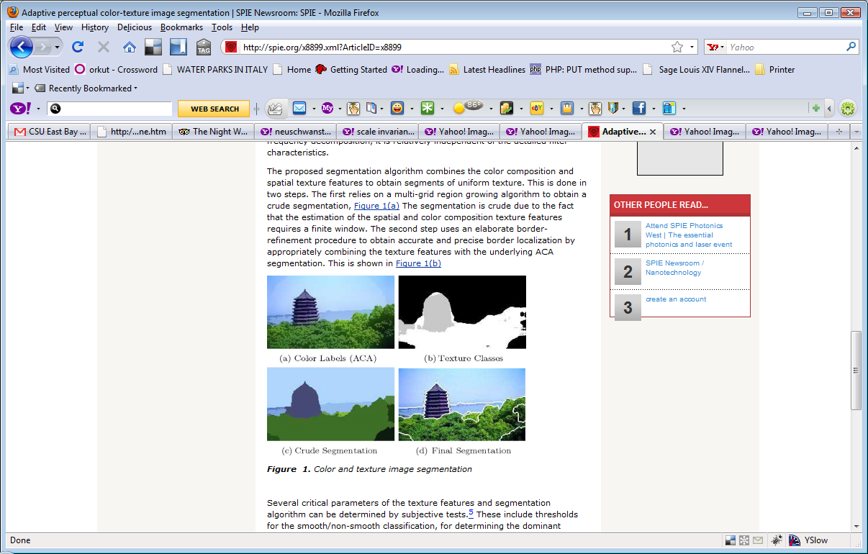
Curve Detection
how do we group points in an image saying they should belong to the same single curve….rather than a set of different curves?
Another idea: First Segment our image into surfaces, then the boundary points of are surfaces each make up a curve we care about. Again can break into multiple curves at intersection points
Answer: How to do this is VERY data/task dependent. Sometimes there is no answer which is why this is a difficult problem

Slide 47
Example Curve Fitting
Detecting curved lane lines in road using first sobel edges that are thresholded
https://www.youtube.com/watch?v=pQuUW3Jp8ic
AND
https://www.youtube.com/watch?v=xKDDiI5xdTk

Slide 48
Curve and Line Detection via Hough Transform
A different way than grouping points and then using optimization to find the best line/curve that fits ALL these points.
Typically uses edge points to indicate a boundary that comprises the line/curve.
We work in the line’s parameterized space that is quantized, we have each point vote for the line (or curve) it can belong to.
Then the peaks in the parameterized space indicate lines (or curves) in the image.

Slide 49
Hough Transform…motivation
Direct feature detection
    Edge points need not be connected into line (or shape detecting)
    The entire shape does not need to be present.
    Edge points suggest various parameters of line (or shape) possible.

Slide 50
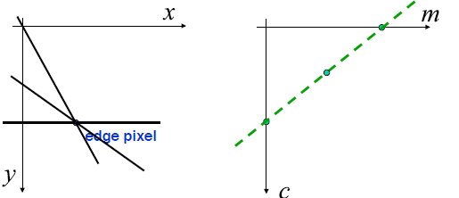
Hough Transformation for Lines – lets understand it
Consider the equation of a line y= mx + c
Any edge point (x’,y’) can contribute to an infinite number of lines that have different slope (m) and
different intercept (c ) values. The m,c space is our parameterized line space.
NOTE: every edge point (x’, y’) leads to a line of
possible values in the m,c space.
c=y’, m=0
c=0, m=y’/x’
Basically change
value of c and
calculate
m= (y’-c)/x’

Slide 51
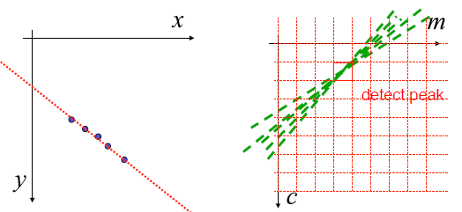
Hough Transform for Lines
1) We start the Hough Transform for Lines by creating a partitioned (quantized) space (called the accummulator) of all the possible values of m and c by creating a grid of possible values. Call these grid areas bins.
2) Initialize each bin to the value 0
3) For each edge pixel (x’,y’) figure out the line it creates in the m,c space and increment each bin it crosses by 1.
4) Peaks in the (m,c) space indicate lines in the image
line parameters are
m and c
Each edge point in
x,y space yields its
own green line in
m,c space

Slide 52

Hough Transformed Explained
Have 2D grid representing m,c (Hough) space.
Each edge point for a Hough Transform for lines (m,c) translates to a line in the (m,c) space
Here 2 edge points (possibly on a line in the original image) map each to their own line of possible (m,c) values in Hough space.
The point of intersection (where the
value is 2) indicates the m,c parameters
they share when on the same line
 | 1 |  |  |  |  |  | 1
 |  | 1 |  |  |  | 1
 |  |  | 1 |  | 1
 |  |  |  | 2
 |  |  | 1 |  | 1
 |  | 1 |  |  |  | 1
 | 1 |  |  |  |  |  | 1
possible line going
through 2 points
of original image

Slide 53

Problem with previous algorithm
When you have a vertical line what is the value for the slope m in the equation y= mx+c ?
So, is the range of m infinite?
SOLUTION: There is a common alternative representation of a line, that uses the value ρ as the perpendicular distance from the origin (x=0,y=0) to the line and the angle θ the perpendicular makes with the x axis.
Each edge point in
x,y space yields its
own Sinusoid
CURVE in m,c space

Slide 54

Hough Transform For Lines
We only need to modify our algorithm before by using the new
ρ, θ parameter space.
Note: the 5 points in
the image space map
to 5 different Sinusoid
curves in m,c space.
Note: 4 points in original
image on the same line.
This indicated by point of
Intersection in m,c space

Slide 55

Hough Transform, Lines Example 2
Input one line goes to a single peak in Hough Space

Slide 56

Hough Transform, Line Example 2
Here 2 lines in original image goes to 2 different peaks in Hough space.
Images from http://en.wikipedia.org/wiki/Hough_transform

Slide 57


Hough Transforms for Lines, Another Example
Here we have a number of lines (10 ) that yields corresponding peaks in Hough space (corresponding to horizontal, vertical, and 2 diagonal lines)
View
YouTube
demonstrating
Hough Space
For Lines
Images taken from http://planetmath.org/encyclopedia/HoughTransform.html

Slide 58

Hough Transform, Image with many straight lines
Here is a video showing results of Hough Transform for lines…trying to detect power lines in the image.
Original image
Detected 3 lines
Hough Space
http://www.youtube.com/watch?v=7L2SIy4bY_s
Click above to see video

Slide 59
Hough Transform Issues
How big (many) bins should you have in partitioning of the Hough Space (m,c)?
How do we decide when a peak exists in Hough space that indicates a line in the original image?
  What if peaks are very close (is this the same line)?
Which points in the image belong to the same continuous line
  You can have X lines in the image in different locations with the same (m,c) parameters.

Slide 60
Some video examples of Hough Transform
Student detecting 4 sides of rectangle https://www.youtube.com/watch?v=zGEH6hao3c4
More elaborate –Lane line detection using Hough Lines https://www.youtube.com/watch?v=pQuUW3Jp8ic

Slide 61

Moving on – detecting other than parameterized shapes with Hough Transform
Idea is simple – replace parameterization with that of the new shape.
Example: Circle – described by center (x₀ , y₀ ) and radius r.

Slide 62
Hough transform for circles
Each Edge point in the original image maps to a cylinder in the parameterized Hough space (x₀ , y_{0 ,} r).
Very complicated to do intersection of 3D surfaces.
Solution 1: often assume the radius of the circle you are looking for known. (or do a series of transforms with a few values of r)
Solution 2: estimate value of r for a given edge point and x₀ , y₀ values. This is distance from x₀ , y₀ to edge point p along the perpendicular direction to the edge direction at edge point p.
x
x₀ , y₀
Edge point p
One potential circle p
passes through
y

Slide 63
Hough transform for circles
Solution 3: If assume value of r, then reduce to increasing only 1 point in Hough 2D space as we know the Edge orientation Φ and edge point location x,y. Using the 2 equations below we can solve for x₀,y₀ exactly and increase only the corresponding single bin in the accumulator .
x
x₀ , y₀
Edge point p
One potential circle p
passes through
y

Slide 64

Circle Detection via Hough Transform
Try out this online demo that detects circles of specified radius using Hough Transform
Funny video 1
Coins video 2
Circle road signs
Eye tracking
Oranges detected
Found 5 circles
Of radius 15.
Left original image,
Right Hough space
http://www.markschulze.net/java/hough/

Slide 65
Moving on – detecting more than parameterized shapes with Hough Transform
The Generalized Hough Transform
  by D.H. Ballard in 1981*, is the modification of the Hough Transform using the principle of template matching ^{[1]}. This modification enables the Hough Transform to be used for not only the detection of an object described with an analytic equation (e.g. line, circle, etc.). Instead, it can also be used to detect an arbitrary object described with its model.
  We will discuss template matching later in the course.
*See D.H. Ballard, "Generalizing the Hough Transform to Detect Arbitrary Shapes",
Pattern Recognition, Vol.13, No.2, p.111-122, 1981

Slide 66
Corners as Geometric Features
Image below shows on right a corner/ point of inflection.
Image taken From www.ece.lsu.edu/gunturk/EE7700/Lecture_feature2.ppt

Slide 67
Moravec Corner Detector
Corner exists at a pixel if moving in any (most) directions would result in a significant change at a corner.

Slide 68
Corner Detection – the ideal
Invariant to rotating an object in the image
Invariant to changes in scale.
Invariant to position of corner / object
Invariant to changes in light

Slide 69

Corner Detection via Harris Detector
This detector was derived based on mathematics of calculating the difference in intensity at a potential corner located at x,y in a small area Δx, Δy (in window w(x,y) )
Want
a maximum
value of S
for (x,y) to
be a corner
Possible
Window functions =
or
1 in window, 0 outside
Gaussian

Slide 70
Harris Detector – the math
The following show the math used to solve the previous equation using an approximation when Δx, Δy are small

Slide 71

Harris Detector - more
Can think of the matrix M as Normal Matrix / Second Moment Matrix and what we want is to maximize contribution of M. This can be done with the following metric C(x,y) related to the eigenvalues of M (λ₁ and λ₂ )
Where λ₁ and λ₂ are large, C will be large

Slide 72

Harris Corner Detector Algorithm
M
C
(M)
(M) )²
C

Slide 73

Harris Corner Detection – example 1
Here is an example of a system that uses these corners to match with a “template” image of a cereal box to find it in the scene in the left.
Image taken from http://ivt.sourceforge.net/examples.html

Slide 74

Harris Corner Detection – example 2
Original image on left. Right has corners detected by Harris detector superimposed on faint original image
Image taken from http://www.ikaros-project.org/articles/2004/monoculardepth1/

Slide 75
Harris Corner detector video
Go https://www.youtube.com/watch?v=YyvsNkQNZYU

Slide 76
Use of these point features
Image matching and alignment
Potentially object recognition
Stereo vision – 3D at these points

Slide 77

What’s good about Harris Corner detection
Corners are rotation invariant
Illumination invariance
“Viewpoint” invariance
(not really)
But, NOT scale invariant

Slide 78


SIFT = Scale Invariant Feature Transform
David Lowe, 1999
Kind of like a multi-scale corner detector

Slide 79

SIFT the concept
STEP 1: Scale-space Extrema Detection
  A given scale might work for finding a small corner. But to detect larger corners we need larger windows.
  SOLUTION = do the detection of differenet scales

Slide 80
SIFT STEP 1: Scale-space creation
  Laplacian of Gaussian is found for the image with various σ values. LoG acts as a blob detector which detects blobs in various sizes due to change in σ. In short, σ acts as a scaling parameter.
  DOG =approximate
  LOG

Slide 81

SIFT STEP 2: Keypoint Localization

Slide 82

SIFT STEP 2: Keypoint Localization
  Fine tune location

Slide 83

SIFT STEP 3: Filter - low contrast removal
  potential keypoints locations are found only if the value > threshold (in other words eliminate if < threshold)
  This threshold is called
  contrastThreshold in OpenCV

Slide 84

SIFT STEP 3: Filter – remove edge non corner locations
  We want “corner-like” not “edge lines”
  so apply filter like done in harris

Slide 85

SIFT STEP 4: Keypoint Orientation calculation
  For each keypoint, calculate the orientation
  Now an orientation is assigned to each keypoint to achieve invariance to image rotation.
  A neigborhood is taken around the keypoint location depending on the scale, and the gradient magnitude and direction is calculated in that region

Slide 86
SIFT STEP 4: Keypoint Orientation calculation
  For each keypoint, calculate the orientation
  Now an orientation is assigned to each keypoint to achieve invariance to image rotation.
  A neigborhood is taken around the keypoint location depending on the scale, and the gradient magnitude and direction is calculated in that region

Slide 87
SIFT STEP 4: Keypoint descriptor
  A 16x16 neighborhood around the keypoint is taken.
  It is divided into 16 sub-blocks of 4x4 size.
  For each sub-block, 8 bin orientation histogram is created. So a total of 128 bin values are available. It is represented as a vector to form keypoint descriptor.

Slide 88
SIFT STEP 4: Keypoint matching using 128 element description vector
  keypoint in image 1 matches “closest neighbor” from image 2

Slide 89
Partial sample OpenCV code
First you must declare detector
detector = FeatureDetector.create(FeatureDetector.SIFT);
Imgproc.cvtColor(aInputFrame, aInputFrame, Imgproc.COLOR_RGB2GRAY);
descriptors2 = new Mat();
keypoints2 = new MatOfKeyPoint();
//Perform SIFT detection and compute descriptors
detector.detect(aInputFrame, keypoints2);
descriptor.compute(aInputFrame, keypoints2, descriptors2);
// Matching descriptors2 we detected with previously created descriptors 1
// descriptors1 could be from another image or part of an image
// representing an object
MatOfDMatch matches = new MatOfDMatch();
if (img1.type() == aInputFrame.type()) {
matcher.match(descriptors1, descriptors2, matches);
} else {
return aInputFrame;
}
List<DMatch> matchesList = matches.toList();

Slide 90
Code continued
//now calculate min and max distance in matches
Double max_dist = 0.0;
Double min_dist = 100.0;
for (int i = 0; i < matchesList.size(); i++) {
Double dist = (double) matchesList.get(i).distance;
if (dist < min_dist)
min_dist = dist;
if (dist > max_dist)
max_dist = dist;
}

Slide 91
Code continued
//now select matches based on <1.5* minimum distance found
LinkedList<DMatch> good_matches = new LinkedList<DMatch>();
for (int i = 0; i < matchesList.size(); i++) {
if (matchesList.get(i).distance <= (1.5 * min_dist))
good_matches.addLast(matchesList.get(i));
}
//draw the retained “good” matches found
MatOfDMatch goodMatches = new MatOfDMatch();
goodMatches.fromList(good_matches);
Mat outputImg = new Mat();
MatOfByte drawnMatches = new MatOfByte();
if (aInputFrame.empty() || aInputFrame.cols() < 1 || aInputFrame.rows() < 1) {
return aInputFrame;
}
Features2d.drawMatches(img1, keypoints1, aInputFrame, keypoints2, goodMatches, outputImg, GREEN, RED, drawnMatches, Features2d.NOT_DRAW_SINGLE_POINTS);
Imgproc.resize(outputImg, outputImg, aInputFrame.size());
return outputImg;
}

Slide 92

OpenCV Sample code
https://medium.com/@akshikawijesundara/object-recognition-with-opencv-on-android-6435277ab285

Slide 93
SIFT and SURF no longer in standard OpenCV
Can download and setup but, is patented (SURF is a faster
OR there are some alternatives like ORB that is free alternative to SIFT/SURF
First you must declare detector
detector = FeatureDetector.create(FeatureDetector.ORB);
http://www.willowgarage.com/sites/default/files/orb_final.pdf

Slide 94
If you want to avoid the hassle of SIFT/SURF installation
Try ORB
See video demo (and link to an android github)

Slide 95

Geometric based Object Features
Surfaces (Segmentation)
Taken from
http://spie.org/x8899.xml?ArticleID=x8899
3D model of a chair
Taken from
http://people.csail.mit.edu/chiu/projects.htm

Slide 96
Surface Detection
We will look at segmentation as a topic in another lecture.

Slide 97
Object-Based Features…First Find the Object
We will look later in Recognition at the concept of Template Matching….as a possibility to find objects from raw image data.
Once we have an area that is a potential object, we can do our feature extraction ONLY on this part of the image.

Slide 98
Conclusion
Discussed concept of what a Feature is and its use in “describing” (hopefully uniquely) an object of interest.
Discussed different kinds of features possible
Discussed several geometric features like edges, boundaries, lines, curves, corners, surfaces.
There are many, many features proposed in literature….deciding what to use for your task is a big part of the problem you must solve….knowing some common ones can help

Slide 99
SW
There exists a number of Computer Vision frameworks/libraries that contain code to do most if not all of the algorithms we discussed. Or you can find published code for them.
Example: OpenCV
  Hough line and circle,
  Haris corner detection
  SIFT features and other keypoint features
  Region, Blob extractors and MORE

