Slide 1

Open-Vision Detection Models
Detect and localize objects using categories specified at inference time
* These are specialized Foundation models

Slide 2
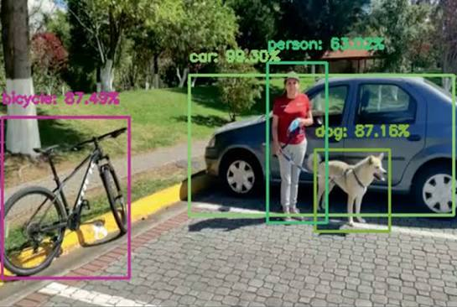
Open-Vocabulary Object Detection Models-> Motivation
Open-Vocabulary Detection
A vision foundation model can allow us to specify the objects of interest using natural language at inference time:
Image + Text Queries
    "person"
    "dog"
    "red backpack"
    "fire hydrant"
    ↓
    Open-Vocabulary Detector
    ↓
    Bounding Boxes + Labels + Scores
    For example, given a street image:
    Prompt: "person, bicycle, dog, car"
Motivation
So far: Zero-shot classification asks: “What is the main object in this image?”
But many computer vision applications need:
“What objects are present, and WHERE are they?”
Traditional Object Detection
    Training Images + Bounding-Box Labels
    ↓
    Train / Fine-Tune Detector
    ↓
    Fixed set of classes:
    person | car | dog | bicycle
The detector's recognition vocabulary is largely established during training.
Open-vocabulary detection
Image Regions ↔ Text Concepts
asks:
Which regions of this image correspond to the concepts I specified?
Example Models
:
Grounding DINO — text-conditioned/open-set object detection (Meta)
OWL-ViT / OWLv2 — open-vocabulary object detection (Google)

Slide 3
Open-Vocabulary Object Detection Models-> CLARIFICATION
Traditional detector such as YOLO | Open-vocabulary detector
Input: Image | Inputs: Image + Text
Finds/localizes objects | Finds/localizes objects
Produces bounding boxes | Produces bounding boxes
Predicts from a learned/fixed class set | Matches detections to text-specified concepts
person, car, dog... established by training | "person", "black bear", "yellow hard hat" supplied at inference
Primarily vision | Multimodal: vision + language
YOLO-style closed-vocabulary detection
IMAGE → Vision Detector → Boxes + Fixed Class Labels
versus
Open-vocabulary detection
What does the language actually contribute?
That's the interesting part.
A conventional YOLO detector might have learned an output vocabulary such as:
person | bicycle | car | dog | ...
Its detector learns to associate visual features with those particular trained classes.
An open-vocabulary detector instead learns relationships between visual features and language representations.
So you can supply:
"yellow construction helmet"
The text gets encoded into a learned language representation. The model then tries to identify regions of the image whose visual representations correspond to that textual concept.
That's closely related to the image↔text alignment idea you just taught with CLIP, but now we have localization:
CLIP-style classification
Whole Image ↔ Text
Open-vocabulary detection
Image Regions ↔ Text
IMAGE ──────────┐
↓
Detector → Bounding Boxes + Labels
↑
TEXT QUERY ─────┘
"black bear"
"yellow hard hat"
"red backpack"

Slide 4
Open-Vocabulary Object Detection Models-> CLARIFICATION
What does the language actually contribute?
A conventional YOLO detector might have learned an output vocabulary such as: person | bicycle | car | dog | ...
Its detector learns to associate visual features with those particular trained classes.
An open-vocabulary detector instead learns relationships between visual features and language representations.
So you can supply:
"yellow construction helmet"
The text gets encoded into a learned language representation. The model then tries to identify regions of the image whose visual representations correspond to that textual concept.
CLIP-style classification
Whole Image ↔ Text
Open-vocabulary detection
Image Regions ↔ Text
object detection + language grounding:
Image + natural-language query → localized visual concepts

Slide 5
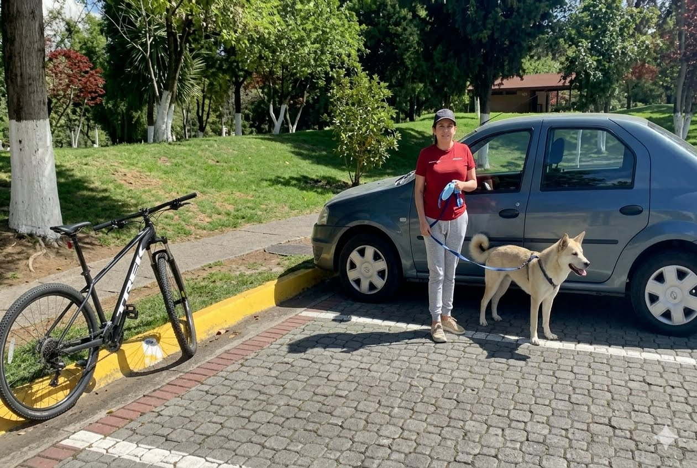
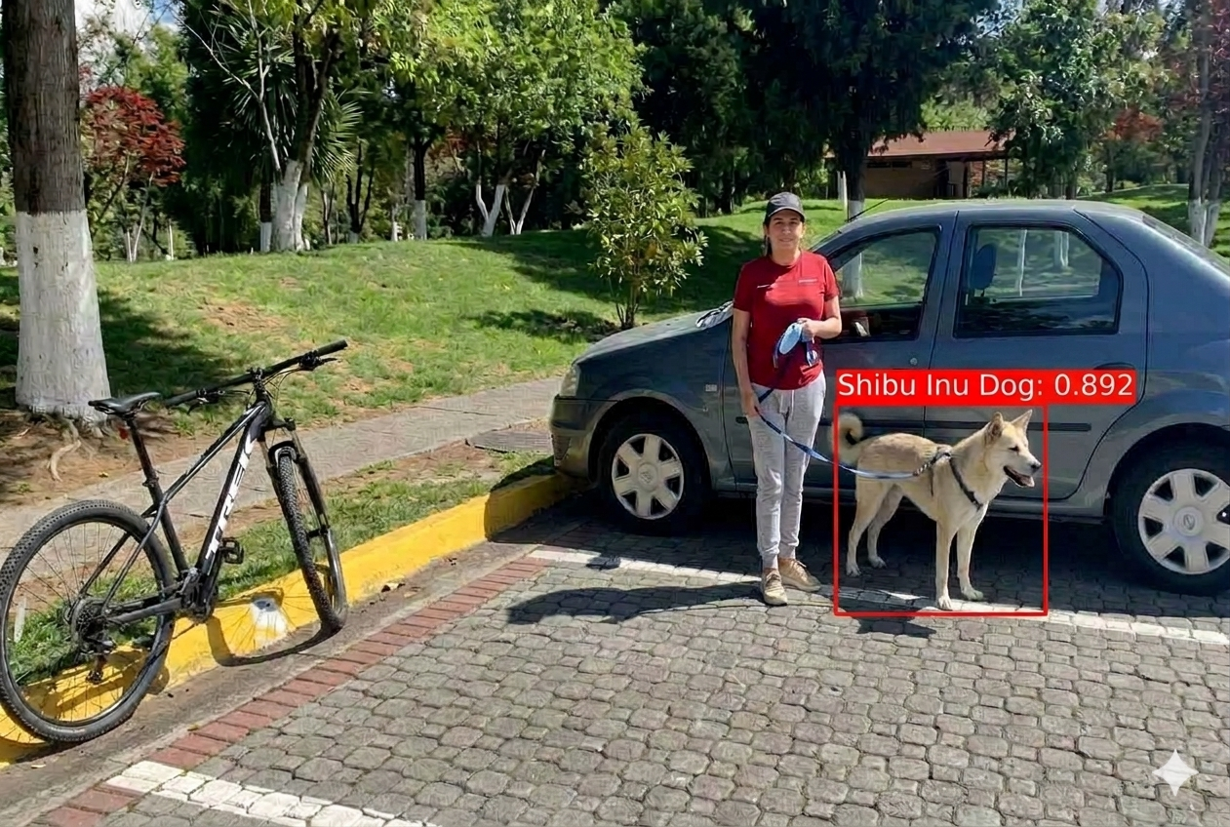
How Open-Vocabulary Detection Works
Key Concept — Visual Grounding
Visual grounding connects a natural-language concept or description to a specific location in an image.
For example:
  Text: "the person wearing a yellow construction helmet"
  ↓
  Model identifies the image region corresponding to that description
  ↓
  Bounding Box
Object Detection + Language Grounding
Two Inputs
  1. Image
    Image → Vision Encoder → Visual Features / Candidate Regions
  2. Natural-Language Query
    “Shiba Inu Dog”
    ↓
    Text Encoder
    ↓
    Text Representation
Bring Vision + Language Together
Connection to What We Already Know
CLIP-style zero-shot classification
  Whole Image ↔ Text Concept
  Does this image correspond to “Shiba Inu Dog”?
Open-Vocabulary Detection
  Image Regions ↔ Text Concept
  Where are the “Shiba Inu Dogs” in this image?
Traditional YOLO-style Detection
  Image → Boxes + Labels from trained class vocabulary
IMAGE
↓
Vision Encoder
↓
Visual Features / Regions ─────┐
↓
Vision ↔ Text
Matching
↓
Text Query ─→ Text Encoder ─────┘
“Shibu Inu Dog"
↓
Matching Image Regions
↓
Bounding Boxes + Labels + Scores
Takeaway
Open-vocabulary detection combines visual localization with language-based recognition, allowing the requested object concepts to be specified at inference time.

Slide 6
An example OVD → OWL-VIt
OWL-ViT is from Google

Slide 7
From CLIP to OWL-ViT
Start with what we already know: CLIP
What we want:
CLIP
IMAGE ──► Image Encoder ──► Image Representation
↕
Similarity
↕
TEXT ───► Text Encoder ───► Text Representation
Whole Image ↔ Text
Whole Image ↔ Text
CLIP
↓
ADD LOCALIZATION
↓
Image Regions ↔ Text
+
Bounding Boxes
↓
OWL-ViT

Slide 8
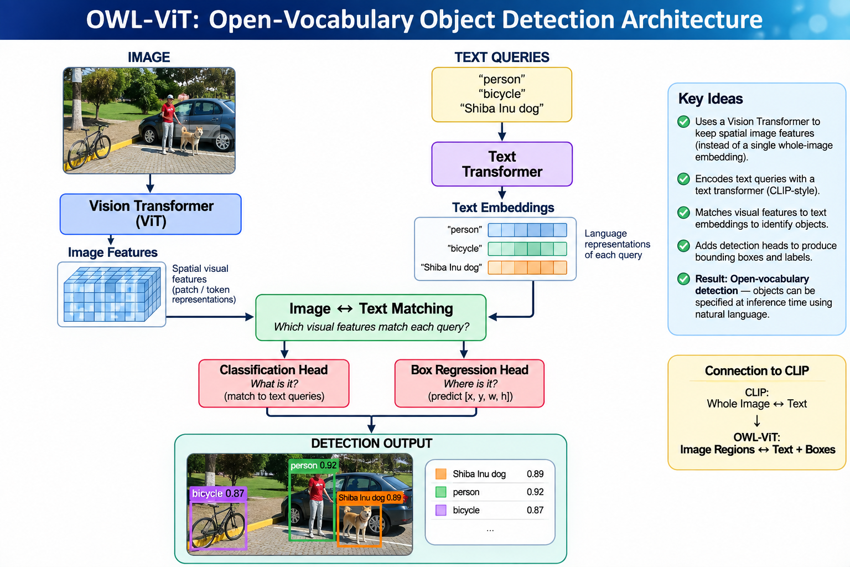
OWL-ViT
(from Google)
OWL-ViT (Open-World Localization Vision Transformer) adapts the vision-language representation learned by CLIP-style models for open-vocabulary object detection.
OWL-ViT Has Two Input Pathways

Slide 9
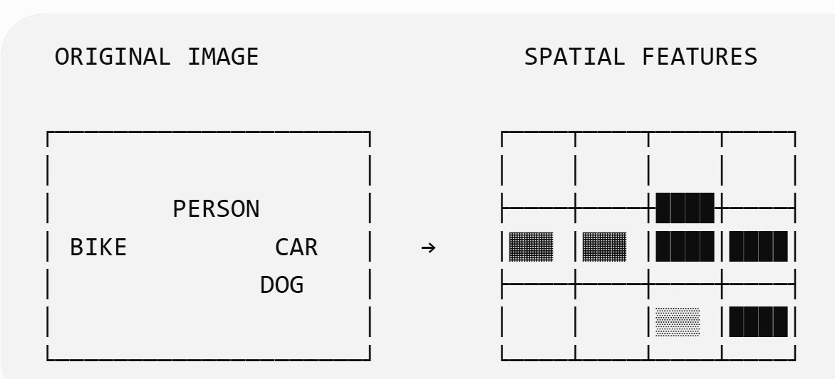
OWL-ViT ---SPECIAL Vision Transformer
Vision Transformer (ViT)
Converts the image into spatial visual features that can represent potential objects.
shading (spatial features) should not be interpreted as object labels. It represents different learned feature patterns.
For example, patches covering the dog may encode features associated with things such as:
  fur + ears + legs + animal shape + surrounding context
while patches covering the bicycle may encode very different visual information:
  wheels + thin frame + handlebars + geometric structure
Important: the spatial organization of these features is preserved.
“The Vision Transformer divides the image into patches and produces a learned feature representation for each spatial location.”

Slide 10
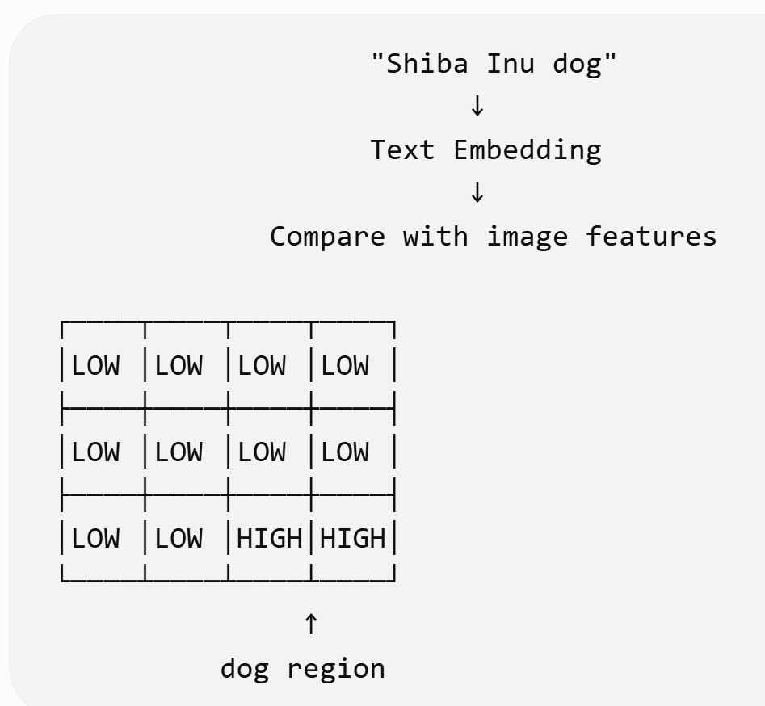
OWL-ViT ---Vision+Text Embedding Comparison
Matching of Image Embeddings/Features
(spatially organized) + Text Embeddings
features around the dog's location are more compatible with the "Shiba Inu dog" text representation than features elsewhere in the image.

Slide 11
OWL-ViT ---WAIT Matching involves a Classification & Regression Head
FOR EACH SPATIAL IMAGE FEATURE (ViT TOKEN)
Classification Head answers “what is it “
    Image Feature
    ↓
    Compare with Text Embeddings
    ↓
    "person" LOW
    "bicycle" LOW
    "Shiba Inu dog" HIGH
Box Regression Head answers “where is it “
    Image Feature
    ↓
    Box Prediction
    ↓
    [x, y, w, h]

Slide 12
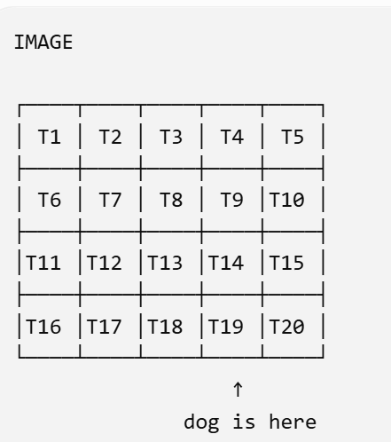
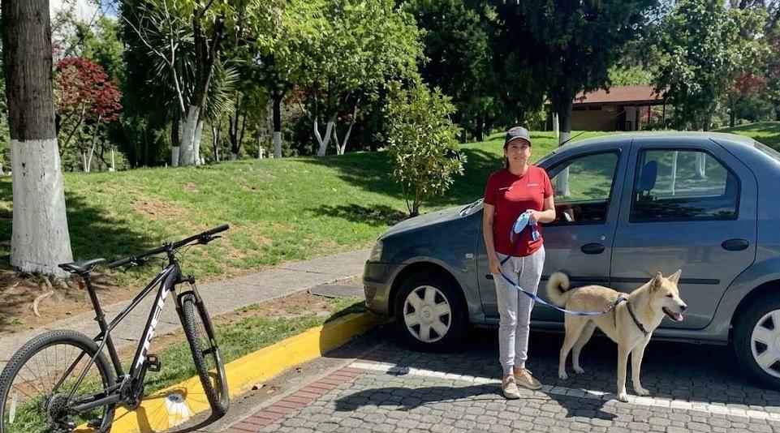
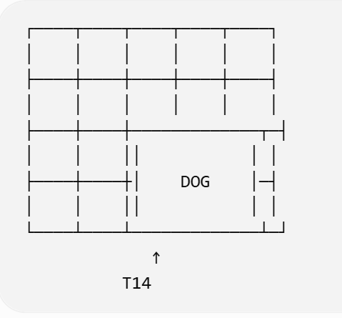
OWL-ViT ---a Classification & Regression Head → HUH?
Imagine your dog image divided into ViT patches:
Suppose T14 has a feature representation that strongly corresponds to the dog.
The classification side can effectively say:
      T14 feature
      ↓
      compare to text embeddings
      ↓
      person 0.03
      bicycle 0.01
      Shiba Inu 0.89
2. But we still don't know the dog's extent.
The dog might extend across several patches:
T14's spatial position is not the bounding box.
That's where the box regression head comes in. From that image feature, it predicts something representing: [center x, center y, width, height]
So the two heads work in parallel

Slide 13
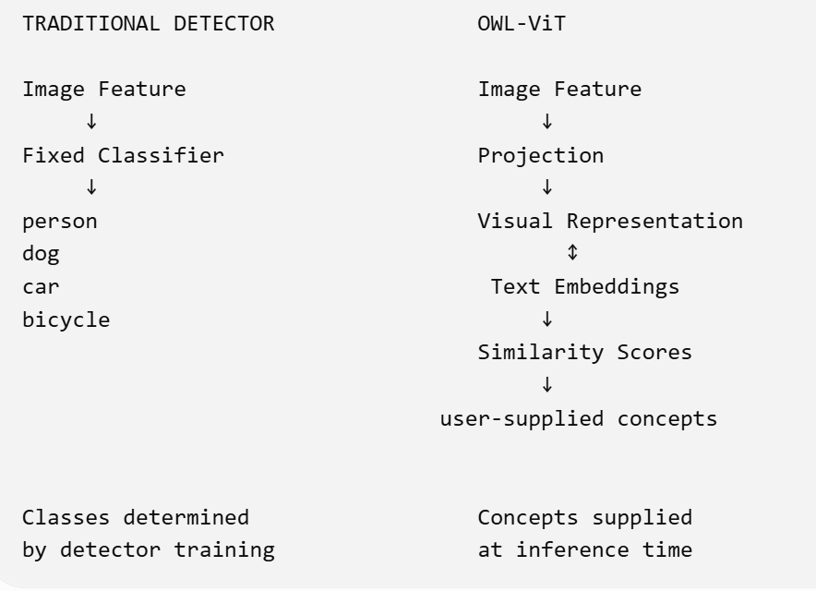
Why Is OWL-ViT “Open Vocabulary”?
The text queries act like the categories against which the visual feature is classified.
The queries can be supplied at inference time rather than being restricted to a fixed detector class list.
OPEN VOCABULARY does not mean the model knows concepts magically. It means the detector's inference-time vocabulary is not restricted to a fixed set of detector class outputs.

Slide 14
How IS OWL-VIT Trained
If OWL-ViT can recognize text-specified concepts at inference time, where did it learn the visual-language relationship in the first place?

Slide 15
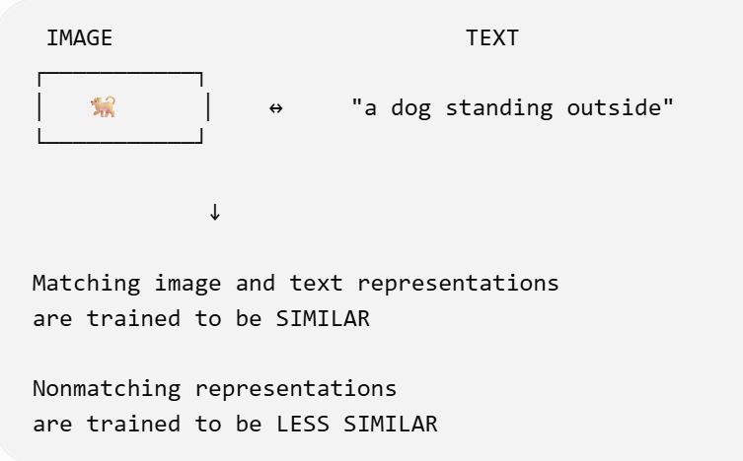
Training of the OWL-ViT by Google
INTERESTING: OWL-ViT is not trained as an object detector from scratch. The original OWL-ViT recipe starts with contrastive image-text pretraining and then performs end-to-end detection fine-tuning.
STAGE 1 — Learn Vision ↔ Language Alignment Example
This is where OWL-ViT acquires broad visual-language knowledge.
LARGE-SCALE IMAGE–TEXT PAIRS
IMAGE TEXT
│ │
▼ ▼
Vision Transformer Text Transformer
│ │
▼ ▼
Image Embedding Text Embedding
│ │
└───────↔─────┘
ALIGN

Slide 16
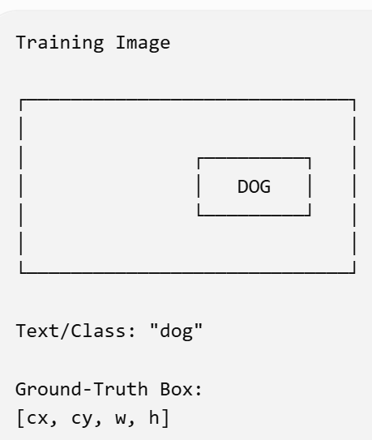
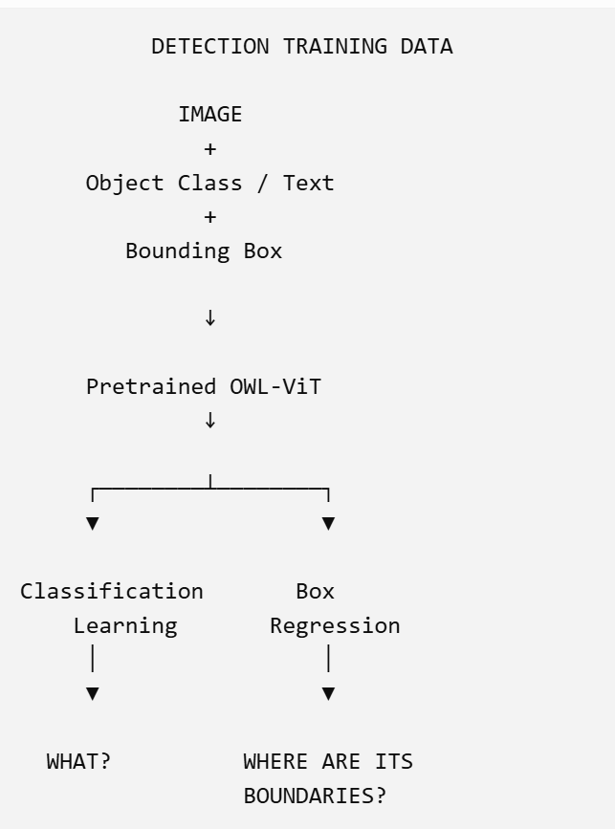
Training of the OWL-ViT by Google
INTERESTING: OWL-ViT is not trained as an object detector from scratch. The original OWL-ViT recipe starts with contrastive image-text pretraining and then performs end-to-end detection fine-tuning.
STAGE 2 — Teach the Model Object Detection Example
Model trains so:
Visual feature
│
├────► matches "dog"
│
└────► predicts correct bounding box
Both errors contribute to training the detector.

Slide 17
But if Stage 2 trains on a fixed set of detection classes, why doesn't OWL-ViT become closed-vocabulary again?
ANSWER – NO — because classification still uses language embeddings
1. Pretraining provides broad vision-language knowledge.
visual concepts ↔ language concepts
2. Detection fine-tuning teaches localization.
object feature → bounding box
3. Classification remains text-conditioned.
visual representation ↔ supplied text embeddings
Therefore:
The detector is not limited to a fixed classifier output layer containing only the detection-training classes.
Detection Fine-Tuning
person | dog | car | bicycle
↓
Learns how to LOCALIZE objects
while retaining vision ↔ language
representations
↓
Image Feature
│
▼
Projection
│
↕
Text Embeddings
AT INFERENCE
Image Feature
│
▼
Visual Representation
│
│ similarity
▼
"person"
"dog"
"Shiba Inu dog" ← NEW QUERY
"yellow hard hat" ← NEW QUERY
"red backpack" ← NEW QUERY

Slide 18
Fine-Tuning OWL-VIT
Why and whats possible?

Slide 19
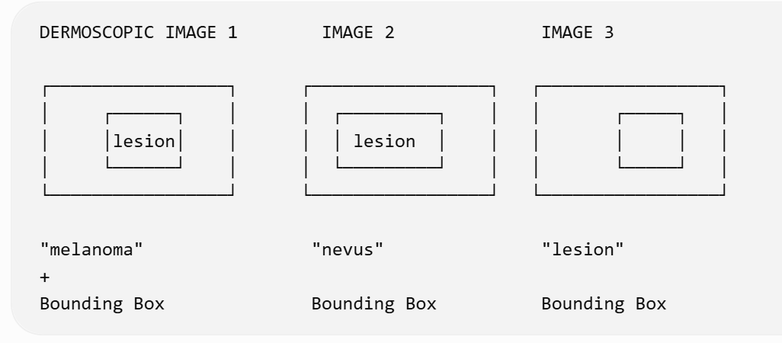
Motivation → you want an Open Vocabulary model for “skin lesion detection”
GENERAL OWL-ViT
Broad visual-language knowledge
+
General object localization
↓
But your application contains
SPECIALIZED MEDICAL IMAGERY
• dermoscopic images
• subtle lesion boundaries
• specialized terminology
• visual patterns unlike everyday images
↓
DOMAIN SHIFT
>>Domain Shift from general images+text
used in fine tuning OWL-ViT

