Slide 1
Cloud Computing --- high level intro

Slide 2
What is Cloud
Cloud computing is the aggregation of various distributed services on disparate computing systems connected via a common network.
Anytime,
Anywhere,
With any device,
Accessing any services
Answers you might hear from people:
Widely distributed,
network based,
storage,
computation,
utility computing,
IaaS,
PaaS,
SaaS.

Slide 3
The timing
Software
Standard Protocols
IPv4, IPv6, IEEE_802.xx, TCP/IP, UDP, HTTP, HTTPS, ..etc
Open Source Software
Highly developed yet license free platforms and APIs
Economics to spur innovation
SOA mentality
Hardware
Cheap Systems
Commoditization of computers
Virtualization of computers
Network
Bandwidth
Constantly Connected
WiFi
Cellular / Mobile
SOA = structured collections of discrete software modules,
known as services, that collectively provide the
complete functionality of a large or complex software
application

Slide 4
Pros and Cons
Benefits
Hardware efficiency
Scalability
Demand based computing
Linear vs Tiered Growth rates
Transactional Accounting
Outsourcing of hardware level administration
Reduced Costs
Significantly lower barriers to entry
Concerns
Security
Increased focus on WebApp security
Security without control/privacy
Availability
Increased network load
SLE (service level expectations) of service provider
Runaway costs
Must scale business model to usage model
Data ownership
Who owns your data?
Legality of intrusions.
Private vs Public

Slide 5
Common cloud concepts
Universal Access
Scalable Services
Infrastructure managing the scaling, not applications
Elasticity: Expenses only incurred when they are needed
New Application Service Models
XaaS = X as a Service
Pay-as-you-go

Slide 6
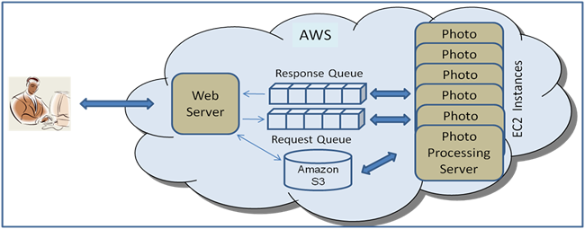
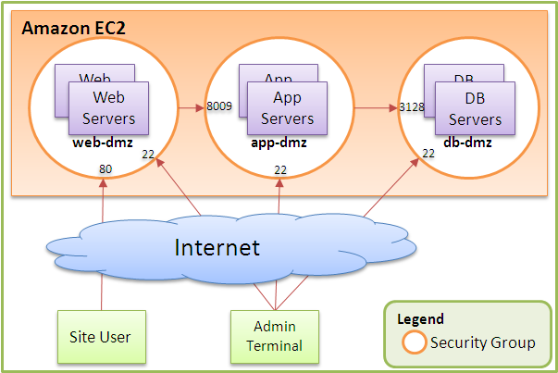
Amazon – the big start
Amazon EC2
Elastic Cloud Computing
virtual servers for rent, called Amazon Machine Images (AMIs)
priced on per hour
Amazon S3
Simple Storage Service
up to $0.XX per GB storage
from $0.XX per GB transfer
via
o REST
o SOAP
o BitTorrent

Slide 7
Amazon Instances-starting
M1 Small Instance – default*
1.7 GiB memory 1 EC2 Compute Unit (1 virtual core with 1 EC2 Compute Unit) 160 GB instance storage 32-bit or 64-bit platform I/O Performance: Moderate EBS-Optimized Available: No
M1 Medium Instance
3.75 GiB memory 2 EC2 Compute Unit (1 virtual core with 2 EC2 Compute Unit) 410 GB instance storage 32-bit or 64-bit platform I/O Performance: Moderate EBS-Optimized Available: No
M1 Large Instance
7.5 GiB memory 4 EC2 Compute Units (2 virtual cores with 2 EC2 Compute Units each) 850 GB instance storage 64-bit platform I/O Performance: Moderate EBS-Optimized Available: 500 Mbps
M1 Extra Large Instance
15 GiB memory 8 EC2 Compute Units (4 virtual cores with 2 EC2 Compute Units each) 1,690 GB instance storage 64-bit platform I/O Performance: High EBS-Optimized Available: 1000 Mbps

Slide 8
Amazon – current free teir
Free Tier*
One year only
750 hours of EC2 running Linux/Unix Micro instance usage
750 hours of EC2 running Microsoft Windows Server Micro instance usage
750 hours of Elastic Load Balancing plus 15 GB data processing
30 GB of Amazon EBS Standard volume storage plus 2 million IOs and 1 GB snapshot storage
15 GB of bandwidth out aggregated across all AWS services
1 GB of Regional Data Transfer

Slide 9
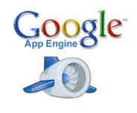
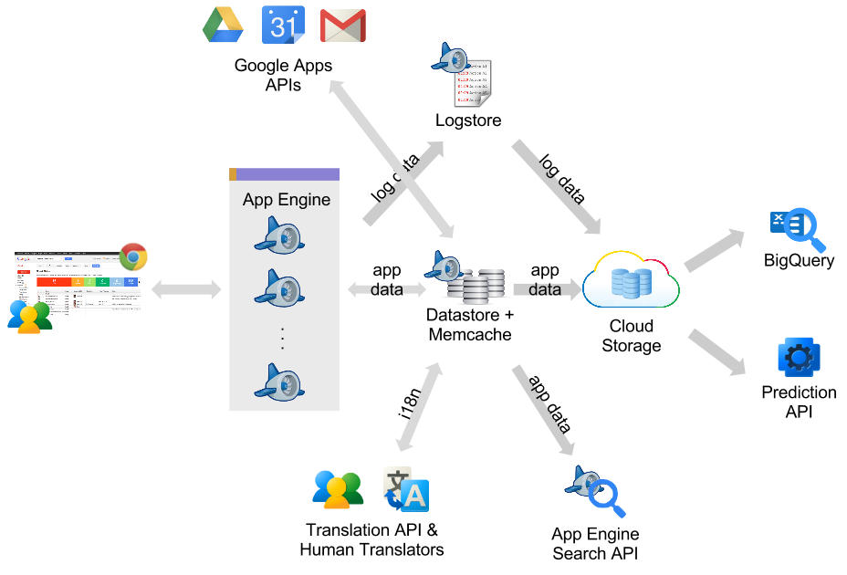
Another company- Google
A web application development framework and hosting solution rolled into one
uses the infrastructure available at Google
Google servers + storage: BigTable
Python/JAVA/Go and GAE SDK
---We will look at this in more detail later-

Slide 10
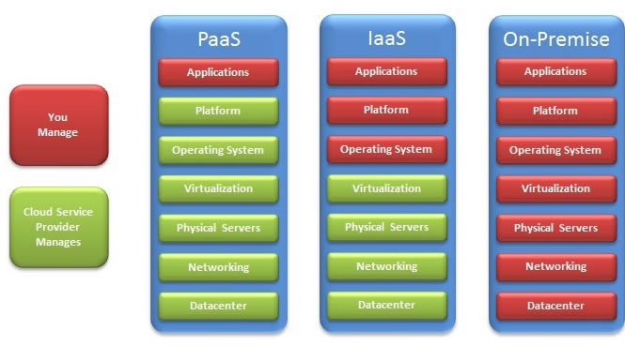
Cloud Layers and Companies

Slide 11
Terms
IaaS = Infrastructure as a Service
PaaS =Platform as a Service
SaaS = Software as a Service

Slide 12
Cloud Layers and Key technologies
Infrastructure as a Service (IaaS)
rent cycles –don’t buy machines, equipment, don’t manage it
Key Technology: Virtualization
Platform as a Service (PaaS)
Get API and take care of the implementation
No (not much) server setup,etc.
Key Technology: New cloud programming paradigm, i.e. MapReduce, PIG, HIVE etc
Software as a Service (SaaS)
Just run it for me!
Key Technology: May use AJAX, other technologies.
Run multiple virtual computers on one physical box…..examples
" Xen
" VMWare
" Parallels
" Amazon AMI
" Microsoft Hype V

Slide 13
Virtualization Benefits --IaaS

Slide 14
Cloud Layers and Companies
SaaS
SalesForce.com
Google Apps
eBay
Paypal
Apple iTunes
Big Belly
Zynga
DropCam
Microsoft Live
Facebook
Twitter
Zoho
ANY WEBSITE!
PaaS
SalesForce's Force.com
Google App Engine
Microsoft Azure
Zoho Creator
Amazon Beanstalk
IaaS
Amazon AWS
Joyent
Rackspace
Rightscale
AT&T Synaptic Service
Verizon
Heroku

Slide 15
Who uses Cloud?
Many large and small companies
Mark Zuckerberg (Facebook)
Sean Parker (Napster, Facebook, Gowalla)
Reed Hastings (Netflix)
Jeff Bezos (Amazon)
Mark Pincus (Zynga)
Greg Duffy and Aamir Virani (DropBox)
Jim Poss (BigBelly Solar)
Pierre Omidyar (eBay)
MTV, IBM, ****

Slide 16
What kind of problems drive the cloud
Web (Internet) Scale applications
data-intensive
May be processing intensive
Examples
Crawling, indexing, searching, mining the Web
Data Intensive (some old numbers)
Google processes 20 PB a day (2008)
“all words ever spoken by human beings” ~ 5 EB(1K PB)
NOAA has ~1 PB climate data (2007)
CERN’s LHC will generate 15 PB a year (2008)

Slide 17
Historical Progression of computing

Slide 18
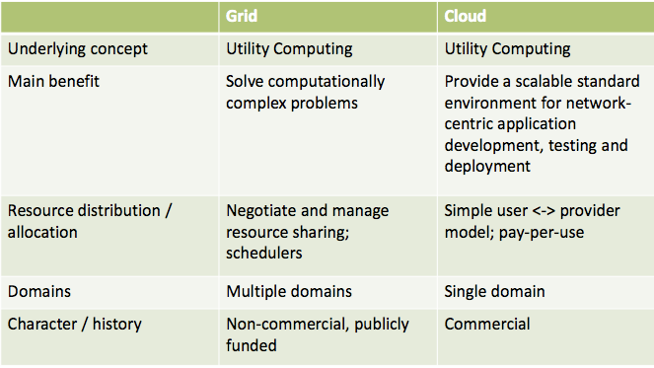
Cloud versus Grid
Sometimes not a difference…but, here are possible differences

Slide 19
Netflix
Premise: Online video rental service.
Cloud Innovation: Internet catalogue browsing, distributed streaming services.
Cloud Benefit: Online queuing allows for on-demand media browsing, user preference tracking, and quicker user activity turnover. Online media streaming allows for on-demand media consumption.
Notes:
Ubiquitous Video Streaming
-- Internet connecting computer
-- Roku media player
-- WD Live Plus media player
-- Apple TV
-- XBOX 360
-- Wii
-- PS3
-- Boxee Box
-- Vizio TVs
-- Samsung TVs
-- Sony TVs
-- Sony Dash
-- iOS devices
-- Android devices
Suggestion Services
-- Recently Watched
-- Genre grouping
-- Online user ratings

Slide 20
PANDORA
Premise: Personalized Internet radio
Cloud Innovation: Near ubiquitous access to Pandora radio streams.
Cloud Benefit: Pandora is able to offer highly accurate song suggestions based off of a combination of user activity signals and song metadata from the "Music Genome Project". This would be highly resource intensive within a fat client architecture
Notes:
Ubiquitous customized radio
-- Internet connected computer
-- iOS devices
-- Android devices
-- Blackberry devices
-- Ford SYNC
-- Mini
-- MercBenz
-- Alpine
-- Pinoeer
-- Apple TV
-- XBOX
-- PS3
-- Home theaters

Slide 21
Zynga
Notes:
Business Model
-- Charge users for enhanced/ extended game play via virtual goods
Usage Model
-- Highly elastic and scalable demand based computing. Extremely low critical mass.
Founded in 2007
Received venture funding in 2009
Farmville Growth
-- 1M daily users in 4 days
-- 2M daily users in 10 days
-- 4M daily users in 30 days
-- 10M daily users in 64 days
-- 70M daily users as of 1/10/2010
Cityville Growth
-- 100M active users in 43 day
Financials
Rumors of a recent round of $250M funding places Zynga with a $7 - $9 Billion dollar valuation.
Estimated 2010 revenue was $850M
Estimated 2010 profit was $400M

Slide 22
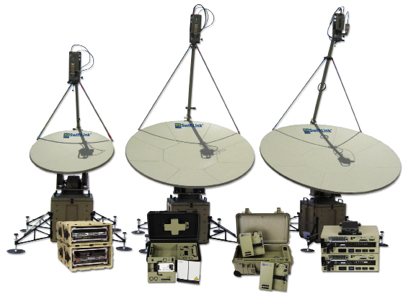
Military
Notes:
DISA
-- Currently a combination 16,000 military personnel, federal civilians or contractors.
-- The Agency that enables real time information dissemination across the armed forces.
RACE
-- Military only IaaS.
-- Like the Amazon AWS of the Military
BIMA (Biometrics Identity Management Agency)
-- Ensure identity of hostage rescue
-- Ensure identity of humanitarian aide distribution
-- Ensure the identity of Maritime Interdiction Operations
-- Military installation access
-- Background checks when contracting foreign nationals.

Slide 23
Example of A question to solve with cloud
Given 100 computers, how do you compute the frequency of words in 1T text files?
you need a new paradigm for storing and processing large scale of data

Slide 24
Some Solutions –driving the cloud –new models of large data
https://opencv.org/android/
2003, First MapReduce Lib developed in Google
2003, 2004, and 2006, Google published papers on GFS/MapReduce/BigTable.
2005- Now, Hadoop project (open source version of GFS/BigTable/MapReduce), initiated by Doug Cutting, sponsored by Yahoo
2008/2009, Yahoo/Facebook contributed PIG/Hive on top of hadoop.

Slide 25
Some Solutions –computation & deployment
Hadoop
MapReduce programs read input data from disk, map a function across the data, reduce the results of the map, and store reduction results on disk.
Spark
Apache Spark is an open-source distributed general-purpose cluster-computing framework.
Docker - https://www.docker.com/
Securely build & run applications anywhere, create containerized applications.
Kubernetes - https://kubernetes.io/
is an open-source system for automating deployment, scaling, and management of containerized applications.
It groups containers that make up an application into logical units for easy management and discovery.

Slide 26
Cloud Future
Trends in HW & SW...
Increase in availability and performance of networks
Decreased reliance on traditional OS and computing systems
Increased consolidation of data, both public and private data.
Decreased costs for hosted computational power.
Increased prevalence of RFID and NFC chips.
Finding opportunities...
Improve on things that bother you!
Focus on the data.
Break down large products into collections of smaller services.
Evaluate how connecting various services could provide additional functionality.
Get involved with Open Source Projects.

Slide 27
Pervasive Computing….
What is the Internet of Things?
A) An idea of all physical objects being universally addressable with most being digitally accessible or network connected.
What is so great about the Internet of Things?
A) Greater control and automation of daily processes. For example, greatly reducing inventories throughout a multi-layered supply chain through RFID inventory tags and interconnected inventory management systems.
What will enable the Internet of Things?
A) High bandwidth and ubiquitous wireless networks, extremely cheap RFID and NFC devices, enormous scaling of universal addresses for non-digital and inanimate objects

