Slide 1
Securing Communications over Internet → TLS (Tansport Layer Security)

Slide 2
Why Secure Communications
Protects User Data: Encryption prevents sensitive information—like passwords, credit card numbers, and personal data—from being intercepted by malicious actors during transmission.
Builds Trust and Credibility: A secure site (HTTPS with a valid certificate) signals to users that the website is trustworthy, which can improve customer confidence and conversion rates.
Prevents Data Tampering: Secure communication ensures that data sent between users and the website isn’t altered or corrupted during transfer, protecting both parties from manipulation or fraud.
Improves SEO and Browser Compatibility: Major search engines rank secure sites higher, and browsers increasingly flag or block insecure (HTTP-only) sites, potentially driving users away from unprotected pages.

Slide 3
TLS from SSL
TLS evolved from a previous encryption protocol called Secure Sockets Layer (SSL)
IETF TLS Working Group (Official Standards)URL: (Internet Engineering Task Force) defines TLS protocol. Includes RFCs for TLS 1.2, 1.3, etc.

Slide 4
HTTPS and TLS?
HTTPS is an implementation of TLS encryption on top of the HTTP protocol, which is used by all websites as well as some other web services.

Slide 5
Goal: enable secure communication over insecure channel
Secure Communications - Issues
Authentication
sender, receiver want to confirm identity of each other
use nonce to confirm liveness, Certificate Authority to confirm identity
Message integrity
sender, receiver want to ensure message not altered (in transit, or afterwards) without detection
Confidentiality
only sender, intended receiver understand message contents
sender encrypts message
receiver decrypts message
use cryptography: public/private key vs symmetric key

Slide 6
Security

Slide 7
Trudy poses as Alice (to Bob) and as Bob (to Alice)
Motivation: Man-in-the-middle Attack
attacker secretly intercepts and possibly alters the communication between two parties who believe they are directly communicating with each other.
I am Alice
I am Alice Nonce
Nonce
-
-
K _{A}(Nonce)
Send me your public key
K _{T}(Nonce)
Send me your public key
Nonce = “number used once” It is a random value generated for each session to ensure uniqueness and prevent replay attacks.
+
K
+
K _{A}
+
T
+
K (m)
-
+
K (m)
-
+
A
m=K (K (m))
T
m = K (K (m))
T T
A
A
sends m to Alice encrypted with Alice’s public key

Slide 8
Use certification authority (CA)
binds public key to particular entity
e.g., Alice, Bob, website, …
100s of certification authorities
BUT….
CAs are critical but potentially weak link …
If a CA makes a mistake or is compromised, any certificate it issued can be used to impersonate trusted websites — even banks, governments, or email providers.
The DigiNotar breach was a significant cybersecurity incident in 2011 where a Dutch certificate authority (CA), DigiNotar, was compromised, leading to the issuance of over 500 fraudulent digital certificates. These certificates allowed attackers to impersonate major websites, including Google, Yahoo, and Microsoft, facilitating man-in-the-middle (MITM) attacks, particularly targeting Iranian internet users. The breach undermined trust in DigiNotar's certificates, leading to its bankruptcy and highlighting vulnerabilities in the public key infrastructure (PKI) system.​

Slide 9
Alice registers her public key with CA
Alice provides proof of identity to CA
CA creates certificate binding Alice to its public key
certificate digitally signed by CA
Alice’s public
key K
Digital signature (encrypt)
+
+ A
K_{A}
CA
Certificate for Alice’s public key, signed by CA
private _{K} -
Alice’s identifying information
key CA

Slide 10
When Bob wants Alice’s public key
gets Alice’s certificate from Alice or elsewhere
applies CA’s public key to Alice’s certificate
gets Alice’s public key
+
Digital signature (decrypt)
Alice’s public key
K_{A}
+
K _{A}
CA
public
key
_{K} +
CA

Slide 11
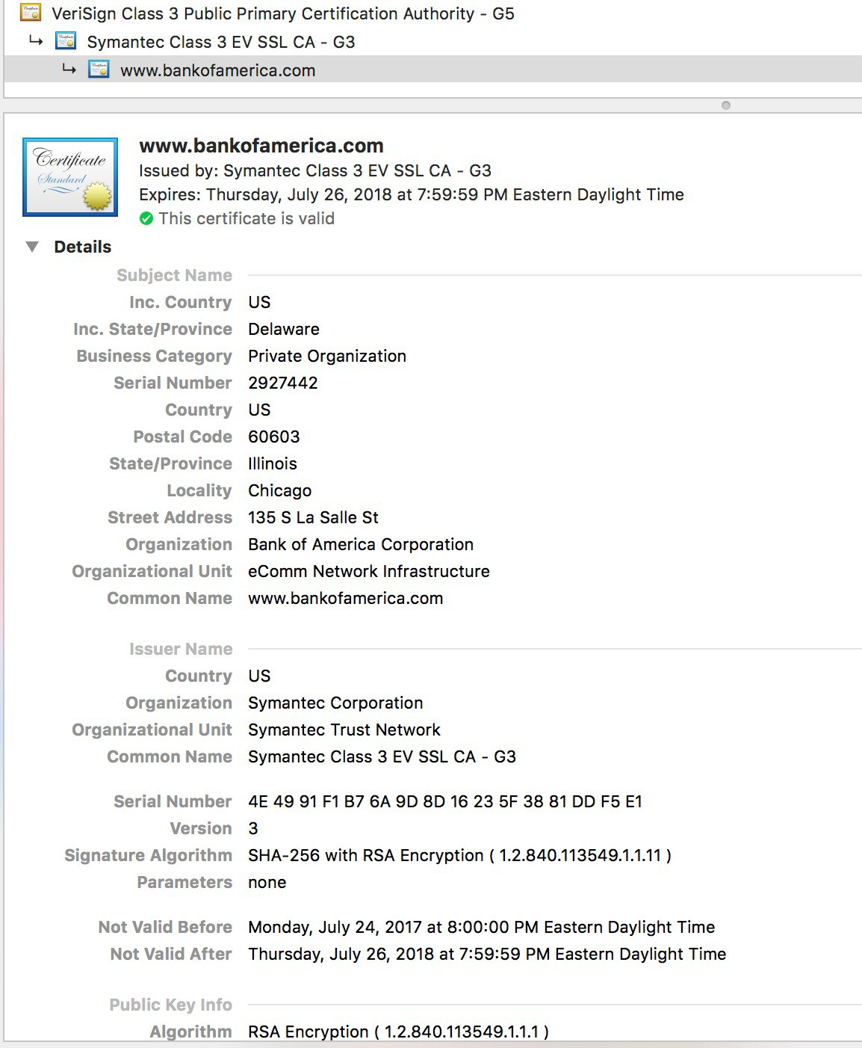
certificate details view typically shown in a web browser when a user clicks the lock icon in the address bar of an HTTPS website.

Slide 12
Security

Slide 13
Alice and Bob must be able to detect whether msg changed
verify msg originated from Alice
verify msg not tampered with on way to Bob
Solution
– digital signatures: cryptographic technique like hand-written signature
Channel
Data, control messages
Secure sender
Secure receiver
Data
Data
Alice
Bob
Trudy

Slide 14
Recipient (Bob)
Sender (Alice)
– encrypts msg m with her private key K_{A} to create
– applies Alice’s public key K⁺ to
A
-
K⁻ (m)
A
-
signed message, K ⁻(m)
– if K⁺(K (m)) = m whoever
A
– proves she is owner/creator
A A
signed m was Alice or has
Alice’s private key
Alice’s private key
Alice’s msg, m
_{K} -
A
⁻ (m)
m, K
Dear Bob
The secret meeting takes place at midnight under the old oak tree
Alice
A
Alice’s msg, m, signed (encrypted) with her private key
Public key encryption algorithm
Bob
Alice

Slide 15
Public key cryptography is expensive
more expensive the longer the message is
Public key cryptography is expensive because it involves mathematically complex operations like exponentiation over very large prime numbers (for RSA) or elliptic curves (for ECC).
Public key cryptography (e.g., RSA, ECDSA) isn't optimized for encrypting large amounts of data.
Solution
sign digital ``fingerprint” of msg rather than msg itself
Message digest
Instead of signing the whole message, you sign its digital "fingerprint".
fingerprint is called a message digest, and it's produced by a cryptographic hash function (e.g., SHA-256).
A hash function takes a message of any length and produces a fixed-size output (the digest).
You then sign the digest using the sender’s private key.

Slide 16
TLS: Signing + Encryption
1. Encrypt the Message (Confidentiality)
Use a symmetric key algorithm (like AES) to encrypt the full message. They use asymmetric key exchange algorithms during the TLS handshake to derive a shared symmetric key
This keeps it secret from anyone but the intended recipient.
2. Sign the Message (Integrity + Authentication)
Use a private key to sign the hash of the original (or encrypted) message.
This ensures it’s not tampered with and proves who sent it.

Slide 17
What happens
SENDER:
Create the Message Digest:
The sender computes a hash (digest) of the full message using a cryptographic hash function (like SHA-256).
Sign the Digest:
The sender encrypts the digest with their private key — this is the digital signature.
Send Both:
The original message (in plaintext or encrypted (symmetric key), depending on the context).
The digital signature (i.e., the signed digest).
RECIEVER:
Hash the Message Again:
The receiver computes their own digest of the received message using the same hash function.
Verify the Signature:
The receiver decrypts the digital signature using the sender’s public key to recover the original digest.
If this matches the digest they computed from the message, the signature is valid.
Read message (decrypt)

Slide 18
More on Symmetric Key generation for data encryption
ECDHE (Diffie-Hellman Key Exchange — Secure & Modern)
- Used in TLS 1.2 and TLS 1.3 (default)
Steps:
Server sends its public ECDHE key in the handshake.
Client generates its own ECDHE public key and sends it.
Both sides now use Elliptic Curve math to compute the same shared secret:
sharedSecret = ECDHE(client_private, server_public) = ECDHE(server_private, client_public)
That secret is then hashed and turned into the symmetric session key using a Key Derivation Function (KDF).
✅ The key was never transmitted, only calculated independently on both sides.

Slide 19
Desired features are what hash function gives
More on Message Digest
fixed-length
easy-to-compute
2 msgs unlikely to have same digest
Apply hash function H to m
Large msg, m
H: Hash Function
H(m) = msg digest
Hash function properties
many-to-1 function
produces fixed-size msg digest, H(m)
given message digest H(m), computationally infeasible to find m’ such that H(m) = H(m’)

Slide 20
MD5 hash function (RFC 1321)
computes 128-bit message digest in 4-step process.
“cryptographically broken and unsuitable for further use”
CMU Software engineering Institute
SHA-1
160-bit message digest
many vulnerabilities, browsers will no longer use/accept
SHA-2, SHA-3

Slide 21
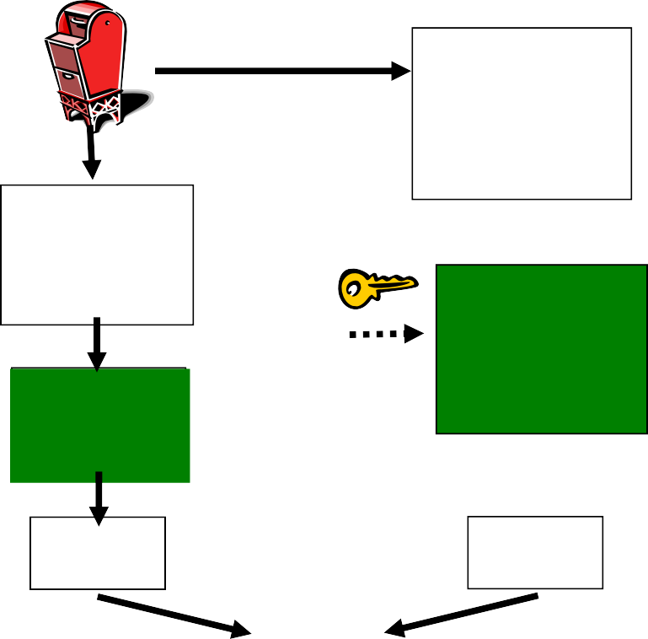
Bob verifies signature, integrity of digitally signed msg
Alice sends digitally signed message
Large msg,m
H: Hash function
H(m)
Encrypted
msg digest
-
K_{A}(H(m))
Alice’s private
key
Digital signature (encrypt)
Large msg, m
-
Alice’s public
key
Digital signature (decrypt)
K_{A}
_{K}+
Encrypted
H: Hash function
A
msg digest
+
K⁻ (H(m))
A
H(m)
H(m)
equal
?

Slide 22
Transport Layer Security → More

Slide 23
TLS provides application programming interface to apps
Application
TCP
IP
Application
TLS
TCP
IP
Normal application
Application with TLS

Slide 24
Send byte streams & interactive data
why? → modern web and network applications (like HTTPS, email, messaging, etc.) need to securely transmit continuous, bidirectional data — such as a video stream
Want set of secret keys for entire connection
why?→ A shared set of session keys (symmetric keys) ensures that all data sent after the handshake is encrypted and authenticated efficiently. Symmetric encryption is fast and scalable,
Want certificate exchange as part of protocol handshake phase
why? → client can verify it's talking to the correct server (and not a malicious actor) before any keys are shared or data is transmitted. This is critical for preventing man-in-the-middle attacks.

Slide 25
Transport Layer Security

Slide 26
Handshake
– Alice and Bob use their certificates, private keys to authenticate each other and exchange shared secret
Key derivation
Alice and Bob use shared secret to derive set of keys
Data transfer
data to be transferred is broken up into series of records
Connection closure
special messages to securely close connection

Slide 27
hello
public key certificate
K
_{B}+
(MasterSecret) = EncryptedMS
Derive keys from master secret
use key derivation function (KDF)
takes master secret and additional random data and creates keys

Slide 28
Don’t use same key for more than one cryptographic operation
keys for message authentication code (MAC): like hash
keys for encryption
Encryption keys
K_{c} = encryption key for data sent from client to server
K_{s} = encryption key for data sent from server to client
MAC keys
M_{c} = MAC key for data sent from client to server
M_{s} = MAC key for data sent from server to client
Used to Encrypt actual data (like website content) (e.g. AES-GCM).
Message Authentication Code. Ensures message integrity — checks that data hasn't been altered. (e.g. SHA)
A MAC (Message Authentication Code) is calculated over each TLS record (i.e., chunk of data). Includes message digest. MAC is verified by receiver to confirm data was not tampered with.

Slide 29
Why not encrypt data in constant stream as we write it to TCP?
where to put MAC?
if at end, no message integrity until all data processed
e.g., instant messaging
how can we do integrity check over all bytes sent before displaying?
Solution: break stream in series of records
each record carries MAC
receiver can act on each record as it arrives
Length | Data | MAC

Slide 30
What if attacker replays or re-orders records?
Solution: put sequence # into MAC (no seq # field)
MAC = MAC(M_{x}, sequence || data)
What if attacker replays all records?
Solution: use nonce
What if attacker forges TCP connection close?
Solution: have record types, with one type for closure
type 0 for data
type 1 for closure
MAC = MAC(M_{x}, sequence || type || data)
Length | Type | Data | MAC

Slide 31
bob.com
hello
certificate, nonce
K
_{B}+
(MasterSecret) = EncryptedMS
type 0, seq 1, data
type 0, seq 2, data
Encrypted
type 0, seq 1, data
type 0, seq 3, data
Nonce = “number used once” It is a random value generated for each session to ensure uniqueness and prevent replay attacks.
type 1, seq 4, close
type 1, seq 2, close

Slide 32
Transport Layer Security

Slide 33
How long are fields? Which encryption protocols? How do client and server negotiate encryption algorithms?
TLS Handshake
confidentiality
client and server negotiate encryption algorithms before data transfer
– i.e., negotiate ciphersuite
derive keys used in data exchange
integrity
check if handshake tampered with based on hash of handshake msgs
authentication
using public key and server’s certificate
optional client authentication

Slide 34
Negotiation: client, server agree on cipher suite
During the TLS handshake, the client and server agree on a cipher suite from a list of supported options.
– client offers choice server picks one TLS_RSA_WITH_3DES_EDE_CBC_SHA
Key exchange algorithm: public- key
Symmetric encryption algorithm: block cipher to encrypt msg stream
MAC
algorithm
Used to securely exchange a symmetric key. (e.g. RSA) – used during Handshake
Used to Encrypt actual data (like website content) (e.g. AES-GCM).
Message Authentication Code. Ensures message integrity — checks that data hasn't been altered. (e.g. SHA)
Which ciphersuites are supported depends on TLS version
TLS 1.2 supports many cipher suites
TLS 1.3 supports many fewer cipher suites
A MAC (Message Authentication Code) is calculated over each TLS record (i.e., chunk of data). Includes message digest. MAC is verified by receiver to confirm data was not tampered with.

Slide 35
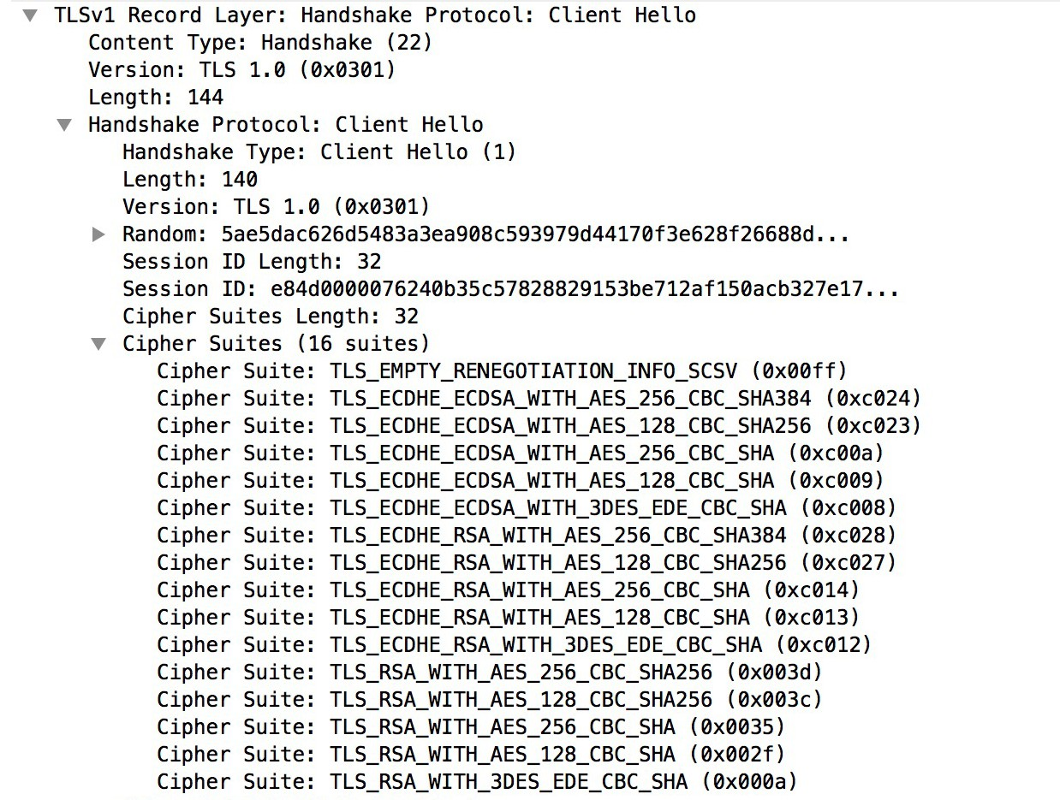
client starts the handshake by sending a Client Hello message, which includes info on cipher suites
Client (e.g., a web browser) initiates a secure connection with a server.

Slide 36
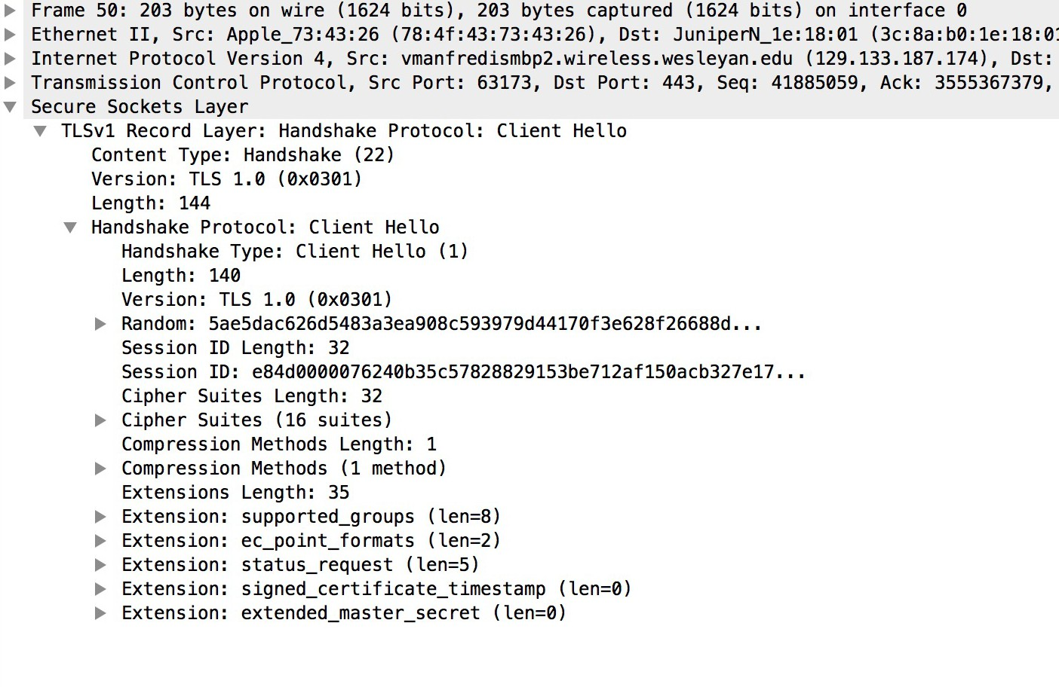

Slide 37
Alice
Integrity: If any handshake message was tampered with, digest won’t match, & connection will be terminated.
Bob
1. Client hello ➔
client nonce, ciphersuites
2. Server hello
server nonce, chosen ciphersuite, RSA certificate
3. Verifies certificate
generates premaster secret
4. Premaster secret ➔ encrypted with Bob’s public key from certificate
5. Generate symmetric keys client nonce, server nonce, premaster, ciphersuite
6. Generate symmetric keys client nonce, server nonce, premaster, ciphersuite
7. Server hello done
MAC of all handshake msgs encrypted with server session keys
8. Client hello done ➔
MAC of all handshake msgs
encrypted with client symmetric key
Protect handshake from tampering
7. Encrypted data ➔
8. Encrypted data

Slide 38
Alice
Bob
1. Client hello ➔
client nonce, ciphersuites
2. Server hello
server nonce, chosen ciphersuite, RSA certificate
Suppose Trudy sniffs all messages between Alice & Bob
next day, Trudy sets up TCP connection with Bob
replays sequence of records
Bob (Amazon) thinks Alice made two separate orders for same thing
Solution
Bob sends different random nonce for each connection
causes encryption keys to be different on the 2 days
Trudy’s messages will fail Bob’s integrity check

Slide 39
Look at TLS traffic and openssl s_client traffic
NEXT shows the output of the command-line tool openssl s_client, which is being used to connect to the HTTPS server and inspect its TLS certificate and connection info.

Slide 40
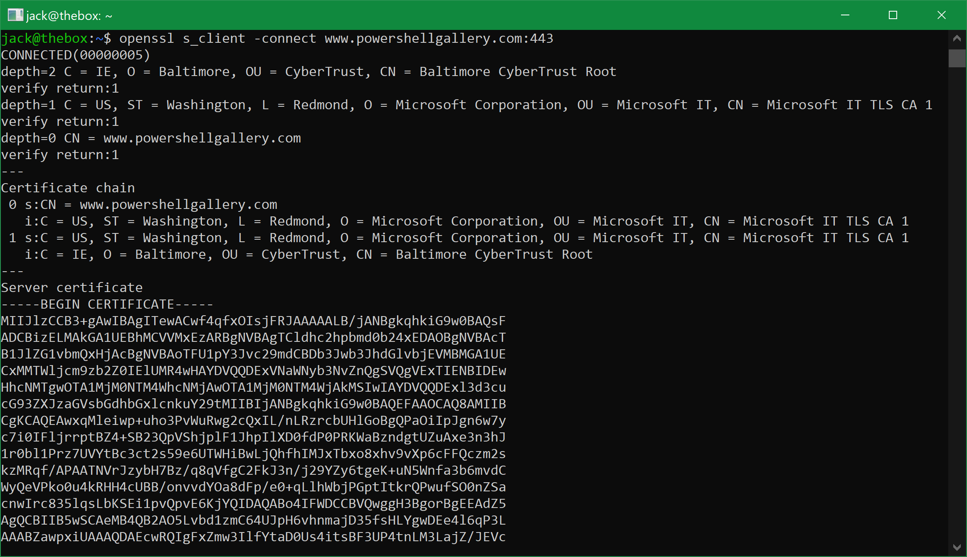
You can see that it verified that the issuer of the top-level certificate in the issuance chain (the CN=Baltimore CyberTrust Root CA) is trusted ("verified", against my local ca files), and each trust relationship all the way down to the peer (or endpoint) certificate for www.powershellgallery.com. From: https://blog.iisreset.me/openssl-s_client-but-in-powershell/

Slide 41
GAE (& most PaaS) handles TLS for you automatically
You don’t need to manually configure TLS certificates or HTTPS listeners in your Node.js app.
TLS and Cloud

Slide 42
TLS and Cloud
Google Compute Engine (& most/all IaaS)
You must set this up.
Option 1: Use HTTPS via Google Cloud Load Balancer (Recommended)
Let Google handle TLS termination for you using a Global HTTP(S) Load Balancer in front of your VM.
🧭 How It Works:
Your VM (GCE instance) runs your Node.js app on HTTP (port 80 or 8080).
You configure a Google Cloud Load Balancer in front of it.
The load balancer:
Terminates TLS/HTTPS.
Forwards traffic as plain HTTP to your Node.js app.
Can use Google-managed SSL certificates (free and auto-renewed).
🛠️ Steps:
Go to Cloud Console > Network Services > Load balancing.
Create a Global HTTP(S) load balancer.
Add:
Backend: your GCE instance group
Frontend: enable HTTPS (port 443)
Attach Google-managed certificate or upload your own
Point your domain's DNS A record to the load balancer's IP.

Slide 43
TLS and Cloud → configure on GCE
🛠️ Option 2: Handle TLS Yourself (on the VM)
You can configure HTTPS directly in your Node.js app, typically using Express + HTTPS module.
🛠️ Basic Setup:
Obtain a certificate:
Use Let’s Encrypt (via Certbot or acme.sh)
Or purchase and install a cert manually
Add this to your Node.js app:
Open ports 443 and optionally 80 in your GCP firewall rules:
gcloud compute firewall-rules create allow-https --allow tcp:443 --target-tags your-instance-tag
Node.js includes a bundled OpenSSL binary → it will support a version of TSL by default
const https = require('https');
const fs = require('fs');
const express = require('express');
const app = express();
app.get('/', (req, res) => res.send('Hello HTTPS!'));
const options = {// Load certificate files
key: fs.readFileSync('/etc/letsencrypt/live/yourdomain.com/privkey.pem'),
cert: fs.readFileSync('/etc/letsencrypt/live/yourdomain.com/fullchain.pem')
};
https.createServer(options, app).listen(443, () => {// Start HTTPS server with certificates specified
console.log('Secure server running on port 443');
});
⚖️

