Slide 1
Apache Kafka

Slide 2
Overview
Kafka is a “publish-subscribe messaging rethought as a distributed commit log”
Fast
Scalable
Durable
Distributed

Slide 3
Kafka adoption and use cases
LinkedIn: activity streams, operational metrics, data bus
400 nodes, 18k topics, 220B msg/day (peak 3.2M msg/s), May 2014
Netflix: real-time monitoring and event processing
Twitter: as part of their Storm real-time data pipelines
Spotify: log delivery (from 4h down to 10s), Hadoop
Loggly: log collection and processing
Mozilla: telemetry data
Airbnb, Cisco, Gnip, InfoChimps, Ooyala, Square, Uber, …

Slide 4
Uses of Kafka
build real-time streaming applications that transform or react to streams of data.
build real-time streaming data pipelines that reliably move data between systems and applications

Slide 5
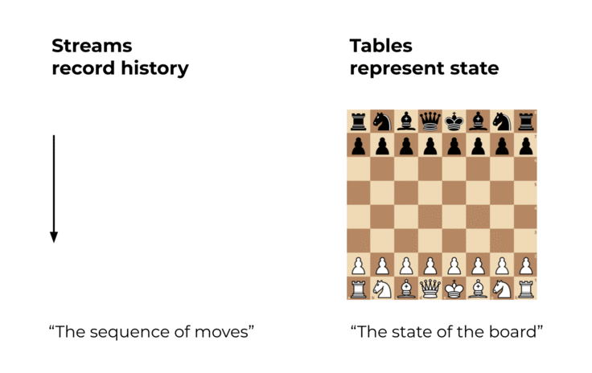
Event Streams??
Record history of events (data)..from blog think of check moves → lets see what a stream records versus a database

Slide 6
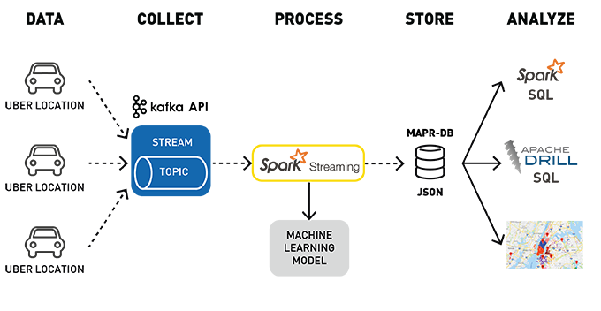
What Kafka can do
Note: the word STREAM
Publish and Subscribe to Streams of Records
Store Streams of Records in a Fault-Tolerant Durable Way
Process Streams of Records as They Occur

Slide 7
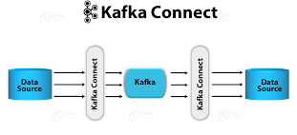
IMPORTANT
Kafka does not have to replace databases…the use case is for a stream of data.
If you need only the current state a database is good
Through Kafka Connect you can send data to/from other data sources like data bases

Slide 8
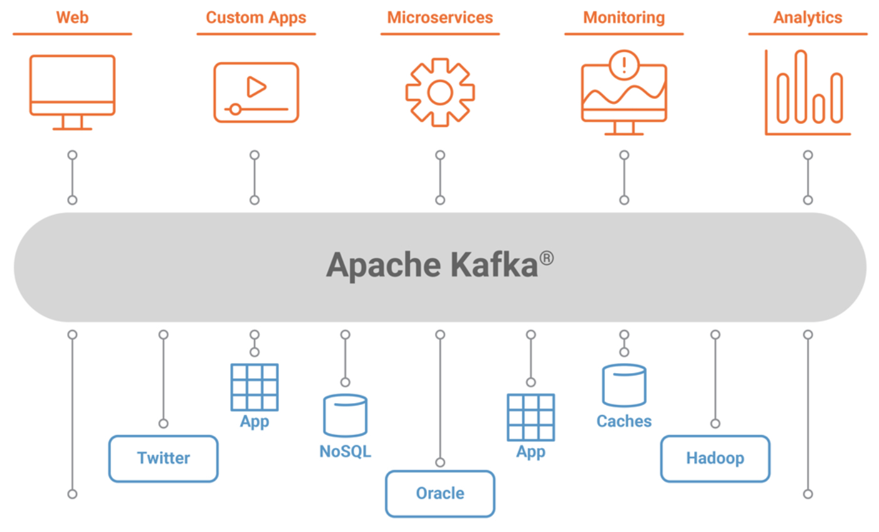
Kafka Driven system design imagined
Note –there are databases still

Slide 9
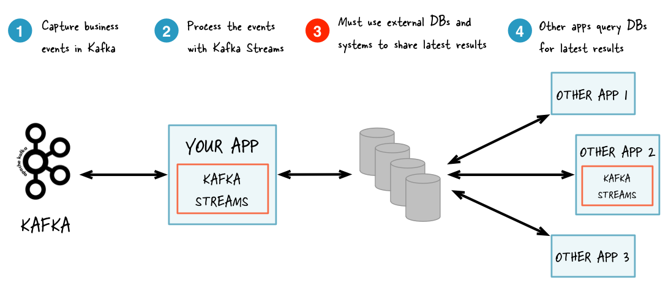
Again you can have Kafka + Databases
There can be room for both Kafka and Database

Slide 10
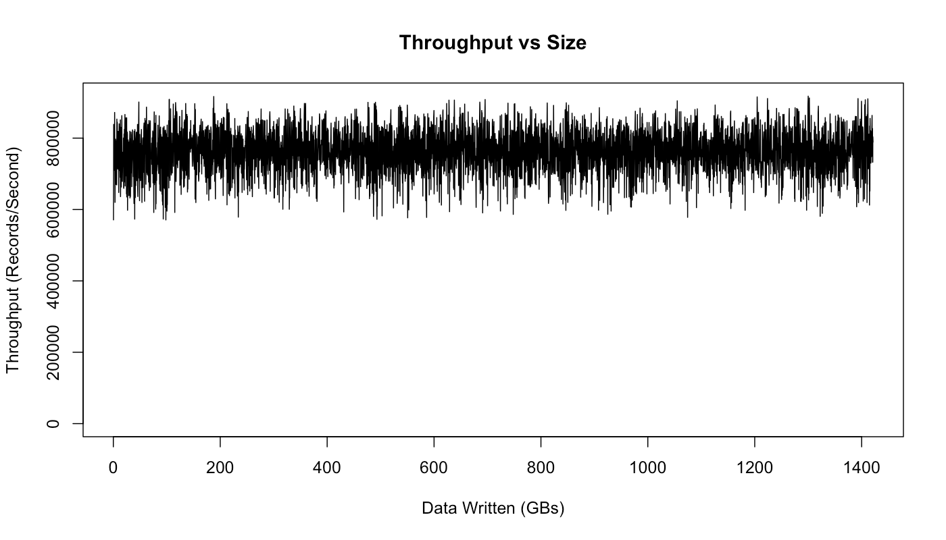
How fast is Kafka?
“Up to 2 million writes/sec on 3 cheap machines”
Using 3 producers on 3 different machines, 3x async replication
Only 1 producer/machine because NIC already saturated
Sustained throughput as stored data grows
Slightly different test config than 2M writes/sec above.

Slide 11
Why is Kafka so fast?
Fast writes:
While Kafka persists all data to disk, essentially all writes go to the page cache of OS, i.e. RAM.
Fast reads:
Very efficient to transfer data from page cache to a network socket
Linux: sendfile() system call
Combination of the two = fast Kafka!
Example (Operations): On a Kafka cluster where the consumers are mostly caught up you will see no read activity on the disks as they will be serving data entirely from cache.

Slide 12
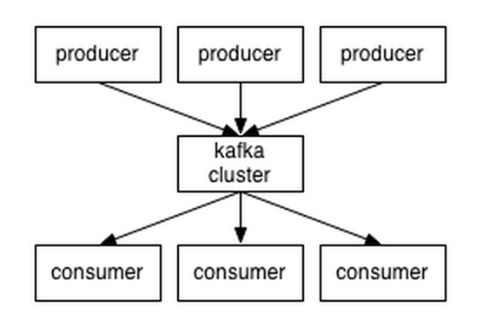
A first look
The who is who
Producers write data to brokers.
Consumers read data from brokers.
All this is distributed.
The data
Data is stored in topics.
Topics are split into partitions, which are replicated.

Slide 13
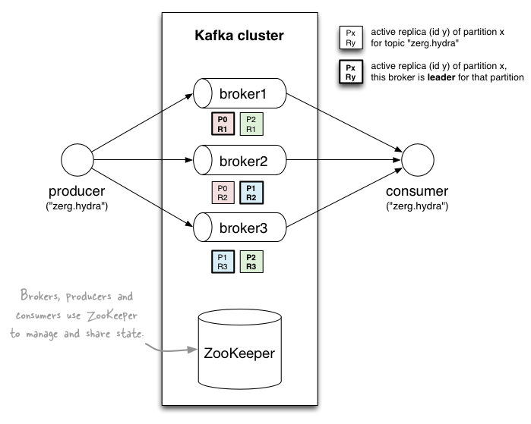
A first look

Slide 14
Kafka Topic
Kafka topics are the categories used to organize messages.
Each topic has a name that is unique across the entire Kafka cluster.
Events are organized and durably stored in topics
ANALOGY: a topic is similar to a folder in a filesystem, and the events are the files in that folder.

Slide 15
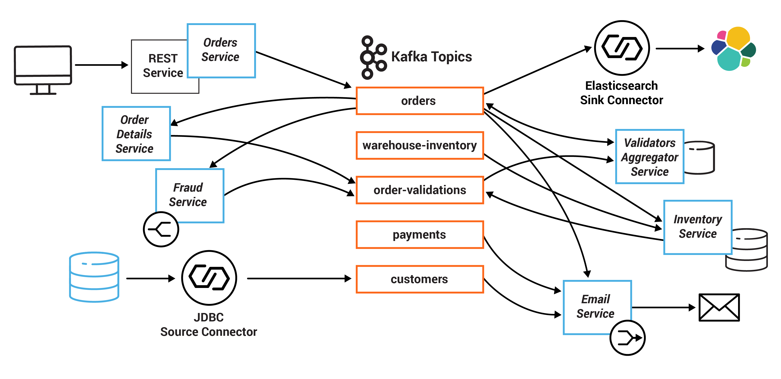
Kafka Topics –an example
Streams here lead to topic like “orders”, “customers”, “payments”, etc

Slide 16
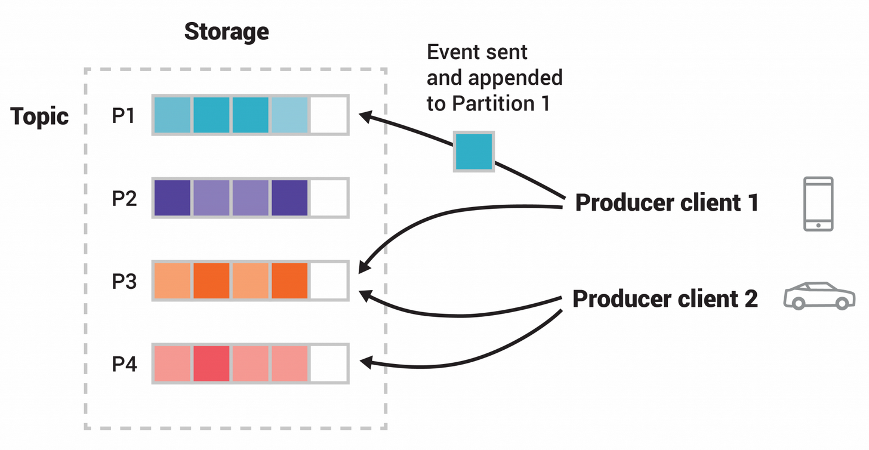
Topics --how it works
are partitioned, meaning a topic is spread over a number of "buckets" located on different Kafka brokers.
4 partitions
2 different producer clients are publishing, independently from each other, new events to the topic by writing events over the network to the topic's partitions. Events with the same key (denoted by their color in the figure) are written to the same partition. Note: both producers can write to the same partition if appropriate.

Slide 17
Topic Partitions
Partitions = "buckets" located on different Kafka brokers.
Scalability = allows client applications to both read and write the data from/to many brokers at the same time.
New Event = it is appended to one of the topic's partitions.
Historical Order Reading = Kafka guarantees that any consumer of a given topic-partition will always read that partition's events in exactly the same order as they were written.

Slide 18
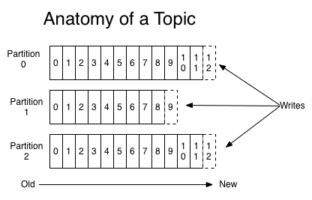
Partitions
A topic consists of partitions.
Partition: ordered + immutable sequence of messages that is continually appended to

Slide 19
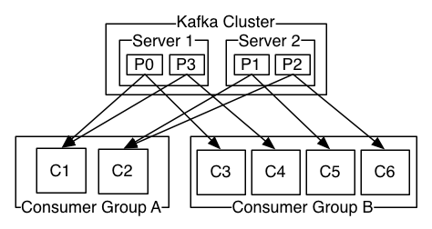
Partitions
#partitions of a topic is configurable
#partitions determines max consumer (group) parallelism
cf. parallelism of Storm’s KafkaSpout via builder.setSpout(,,N)
Consumer group A, with 2 consumers, reads from a 4-partition topic
Consumer group B, with 4 consumers, reads from the same topic

Slide 20
Partition offsets
Offset: messages in the partitions are each assigned a unique (per partition) and sequential id called the offset
Consumers track their pointers via (offset, partition, topic) tuples
Consumer group C1

Slide 21
Replicas of a partition
Replicas: “backups” of a partition
They exist solely to prevent data loss.
Replicas are never read from, never written to.
They do NOT help to increase producer or consumer parallelism!
Kafka tolerates (numReplicas - 1) dead brokers before losing data
LinkedIn: numReplicas == 2 → 1 broker can die

Slide 22
Write your Kafka Application → APIs
Admin API to manage and inspect topics, brokers, and other Kafka objects.
Producer API to publish (write) a stream of events to one or more Kafka topics.
Consumer API to subscribe to (read) one or more topics and to process the stream of events produced to them.
Kafka Streams API to implement stream processing applications and microservices. Higher-level functions: including transformations, stateful operations like aggregations and joins, windowing, processing based on event-time, and more. Input is read from one or more topics in order to generate output to one or more topics, effectively transforming the input streams to output streams.
Kafka Connect API to build and run reusable data import/export connectors that consume (read) or produce (write) streams of events from and to external systems and applications so they can integrate with Kafka. For example, a connector to a relational database like PostgreSQL might capture every change to a set of tables. However, in practice, you typically don't need to implement your own connectors because the Kafka community already provides hundreds of ready-to-use connectors.

Slide 23
Kafka Quickstart
Steps for downloading Kafka, starting a server, and creating a console-based consumer/producer
Requires ZooKeeper to be installed and running
https://kafka.apache.org/documentation.html#quickstart
https://github.com/adamjshook/hadoop-demos/tree/master/kafka

