Slide 1
Google Cloud Run vs Google App Engine AND GAE Load Balancing + Scaling Control
A Comparison of Managed Services

Slide 2
Overview
Google Cloud Run: Fully managed compute platform for running containerized applications. Learn more: https://cloud.google.com/run/docs
is a managed compute platform that allows you to run containerized applications directly in the cloud. It abstracts away the underlying infrastructure, enabling you to deploy and scale applications based on containers without having to worry about server management.
Google App Engine: Platform-as-a-Service (PaaS) for deploying web applications and services. Learn more: https://cloud.google.com/appengine/docs
is a fully managed platform as a service (PaaS) that allows you to build, deploy, and scale applications without managing the underlying infrastructure. It supports several programming languages and frameworks, making it easy to develop and run applications in a serverless environment.

Slide 3
Execution Model
Cloud Run: Runs stateless containers. You package your application into a Docker container image. Learn more: https://cloud.google.com/run/docs/container-contract
App Engine: Deploys code in specific runtimes (Standard) or custom containers (Flexible). Learn more: https://cloud.google.com/appengine/docs/the-appengine-environments

Slide 4
Scaling
Cloud Run: Automatically scales up based on traffic and scales down to zero when no traffic. Learn more: https://cloud.google.com/run/docs/about-auto-scaling
App Engine: Scales automatically (Standard) or to a minimum number of instances (Flexible). Learn more: https://cloud.google.com/appengine/docs/standard#automatic-scaling

Slide 5
Supported Languages/Technologies
Cloud Run: Supports any language or framework that can be packaged into a container. Learn more: https://cloud.google.com/run/docs/quickstarts
App Engine: Supports limited languages (Standard) and custom containers (Flexible). Learn more: https://cloud.google.com/appengine/docs/standard#runtimes

Slide 6
Use Cases
Cloud Run: Best for microservices, serverless containers, and stateless applications. Learn more: https://cloud.google.com/run/docs/when-to-use-cloud-run
App Engine: Great for web applications and mobile backends. Learn more: https://cloud.google.com/appengine/docs/what-is-app-engine

Slide 7
Pricing
Cloud Run: Pay only for what you use; billed based on CPU, memory, and request time. Learn more: https://cloud.google.com/run/pricing
App Engine: Billed based on instance hours (Standard) and resources consumed (Flexible). Learn more: https://cloud.google.com/appengine/pricing

Slide 8
Deployment Process
Cloud Run: Requires a Docker container image for deployment. Learn more: https://cloud.google.com/run/docs/deploying
App Engine: Deploys code (Standard) or containerized applications (Flexible). Learn more: https://cloud.google.com/appengine/docs/deploying

Slide 9
Customizability & Environment Control
Cloud Run: Full control over the containerized environment, including OS and libraries but, NO control over the environment/infrastructure.
App Engine: Limited control (Standard) and moderate control (Flexible) over the environment.

Slide 10
Summary of Differences
Execution Model: Cloud Run (Containerized), App Engine (Code/Container).
Supported Technologies: Cloud Run (Any language), App Engine (Limited languages).
Scaling: Cloud Run (Automatic, to zero), App Engine (Automatic, to minimum).
Environment Control: Cloud Run (Full control), App Engine (None/Moderate).
Infrastructure Control: Cloud Run (NONE), App Engine (Limited/Moderate)
Pricing: Cloud Run (Pay for usage), App Engine (Instance hours).
Best For: Cloud Run (Microservices), App Engine (Web apps).
Deployment Method: Cloud Run (Container images), App Engine (Code or containers).

Slide 11
Wait –Cloud Run + GAE Flexible Environment seems very similar
seem very similar especially when you consider that Google App Engine Flexible Environment allows deployment with containers and you can specify language, etc.
App Engine Flexible Environment: While it's a managed service, you have more control over the infrastructure, such as the ability to customize the virtual machines (VMs) that run your applications. This gives more flexibility in terms of configuration (e.g., choosing specific CPU types, setting memory, etc.). It also provides more persistent environments, as apps run continuously and aren't automatically scaled down to zero.
Cloud Run: It's a fully serverless platform where Google Cloud handles all the underlying infrastructure automatically. You don’t have control over the VM configuration or persistence. Apps in Cloud Run scale down to zero when not in use, reducing costs but making it best suited for stateless or event-driven applications.

Slide 12
GAE Flexible Environment –Customizable VMs
Customizable Virtual Machines (VMs):
In App Engine Flexible, your application runs on virtual machines (VMs), and you have some control over how these VMs are configured. Specifically, you can:
Choose the machine type: You can select how much CPU and memory you want for the VMs running your app. For instance, you can choose between standard machine types with different combinations of vCPUs and RAM.
Persistent Disks: You can configure persistent disk storage attached to your VMs, which allows for storage that is retained across VM restarts.
SSH Access: You can enable SSH access to the underlying VM for debugging purposes. This is something that’s not possible in fully serverless environments like Cloud Run or App Engine Standard.

Slide 13
GAE Flexible Environment –Custom Docker Containers
This is the same as in Google Cloud Run but, NOT GAE Standard Environment
define your own custom Docker container. Gives control over the runtime environment inside the container (operating system, libraries, etc.), but the infrastructure that runs the container (the VM, its scaling, etc.) is still partially under your control:
choose the base image for your container (e.g., a specific Linux distribution or even a custom OS image).
control all aspects of the software environment within the container.

Slide 14
GAE Flexible Environment –Enhanced Scaling Control
Scaling Configuration:
While scales your application automatically, you have more fine-grained control over the scaling behavior:
Minimum and Maximum Instances: can define the minimum number of instances that are always running, which ensures that your app remains available even during idle periods. You can also set a maximum number of instances to limit resource use.
Manual Scaling: While automatic scaling is the default, you can also configure manual scaling if you want more control over the instance count.
Scaling Delay: Can configure the scaling behavior, including the time that VMs should wait before being shut down during low-traffic periods, which gives you a balance between cost and performance.

Slide 15
GAE Flexible Environment – More control of Load Balancing
more control over the global load balancer when using GAE Flexible. This allows you to tweak aspects of traffic distribution, such as setting up custom load balancing rules or routing traffic based on custom conditions (e.g., path-based routing). You can also use Google Cloud’s HTTP(S) Load Balancer to define more advanced configurations for traffic distribution.

Slide 16
Google Cloud Run – Limited Load Balancing
Managed Load Balancer: automatically use Google's global HTTP(S) Load Balancer, but it’s managed by Google, meaning you don’t have deep control over the internal workings of it.
Traffic Splitting: You can direct a certain percentage of traffic to different revisions of your service. This is useful for canary deployments or A/B testing, allowing gradual rollouts of new versions.
Routing Based on URL Paths: If you deploy multiple services (e.g., microservices), you can route traffic to different services based on URL paths. This allows some flexibility in routing requests to specific parts of your application.
Autoscaling and Load Distribution: Cloud Run automatically scales instances based on incoming traffic. It scales down to zero when there’s no traffic and dynamically increases as traffic grows, but this scaling is handled by Google with little manual intervention.

Slide 17
GAE Standard – Limited Load Balancing
Managed Load Balancer: Like Cloud Run, GAE Standard uses Google’s managed HTTP(S) Load Balancer without giving you access to tweak load balancing rules or policies.
Traffic Splitting: You can split traffic between different versions of your application (just like in Cloud Run), useful for testing new versions or doing a phased rollout.
Path-based Routing: You can route requests based on specific paths in your URL, but this is mostly tied to versioning rather than the custom routing flexibility that GAE Flexible offers.
Autoscaling: Like Cloud Run, GAE Standard automatically handles scaling based on demand. The autoscaling is more rigid, especially because GAE Standard operates in a more isolated and constrained environment (sandboxed).

Slide 18
CANARY DEPLOYMENT: Load Balancing Control for 2 software Versions → For BOTH GAE Standard and Flexible

Slide 19
GAE Standard OR Flexible – Example Version 1 + Version 2 Load Balancing
useful for performing canary releases or A/B testing, where you gradually roll out a new version of your app to a small subset of users.
Let’s go through an example of how to split traffic between two versions of a Node.js Express application:
Version 1: The current stable version.
Version 2: The new version you want to test.

Slide 20
GAE – Example Version 1 + Version 2 Load Balancing- Steps to Deploy and Split Traffic:
Deploying Version 1 (Stable Version)
First, you need to deploy your initial (stable) version of your Node.js Express app.
Let’s assume your app.yaml looks like (+ how to deploy
runtime: nodejs16
instance_class: F1 # Define your instance class
# Environment variables
env_variables:
NODE_ENV: 'production'
service: default # The default service
version: v1 # Tagging it as version 1
gcloud app deploy --version=v1

Slide 21
GAE– Example Version 1 + Version 2 Load Balancing- Steps to Deploy and Split Traffic:
Deploying Version 2 (New Version to test)
Now, you make updates to your code (perhaps adding a new feature or fixing a bug). After making changes, update you yaml file as shown w/ command to deploy
runtime: nodejs16
instance_class: F1
# Environment variables
env_variables:
NODE_ENV: 'production'
service: default # Still using the default service
version: v2 # Tagging it as version 2
gcloud app deploy --version=v2

Slide 22
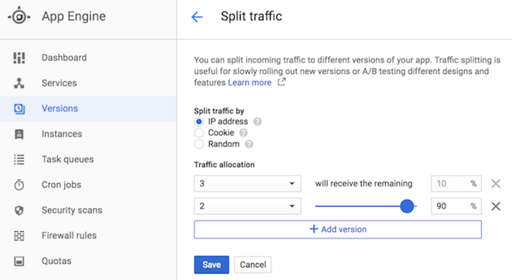
GAE – Example Version 1 + Version 2 Load Balancing- Steps to Deploy and Split Traffic:
Splitting Traffic Between Versions
For example, you can send 90% of traffic to version 1 (v1) and 10% of traffic to version 2 (v2).
Using Google gcloud command line
v1=0.9 means 90% of the traffic goes to version 1.
v2=0.1 means 10% of the traffic goes to version 2.
test version 2 with 10% of your users while keeping the majority of your users on the stable version 1.
Using the Google Cloud Console:
Navigate to App Engine section in Console.
Go to Versions under the App Engine service.
You’ll see both versions (v1 and v2) listed.
Click Split Traffic and enter the percentages (90% for v1 &10% for v2).
Save the changes.
gcloud app services set-traffic default --splits v1=0.9,v2=0.1

Slide 23
GAE– Example Version 1 + Version 2 Load Balancing – Monitor and go to V2 completely
Command line or in console shift to 100% traffic to v2.
gcloud app services set-traffic default --splits v2=1

Slide 24
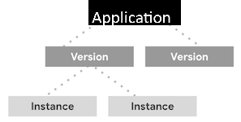
Example Scaling Control – For GAE Flexible Environment ONLY

Slide 25
GAE Flexible ONLY – Granular Scaling Control
can define minimum and maximum number of instances for your Node.js application in the app.yaml file. This file will define your runtime, instance class, and scaling settings.
runtime: nodejs16 # Specify the Node.js runtime
env: flex # Use the Flexible Environment
# Specify the instance class (optional)
instance_class: F2 # Use a higher instance class for more resources
# Define automatic scaling configuration
automatic_scaling:
min_instances: 2 # Minimum number of instances
max_instances: 5 # Maximum number of instances
cpu_utilization:
target_utilization: 0.6 # Target CPU utilization
min_instances: This specifies min # of instances that should always be running, ensuring that your application can handle a baseline level of traffic without delays.
max_instances: max # of instances your application can scale up to, preventing over-provisioning of resources.
target_utilization:helps decide when to add or remove instances based on CPU utilization, allowing for more responsive scaling

Slide 26
GAE Flexible ONLY – Granular Scaling Control – ANOTHER exmaple
2 kinds of target_utlization
automatic_scaling:
min_instances: 1
max_instances: 5
target_cpu_utilization: 0.6 # Specifies target CPU utilization
target_throughput_utilization: 0.6 # Specifies target throughput utilization
target_cpu_utlization: hspecifies the target CPU usage level for your application instances. It indicates the percentage of CPU resources that you want your application to utilize on average. For example, if you set this value to 0.6 GAE will attempt to keep the CPU usage at about 60%.
target_throughput_utlilization: refers to average number of requests handled per second by an instance. By setting this value, you define the target throughput that you expect from your application. A value of 0.6 would mean you are instructing Google App Engine to maintain the throughput at approximately 60% of the instance's maximum capacity. If an instance can handle, say, 100 requests per second at full capacity means you want it to target about 60 requests per second on average.

Slide 27
Summary- Google Cloud Run Vs GAE

Slide 28
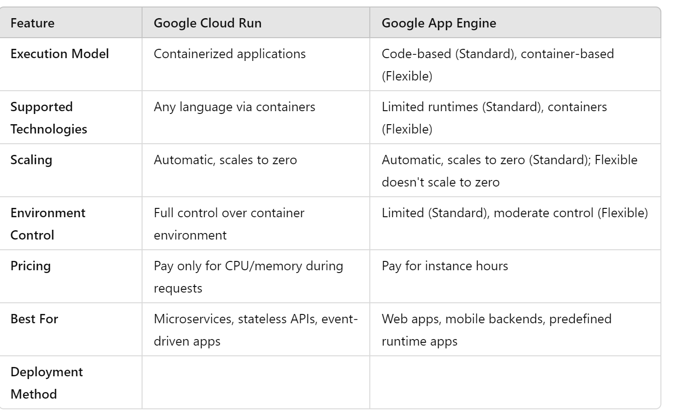
Summary of Differences

Slide 29
When to Use
Use Cloud Run when you need:
- Containerized applications with full control.
- Unpredictable or spiky traffic handling.
- Microservices or serverless APIs.
- Portability across environments.
Use App Engine when you need:
- Web applications or mobile backends.
- Minimal infrastructure management.

