Slide 1
APIs, FaaS and SaaS
Differences and Options

Slide 2
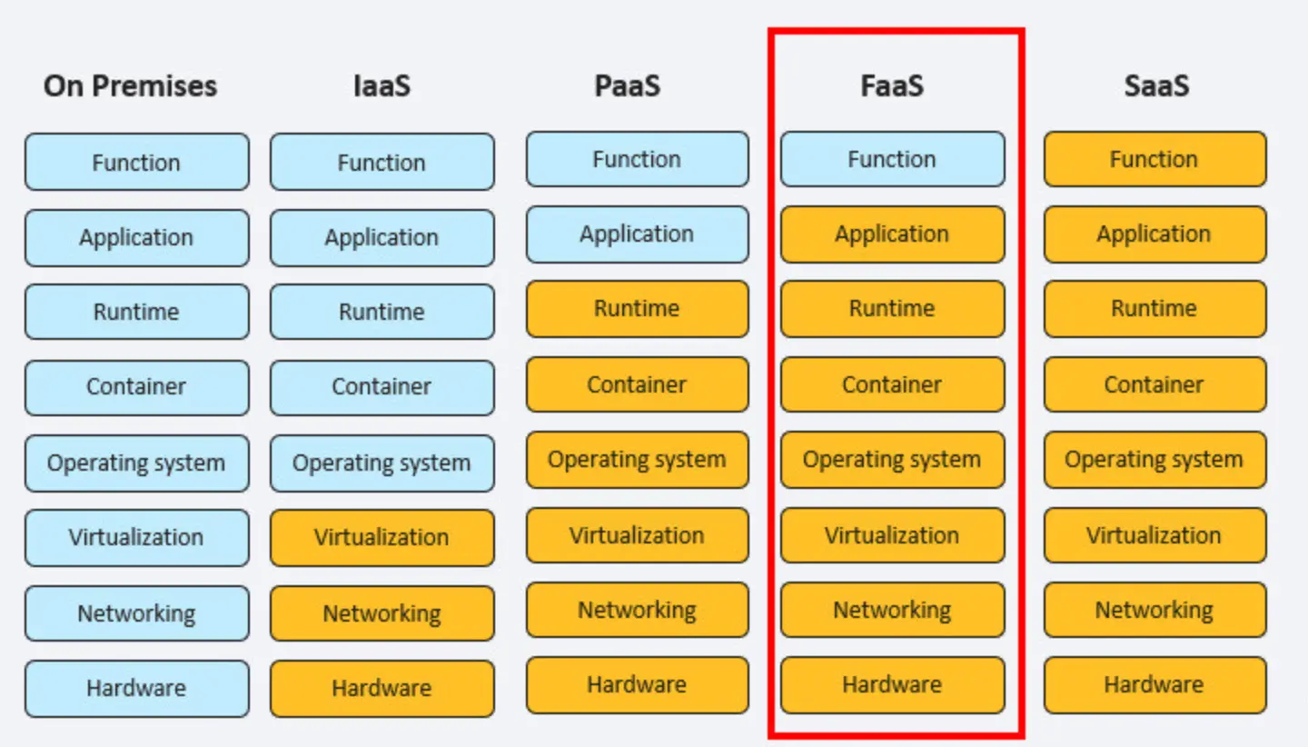
Some definitions
Concept
SaaS | A finished application (or API) delivered to users or developers
FaaS | A way to build small pieces of logic that can power SaaS apps or expose tiny services (like APIs)
APIs | Interfaces that connect users, apps, or systems to the logic you built — often implemented using FaaS

Slide 3
Google & Amazon Cloud
Category | Google Cloud Offerings | Amazon AWS Offerings
SaaS Support (running web apps for users) | - Google App Engine (GAE) - Google Cloud Run - Firebase Hosting (for mobile/web apps) | - AWS Elastic Beanstalk - AWS Amplify (for mobile/web apps) - Amazon Lightsail (simple VPS-based SaaS hosting)
FaaS Support (running functions) | - Google Cloud (Run) Functions | - AWS Lambda
APIs (building, exposing, managing) | - Apigee API Management - Google API Gateway - Cloud Endpoints (smaller scale) | - Amazon API Gateway - AWS AppSync (for GraphQL APIs)

Slide 4
SaaS
SaaS apps, you usually run full applications (web or mobile) that users interact with directly.

Slide 5
APIs
API = the "how" → It defines how systems or applications communicate/interact programmatically, without requiring a graphical user interface (GUI).

Slide 6
Is Google Cloud Vision SaaS or an API?
BOTH
Aspect | Answer | Why
Service Type (high-level) | Software as a Service (SaaS) | Google Cloud Vision provides ready-to-use machine learning services that you access over the internet — you don't manage models, servers, or infrastructure.
Interface (how you use it) | API | You access it by calling its REST API endpoints — for example, POST https://vision.googleapis.com/v1/images:annotate with an image payload.

Slide 7
What are Functions in FaaS
Concept | Meaning
Definition | A function in FaaS is a small, single-purpose piece of code designed to run in response to an event — like an HTTP request, file upload, message arrival, etc.
Focus | Each function is focused on one clear task — e.g., resize an image, validate a form, process a payment.
Deployment | You deploy the function's code to the cloud (e.g., Google Cloud Functions), and the cloud provider automatically handles scaling, execution, and server management.
Trigger | Functions are event-driven — they only execute when a specific event occurs.
Lifecycle | Functions typically run quickly, perform their task, and then exit — they are short-lived and stateless.

Slide 8
API Development on Google Cloud: Where Should You Host Your API?
You can host API endpoints on any of these Google Cloud services:
  Cloud Run Functions (previous Cloud Functions)
  Cloud Run
  App Engine (GAE)
→ All three can integrate with Google API Gateway for:
  Authentication
  Authorization
  Rate limiting
  Monitoring
  Secure exposure to users
IMPORTANT Google Cloud Functions rebranded to Google Cloud Run Functions
Google Cloud Functions (1st gen) was the traditional FaaS service (this is what most people learned originally).
Google Cloud Functions (2nd gen) is built on top of Cloud Run internally.
When you deploy a "2nd gen" function, under the hood, Google deploys it as a tiny Cloud Run service.
But from your perspective, you still write and deploy it as a function — NOT as a container manually.

Slide 9
Case-where to host API on Google Cloud COMPARISONS
 | Cloud (Run) Functions | Cloud Run | App Engine (GAE)
Best for | Small, lightweight APIs | Custom, scalable APIs | Traditional web apps with APIs
Granularity | One function = one endpoint | Full microservice or containerized app | Full web app or backend
Customization | Very little (pure function) | Full container control (any language) | Moderate (predefined runtimes or flexible Docker)
Startup Time | Fast, cold starts possible | Faster startup than GAE Flexible | Standard = fast; Flexible = slower startup
Scaling | Per function call | Per HTTP request | Auto scales (Standard); Configurable (Flexible)

Slide 10
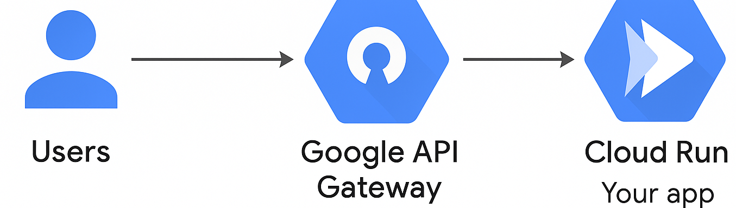
APIs → where BEST to Host (google cloud)
For most modern companies building APIs,→ Cloud Run is usually best:
Full control over environment
Supports any language (Node.js,aa Python, Go, Java, etc.)
Easily connects to API Gateway
Simple container deployment
Client (mobile app / website) → Google API Gateway → Cloud Run container → Your app handles API call → Respond back to client
Situation | Best Hosting
Very lightweight API (example: send confirmation emails) | Cloud Functions
Full-featured REST or GraphQL API (multiple endpoints, business logic) | Cloud Run
Web app + APIs combined (classic websites) | App Engine

Slide 11
EXAMPLE: "User Registration API" implemented using Google Cloud Functions
Endpoint: https://YOUR_REGION-YOUR_PROJECT.cloudfunctions.net/registerUser
Method: POST
Payload (incoming JSON):
Response (outgoing JSON):
{
"email": "newuser@example.com",
"password": "SuperSecret123"
}
{
"status": "success",
"message": "User account created!"
}

Slide 12
How It’s Implemented (inside Google Cloud Run Functions)
You deploy a Cloud Function called registerUser that:
Receives the HTTP POST request.
Parses the incoming JSON body.
Creates a new user record in a database (e.g., Firestore, etc.).
Returns a success message or an error.

Slide 13
Example Code (Node.js on Google Cloud Run Functions)
// Import and initialize Firebase Admin SDK to access Firestore database
const admin = require('firebase-admin');
admin.initializeApp();
const db = admin.firestore();
// Export the Cloud Function 'registerUser'
exports.registerUser = (req, res) => {
  // Check if the HTTP request method is POST
  if (req.method !== 'POST') {
  return res.status(405).send({ message: 'Only POST requests allowed' });
  }
  // Extract 'email' and 'password' from the incoming JSON body
  const { email, password } = req.body;
  // Validate that both email and password are provided
  if (!email || !password) {
  return res.status(400).send({ message: 'Missing email or password' });
  }
Concept | Meaning
exports | Special object provided by Node.js for sharing functions, variables, etc. outside the file
registerUser | The name of the function you're making available to be called by Google Cloud

Slide 14
CONTINUED
  // Add the new user to the 'users' collection in Firestore
  db.collection('users').add({
  email: email,
  password: password // ⚠️ WARNING: In real apps, passwords must be hashed before storing!
  })
  .then(() => {
  // Successfully created the user - send back a success response
  res.status(201).send({
  status: 'success',
  message: 'User account created!'
  });
  })
  .catch(error => {
  // Handle any errors that occurred during database operation
  res.status(500).send({ message: `Error creating user: ${error.message}` });
  });
};

Slide 15
DEPLOY: How You Deploy the Node.js registerUser Function to Google Run Functions
STEP 1:
Prepare your project folder
Create a folder, e.g., registerUserFunction/
Inside it, have:
  index.js → (your function code — with exports.registerUser = ...)
  package.json → (specifying the dependencies, like Firebase Admin SDK)
{
"name": "register-user-function",
"version": "1.0.0",
"dependencies": {
"firebase-admin": "^11.0.0"
}
}

Slide 16
Deploy- STEP 2
Then log into Google Cloud & set the project
gcloud auth login
gcloud config set project [YOUR_PROJECT_ID]
Then deploy
registerUser = the name you exported in index.js
--allow-unauthenticated = allows public access (optional — you can lock this down later)
gcloud functions deploy registerUser \
--gen2 \
--runtime nodejs20 \
--trigger-http \
--allow-unauthenticated
After deployment, Google Cloud will print a URL like:
https://REGION-PROJECT_ID.cloudfunctions.net/registerUser

Slide 17
How to use the registerUser deployed function
Example 1: called from frontend (javascript)
fetch('https://REGION-PROJECT_ID.cloudfunctions.net/registerUser', {
method: 'POST',
headers: {
'Content-Type': 'application/json'
},
body: JSON.stringify({
email: 'newuser@example.com',
password: 'SuperSecret123'
})
})
.then(response => response.json())
.then(data => console.log('Success:', data))
.catch(error => console.error('Error:', error));

Slide 18
Example 2: Call from another backend service (Node.js)
const axios = require('axios');
axios.post('https://REGION-PROJECT_ID.cloudfunctions.net/registerUser', {
email: 'newuser@example.com',
password: 'SuperSecret123'
})
.then(response => {
console.log('User created:', response.data);
})
.catch(error => {
console.error('Error creating user:', error);
});

