Slide 1
Bootstrap
front-end UI framework consisting of CSS plus JavaScript components.

Slide 2
The Problem Bootstrap Solves
Without a framework, developers repeatedly create:
Responsive page layouts
Navigation bars
Buttons
Forms
Cards
Spacing and alignment
Mobile layouts
Interactive UI components
Goal:
Reuse tested UI patterns rather than implementing everything from scratch.

Slide 3
Bootstrap provides TWO major pieces:
Bootstrap CSSs | Bootstrap JavaScript
Grid / responsive layout | Modals
Buttons | Dropdowns
Forms | Collapse
Cards | Offcanvas
Typography | Carousel
Utility classes | Tooltips
Bootstrap CSS → styling + responsive layout
Bootstrap JS → behavior for UI components
Your JS → application logic

Slide 4
Bootstrap Is NOT React
They solve different problems and can be used together.
React
↓
Application UI / State
Bootstrap
↓
Styling / Layout / UI Components
Bootstrap | React
UI framework | UI/application library
Styling & layout | Component architecture
Responsive grid | Application state
Prebuilt UI components | Dynamic rendering
Some component behavior | Application behavior

Slide 5
Adding Bootstrap to a Page
NOTE: Use the current URLs from the official Bootstrap documentation.
integrity (SRI): Security hash that lets the browser verify the downloaded CDN file has not been modified.
Bootstrap CSS goes in <head>:
  <link
  href="https://cdn.jsdelivr.net/npm/bootstrap@5.3.8/dist/css/bootstrap.min.css"
  rel="stylesheet"
  integrity="sha384-sRIl4kxILFvY47J16cr9ZwB07vP4J8+LH7qKQnuqkuIAvNWLzeN8tE5YBujZqJLB"
  crossorigin="anonymous">
Bootstrap JavaScript:
  <script
  src="https://cdn.jsdelivr.net/npm/bootstrap@5.3.8/dist/js/bootstrap.bundle.min.js"
  integrity="sha384-FKyoEForCGlyvwx9Hj09JcYn3nv7wiPVlz7YYwJrWVcXK/BmnVDxM+D2scQbITxI"
  crossorigin="anonymous">
  </script>

Slide 6
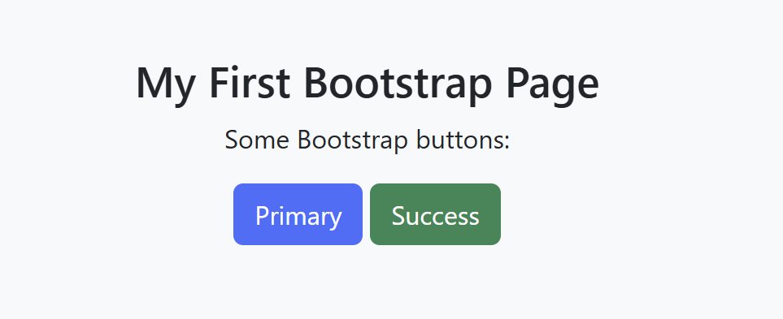
Bootstrap CSS — Using Predefined Classes →example
<head>
<title>Bootstrap Example</title>
<meta name="viewport" content="width=device-width, initial-scale=1">
<link href="https://cdn.jsdelivr.net/npm/bootstrap@5.3.8/dist/css/bootstrap.min.css" rel="stylesheet">
<script src=https://cdn.jsdelivr.net/npm/bootstrap@5.3.8/dist/js/bootstrap.bundle.min.js defer></script>
</head>
<body>
<div class="bg-light p-5 text-center">
<h2>My First Bootstrap Page</h2>
<p>Some Bootstrap buttons:</p>
<button class="btn btn-primary">Primary</button>
<button class="btn btn-success">Success</button>
</div>
</body>
</html>
Here there are two CSS classes:
btn
btn-primary
Bootstrap already contains CSS rules associated with those class names.
Normal HTML:
  <button>Save</button>
Bootstrap:
  <button class="btn btn-primary">
  Save
  </button>
Another style:
  <button class="btn btn-danger">
  Delete
  </button>
Bootstrap classes tell the browser which Bootstrap CSS rules to apply.
  HTML element
  +
  Bootstrap classes
  ↓
  Styled component
See W3Schools
for other examples

Slide 7
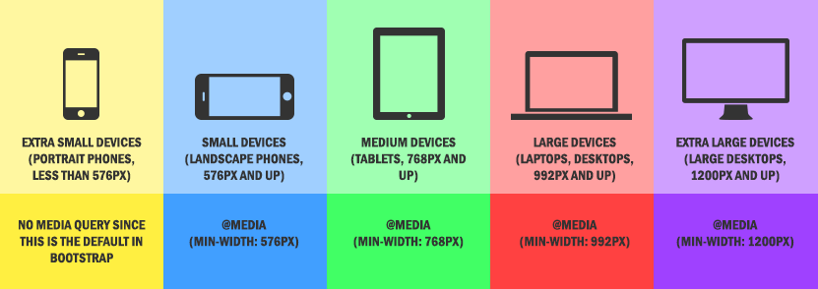
Responsive Web Design
A modern web interface should adapt to different resolutions
    Desktop Tablet Phone
Bootstrap provides:
  Responsive grid
  Breakpoints
  Responsive utilities
  Responsive components

Slide 8
“Mobile” – First
(“smallest viewport first.”)
Breakpoint = screen-width threshold where a new responsive rule begins to apply.
Bootstrap | Screen width starts at | Think of it as
Nso abbreviation | < 576px | Smallest
sm | ≥ 576px | Small
md | ≥ 768px | Medium
lg | ≥ 992px | Large
xl | ≥ 1200px | Extra large
xxl | ≥ 1400px | Extra-extra large
What does Mobile-First mean?
Design for the smallest screen first, then progressively change the layout as the screen becomes larger.
Bootstrap provides responsive breakpoints:
col-12
Bootstrap imagines every row as being divided into 12 equal slots:
| 1 | 2 | 3 | 4 | 5 | 6 | 7 | 8 | 9 | 10 | 11 | 12 |
class="col-12"
means: Take 12 out of 12 slots = 100% of row
For example:
<div class="col-12 col-md-6 col-lg-4">
< 768px ≥ 768px ≥ 992px
col-12 col-md-6 col-lg-4
12/12 6/12 4/12
100% 50% 33%
col-12
has no breakpoint, so it applies from the smallest size upward until another responsive class overrides it.

Slide 9
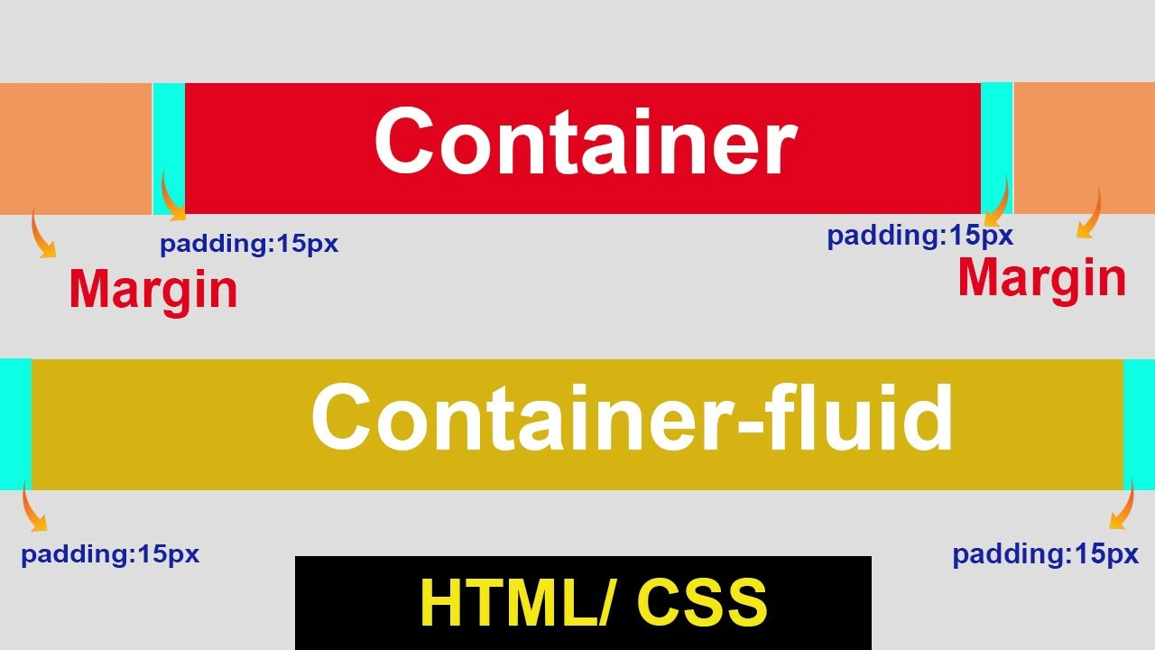
Bootstrap Container versus container-fluid
.container is a Bootstrap CSS class commonly applied to an outer HTML wrapper for page content & creates a centered content region, and on larger resolutions will have a left and right margin
  <div class="container">
  <h1>CS651</h1>
  <p>Welcome to Web Systems</p>
  </div>
  container-fluid uses essentially the full available width at every viewport size:
    <div class="container-fluid">
    <h1>CS651</h1>
    <p>Welcome to Web Systems</p>
    </div>

Slide 10
Bootstrap Grid System
Container = overall content area. Grid = how we divide that area into a layout.
Bootstrap divides each row into 12 equal conceptual columns.
.container
│
└── .row
│
└── 12 available column units
1 2 3 4 5 6 7 8 9 10 11 12
|--|--|--|--|--|--|--|--|--|--|--|--|
Example: Sidebar + Main Content
<div class="container">
<div class="row">
<div class="col-4">
Sidebar
</div>
<div class="col-8">
Main Content
</div>
</div>
</div>
ROW = 12 column units
┌──────────────┬──────────────────────────┐
│ │ │
│ Sidebar │ Main Content │
│ │ │
│ col-4 │ col-8 │
│ 4/12 │ 8/12 │
│ 33% │ 67% │
│ │ │
└──────────────┴──────────────────────────┘
4 + 8
=
12
.container → overall content area
.row → creates a horizontal group
.col-* → determines how much of the
12-column row an item occupies

Slide 11
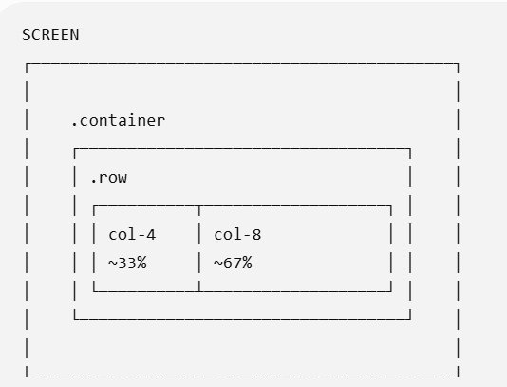
Important
Remember col-4 or col-8 is a percentage of the available width of the row, which is normally inside a container:
Think of the 12-column grid as an easy way to specify fractions/percentages of a row.

Slide 12
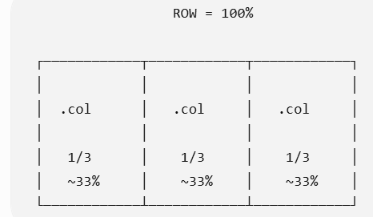
Automatic Equal-Width Columns
You do not always need to specify col-4, col-6, etc.
If you simply use:
Bootstrap divides the available row width equally among the .col elements.
<div class="row">
<div class="col">
Column 1
</div>
<div class="col">
Column 2
</div>
<div class="col">
Column 3
</div>
</div>
.col means: “Give me an equal share of the available row width.”

Slide 13
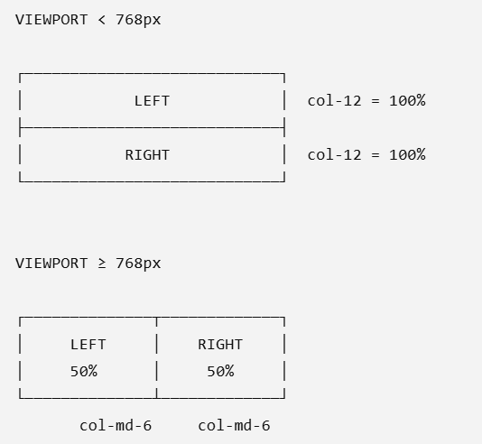
Responsive Columns with Breakpoints → Making the Grid Responsive
Bootstrap lets you change how many columns an element occupies as the viewport width changes.
<div class="row">
<div class="col-12 col-md-6">
Left
</div>
<div class="col-12 col-md-6">
Right
</div>
</div>
Read each class separately
col-12
↓
No breakpoint specified
12/12 = 100% width
col-md-6
↓
Starting at md (≥ 768px)
6/12 = 50% width
The HTML does not change. Bootstrap CSS changes the layout based on the viewport width.

Slide 14
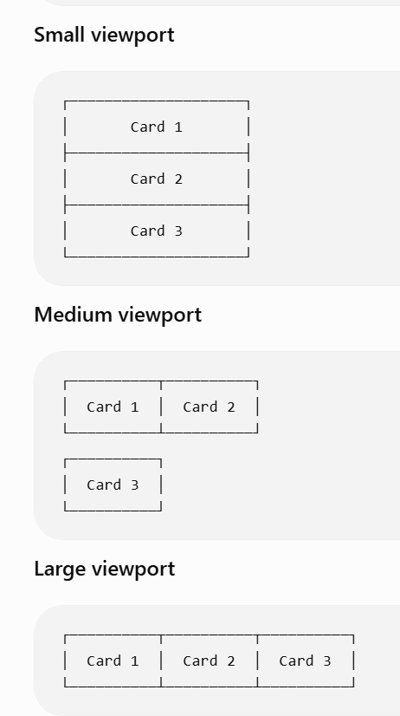
Bootstrap Grid Is Mobile-First
Define the layout for the smallest viewport first, then progressively change it for wider viewports
<div class="col-12 col-md-6 col-lg-4">Card 1</div>
<div class="col-12 col-md-6 col-lg-4">Card 2</div>
<div class="col-12 col-md-6 col-lg-4">Card 3</div>
Read from smallest → largest
Viewport width | Class controlling width | Result
< 768px | col-12 | 12/12 = 100%
768–991px | col-md-6 | 6/12 = 50%
≥ 992px | col-lg-4 | 4/12 = 33.3%

Slide 15
Bootstrap Utility Classes
Bootstrap provides predefined CSS classes for common styling operations.
Instead of writing your own CSS:
    .myBox {
    margin-top: 1rem;
    padding: 1.5rem;
    text-align: center;
    font-weight: bold;
    }
you can apply Bootstrap utility classes directly:
    <div class="mt-3 p-4 text-center fw-bold">
    Hello Bootstrap
    </div>
Go to Bootstrap Official site to learn more
Bootstrap class | Meaning
mt-3 | Add margin at the top
p-4 | Add padding on all sides
text-center | Center the text
fw-bold | Make font bold

Slide 16
Understanding Bootstrap Spacing Utilities
Bootstrap uses a naming pattern:
  {property}{side}-{size}
Letter | Meaning
t | top
b | bottom
s | start (left in normal LTR layouts)
e | end (right in normal LTR layouts)
x | left + right
y | top + bottom
none | all sides
mt-3
││ │
││ └── size
│└──── top
└───── margin
Size — How much spacing?
Bootstrap provides a predefined spacing scale:
0 → none
1 → very small
2 → small
3 → normal
4 → larger
5 → largest standard spacing
Bootstrap class | Meaning
mt-3 | Add margin at the top
p-4 | Add padding on all sides
text-center | Center the text
fw-bold | Make font bold

Slide 17
Understanding Bootstrap Spacing Utilities -SIZE
Number | Default spacing | Meaning
0 | 0 | No spacing
1 | 0.25rem | Very small
2 | 0.5rem | Small
3 | 1rem | Standard
4 | 1.5rem | Larger
5 | 3rem | Large
Bootstrap uses a naming pattern:
  {property}{side}-{size}
rem is a CSS unit meaning “root em.” It measures size relative to the root <html> element's fonts
mt-3
││ │
││ └── size
│└──── top
└───── margin
Assuming the common browser default of 1rem = 16px, that corresponds approximately to:
0 → 0 px
1 → 4 px
2 → 8 px
3 → 16 px
4 → 24 px
5 → 48 px
So: <div class="mt-0">
means no top margin.
Size — How much spacing?
Bootstrap provides a predefined spacing scale:
0 → none
1 → very small
2 → small
3 → normal
4 → larger
5 → largest standard spacing

Slide 18
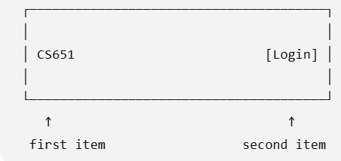
Bootstrap Flexbox Utilities
Bootstrap provides utility classes that apply common CSS Flexbox properties
Bootstrap's classes correspond to CSS:
Without Bootstrap
You might write:
.toolbar {
display: flex;
justify-content: space-between;
align-items: center;
}
With Bootstrap
<div class="d-flex
justify-content-between
align-items-center">
<span>CS651</span>
<button>Login</button>
</div>
Bootstrap | CSS
d-flex | display: flex
justify-content-between | justify-content: space-between
align-items-center | align-items: center
makes the <div> a flex container. By default, its children are arranged horizontally:
CS651 [Login]
justify-content-between
This is what pushes them apart:

Slide 19
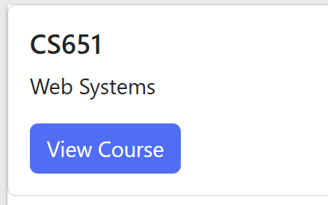
Bootstrap Cards
<div class="card">
<div class="card-body">
<h5 class="card-title">
CS651
</h5>
<p class="card-text">
Web Systems
</p>
<a href="#" class="btn btn-primary">
View Course
</a>
</div>
</div>
.card
↓
Outer card container
.card-body
↓
Content area + spacing
.card-title
↓
Styles the title
.card-text
↓
Styles card text
.btn btn-primary
↓
Bootstrap button
A card is a flexible content container used to group related information.
Typical uses:
  Products
  Courses
  User profiles
  News/articles
  Dashboard items

Slide 20
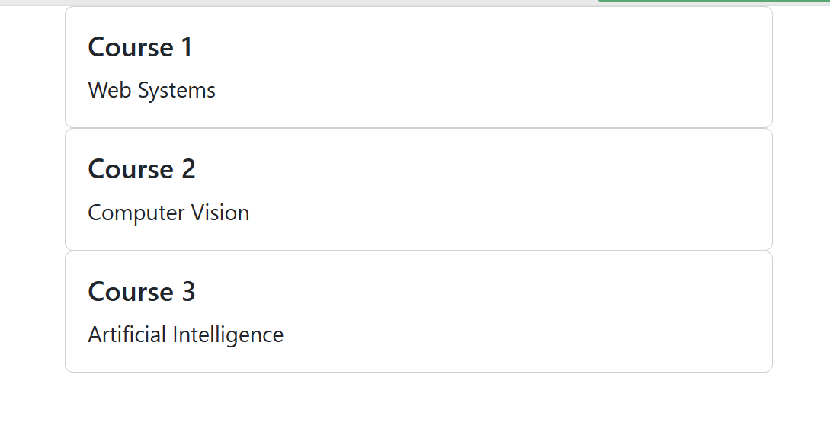
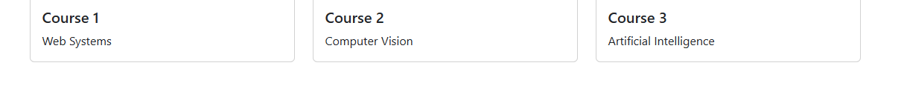
Responsive Cards: Combining Components + Grid
<div class="container">
<div class="row">
<div class="col-12 col-md-6 col-lg-4">
<div class="card">
<div class="card-body">
<h5 class="card-title">Course 1</h5>
<p class="card-text">Web Systems</p>
</div>
</div>
</div>
<div class="col-12 col-md-6 col-lg-4">
<div class="card">
<div class="card-body">
<h5 class="card-title">Course 2</h5>
<p class="card-text">Computer Vision</p>
</div>
</div>
</div>
<div class="col-12 col-md-6 col-lg-4">
<div class="card">
<div class="card-body">
<h5 class="card-title">Course 3</h5>
<p class="card-text">Artificial Intelligence</p>
</div>
</div>
</div>
</div>
</div>
Suppose we want 3 cards:
  Small viewport → cards stacked vertically
  Medium viewport → 2 cards per row
  Large viewport → 3 cards per row
Lower resolution
The card itself isn't responsive because it is a card.
The surrounding Bootstrap grid classes determine how much space each card receives:
Higher resolution

Slide 21
MORE….learn on your own
Go online to learn about styling forms
<input type="email" id="email" class="form-control">
Area | What Bootstrap Provides
Colors | Text, background, link and theme colors
Typography | Font sizes, weights, alignment, headings
Spacing | Margin, padding, gaps
Borders | Borders, colors, widths, rounded corners
Shadows | Predefined box shadows
Sizing | Width, height, max-width
Display | Show/hide, block, inline, flex
Flexbox | Alignment, direction, wrapping, distribution
Position | Relative, absolute, fixed, sticky
Images | Responsive images, thumbnails
Tables | Styled, striped, bordered, responsive tables
Backgrounds | Background colors and utilities
Visibility | Responsive show/hide behavior
<nav aria-label="breadcrumb">
<ol class="breadcrumb">
<li class="breadcrumb-item">
<a href="/">Home</a>
</li>
<li class="breadcrumb-item">
<a href="/courses">Courses</a>
</li>
<li class="breadcrumb-item active"
aria-current="page">
CS651
</li>
</ol>
</nav>
Learn about built in components for
Alerts
Badges
Breadcrumbs
Button groups
List groups
Pagination
Progress bars
Spinners
Tables

Slide 22
now for some Bootstrap Javascript

Slide 23
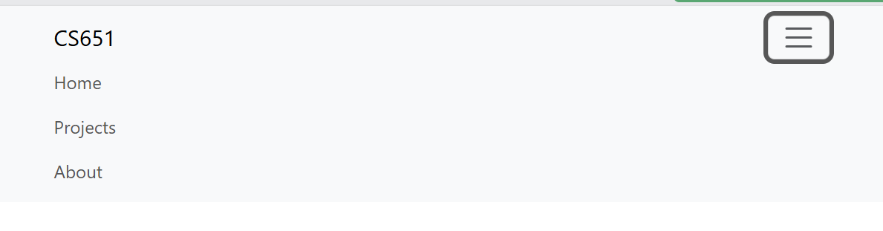
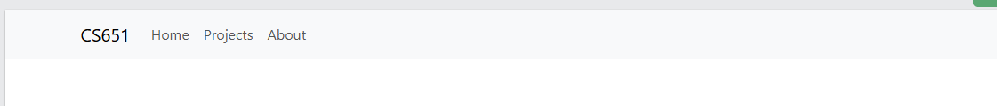
Bootstrap Navbar
<nav class="navbar navbar-expand-lg bg-body-tertiary">
<div class="container">
<a class="navbar-brand" href="#">
CS651
</a>
<button
class="navbar-toggler"
type="button"
data-bs-toggle="collapse"
data-bs-target="#navbarMenu">
<span class="navbar-toggler-icon"></span>
</button>
<div
class="collapse navbar-collapse"
id="navbarMenu">
<div class="navbar-nav">
<a class="nav-link" href="#">
Home
</a>
<a class="nav-link" href="#">
Projects
</a>
<a class="nav-link" href="#">
About
</a>
</div>
</div>
</div>
</nav>
Code | What it does
navbar | Base Bootstrap navbar styling
navbar-expand-lg | Expanded navbar at lg (≥992px); collapsed below
navbar-brand | Styles the site's name/logo
navbar-toggler | Styles the button used to open/close the collapsed navbar
navbar-toggler-icon | Displays Bootstrap's hamburger/menu icon
navbar-nav | Container for the navigation links
nav-link | Styles an individual navigation link
collapse | Makes an element capable of being shown/hidden
navbar-collapse | Navbar-specific styling for the collapsible section
navbar provides site navigation and can automatically change layout at a Bootstrap breakpoint.
Bootstrap JavaScript: data-bs-toggle="collapse" → behavior
data-bs-target="#navbarMenu": identifies which DOM element the behavior acts upon
Lower Resolution
High Resolution

Slide 24
On your own…more Bootstrap Javascript
Component | What it Does
Dropdown | Opens/closes menus
Collapse | Shows/hides content — used by responsive navbar
Offcanvas | Slides content in from the side, top, or bottom
Carousel | Cycles through images/content
Tooltip | Displays small informational popups
Popover | Displays richer popup content
Toast | Displays temporary notification messages
Accordion | Expand/collapse sections of content
Tabs | Switch between content panels
Scrollspy | Updates navigation based on scroll position
How Bootstrap JS generally works
User Interaction
↓
Bootstrap JavaScript Component
↓
DOM Manipulation
↓
UI Changes
Components can commonly be activated/configured through:
  data-bs-* attributes
or programmatically through the:
  Bootstrap JavaScript API

