Slide 1
AngularJS PART 2 - services and data from database examples
L. Grewe

Slide 2
Adding dynamic data to our loc8r application
From hard coding to

Slide 3
First lets create a /getAllLocations

Slide 4
Routing in index.js maps to controller in database.js file
var controllerMongoCollection = require('../controllers/database’);
//************************************************************************** //***** mongodb get all of the Locations in the LOCATIONS collection // and sort by the name of the route. Render router.get('/getAllLocations', controllerMongoCollection.getAllLocations);//end app.get

Slide 5
Now the controller code in controllers/database.js
var mongodb = require('mongodb'); var mongoDBURI = process.env.MONGODB_URI || 'mongodb://XXXX.mlab.com:53239/YY’;
module.exports.getAllLocations = function (request, response) { mongodb.MongoClient.connect(mongoDBURI, function(err, db) { if(err) throw e //get collection of Locations var Locations = db.collection('LOCATIONS'); //get all Locations Locations.find().toArray(function (err, docs) { if(err) throw err; response.render('getAllLocations', {results: docs}); }); //close connection when your app is terminating. db.close(function (err) { if(err) throw err; }); });//end of connect };//end function

Slide 6
View views/getAllLocations
We will get rid of this view later when we modify the controller to simply return the results for use in an ANGULAR output –so lets ignore it for now but, we have seen the output

Slide 7
LETS instead respond with json response
module.exports.getAllLocationsData = function (request, response) { mongodb.MongoClient.connect(mongoDBURI, function(err, db) { if(err) throw e //get collection of orders var Locations = db.collection('LOCATIONS'); //get results of ALL locations with using the toArray function Locations.find().toArray(function (err, docs) { if(err) throw err; //Instead of sending it to an ejs for rending //simply return the array of JSON documents response.json(docs); //send as JSON documents response }); //close connection when your app is terminating. db.close(function (err) { if(err) throw err; }); });//end of connect };//end function
Controller code in
controllers/database.js

Slide 8
Back to Angular
We are going to create a service

Slide 9
Angular Service
self-contained units of functionality that can be combined to provide the complete functionality of a software application.
BEST PRACTICE: in Angular most application logic should be deferred to services, making it reusable from multiple controllers

Slide 10
An Angular service to access data –edit the public/angular/loc8rapp.js
angular.module("loc8rApp", []);
var loc8rData = function () { return [{ name: 'Burger Queen', address: '125 High Street, Reading, RG6 1PS', rating: 3, facilities: ['Hot drinks', 'Food', 'wifi'], distance: '0.296456', _id: '5370a35f2536f6785f8dfb6a' },{ name: 'Open Internet Cafe', address: '12 A Street, Hayward, CA', rating: 5, facilities: ['Hot drinks', 'Food', 'wifi'], distance: '0.3864323', _id: '51230a35f2536f6785f8dfb6a' }, { name: 'Costy', address: '125 High Street, Reading, RG6 1PS', rating: 5, facilities: ['Hot drinks', 'Food', 'Alcoholic drinks'], distance: '0.7865456', _id: '5370a35f2536f6785f8dfb6a' }]; };

Slide 11
CONTINUED……..public/angular/loc8rapp.js
//define application to use service
angular .module('loc8rApp’) .service('loc8rData’ , loc8rData );
//getting data from a service var locationListCtrl = function ($scope, loc8rData ) { $scope.data = { locations: loc8rData }; };
//define application to use controller
angular .module('loc8rApp') .controller('locationListCtrl', locationListCtrl) .filter('formatDistance', formatDistance) .directive('ratingStars', ratingStars) .directive('ratingStars2', ratinginStars2) .service('loc8rData', loc8rData);

Slide 12
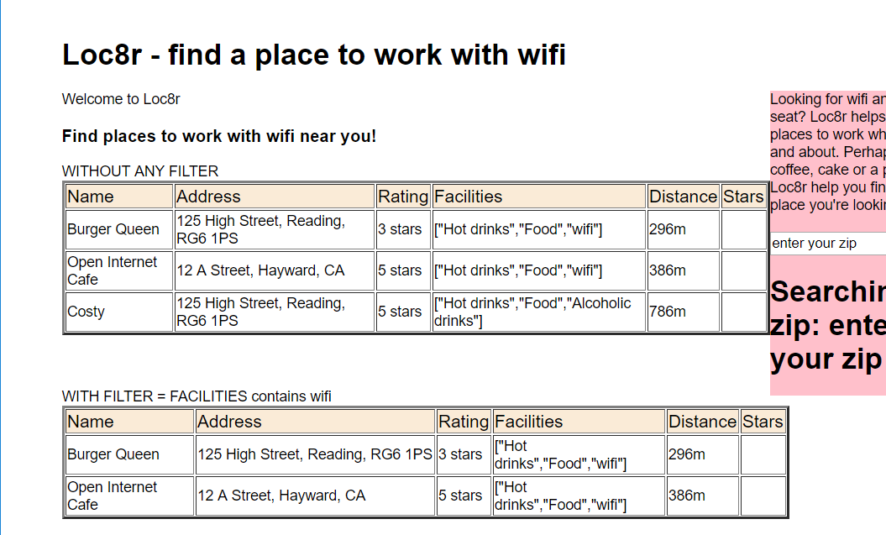
Output same and STILL have Hardcoded the data but, NOW in the service

Slide 13
Want AngularJS Service code to be able to use our /getAllLocations URI—get data
we use the BUILT IN Angluar $http service
CHANGE our previously defined service function loc8rData function in the public/angular/loc8rapp.js file
var loc8rData = function ($http) {
return $http.get(‘/getAllLocations’); }
THIS CODE WON’T WORK -→ see next slide

Slide 14
BUT what happened --- I GET NOTHING NOW? ---lets fix this
THE ANSWER is --- the $http.get method in your service function loc8rData is ASYNCHROUNOUS and takes time so simply having your controller try to use the service method directly WONT work you need to HAVE A success callback function
In the public/angular/loc8rapp.js angular code
locationListCtrl = function ($scope, loc8rData) {
loc8rData
.success(function(data) {
$scope.data = { locations: data };
})
.error(function (e) {
console.log(e);
});
};

