Slide 1
Ruby on Rails

Slide 2
What is Ruby on Rails?
Ruby on Rails is an open source full-stack web framework.
It is an alternative to PHP/MySQL.
It can render templates, handle user authentication, has built-in database functionality, etc.
Ruby is a “ruby gem” it is written in Ruby
gem is a package in Ruby
(note > gem list --local will list all the gems installed on your machine)
(see current install but in past installed via > gem install rails)

Slide 3
Advantages
Convention over Configuration
Less code, but can be confusing to beginners.
A lot of “automagic” behavior
Notes:
In other frameworks, you might have to CONFIGURE the system to hook up these associations between objects and data. Rails does this for you automatically.
However, can be confusing to beginners. Hard to remember which variables are automatically defined and what they’re called. Can be hard to look under the hood.

Slide 4
Advantages
Active (smaller—well then java) community, resources
The pains of Rails are quickly getting better
Gems (again these are Ruby pacakges you can install)
Bootstrap-sass, jquery-rails – automatically imports those
Faker – tool to automatically generate fake data
Rspec, capybara – testing integrated with rails (TDD)
Guard – automatically watch files and run tests
Notes:
Gems are little packages you can install
TDD = Test Driven Development, something we won’t have time for today

Slide 5
Disadvantages
Things are changing quickly can have compatibility issues (rvm and gemsets help to solve this)
High initial learning curve
Lots of black magic
Forced to do things “the Rails Way”
Rails makes assumptions about the best way to do things. It can be hard to get Rails to do what you want *the way that you want it*.

Slide 6
Ruby
Need a subset of Ruby to start using Rails.
See other lecture on Ruby

Slide 7
The Rails Way
Convention Over Configuration
Rails makes assumptions about what you want to do and how you’re going to do it, but, this may be constraining
REST is the best pattern for web applications
– organizing your application around resources and standard HTTP verbs is the fastest way to go.
Notes:
DRY – “Don’t Repeat Yourself” – suggests that writing the same code over and over again is a bad thing.
Convention Over Configuration – means that Rails makes assumptions about what you want to do and how you’re going to do it, rather than requiring you to specify every little thing through endless configuration files.
REST is the best pattern for web applications – organizing your application around resources and standard HTTP verbs is the fastest way to go.

Slide 8
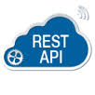
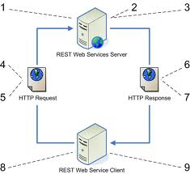
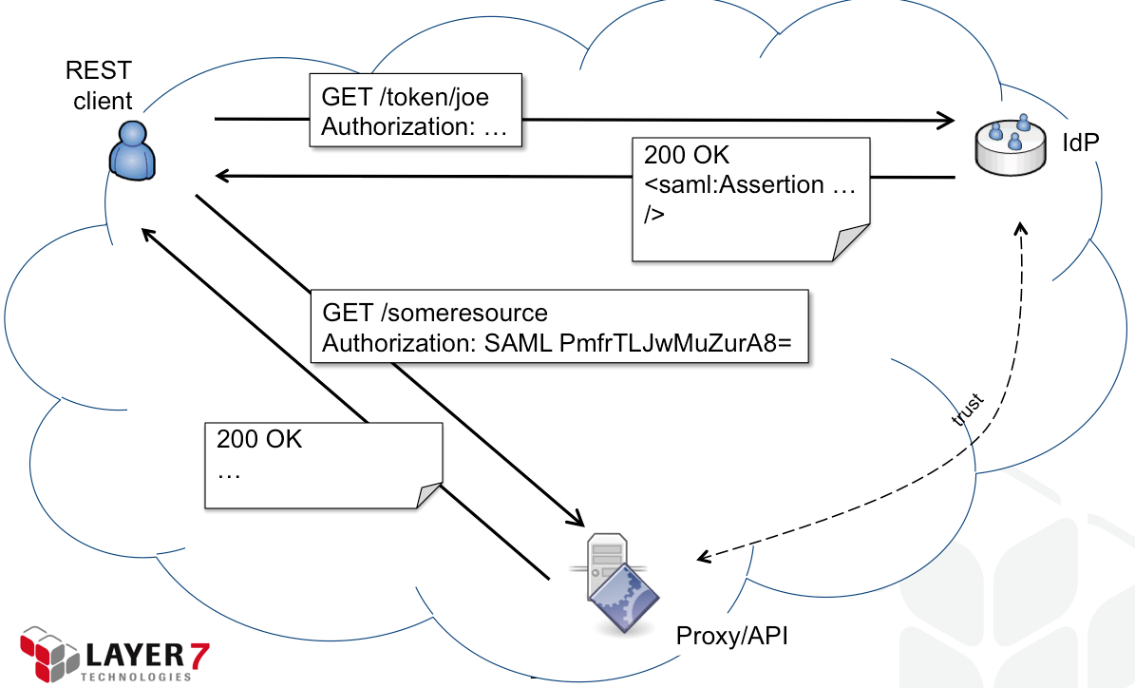
REST
“Representational State Transfer”
Using resource identifiers such as URLs to represent “resources”.

Slide 9
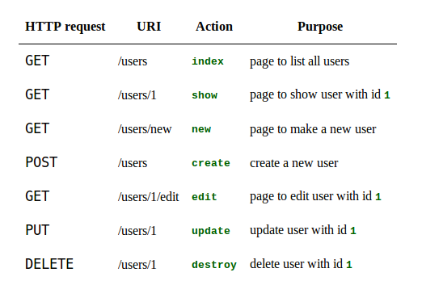
Resources
Rails expects your URLs to be like this for every single of your resources (users, posts, tweets, etc.)
Example with a “user” resource
Get back to this when talking about controllers.

Slide 10
Model-View-Controller Paradigm
A way of organizing a software system
Benefits:
Isolation of business logic from the user interface
Code Reusability
Making it clear where different types of code belong for easier maintenance

Slide 11
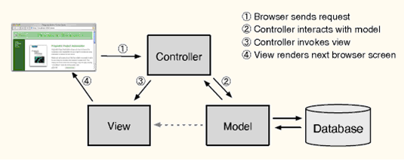
MVC
Model - the information (data) of the application and the rules to manipulate that data. Business logic
View – takes data and displays it
Controller – the glue between the model and controller. In Rails, they’re responsible for processing the incoming requests from the web browser, interrogating the models for data, and passing that data on to the views for presentation.

Slide 12
Models (with demo)
the information (data) of the application and the rules to manipulate that data. Business logic should be concentrated here.
Models are usually related to tables in a database.
Model’s attributes are “columns”.
But not always.
Models that are not related to database tables are transient.
EXAMPLE: If a model is related to a table, the table’s name will be “line_items” for model LineItem, for example. Demo: app/model/user.rb
Notes:
If a model is related to a table, the table’s name will be “line_items” for model LineItem, for example.

Slide 13
Models
Use interactive “rails console” to play with your models (and even modify your database)
Can also access the methods in your controllers (next slide)
Examples of methods on models:
david = User.find_by_name('David')
users = User.where(name: 'David', occupation: 'Code Artist').order('created_at DESC')
user.update(name: 'Dave')
More:
User.new, User.save, User.create, User.first, User.all, User.destroy
Notes:
Examples: User.new, User.save, User.create, User.first, User.all, User.destroy

Slide 14
Controllers (with demo)
Glue between model and view
responsible for processing the incoming requests from the web browser, interrogating the models for data, and passing that data on to the views for presentation.
Demo: app/controllers/user_controllers.rb
Notes:
responsible for processing the incoming requests from the web browser, interrogating the models for data, and passing that data on to the views for presentation.
Demo: app/controllers/user_controllers.rb

Slide 15
Controllers
conform to REST
The expectation is that each controller corresponds to a resource and each controller action corresponds to a RESTful action.
To tweak, go to config/routes.rb
Notes:
The expectation is that you have

Slide 16
RESTful controller actions
Notes:
Here it is again

Slide 17
Views
the user interface of your application
all code in views should deal with presentation of data.
usually HTML with embedded Ruby
Rails will automatically render a view at the end of a controller action.
If action was “index”, Rails will render index.html.erb
Demo: app/views/user/index.html.erb
Notes:
Demo: app/views/user/index.html.erb

Slide 18
Views
Additional organization to view files
Layouts (application.html.erb)
Partials (_header.html.erb)

Slide 19
Rails tools
Rails comes with a ton of tools
Manage your databases
Generate boilerplate code
Generators
rails generate controller Users new
rails generate model User name:string email:string

Slide 20
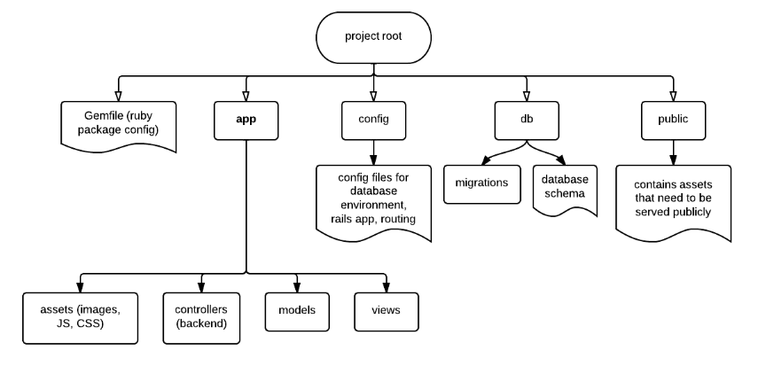
Structure of the Rails Project Directory
subset of the most common directories. There’s also directories for tests, rails (rake) tasks, etc.
You will put a lot of the code in app/* directories

Slide 21
App Directory
Where you have most of your application code, like your Models, Views and Controllers (more about this in future lectures)
app/assests = images, CSS, javascript files

Slide 22
Config Directory
Contains various config files
database.yml = information to connect to your database
routes.rb = file specifying routes (mapping between URIs and methods called in your Controller classes)
config/environments = can run in developer, test and production and will keep data separately

Slide 23
Docs Directory
Tool called rdoc that will create documentation from code.
Will not cover.

Slide 24
Lib and Log and Public Directories
Lib = to change how rails work
Log = text file to show requests to server, etc.
public = root of webserver, used to (in older rails) have index.html file here. NOW, we have view files *.html.erb located inside the app/views folder. We will discuss Views in a later lecture

Slide 25
How to do Static Pages
Demo: config/routes.rb
Demo: app/controllers/static_page_controller
Demo: app/views/static_pages/home.html.erb
Notes:
Demo: config/routes.rb
Demo: app/controllers/static_page_controller
Demo: app/views/static_pages/home.html.erb

Slide 26
Installing Rails
http://rubyonrails.org/download/
Currently you install ruby first that includes gems program which you use to install rails (gem install rails)
See tips on website if you have any problems.

Slide 27
Deploying Rails
Your own server OR
You can run it on Heroku ("cloud application platform") or with Phusion Passenger (module for Apache).
IDE: well there are a few options out there (do a web search) and even some develop only with text editors and command line tools (yuck for me)→ Choices include Aptana (Eclipse), Netbeans, RubyMine and more

Slide 28
Rails More
Will learn in other lectures about Databases and more about Model, View, Controllers.

Slide 29
Sample Code
https://github.com/MarkAZhang/sample_app

