Slide 1
iOS with Swift
Hello world app

Slide 2
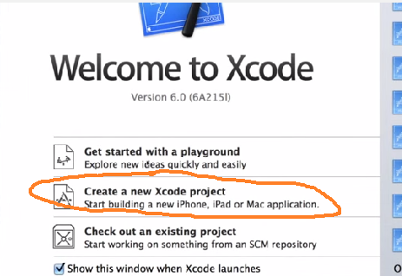
Step 1 launch XCode
Version 6 or more for Swift
Create New Xcode project

Slide 3
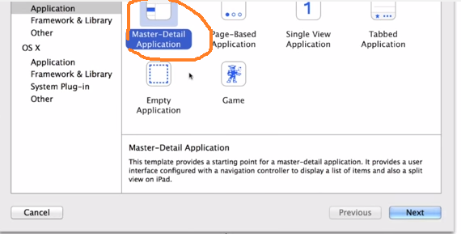
Step 2: Choose type of project
Master-Detail Applicaton: This good for Ipad (has list on left and details on larger right area)

Slide 4
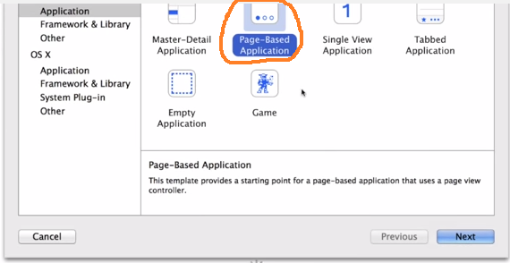
Step 2: Choose type of project
Page-Based Applicaton: Scrolling application (like iPhone home screen)

Slide 5
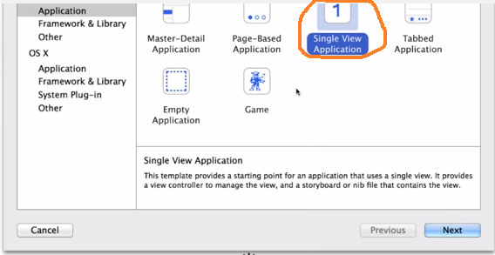
Step 2: Choose type of project
Single View Application: simple with only 1 view

Slide 6
Step 2: Choose type of project
Tabbed Application: tabs on bottom application (like app store application)

Slide 7
Step 2: Choose type of project
Empty Application: no views specified

Slide 8
Step 2: Choose type of project
Game: no views specified

Slide 9
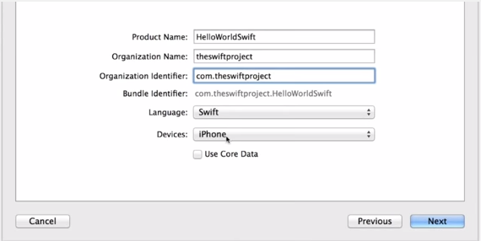
Step 3: name project & select Swift
name of application, organization, and select Swift language.
Also, specify iPhone or iPad or..
Next ---and save it somewhere on machine
Organization Name: The name of your organization or your own name.
Organization Identifier: Your organization identifier, if you have one.
If you don’t, use com.example.
Bundle Identifier: This value is automatically generated based
your product name and organization identifier.
Language: Swift
Devices: Universal
A Universal app is one that runs
on both iPhone and iPad.

Slide 10
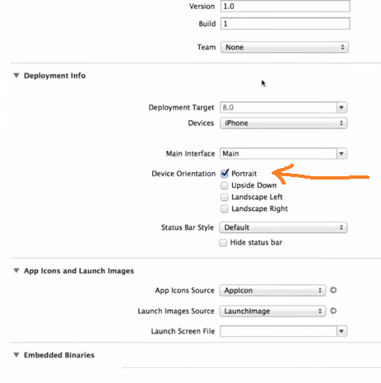
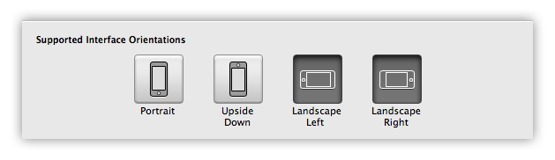
Step 4: setup project properties
Identity: (version, etc) Deployment : (target SDK, device, main interface, orientation)
Icons/Launch Images
Embedded Binaries
Linked Frameworks/Libraries
We are not going to change anything from defaults except to specify it in “portrait” orientation

Slide 11
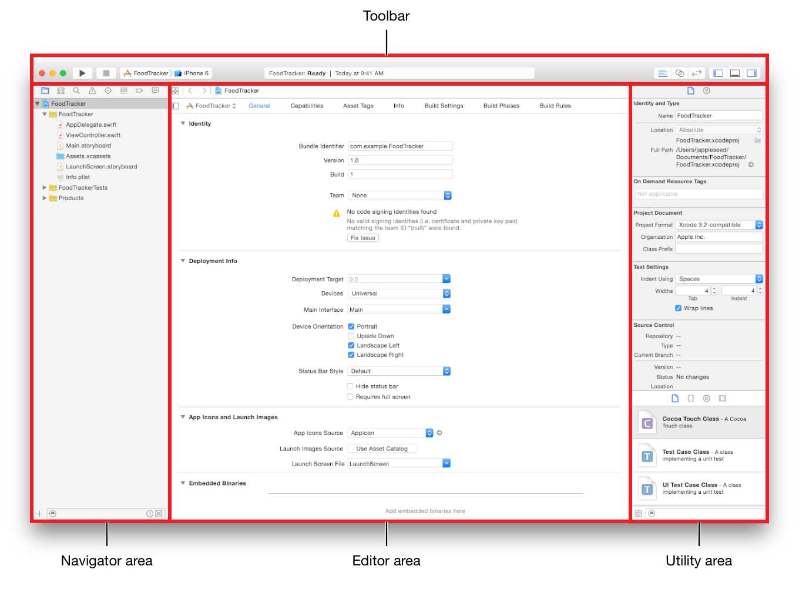
What Xcode looks like

Slide 12
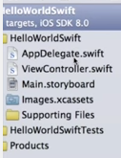
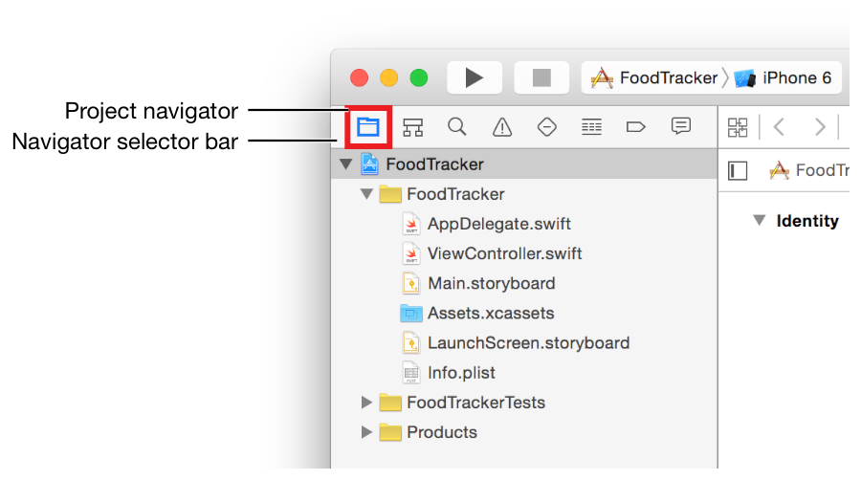
Project Structure
AppDelegate.swift
  Communicates with phones iOS system, tells about this app
ViewController.swift
  Has lifecycle methods of app and setups up main window for app. Often don’t edit
Main.storyboard
  Used to setup interface(s) with a visual editor
*.xcassets = contains
assets (like resources
in Android)
HelloWorldSwiftTests =
contains any testing
code
Products = contains

Slide 13
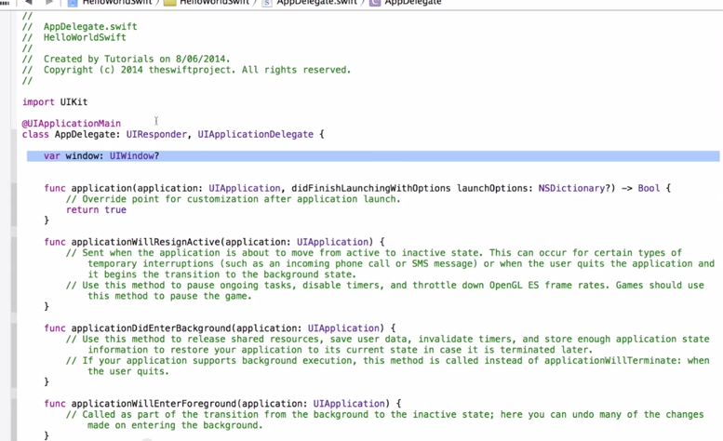
AppDelegate.swift
Create code inside any
of the methods you wish
Auto generated with project
Various app lifecycle
methods
Creating a window

Slide 14
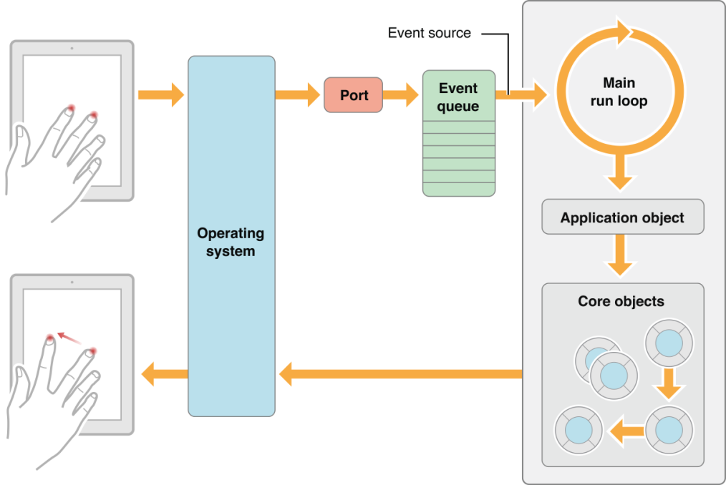
AppDelegate.swift – Main purpose 1: run loop
creates entry point to your app and a run loop that delivers input events to your app.
  This work is done by the UIApplicationMain attribute (@UIApplicationMain),
  UIApplicationMain creates an application object that’s responsible
  for managing the life
  cycle of the app

Slide 15
AppDelegate.swift – Main purpose 2 : window
creates the window where your app’s content is drawn and provides a place to respond to state transitions within the app.
  where you write your custom app-level code.
var window: UIWindow?
This is the main window.

Slide 16
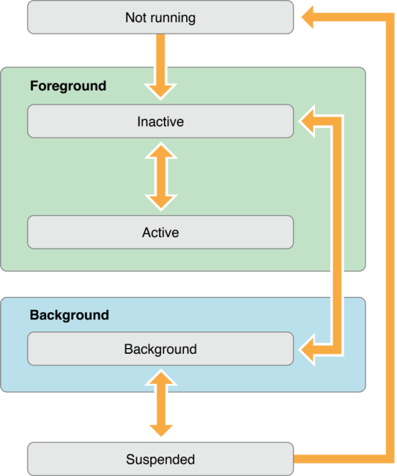
AppDelegate –app lifecycle states
State | Description
Not running | app has not been launched or was running but was terminated by the system.
Inactive | app is running in the foreground but is currently not receiving events. (It may be executing other code though.) An app usually stays in this state only briefly as it transitions to a different state.
Active | app is running in the foreground and is receiving events. This is the normal mode for foreground apps.
Background | app is in the background and executing code. Most apps enter this state briefly on their way to being suspended.
Suspended | app is in the background but is not executing code. The system moves apps to this state automatically and does not notify them before doing so. While suspended, an app remains in memory but does not execute any code. When a low-memory condition occurs, the system may purge suspended apps without notice to make more space for the foreground app.

Slide 17
AppDelegate.swift – lifecycle methods
application:willFinishLaunchingWithOptions:—This method is your app’s first chance to execute code at launch time.
application:didFinishLaunchingWithOptions:—This method allows you to perform any final initialization before your app is displayed to the user.
applicationDidBecomeActive:—Lets your app know that it is about to become the foreground app. Use this method for any last minute preparation.
applicationWillResignActive:—Lets you know that your app is transitioning away from being the foreground app. Use this method to put your app into a quiescent state.
applicationDidEnterBackground:—Lets you know that your app is now running in the background and may be suspended at any time.
applicationWillEnterForeground:—Lets you know that your app is moving out of the background and back into the foreground, but that it is not yet active.
applicationWillTerminate:—Lets you know that your app is being terminated. This method is not called if your app is suspended.

Slide 18
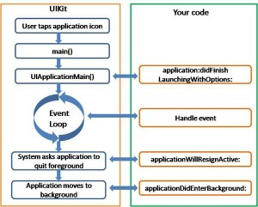
AppDelegate Lifecycle –example of what you might implement
You don’t have
to implement all
of the methods. The ones you don’t implement will take on
default behavior

Slide 19
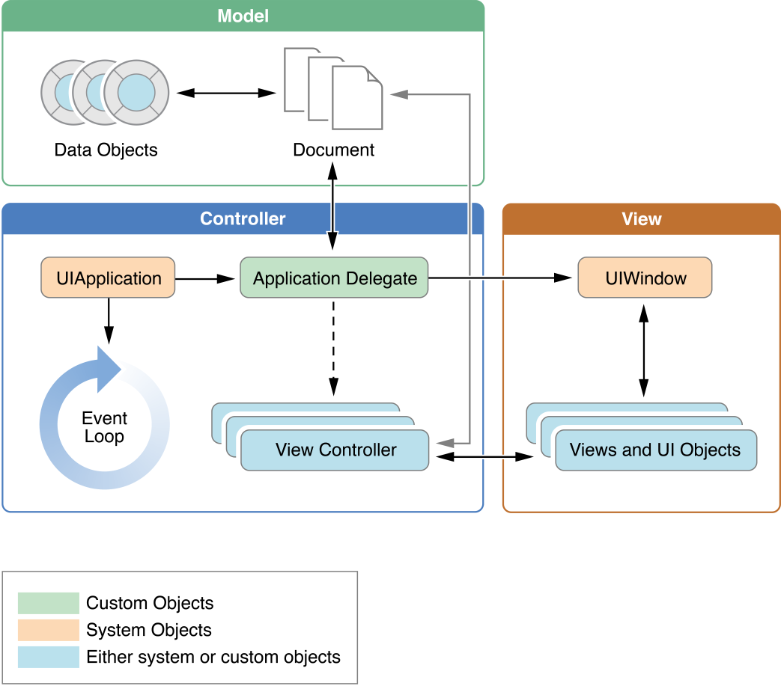
App Bigger
Picture
A view is an object that draws content in a
area and responds to events within that area.
Controls are a specialized type of view responsible
for implementing familiar interface objects such
as buttons, text fields, and toggle switches.
Heart of custom code to respond to lifecycle methods
UIWindo coordinates the presentation of one or more views on a screen
View Controller- view controller manages a single view and its collection of subviews & makes its views visible by installing them in the app’s window.

Slide 20
Making our GUI
ViewController, Storyboard and examples

Slide 21
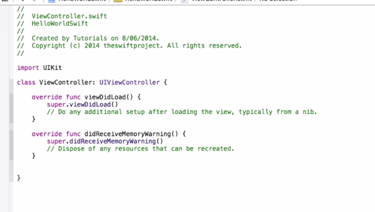
ViewController
Has method viewDidLoad()
that we will alter to setup –
like loading from nib a view
nib file is a type of resource file that you use to store the user interfaces of iOS

Slide 22
Main.storyboard
Has Visual Editing interface
that lets us specify multiple Views
and their interfaces
NEW IDEA
A storyboard is a visual representation of the app’s user interface, showing
screens of content and the transitions between them.

Slide 23
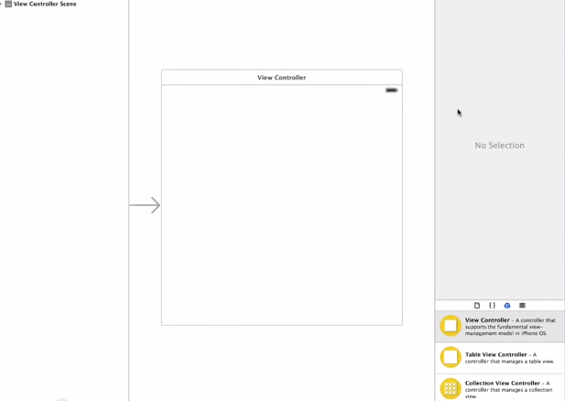
Main.storyboard interface
Can visually edit

Slide 24
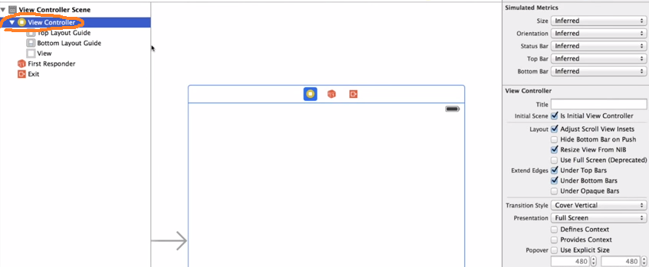
Step 6: add “hello world” to single view interface we have in our Main.storyboard
Step 6.1: select View controller
NOTE: currently have one scene (one interface), left arrow means this is
launched at start of app

Slide 25
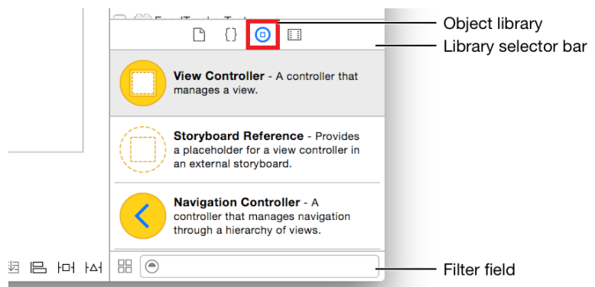
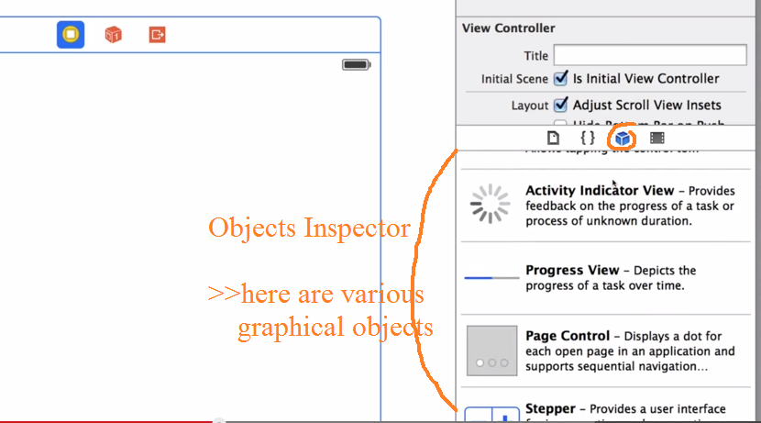
Step 6.2: bring up Objects Inspector
Use Objects Inspector to select widgets you want to drag and drop to your interface
Drag and Dop

Slide 26
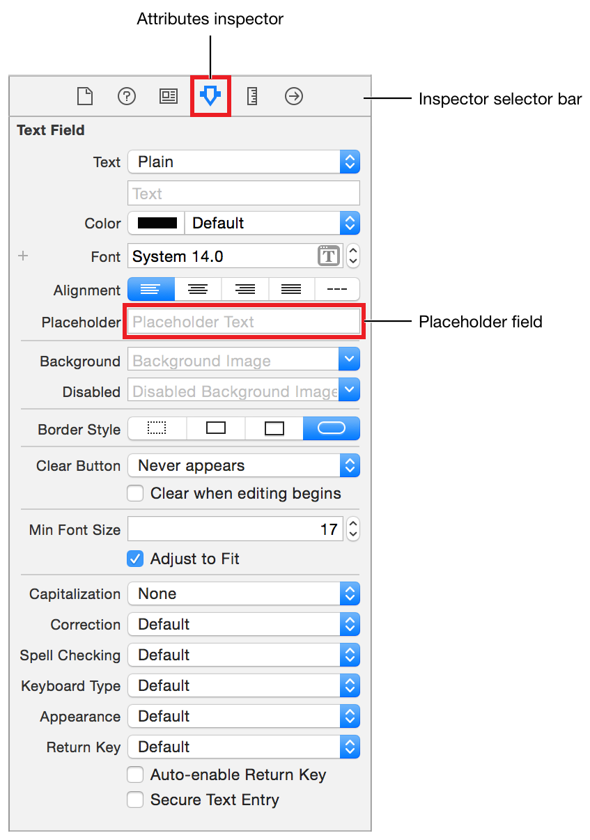
Step 6.3: any View you dragged into ViewController – you can alter the properties
Click on View object
Go to Attributes Inspector
& alter desired properties

Slide 27
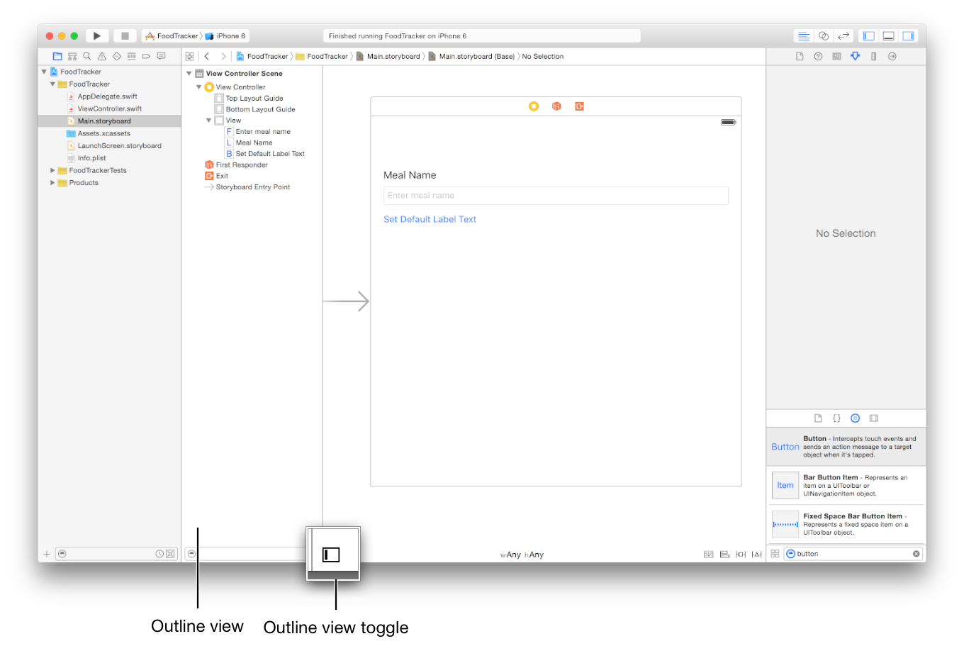
What it looks like after adding a few Views
Added Label, TextField and Button

Slide 28
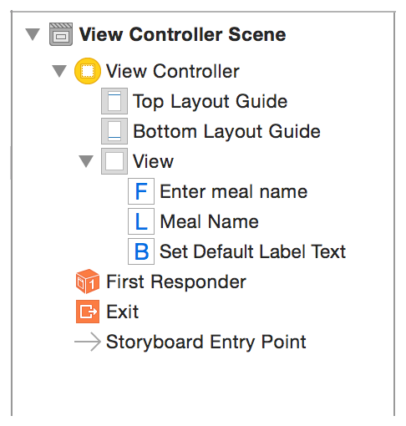
Zoom in on Outline view

Slide 29
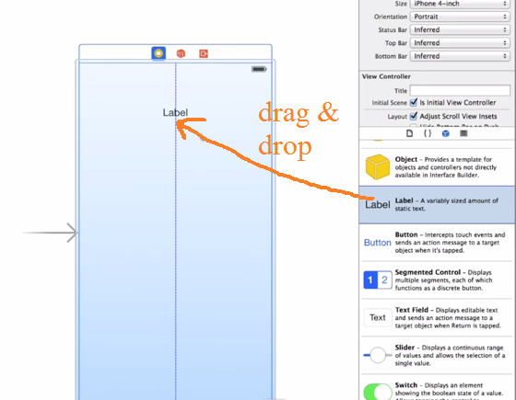
ANOTHER EXAMPLE
: find Label in Objects Inspector drag and drop

Slide 30
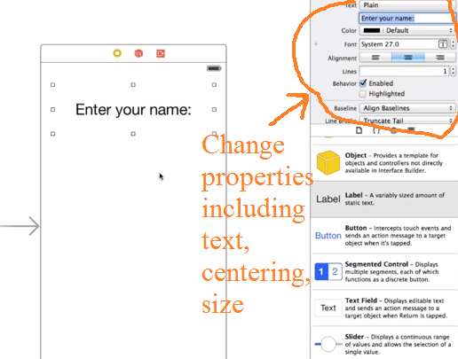
change properties of Label in inspector
Change text, size, center it

Slide 31
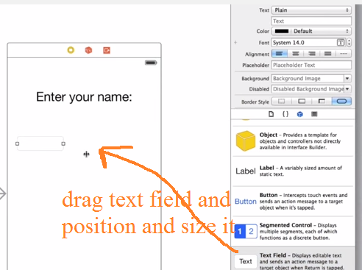
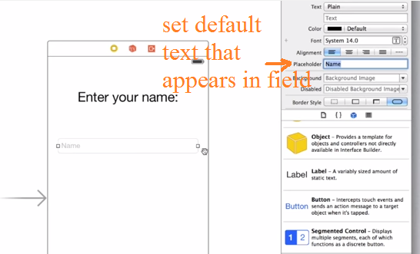
Now…Add a Text Field
Make it width bigger, setup properties:
set text that initially appears (placeholder)

Slide 32
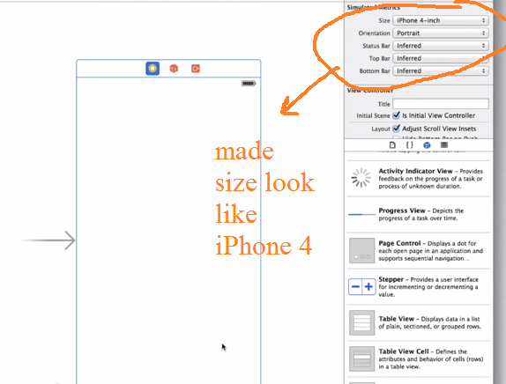
Step 6.4: in inspector window Set Simulator Metrics
Here choose the smaller iPhone 4 option in portrait view

Slide 33
Event Hadling
….how we do it

Slide 34
Step 7: Add some Event handling code so your gui works
Here when user types in something in the Text Field you will read it in and change the Label to say Hello “Name Entered”

Slide 35
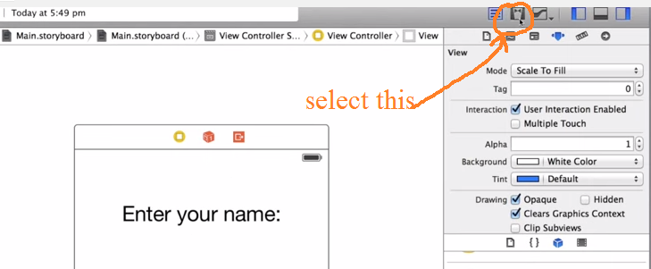
Step 7.1: bring up assistant editor
Lets you see storyboard AND code

Slide 36
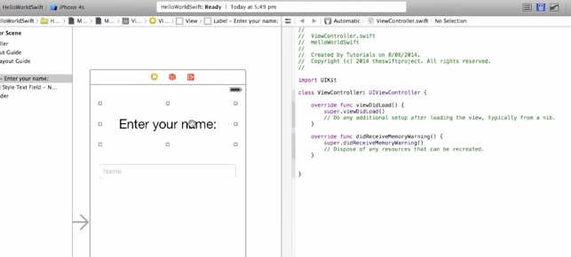
Step 7.1: assistant editor—what it looks like
Code –here ViewController
Storyboard

Slide 37
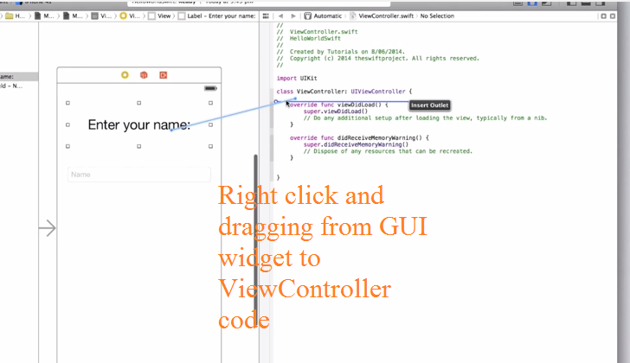
Step 7.2: Create IBoutlets for all GUI widgets you want “handles to in your code
Select Gui Widget in Storyboard
Right Click on it and drag to ViewController code below the class statement
You want a “handle” to
a view object in your
interface when you want
to manipulate the view
object or read data / state
from it

Slide 38
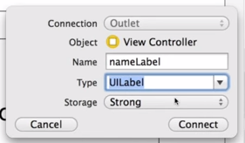
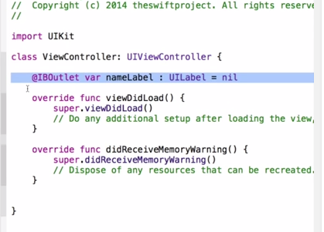
Step 7.2: Create IBoutlets for all GUI widgets you want “handles” to in your code
  Now release and fill in pop-up --- give it a name (here “nameLabel”) and hit CONNECT
  Now you will have the following code
IBOutlet is a kind of
“connection” like an
electrical outlet between
code and the GUI
NOTE: the nil here does not
mean a nil object but, rather
we are not changing the properties
or text of the Label in the GUI

Slide 39
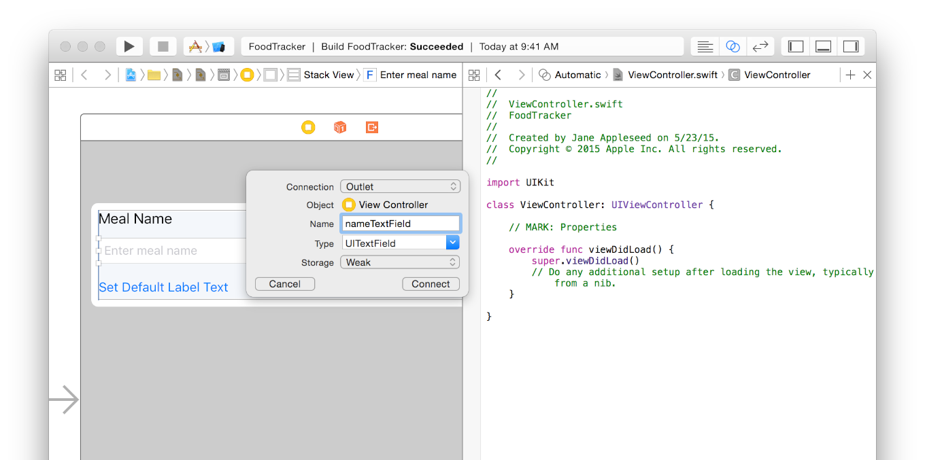
Step 7.2: another example –here for a UITextField object
@IBOutlet weak var nameTextField: UITextField!

Slide 40
What is the purpose of an outlet?
provide a way to reference, “point to”, “grab a handle to” an interface objects you added to your storyboard in your source code.
Creating an Outlet → creates a property for the object in your view controller file, which lets you access and manipulate that object from code at runtime.

Slide 41
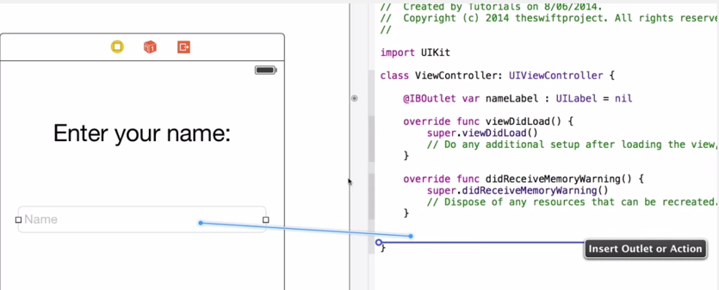
Step 7.3: Create IBActions for all GUI widgets you want handle events from
Here we want to handle the even when user types (something first) and hits return in the Text Field GUI.
Select Gui Widget in Storyboard
Right Click on it and drag to ViewController code before end of class

Slide 42
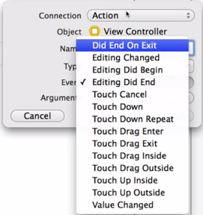
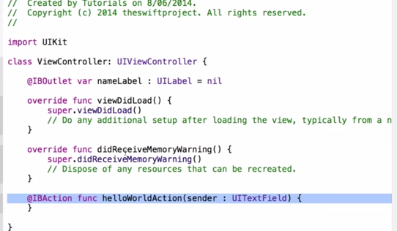
Step 7.3: Create IBActions for all GUI widgets you want handle events from
  Now release and fill in pop-up ---
    Connection = action
    Event = “Did End On Exit”
    Type = “UIText Field”
    Argument= sender
    Name=(here “helloWorldAction”)
Different Types,
End on Exit will be created
when user hits return in text
box and will invoke the method
name (here helloWorldAction)
Creates dummy function
that YOU must edit to create
code to handle this event

Slide 43
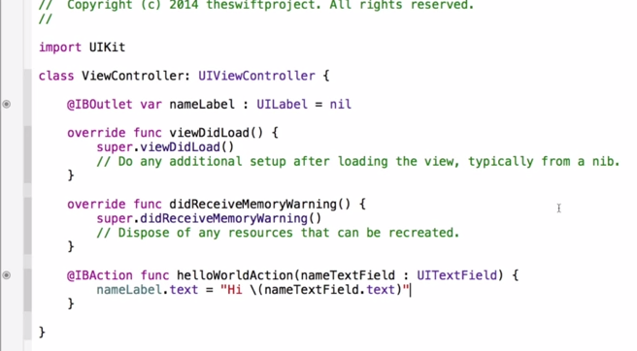
Step 7.3: create even handling code
  Change the name of the parameter form sender to nameTextField (better to be specific)
  Grab the text typed in the Text Field
  Create string to alter the label.
Remember “nameLabel” is the
variable (IBOutlet) pointing to
Label
SWIFT reminders
Set text the setter is just .text
on nameLabel
Print out variable in string \(varname)
NO NEED for SEMI-COLON at end of lines in swift
This app will when the user types into
the UITextField read the value and set the
label widget to “Hi ***theValueTyped****”

Slide 44
Step 7.4: tip: getting rid of keyboard that the TextField popped up
  Then inside the event handler say that the UITextField should give up its focus
  @IBAction func helloWorldAction(nameTextField : UITextField) {
  nameLabel.text = “Hi \(nameTextField.text)”
  nameTextField.resignFirstResponder()
  }
This says that the UIField
nameTextField is giving up its
FirstResponse status ---which means it is no longer in focus,
And the associated keyboard
will dissapear

Slide 45
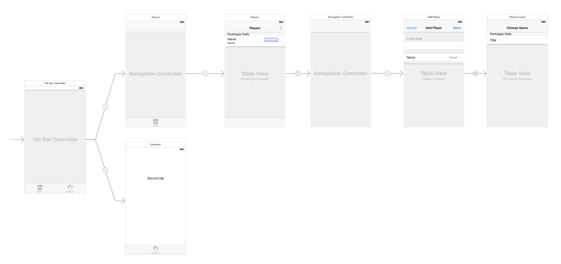
A note about Storyboard
Can have multiple interfaces and connections between them.
a single file describes all of this
These between interfaces transitions are called “segues”
  you create them by connecting your view controllers right in the storyboard.
WOW that is cool and complex

Slide 46
Lets Run the program
Emulator or on a device…lets show emulator

Slide 47
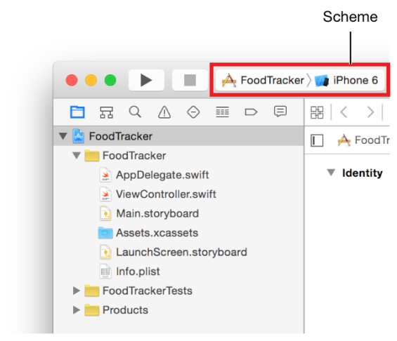
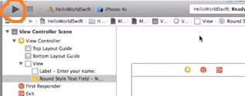
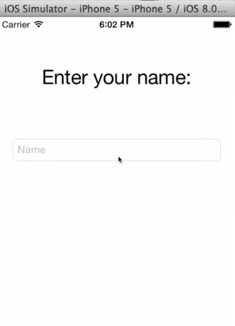
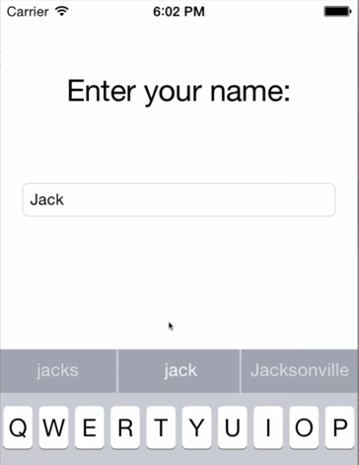
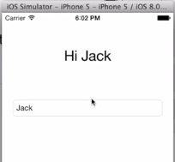
Step 8: run the program
To run your program hit the “play/run” button in upper left of xcode
You can change device type
here currently set at iPhone 4 to
whatever you want, like iPhone 7

Slide 48
FirstResponder
What is it?

Slide 49
Special Note about First Responder
won’t be using the First Responder very much.
a proxy object that refers to whatever object has first responder status at any given time.

Slide 50
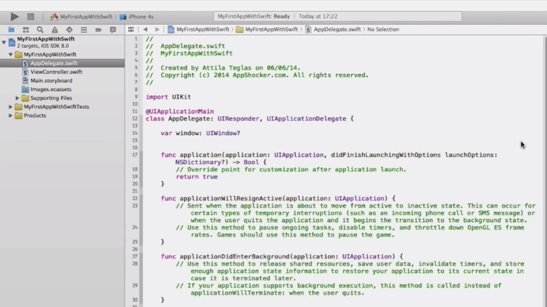
How does everything launch???
@UIApplicationMain =says this class
is launch/entry point
application() function will be called
NO CODE??? -→ see next slide
AppDelegate class

Slide 51
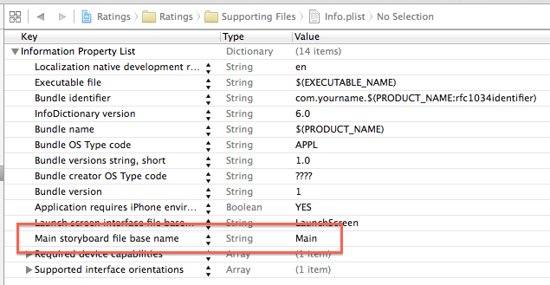
It looks to Info.plist
Located in Supporting Files group
In android like loading up the main
layout for an Activity
Contains information (like Android Manifest) about the app
HERE specifies the storyboard to launch

Slide 52
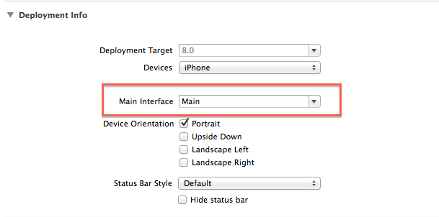
How to change the name of the Storyboard file
Go to project settings

Slide 53
MORE on Storyboard
Multiple views

Slide 54
Storyboard with multiple views
Getting started ….

Slide 55
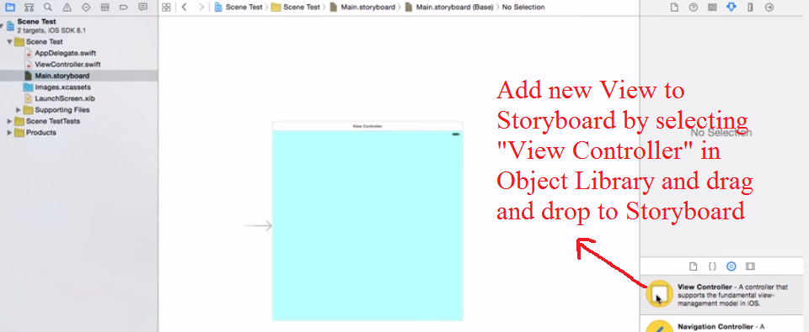
Bring up Storyboard
Zoom out so have room in interface
Add “View Controller” to Storyboard

Slide 56
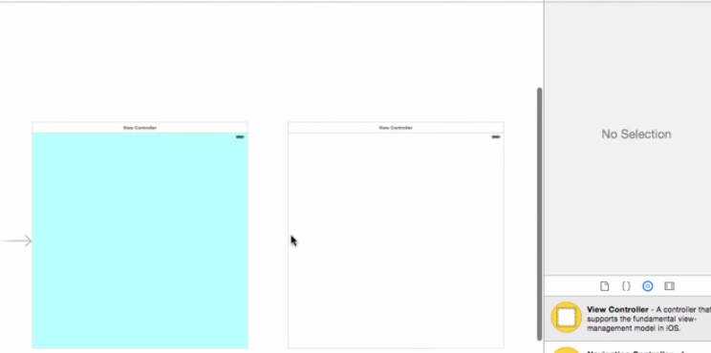
Results..of adding 2nd View Controller

Slide 57
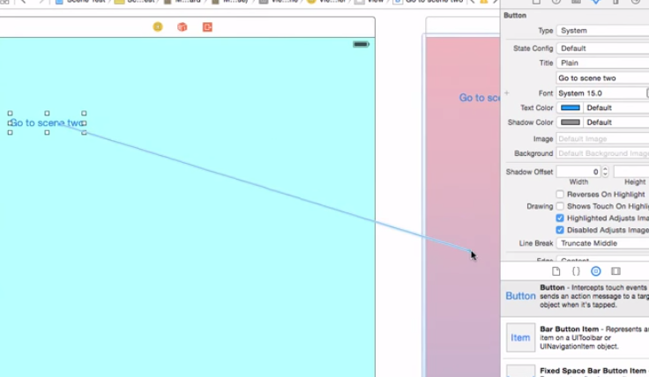

Change background colors &add 3rd View Controller &add SEGUES
Add some buttons that we will have Actions for to transition from one View to another
Segue = Cntrl-Click on button in #1 interface and drag to #2 interface (this says we transition from one interface to another)
Type = show, present modally or …..

Slide 58


Result ---see relationship between 2 views
Lets Run it →

Slide 59

Special note on creating segues
The starting point of a segue must be a view or object with a defined action, such as a control, bar button item, or gesture recognizer.
Here we see creation of a segue where starting point is a table row (in a Table View) is tapped.

Slide 60

Do similar with 2nd View’s button to segue to 3rd View
Run it →

Slide 61
Segue Types
Remember you
Specified
type of Segue
when creating it
Type | Behavior
Show (Push) | displays the new content using the showViewController:sender: method of the target view controller. presents the new content modally over the source view controller.
Show Detail (Replace) | This segue displays the new content using the showDetailViewController:sender: method of the target view controller. relevant only for view controllers embedded inside a UISplitViewController object. a split view controller replaces its second child view controller (the detail controller) with the new content
Present Modally | displays the view controller modally using the specified presentation and transition styles. The view controller that defines the appropriate presentation context handles the actual presentation.
Present as Popover | In a horizontally regular environment, the view controller appears in a popover. In a horizontally compact environment, the view controller is displayed using a full-screen modal presentation.

Slide 62
Navigation Control
Adding it to your app—so you can move around interfaces using “navigation controls”

Slide 63


Suppose we want to add NAVIGATION Controller to 1st View
Select 1st view in storyboard
Menu: Editor->Embed In ->Navigation Controller
Inserts a “Navigation Controller for entire app

Slide 64

Lets Run
Right now no navigation controls added yet but, see bar area at the top.
Will be there for every View in this Storyboard
NOTICE: it adds Back link in 2nd View automatically

Slide 65

See developer.app for more on Navigation Controller
Navigation Controller: https://developer.apple.com/library/ios/documentation/WindowsViews/Conceptual/ViewControllerCatalog/Chapters/NavigationControllers.htmll

Slide 66
Example 2: Storyboard w/ multiple Views—started –see
http://www.raywenderlich.com/81879/storyboards-tutorial-swift-part-1

Slide 67
Example multiple views with Storyboard
Go to Main.storyboard and delete the view controller you worked with earlier. This can be done by clicking on View Controller in the Document Outline and pressing the Delete key.
Drag a Tab Bar Controller from the Object Library into the canvas.
    the Tab Bar Controller comes with two view controllers
ZOOM tip: zoom in and out by double-clicking the canvas, or set zoom scale by ctrl-clicking the canvas and selecting the zoom level.

Slide 68
Using TabBar Controller
Yet another way to navigate → DO ON OWN

Slide 69
Example Multi View Storyboard from http://www.raywenderlich.com/81879/storyboards-tutorial-swift-part-1
DO on own –this
just shows you the start
Finish by going to http://www.raywenderlich.com/81879/storyboards-tutorial-swift-part-1

Slide 70

Example multiple views with Storyboard
DO on own –this
just shows you the start
Tab Bar Controller with two view controllers

Slide 71

Multiple view Storyboard example—notice the relationship
DO on own –this
just shows you the start
Between Tab Bar Controller and one of it view controllers

Slide 72
Finish the example at http://www.raywenderlich.com/81879/storyboards-tutorial-swift-part-1 also see http://www.swiftvideotutorials.com/using-storyboards-for-osx
DO on own –this
just shows you the start

