Slide 1
Android – Location Services
L. Grewe

Slide 2
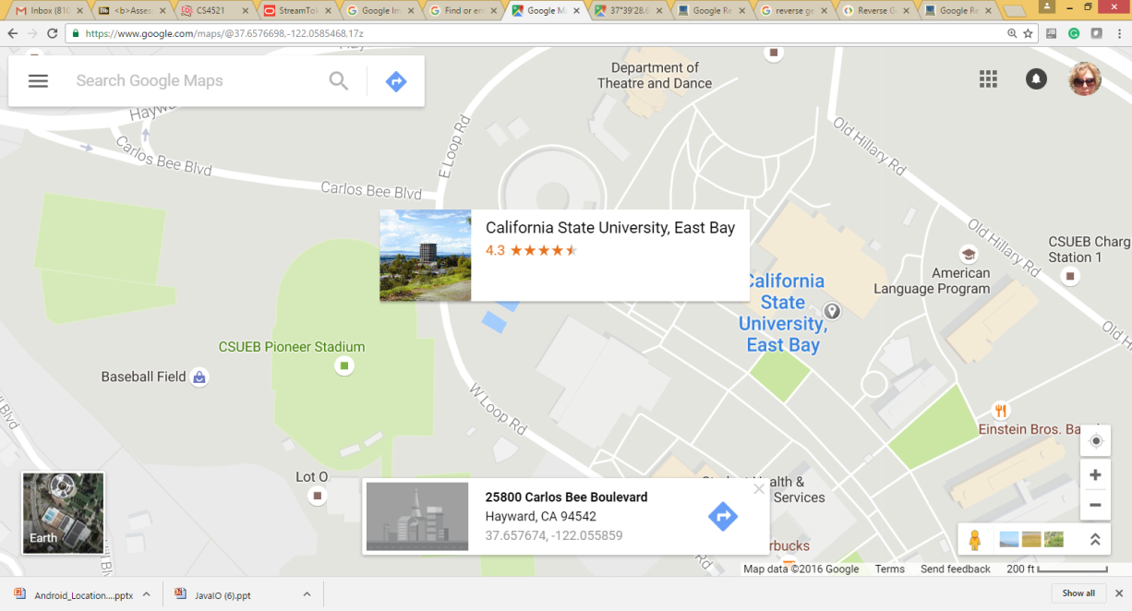
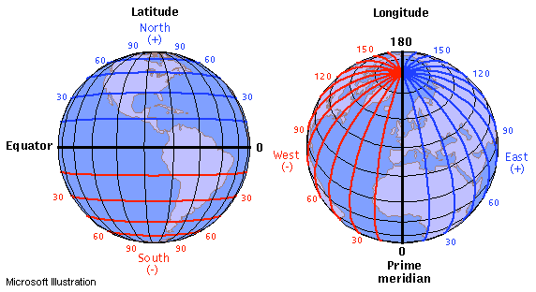
What and why
Use Maps to display locations
Geocoding = translation from and to addresses and latitude,longitude
GPS to sense current location (LocationManger class in Android)s

Slide 3
GOOGLE Maps in transition
There is a v1 and v2 Google Maps API.
Both are presented here
Use the later version
Warning depending on version of emulator it may not support v2 yet → but, you can test on device too and frankly better if you are using Location Services (like GPS) anyways

Slide 4
Newer Google Maps API v2
--note v1 is deprecated!

Slide 5
NEWER Google Maps Android API v2 --- whats New
part of the Google Play services SDK,
Use MapFragment class
(version 1 used MapActivity
Version 2 uses vector tiles. Their data representation is smaller, so maps appear in your apps faster, and use less bandwidth.
Caching is improved, so users will typically see a map without empty areas.
Maps are now 3D. You can change user perspective

Slide 6
PROBLEM: newer v2 is not supported on some Android Emulator –make sure AVD has Google Play SDK
Generally best to have a physical device to test.
ALSO: devices not supporting OpenGL ES2.0 won't be able to run apps with maps (but, these are generally older devices)

Slide 7
HACK –I got to work
Spent a few hours on this
See our website http://algebra.sci.csueastbay.edu/~grewe/CS4521/Mat/Android/Eclipse/HACK_AVD_Work_With_Map_API_V2.html

Slide 8
App must ask for permissions
In AndroidManifest.xml file (right after <manifest tag):
<uses-permission android:name="android.permission.INTERNET"/>
<uses-permission android:name="android.permission.ACCESS_NETWORK_STATE"/>
<uses-permission android:name="android.permission.WRITE_EXTERNAL_STORAGE"/>
<!-- The following two permissions are not required to use
Google Maps Android API v2, but are recommended. -->
<uses-permission android:name="android.permission.ACCESS_COARSE_LOCATION"/>
<uses-permission android:name="android.permission.ACCESS_FINE_LOCATION"/>

Slide 9
App specify use of OpenGL –maps use this to draw (recommended…not required yet)
The Google Maps Android API uses OpenGL ES version 2 to render the map. If OpenGL ES version 2 is not installed, your map will not appear.
We recommend that you add the following <uses-feature> element as a child of the <manifest> element inAndroidManifest.xml:
<uses-feature
android:glEsVersion="0x00020000"
android:required="true"/>

Slide 10
HOW TO: Adding Map code (v2) to your Project
Download and configure the Google Play services SDK. The Google Maps Android API is distributed as part of this SDK. (DONE BEFORE)
Obtain an API key. To do this, you will need to register a project in the Google APIs Console, and get a signing certificate for your app.
Setup your Project to say it is using the GooglePlay Services
Specify settings in the Application Manifest. Add a map to a new or existing Android project.

Slide 11
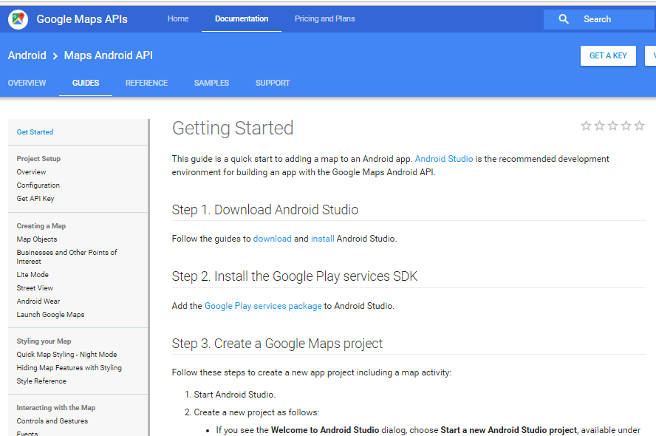
HOW to create app using Google Maps
Follow for latest details
https://developers.google.com/maps/documentation/android/start#install_and_configure_the_google_play_services_sdk

Slide 12
Next – register your app for Google API key & add map code
See next example
Need to register your app (pacakgename.app) in google console to use maps to get api key
Update your Android project (typically manifest file) to contain this new api key
Add MapFragment (or other related class) to display and configure a Google map.

Slide 13
App using Maps
Step by Step with Android Studio

Slide 14
Two alternatives
OPTION 1: Start project out as a MapActivity project
OPTION 2:Integrate maps into existing project

Slide 15
Option 1: start out as a MapActivity Project

Slide 16
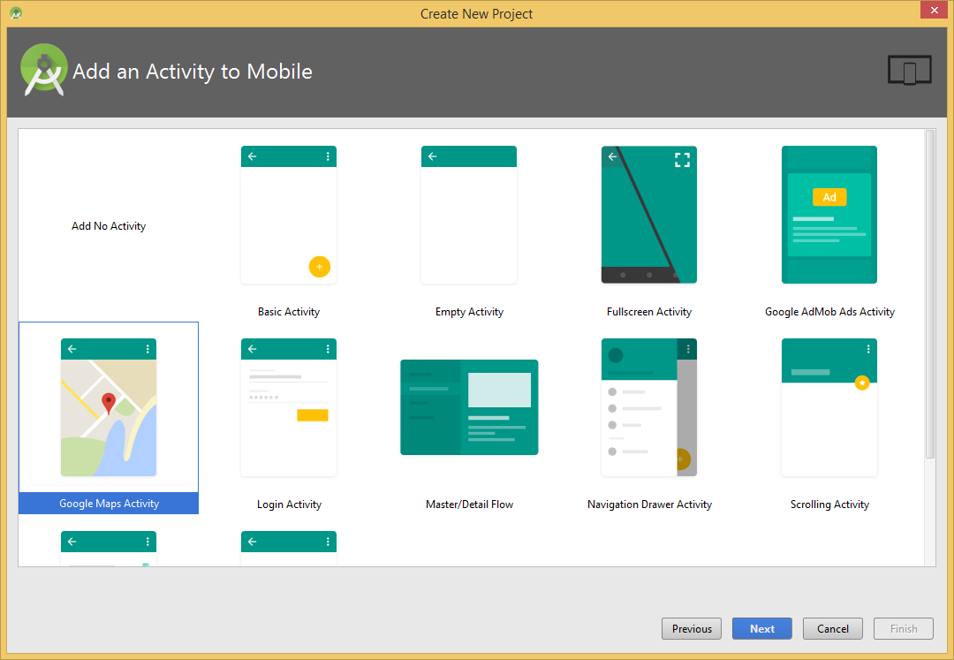
Create Project
Create a new project as follows:
Enter your app name, company domain, and project location, as prompted. Then click Next.
Select the form factors you need for your app. If you're not sure what you need, just select Phone and Tablet. Then click Next.
Select Google Maps Activity in the 'Add an activity to Mobile' dialog. Then click Next.
Enter the activity name, layout name and title as prompted. The default values are fine. Then click Finish.

Slide 17
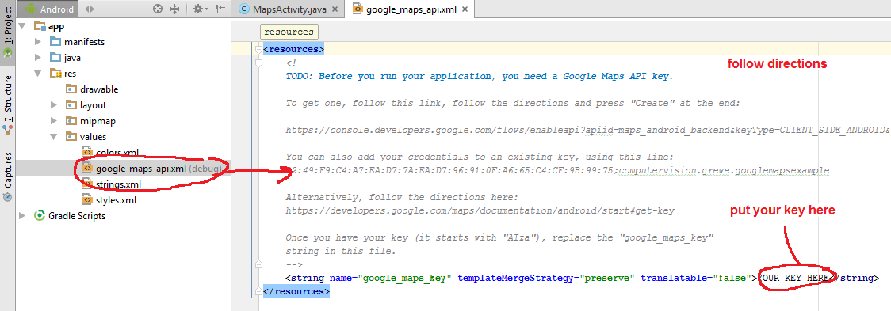
Edit your Activity and get Maps API setup
Obviously edit your MapActivity and Project to add functionality YOU WANT
FOR MAPS API KEY follow instructions (you will edit your google_maps_api.xml) https://developers.google.com/maps/documentation/android-api/start

Slide 18
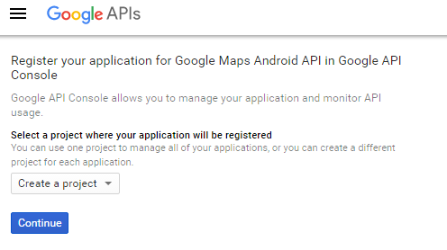
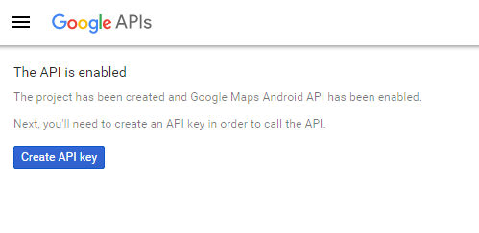
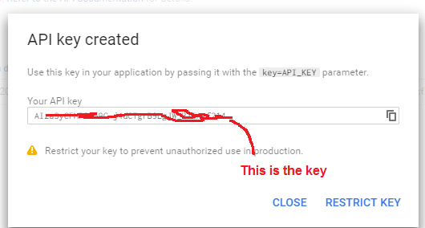
Getting key –the start
(must have google account)
Here following URL in the google_maps_api.xml file

Slide 19
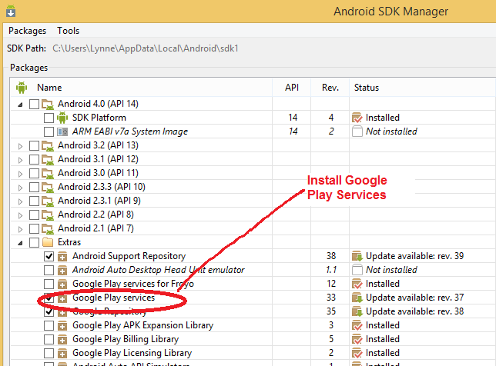
Install Google Play Services
FOLLOW DIRECTIONS ON developer.android.com ---it can change so I am not going to teach this in class—you read and follow instructions.
To learn how to install the package, see Installing the Maps API SDK.
See specifically https://developer.android.com/google/play-services/setup.html#Setup

Slide 20
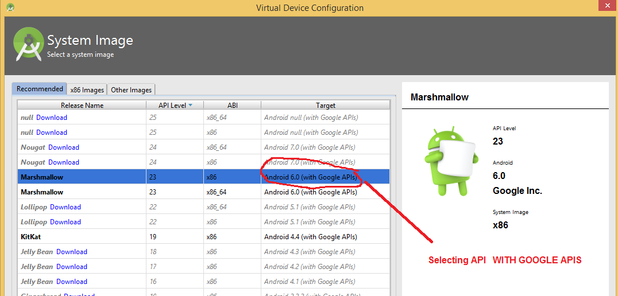
Make AVD using Google Play Services SDK

Slide 21
Option 2: Integrate Maps into existing project
--or new one you don’t want main activity to be a map

Slide 22
STEP 1: Install Google Play Services
FOLLOW DIRECTIONS ON developer.android.com ---it can change so I am not going to teach this in class—you read and follow instructions.
To learn how to install the package, see Installing the Maps API SDK.
See specifically https://developer.android.com/google/play-services/setup.html#Setup

Slide 23
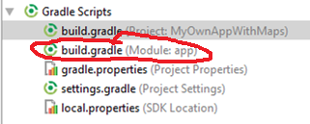
STEP 2: Setting up a Project to use Google Play Services
  Unfortunately pretty manual process
STEP 2.1 Open the build.gradle file inside your application module directory.Note: Android Studio projects contain a top-level build.gradle file and a build.gradle file for each module. Be sure to edit the file for your application module. See Building Your Project with Gradle for more information about Gradle.
  Add a new build rule under dependencies for the latest version of play-services. For example:|
  apply plugin: 'com.android.application'
  ...
  dependencies {
  compile 'com.android.support:appcompat-v7:21.0.3'
  compile 'com.google.android.gms:play-services:6.5.87' }
  Be sure you update this version number each time Google Play services is updated.
If you don’t know the correct play
service version you installed --- look at C:\Users\**\AppData\Local\Android\sdk\extras\google\m2repository\com\google\android\gms\play-services

Slide 24
STEP 2.1: continued
Save the changes and click Sync Project with Gradle Files in the toolbar.

Slide 25
STEP 2.2 : Add google Play services VERSION to the manifest file
Edit your application's AndroidManifest.xml file, and add the following declaration within the <application> element. This embeds the version of Google Play services that the app was compiled with.
<meta-data
android:name="com.google.android.gms.version"
android:value="@integer/google_play_services_version" />

Slide 26
STEP 3: Get an API Key
you have to add a Maps API key to your application.
The key is free
Get a Maps API key from the Google APIs Console by providing your application's signing certificate and its package name.
YOU NEED A CERTIFICATE
THIS PROCESS CAN CHANGE – you need to follow instructions at developer.android.com
https://developers.google.com/maps/documentation/android/start#get_an_android_certificate_and_the_google_maps_api_key

Slide 27
STEP 3: Get an API Key--- you need to sign your application
The certificate does not need to be signed by a certificate authority: it is perfectly allowable, and typical, for Android applications to use self-signed certificates.
See developer.android.com for details on how to sign your Application
See http://developer.android.com/tools/publishing/app-signing.html

Slide 28
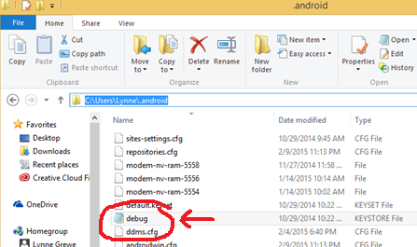
STEP 3: More on signing your app
See https://developer.android.com/tools/publishing/app-signing.html
Android Studio signs your app in debug mode automatically when you run or debug your project from the IDE.
Debug key info (The debug keystore is located in $HOME/.android/debug.keystore)
You can’t publish the app with this debug key
Location on windows
C:/Users/name/.android

Slide 29
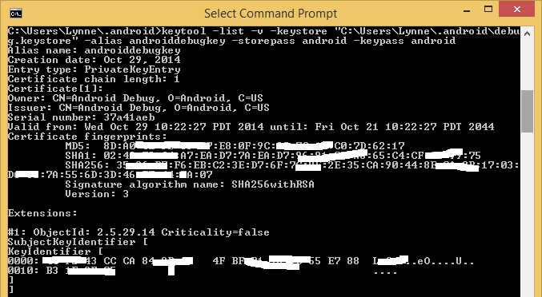
STEP 3: getting the certificate information → towards getting your Maps API Key
DEBUG CASE ONLY (see developer.android.com)
List the SHA-1 fingerprint.
  For Linux or OS X, open a terminal window and enter the following:
      keytool -list -v -keystore ~/.android/debug.keystore -alias androiddebugkey -storepass android -keypass android
  For Windows Vista and Windows 7, run:
      keytool -list -v -keystore "C:\Users\your_user_name\.android\debug.keystore" -alias androiddebugkey -storepass android -keypass android

Slide 30
STEP 3: getting the certificate information → towards getting your Maps API Key
DEBUG CASE ONLY (see developer.android.com)
(e.g. mine is C:\Users\grewe\.android\debug.keystore)
List the SHA-1 fingerprint.
      keytool -list -v -keystore "C:\Users\your_user_name\.android\debug.keystore" -alias androiddebugkey -storepass android -keypass android
You should see output similar to this:
The line that begins SHA1 contains the certificate's SHA-1 fingerprint. The fingerprint is the sequence of 20 two-digit hexadecimal numbers separated by colons.
Alias name: androiddebugkey
Creation date: Jan 01, 2013
Entry type: PrivateKeyEntry
Certificate chain length: 1
Certificate[1]:
Owner: CN=Android Debug, O=Android, C=US
Issuer: CN=Android Debug, O=Android, C=US
Serial number: 4aa9b300
Valid from: Mon Jan 01 08:04:04 UTC 2013 until: Mon Jan 01 18:04:04 PST 2033
Certificate fingerprints:
MD5: AE:9F:95:D0:A6:86:89:BC:A8:70:BA:34:FF:6A:AC:F9
SHA1: BB:0D:AC:74:D3:21:E1:43:07:71:9B:62:90:AF:A1:66:6E:44:5D:75
Signature algorithm name: SHA1withRSA
Version: 3

Slide 31
Step 3-1 Getting Map API Key using SHA fingerprint from Certificate your App is signed with
To get a project and register for the API:
In a browser, navigate to the Google APIs Console. (https://code.google.com/apis/console)
  If you haven't used the Google APIs Console before, you're prompted to create a project that you use to track your usage of the Google Maps Android API. Click Create Project; the Console creates a new project called API Project. On the next page, this name appears in the upper left hand corner. To rename or otherwise manage the project, click on its name.
  If you're already using the Google APIs Console, you will immediately see a list of your existing projects and the available services. It's still a good idea to use a new project for Google Maps Android API, so select the project name in the upper left hand corner and then click Create.
You should see a list of APIs and services in the main window. If you don't, select Services from the left navigation bar.
In the list of services displayed in the center of the page, scroll down until you see Google Maps Android API v2. To the right of the entry, click the switch indicator so that it is on.
This displays the Google Maps Android API Terms of Service. If you agree to the terms of service, click the checkbox below the terms of service, then click Accept. This returns you to the list of APIs and services.

Slide 32
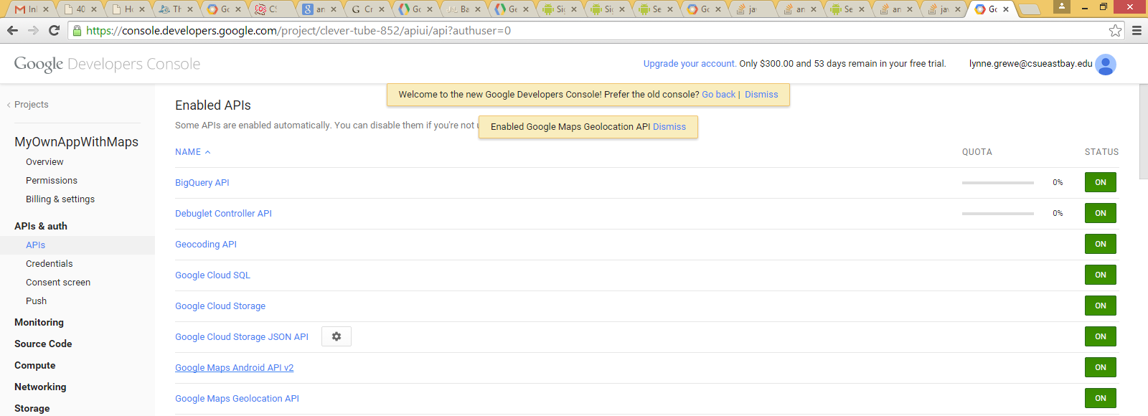
Step 3-1: Setting up app in Google Console to include Maps api
Here you can see I selected maps api “Google Maps Android API v2.” to be turned on…you can add whatever else you want

Slide 33
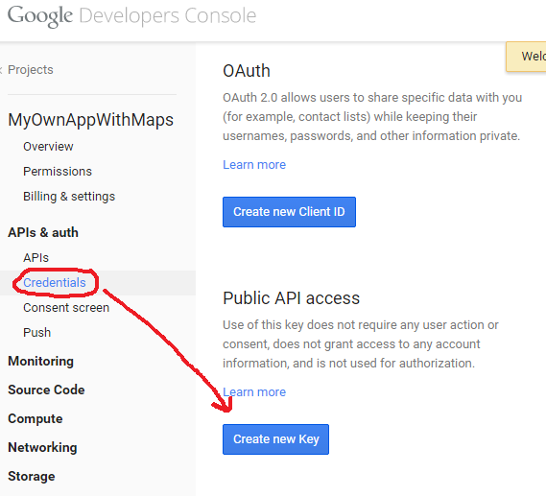
Step 3-1 Getting Map API Key using SHA fingerprint from Certificate your App is signed with
Part 1 ---
APIs -> Credentials
-> Create New Key

Slide 34
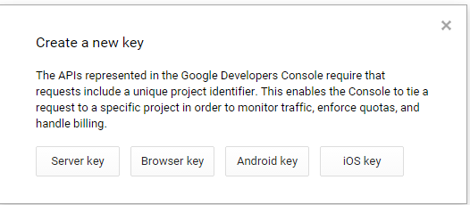
Step 3-1 continued….
Now select “Android Key”

Slide 35
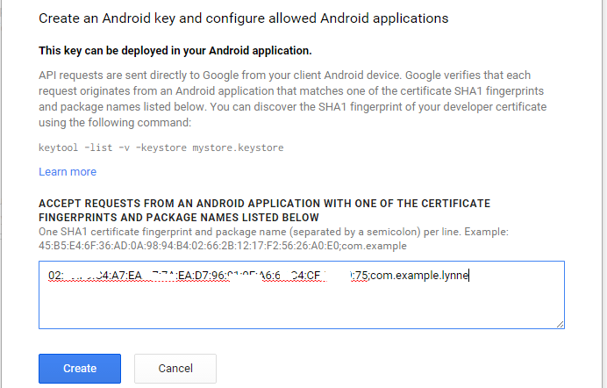
Step 3-1 continued….
Now fill in the SHA-1 number followed by ; and your project’s package name

Slide 36
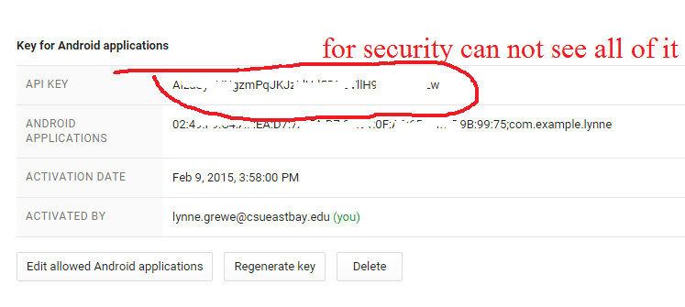
Step 3-1 now you will get the Maps API key you can use
Now you can go back to console anytime you want to see the API key –but, you will need it in the next step to add to your manifest file

Slide 37
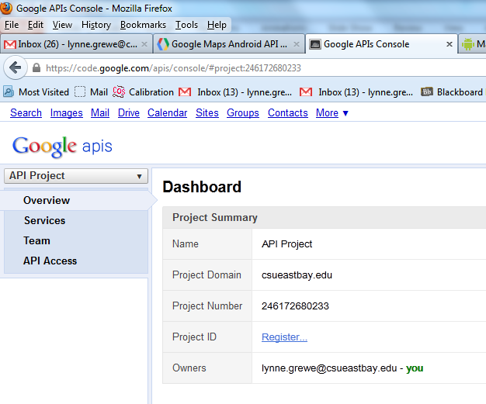
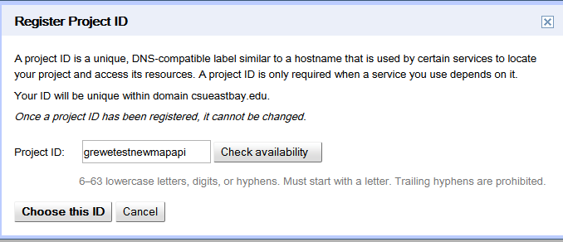
Step 3-1 Getting Map API Key using SHA fingerprint from Certificate your App is signed with
Part 1 ---
click
Register
choose
ID

Slide 38
STEP 3-2: PUT Maps API key in Applications Manifest file
AndroidManifest.xml
To add the key to your application:
  1) ADD between <application> and </application>:
    <meta-data
    android:name="com.google.android.maps.v2.API_KEY"
    android:value="your_api_key"/>
    substituting your API key for your_api_key.
    This element sets the key com.google.android.maps.v2.API_KEY to the value your_api_key and makes the API key visible to any MapFragment in your application.
  2) ADD permission to use maps (note: replace com.example.mapdemo with the package name of your application)
    <permission android:name="com.example.mapdemo.permission.MAPS_RECEIVE" android:protectionLevel="signature"/>
    <uses-permission android:name="com.example.mapdemo.permission.MAPS_RECEIVE"/>

Slide 39
STEP 3-2: PUT Maps API key in Applications Manifest file
AndroidManifest.xml
CONTINUED
  3) ADD following permissions (some you may change depending on app needs)
    <uses-permission android:name="android.permission.INTERNET"/>
    <uses-permission android:name="android.permission.WRITE_EXTERNAL_STORAGE"/>
    <uses-permission android:name="com.google.android.providers.gsf.permission.READ_GSERVICES"/>
    <uses-permission android:name="android.permission.ACCESS_COARSE_LOCATION"/>
    <uses-permission android:name="android.permission.ACCESS_FINE_LOCATION"/>
  4) Add for graphics the feature under <manifest> tag
    <uses-feature
    android:glEsVersion="0x00020000"
    android:required="true"/>

Slide 40
Step 3-2: finish
Re build project
Now you are ready to add some map api code calls to your application.

Slide 41
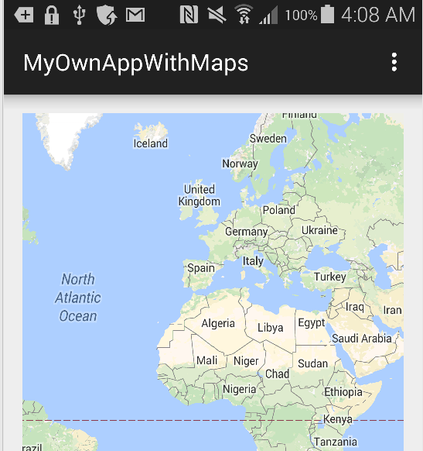
Step 4 – Adding a MapFragment to Activity
First Android Manifest file complete
<?xml version="1.0" encoding="utf-8"?>
<manifest xmlns:android="http://schemas.android.com/apk/res/android" package="com.example.lynne.myownappwithmaps" >
<uses-permission android:name="android.permission.INTERNET" />
<uses-permission android:name="android.permission.ACCESS_NETWORK_STATE" />
<uses-permission android:name="android.permission.WRITE_EXTERNAL_STORAGE" />
<uses-permission android:name="com.google.android.providers.gsf.permission.READ_GSERVICES" />
<!--
The ACCESS_COARSE/FINE_LOCATION permissions are not required to use
Google Maps Android API v2, but are recommended.
-->
<uses-permission android:name="android.permission.ACCESS_COARSE_LOCATION" />
<uses-permission android:name="android.permission.ACCESS_FINE_LOCATION" />
<uses-feature android:glEsVersion="0x00020000" android:required="true"/>
<application
android:allowBackup="true"
android:icon="@drawable/ic_launcher"
android:label="@string/app_name"
android:theme="@style/AppTheme" >
<activity
android:name=".MainActivity"
android:label="@string/app_name" >
<intent-filter>
<action android:name="android.intent.action.MAIN" />
<category android:name="android.intent.category.LAUNCHER" />
</intent-filter>
</activity>
<meta-data android:name="com.google.android.gms.version" android:value="@integer/google_play_services_version"/>
<meta-data android:name="com.google.android.maps.v2.API_KEY" android:value="AIzaSyBxv3C2D8sGDLCTJtEeN5L0pedYq44JNtA"/>
</application>
</manifest>

Slide 42
Step 4 – Adding a MapFragment to Activity
First Android Manifest file complete
<application
android:allowBackup="true"
android:icon="@drawable/ic_launcher"
android:label="@string/app_name"
android:theme="@style/AppTheme" >
<activity
android:name=".MainActivity"
android:label="@string/app_name" >
<intent-filter>
<action android:name="android.intent.action.MAIN" />
<category android:name="android.intent.category.LAUNCHER" />
</intent-filter>
</activity>

Slide 43
Step 4 – Adding a MapFragment to Activity
First Android Manifest file complete
<meta-data android:name="com.google.android.gms.version" android:value="@integer/google_play_services_version"/>
<meta-data android:name="com.google.android.maps.v2.API_KEY" android:value="AIzaSyBxv3C2D8sGDLCTJtEeN5L0pedYq44JNtA"/>
</application>
</manifest>

Slide 44
Step 4- Activity class
public class MainActivity extends ActionBarActivity {
@Override
protected void onCreate(Bundle savedInstanceState) {
super.onCreate(savedInstanceState);
setContentView(R.layout.activity_main);
if (savedInstanceState == null) {
getSupportFragmentManager().beginTransaction()
.add(R.id.container, new PlaceholderFragment())
.commit();
}
}
public static class PlaceholderFragment extends Fragment {
public PlaceholderFragment() {
}
@Override
public View onCreateView(LayoutInflater inflater, ViewGroup container,
Bundle savedInstanceState) {
View rootView = inflater.inflate(R.layout.fragment_main_map, container, false);
return rootView;
}
}
}

Slide 45
Step 4- Fragments xml layout
<RelativeLayout xmlns:android="http://schemas.android.com/apk/res/android"
xmlns:tools="http://schemas.android.com/tools" android:layout_width="match_parent"
android:layout_height="match_parent" android:paddingLeft="@dimen/activity_horizontal_margin"
android:paddingRight="@dimen/activity_horizontal_margin"
android:paddingTop="@dimen/activity_vertical_margin"
android:paddingBottom="@dimen/activity_vertical_margin"
tools:context=".MainActivity$PlaceholderFragment">
<fragment xmlns:android="http://schemas.android.com/apk/res/android"
android:id="@+id/map"
android:layout_width="match_parent"
android:layout_height="match_parent"
android:name="com.google.android.gms.maps.MapFragment"/>
</RelativeLayout>

Slide 46
Lets look at a slightly differently coded step 4
……MapFragment declared in Activities layout.xml file rather than as in past example done with code and Fragment class you defined

Slide 47
Step 4: ADDING MapFragment to your layout – Activity here is simple
Android API 12 or later
Main.xml
  <?xml version="1.0" encoding="utf-8"?>
  <fragment xmlns:android="http://schemas.android.com/apk/res/android"
  android:id="@+id/map"
  android:layout_width="match_parent"
  android:layout_height="match_parent"
  class="com.google.android.gms.maps.MapFragment"/>
ACTIVITY
package com.example.mapdemo;
import android.app.Activity;
import android.os.Bundle;
public class MainActivity extends Activity {
@Override
protected void onCreate(Bundle savedInstanceState) {
super.onCreate(savedInstanceState);
setContentView(R.layout.main);
}
}
Build and run your application.

Slide 48
ADDING MapFragment XML options---add to main.xml
<fragment xmlns:android="http://schemas.android.com/apk/res/android"
xmlns:map="http://schemas.android.com/apk/res-auto"
android:id="@+id/map"
android:layout_width="match_parent"
android:layout_height="match_parent"
map:cameraBearing="112.5"
map:cameraTargetLat="-33.796923"
map:cameraTargetLng="150.922433"
map:cameraTilt="30"
map:cameraZoom="13"
map:mapType="normal"
map:uiCompass="false"
map:uiRotateGestures="true"
map:uiScrollGestures="false"
map:uiTiltGestures="true"
map:uiZoomControls="false"
map:uiZoomGestures="true"
class="com.google.android.gms.maps.MapFragment"/>

Slide 49
Changing Map in Code—inside Activity
public class MapPane extends Activity implements OnMapReadyCallback {
protected void onCreate(Bundle savedInstanceState) {
MapFragement mapfrag;
super.onCreate(savedInstanceState);
setContentView(R.layout.activity_main);
//Grab MapFragment
mapfrag = ((MapFragment) getFragmentManager().findFragmentById(R.id.map)) .getMap();
// Grab the Map from MapFragment
mapFragment.getMapAsync(this);
}
NOTE: This activity
is acting as an OnMapReadyCallback
class and implements (next page)
onMapReady method that gets the
Actual GoogleMap instance to manipulate

Slide 50
Changing Map in Activity Code--continued
NOTE: This activity
is acting as an OnMapReadyCallback
class and implements (next page)
onMapReady method that gets the
Actual GoogleMap instance to manipulate
Indise the Activity
@Override
public void onMapReady(GoogleMap map) {
LatLng sydney = new LatLng(-33.867, 151.206);
// CREATING MARKER
Marker hamburg = map.addMarker(new MarkerOptions().position(HAMBURG) .title("Hamburg"));
Marker kiel = map.addMarker(new MarkerOptions() .position(KIEL) .title("Kiel") .snippet("Kiel is cool") .icon(BitmapDescriptorFactory .fromResource(R.drawable.ic_launcher)));
// Move the camera instantly to hamburg with a zoom of 15.
map.moveCamera(CameraUpdateFactory.newLatLngZoom(HAMBURG, 15)); // Zoom in, animating camera.
map.animateCamera(CameraUpdateFactory.zoomTo(10), 2000, null);
}

Slide 51
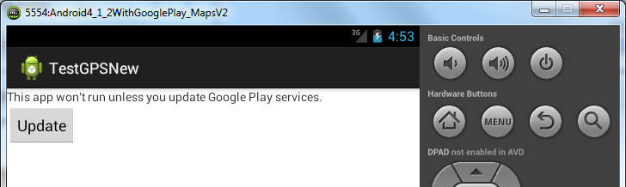
Remember to Run in emulator you must try a Hack (I have not gotten it to work yet)
FOR EMULATION: Create AVD that uses Google Play Services (NOTE that you need to do a HACK here for emulator to work – see previous slides)
What you see when you try to run in emulator

Slide 52
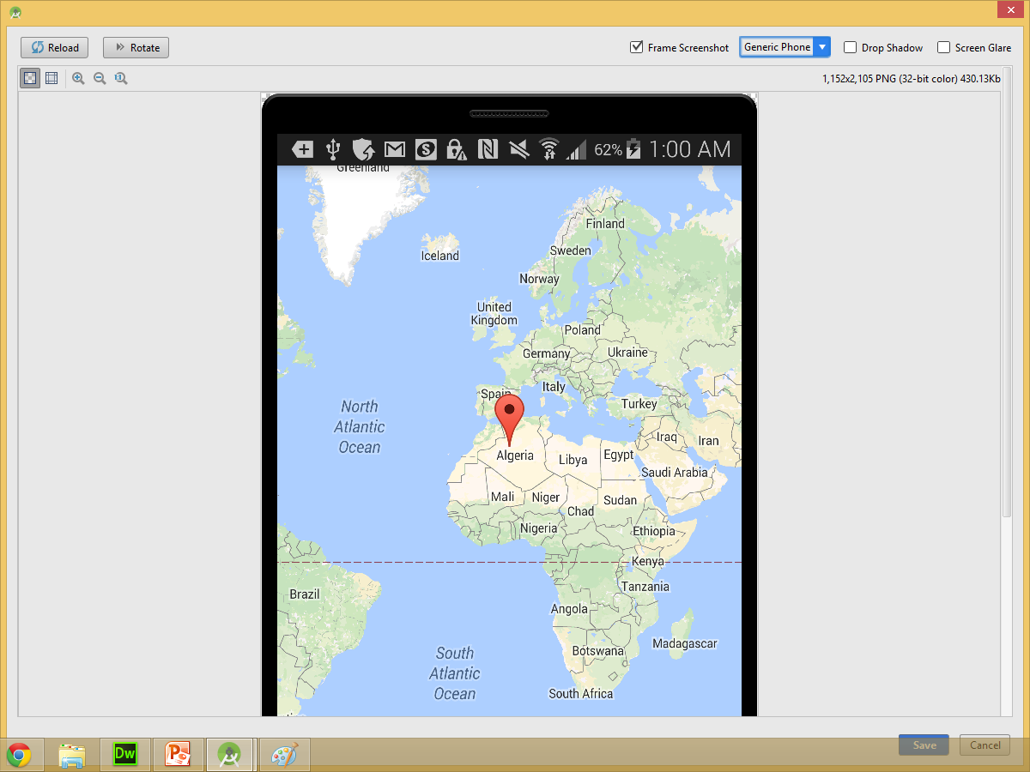
Better yet
Run on your real HW device!!!!

Slide 53
Example of Map app in Android Studio
Using the default GoogleMapsActivity launch interface … which uses the SupportMapFragment class instance specified as a fragment in the Activity’s layout.xml file

Slide 54
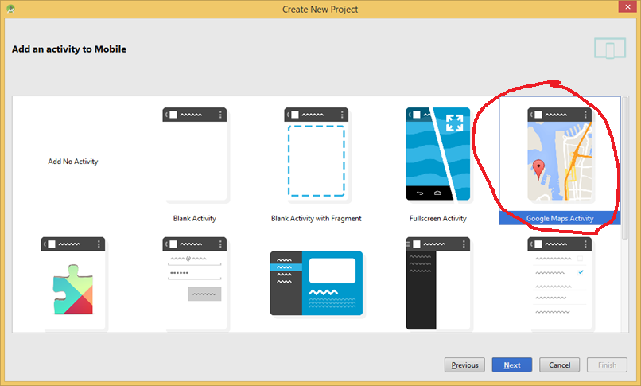
AndroidStudio: example project with launch activity a map interface
Here you create project of type “GoogleMapsActivity”

Slide 55
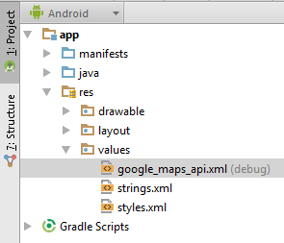
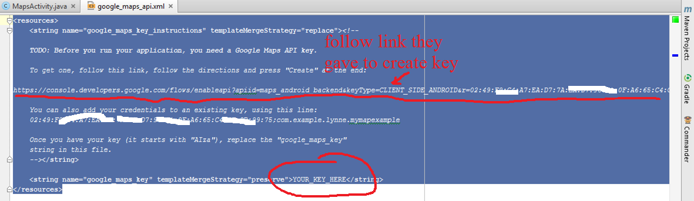
Android Studio Example
Continued
When you create an App using GoogleMapsActivity it will setup a file called google_maps_api.xml that will contain Google Maps key

Slide 56
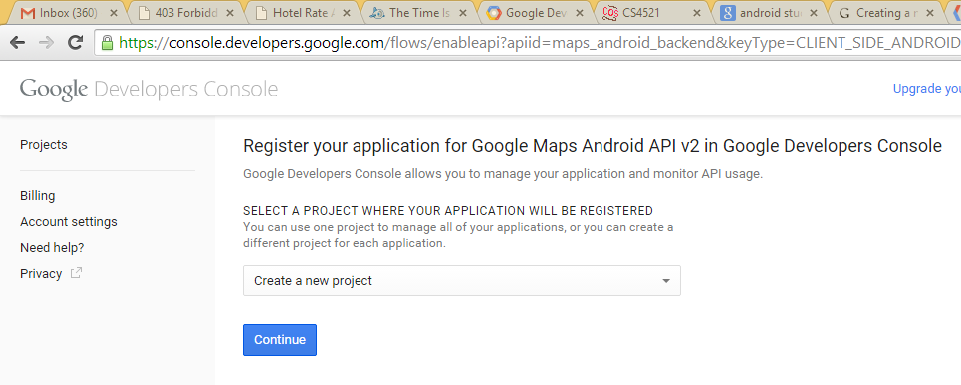
Following link to get api key- step 1
HERE is URL it created for me https://console.developers.google.com/project/our-reason-852/apiui/credential?keyType=CLIENT_SIDE_ANDROID&r=02:33:F9:24:A7:EA:29:7A:32:D7:48:0F:09:33:65:AF:CF:3B:C6:75%3Bcom.example.lynne.mymapexample#
>>which takes me to a google developers console ready to create a new project registration for my com.example.lynne.mymapexample app
This is really
the same as step
3 in previous examples
--Getting the API key
But has been a bit simplified
copies in automatically the
SHA-1 fingerprint in URL request

Slide 57
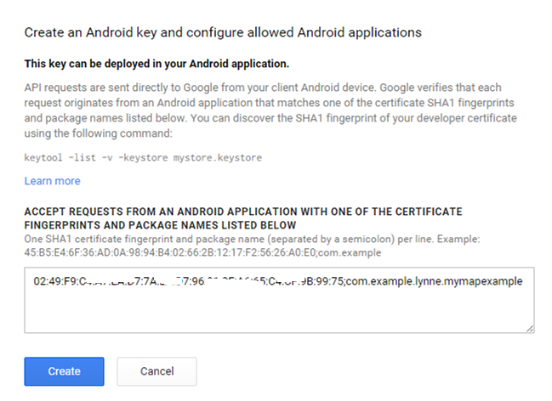
Getting api key –step 2

Slide 58
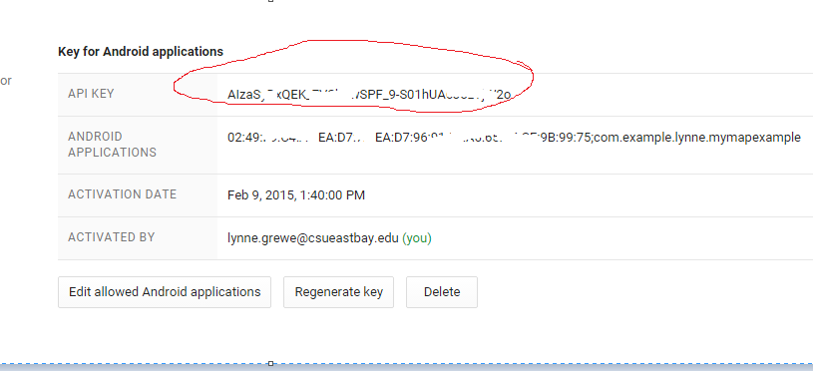
Getting api key –step 3

Slide 59
The default Android Studio Maps Activity class
private void setUpMapIfNeeded() {
// Do a null check to confirm have not already instantiated map
if (mMap == null) {
// Try to obtain the map from the SupportMapFragment.
mMap = ((SupportMapFragment) getSupportFragmentManager().findFragmentById(R.id.map)).getMap();
// Check if we were successful in obtaining the map.
if (mMap != null) {
setUpMap();
}
}
}
//where we can add markers or lines, add listeners move camera\
private void setUpMap() {
mMap.addMarker(new MarkerOptions().position(new LatLng(30, 0)).title("Marker"));
}
}
public class MapsActivity extends FragmentActivity {
private GoogleMap mMap; // Might be null if Google Play services APK is not available.
@Override
protected void onCreate(Bundle savedInstanceState) {
super.onCreate(savedInstanceState);
setContentView(R.layout.activity_maps);
setUpMapIfNeeded();
}
@Override
protected void onResume() {
super.onResume();
setUpMapIfNeeded();
}
activity_maps.xml
<fragment xmlns:android="http://schemas.android.com/apk/res/android"
xmlns:tools="http://schemas.android.com/tools" android:layout_width="match_parent"
android:layout_height="match_parent" android:id="@+id/map" tools:context=".MapsActivity"
android:name="com.google.android.gms.maps.SupportMapFragment" />

Slide 60
STOP----
Note the method getMap is deprecated –kind of surprising as that was auto generated code by AndroidStudio ---
It is replaced by use of getMapAsync(OnMapReadyCallback callback)
    Sets a callback object which will be triggered when the GoogleMap instance is ready to be used.
    WE SAW AN EXAMPLE OF USING THIS PREVIOUSLY

Slide 61
STOP– what is difference between MapFragment and SupportMapFragment classes???
---answer (maybe not much)
SupportMapFragment is for use with the Android Support package's backport of fragments. It can be used on Android devices running API 10 and lower, as well as Android devices running 11 and higher.
MapFragment requires the native API Level 11 fragment implementation, and therefore can only be used on API Level 11 and higher devices.

Slide 62
Copy key into xml file
COPY key you just got into google_maps_api.xml location
circled here--- <string name=google_maps_keys

Slide 63
Running on device (screenshot)
This is what I get after with marker set to 30, 0 lat/long

Slide 64
MapFragment
Lets explore a little the methods

Slide 65
MapFragment
Methods to change location, zoom, move, etc.
http://developer.android.com/reference/com/google/android/gms/maps/MapFragment.html

Slide 66
ANOTHER OPTION: Using MapView ---see example following in old version

Slide 67
Map Features
Zoom in/out
Location on map
Adding Markers

Slide 68
Camera – changing location
See https://developers.google.com/maps/documentation/android/views
Change location
private static final LatLng SYDNEY = new LatLng(-33.88,151.21);
private GoogleMap map;
... // Obtain the map from a MapFragment or MapView.
// Move the camera instantly to Sydney with a zoom of 15.
map.moveCamera(CameraUpdateFactory.newLatLngZoom(SYDNEY, 15));

Slide 69
Camera –zoom
See https://developers.google.com/maps/documentation/android/views
Zoom in and out
// Zoom in, animating the camera.
map.animateCamera(CameraUpdateFactory.zoomIn());
// Zoom out to zoom level 10, animating with a duration of 2 seconds.
map.animateCamera(CameraUpdateFactory.zoomTo(10), 2000, null);

Slide 70
Camera – animate to new location/zoom/bearing/tilt
// Construct a CameraPosition focusing on Mountain View and animate the //camera to that position.
private static final LatLng MOUNTAIN_VIEW = new LatLng(37.4, -122.1);
CameraPosition cameraPosition = new CameraPosition.Builder()
.target(MOUNTAIN_VIEW) // Sets the center of map to Mountain View
.zoom(17) // Sets the zoom
.bearing(90) // Sets the orientation of the camera to east
.tilt(30) // Sets the tilt of the camera to 30 degrees
.build(); // Creates a CameraPosition from the builder
map.animateCamera(CameraUpdateFactory.newCameraPosition(cameraPosition));
Bearing (orientation) = direction in which a vertical line on the map points, measured in degrees clockwise from N.
Tilt (viewing angle) = camera's position on an arc between directly over map's center position and surface of Earth,
measured in degrees from the the direction pointing directly below the camera

Slide 71
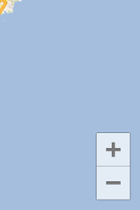
Zoom Control
Hit (bottom of map)
– icon to zoom in
+ icon to zoom out
On real device you can pinch to zoom in and out but, not on an emulator
The Maps API provides built-in zoom controls that appear in the bottom right hand corner of the map. These are disabled by default, but can be enabled by calling UiSettings.setZoomControlsEnabled(true).

Slide 72
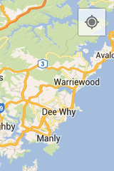
My Location in Map
To enable:
  map.setMyLocationEnabled(true);
The My Location button appears in the top right corner of the screen only when the My Location layer is enabled.
Click goes to user location if known. A click will also trigger the GoogleMap.OnMyLocationButtonClickListener.
disable the button from appearing altogether by calling
UiSettings.setMyLocationButtonEnabled(boolean)

Slide 73
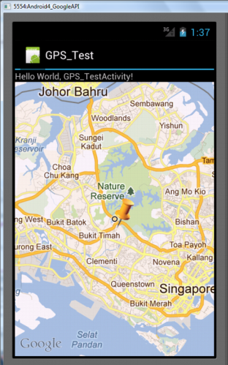
Adding a Marker
//grab GoogleMap instance from MapFragment or SupportMapFragment or….
//Add marker at location with title Hello world
map.addMarker(new MarkerOptions()
.position(new LatLng(10, 10))
.title("Hello world"));
See https://developers.google.com/maps/documentation/android/marker for other options including:
  Position (required)
  Title = A string that's displayed in the info window when the user taps the marker.
  Snippet = Additional text that's displayed below the title.
  Icon =A bitmap that's displayed in place of the default marker

Slide 74
Changing Marker color
static final LatLng MELBOURNE = new LatLng(-37.813, 144.962);
Marker melbourne = mMap.addMarker(new MarkerOptions()
.position(MELBOURNE)
.icon(BitmapDescriptorFactory.defaultMarker(BitmapDescriptorFactory.HUE_AZURE)));

Slide 75
Getting a Location that was touched
GoogleMap.setOnMapClickListener(OnMapClickListener)

Slide 76
Register and implement OnMapClickListener
GoogleMap.setOnMapClickListener(OnMapClickListener)
Implement onMapClick(LatLng) method
  When a user clicks (taps) somewhere on the map, you will receive an event that indicates the location on the map that the user clicked.
  Note that if you need the corresponding location on the screen (in pixels), you can obtain a Projection from the map which allows you to convert between latitude/longitude coordinates and screen pixel coordinates.

Slide 77
Getting a Location that was touched when using MapView class (alternative to MapFragment)
You need to create another class that extends com.google.android.maps.Overlay and implement its onTouchEvent(*) method

Slide 78
Where user touched
Create Instance of
com.google.android.maps.Overlay
  Implement onTouchEvent
  In MapActivity classes onCreate
  add
  //onCreate ()>>>>
MapOverlay mO = new MapOverlay();
List<Overlay> listO = mapView.getOverlays();
listO.clear();
list).add(mapOverlay);
private class MapOverlay extends com.google.android.maps.Overlay
{
@Override
public boolean OnTouchEvent(MotionEvent e, MapView mapView)
{
//user lifts finger
if(e.getAction() == 1) {
GeoPoint p = mapView.getProjection().fromPixels((int) e.getX(),
(int) e.getY());
//do whatever with location p

Slide 79
Moving on to Location -- GPS
Location,location,location

Slide 80
Getting Location of device
Use LocationManager, LocationListener and Location classes (android.location.*)
See https://developers.google.com/maps/documentation/android/location
AND
https://developer.android.com/google/play-services/location.html

Slide 81
Location API
The Google Play services Location API is recommended for all programmatic requests for location data:
  Determine the device location.
  Listen for location changes.
  Determine the mode of transportation, if the device is moving.
  Create and monitor predefined geographical regions, known as geofences.
The LocationSource interface allows you to provide a custom location provider.

Slide 82
Getting the Last Known Location
Inside Activity
  public class MainActivity extends ActionBarActivity implements
  ConnectionCallbacks, OnConnectionFailedListener {
Step 1: specify permission in Android Manifest file:
    <uses-permission android:name="android.permission.ACCESS_COARSE_LOCATION"/>
Step 2: create instanceGoogle Play services API client
  INSIDE ACTIVITIES onCreate(*) method:
    mGoogleApiClient = new GoogleApiClient.Builder(this)
    .addConnectionCallbacks(this)
    .addOnConnectionFailedListener(this)
    .addApi(LocationServices.API)
    .build();
NOTE: once the GoogleApiClient
is ready for use will call this Activity
as it is the ConnectionCallbacks
invoke onConnected(*) method
NOTE: we add LocationServices as
Google API we want to access in client

Slide 83
Getting Last Known Location -continued
STEP 3: now create instance of FusedLocationProviderAPI to call its getLastLocation method inside the callback onConnected method that is called when GoogleApiClient is ready
//class variable: Location mLastLocation
//inside Activity acts as ConnectionCallbacks
@Override
public void onConnected(Bundle connectionHint) {
mLastLocation = LocationServices.FusedLocationApi.getLastLocation(mGoogleApiClient);
if (mLastLocation != null) {
mLatitudeText.setText(String.valueOf(mLastLocation.getLatitude()));
mLongitudeText.setText(String.valueOf(mLastLocation.getLongitude()));
}
}
}

Slide 84
Retrieving Location Updates
As phone/device moves you get updates to your app
Besides Lat / Long you can get bearing, velocity and altitude
Can use wifi, gps, cell info
Accuracy determined by provider
Uses FusedLocationProviderApi.requestLocationUpdates(*)

Slide 85
Retrieving Location Updates-continued
Step 1: Activity declare it as a LocationListener
  public class MainActivity extends ActionBarActivity implements
  ConnectionCallbacks, OnConnectionFailedListener, LocationListener {
Step 2: specify permission in Android Manifest file:
    <uses-permission android:name="android.permission.ACCESS_FINE_LOCATION"/>
Step 3: create instanceGoogle Play services API client
  INSIDE ACTIVITIES onCreate(*) method:
    mGoogleApiClient = new GoogleApiClient.Builder(this)
    .addConnectionCallbacks(this)
    .addOnConnectionFailedListener(this)
    .addApi(LocationServices.API)
    .build();
NOTE: once the GoogleApiClient
is ready for use will call this Activity
as it is the ConnectionCallbacks
invoke onConnected(*) method
NOTE: we add LocationServices as
Google API we want to access in client

Slide 86
Retrieving Location Updates-continued
STEP 4: now create instance of FusedLocationProviderAPI to call its requestLocationUpdates method inside the callback onConnected method that is called when GoogleApiClient is ready
...
@Override
public void onConnected(Bundle connectionHint) {
//whatever other code you have here………
if (mRequestingLocationUpdates) {
startLocationUpdates();
}
protected void startLocationUpdates() {
LocationServices.FusedLocationApi.requestLocationUpdates(
mGoogleApiClient, mLocationRequest, this);
}
}
}

Slide 87
Retrieving Location Updates--continued
STEP 5: implement the onLocationChanged method of the LocationListener interface in your activity
    @Override
    public void onLocationChanged(Location location) {
    mCurrentLocation = location;
    mLastUpdateTime = DateFormat.getTimeInstance().format(new Date());
    updateUI();
    }
    private void updateUI() { //just a method to alter GUI with new lat/long
    mLatitudeTextView.setText(String.valueOf(mCurrentLocation.getLatitude()));
    mLongitudeTextView.setText(String.valueOf(mCurrentLocation.getLongitude()));
    mLastUpdateTimeTextView.setText(mLastUpdateTime);
    }
NOTE: onLocationChanged called automatically
each time a new Location event has occurred.

Slide 88
Retrieving Location Updates –continued (Pause and Resume)
Consider when Activity Paused and Resumed--
    @Override
    protected void onPause() {
    super.onPause();
    LocationServices.FusedLocationApi.removeLocationUpdates(
    mGoogleApiClient, this);
    }
    @Override
    public void onResume() {
    super.onResume();
    if (mGoogleApiClient.isConnected() && !mRequestingLocationUpdates) {
    startLocationUpdates();
    }
    }
See previous slide for starting Location
updates

Slide 89
Retrieving Location Updates – (saved state when Activity destroyed)
Changing orientation can cause Activity to be destroyed --- we need to save our current operational state (that we are using location services) and then in onCreate restore these values
    public void onSaveInstanceState(Bundle savedInstanceState) {
    savedInstanceState.putBoolean(REQUESTING_LOCATION_UPDATES_KEY,
    mRequestingLocationUpdates);
    savedInstanceState.putParcelable(LOCATION_KEY, mCurrentLocation);
    savedInstanceState.putString(LAST_UPDATED_TIME_STRING_KEY, mLastUpdateTime);
    super.onSaveInstanceState(savedInstanceState);
    }

Slide 90
Retrieving Location Updates – (saved state when Activity destroyed)
and then in onCreate restore these values
@Override
public void onCreate(Bundle savedInstanceState) {
...
updateValuesFromBundle(savedInstanceState);
}
private void updateValuesFromBundle(Bundle savedInstanceState) {
if (savedInstanceState != null) {
// Update the value mRequestingLocationUpdates
// from the Bundle, & make sure that the Start
//Updates and Stop Updates buttons are
// correctly enabled or disabled.
if (savedInstanceState.keySet().contains(REQUESTING_LOCATION_UPDATES_KEY)) {
mRequestingLocationUpdates = savedInstanceState.getBoolean(
REQUESTING_LOCATION_UPDATES_KEY);
setButtonsEnabledState();
}
@Override
// Update the value of mCurrentLocation from the Bundle and update the
// UI to show the correct latitude and longitude.
if (savedInstanceState.keySet().contains(LOCATION_KEY)) {
// Since LOCATION_KEY was found in the Bundle, we can be sure that
// mCurrentLocationis not null.
mCurrentLocation = savedInstanceState.getParcelable(LOCATION_KEY);
}
// Update the value of mLastUpdateTime from the Bundle and update the UI.
if (savedInstanceState.keySet().contains(LAST_UPDATED_TIME_STRING_KEY)) {
mLastUpdateTime = savedInstanceState.getString(
LAST_UPDATED_TIME_STRING_KEY);
}
updateUI();
}
}

Slide 91

STOP ---rest is older code
Look as needed –some still works and other is deprecated

Slide 92
Used to be prior to mid 2013 a different way to do Location
The Location Manager → turned into the newer way of using FusedLocationApi

Slide 93
Location Manager
Location Manager
- Uses GPS – most accurate, slow, battery
drain, and primarily for outdoor
use.
- Uses the Android Network provider which
uses cell tower and wi-fi signals.

Slide 94
Using LocationManager --STEPS
Ask system for a pointer to the LocationManager.
Permissions requested in the manifest (android.permission.ACCESS_*_LOCATION---*=FINE)
Implement a LocationListener.
Receive a GeoCoder object.
A GeoCoder provides geocoding and reverse geocoding. Geocoding is the process of transforming a street address or other description of a location into a (latitude, longitude) coordinate. Reverse geocoding is the process of transforming a (latitude, longitude) coordinate into a (partial) address.
<uses-permission android:name="android.permission.ACCESS_COARSE_LOCATION"/>
<uses-permission android:name="android.permission.ACCESS_FINE_LOCATION"/>

Slide 95
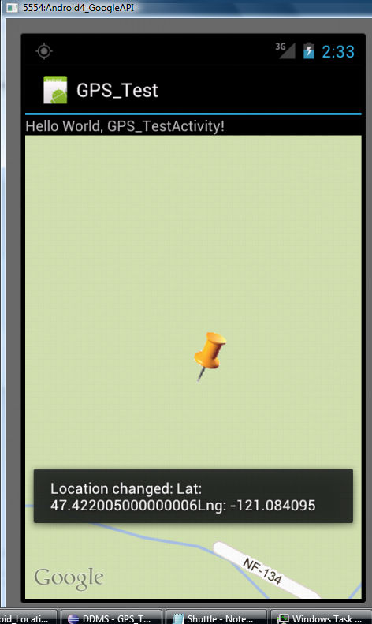
Changing GPS location results
Used emulator (see web page) to alter lat and long
Here you see Toast message
showing the change and map
is readjusted using new
GeoPoint

Slide 96
Add permission to AndroidManifest.xml file
<?xml version="1.0" encoding="utf-8"?>
<manifest xmlns:android="http://schemas.android.com/apk/res/android"
package="grewe.gps_test"
android:versionCode="1"
android:versionName="1.0" >
<uses-sdk android:minSdkVersion="14" />
<uses-permission android:name="android.permission.INTERNET"/>
<uses-permission android:name="android.permission.ACCESS_FINE_LOCATION"/>

Slide 97
Some new imports for your MapActivity class
import android.location.Location;
import android.location.LocationListener;
import android.location.LocationManager;

Slide 98
MapActivity class
in onCreate method grab LocationManager
Setup instance of MyLocationListener
Class variables
  LocationManger lm;
  LocationListener locationListener;
public void onCreate(Bundle s) {
///********Code ********
lm = (LocationManager) (LocationManager) getSystemService(Context.LOCATION_SERVICE);
locationListener = new MyLocationListener();
}

Slide 99
MapActivity class
Implement onResume()
public void onResume() {
super.onResume();
lm.requestLocationUpdates( LocationManger.GPS_PROVIDER,
0,0, locationListener);
}

Slide 100
MapActivity class
Implement onPause()
public void onPause () {
super.onPause();
lm.removeUpdates(locationListener);
}

Slide 101
The MyLocationListener class
private class MyLocationListener implements LocationListener
{
public void onLocationChanged(Location loc) {
  if(loc !=null) {
  Toast.makeText(getBaseContext(), "Location changed: Lat: " + loc.getLatitude() + "Lng: " + loc.getLongitude(),
  Toast.LENGTH_SHORT).show();
  //set new location to GeoPoint class variable p
  p = new GeoPoint ( (int) (loc.getLatitude() *1E6), (int) (loc.getLongitude() * 1E6));
  mc.animateTo(p);
  mc.setZoom(18);
}
}
//other methods do nothing

Slide 102
REST OF SLIDES IS FOR OLDER GOOGLE API
DO NOT NEED TO READ ---but, there IF YOU WANT TO

Slide 103
Older version Google API
Old Version Google API with Android needed a Key…Following slides show this.

Slide 104
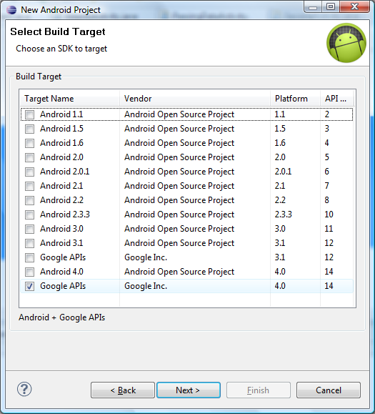
Uses Google API
Must declare use a Google API

Slide 105
To use Google Api you must register
See http://code.google.com/android/add-ons/google-apis/mapkey.html
Free to get a google maps api key
WHAT YOU NEED TO REGISTER: For running in Eclipse emulator you provide the MD5 fingerprint associated with the Eclipse debug certificate ---- NEXT few slides go over how to get this

Slide 106
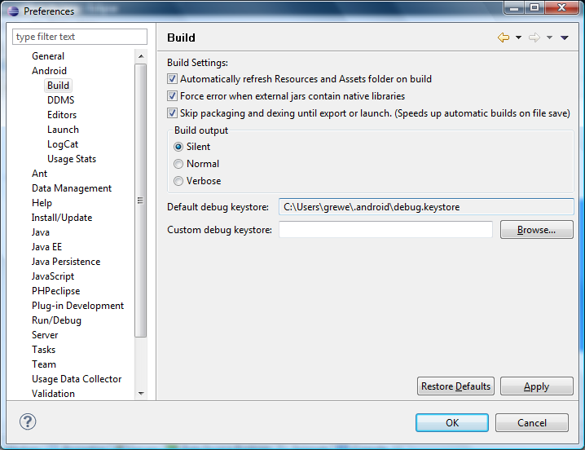
Find location of SDK emulator Certificate
Eclipse: window->preferences
>>>Android->Build, Default debug keystore

Slide 107
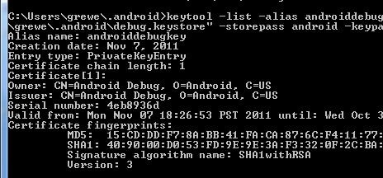
Getting MD5 fingerprint from debug keystore
There is a tool that comes with JDK called “keytool” that lets you extract the MD5 fingerprint you will need for registration:
keytool –list –alias androiddebugkey –keystore “LOCATION YOU FOUND LAST SLIDE” –storepass android –keypass android -v
Copy the MD5 fingerprint and use it at http://code.google.com/android/maps-api-singup.html to get akey

Slide 108
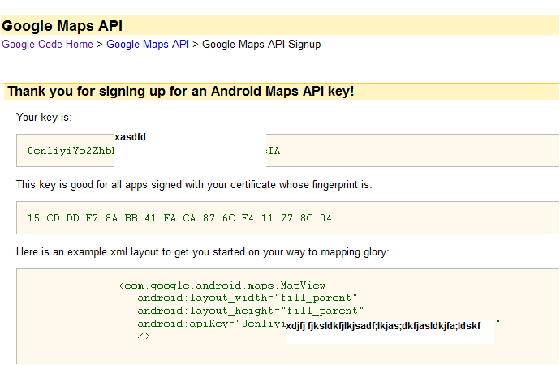
Once you get google map key will look like

Slide 109
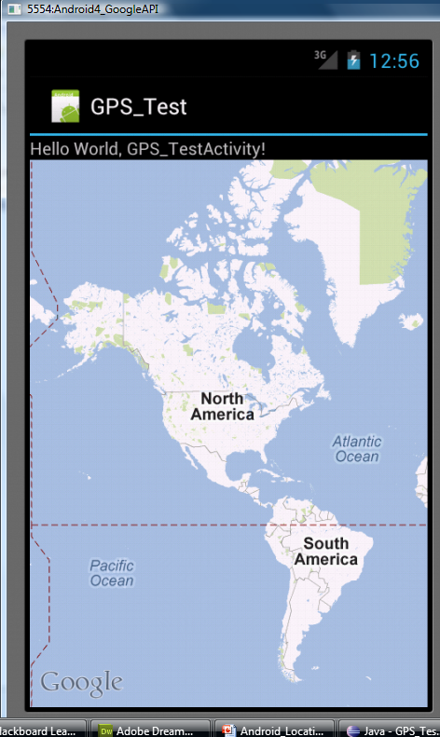
Displaying a Map
AndroidManifext.xml --- add <uses-library> and INTERNET permission
Layout file add <MapView> to UI
Activity should extend MapActivity class

Slide 110
AndroidManifest.xml file
You must ask permission to use INTERNET and add <uses-library> for google maps
<?xml version="1.0" encoding="utf-8"?>
<manifest xmlns:android="http://schemas.android.com/apk/res/android"
package="net.learn2develop.LBS"
android:versionCode="1"
android:versionName="1.0" >
<uses-sdk android:minSdkVersion="13" />
<uses-permission android:name="android.permission.INTERNET"/>
<uses-permission android:name="android.permission.ACCESS_FINE_LOCATION"/>
<uses-permission android:name="android.permission.ACCESS_COARSE_LOCATION"/>
<application
android:icon="@drawable/ic_launcher"
android:label="Where Am I" >
<uses-library android:name="com.google.android.maps" />
<activity
android:label="@string/app_name"
android:name=".LBSActivity" >
<intent-filter >
<action android:name="android.intent.action.MAIN" />
<category android:name="android.intent.category.LAUNCHER" />
</intent-filter>
</activity>
</application>
</manifest>

Slide 111
Add MapView to layout
<?xml version="1.0" encoding="utf-8"?>
<LinearLayout xmlns:android="http://schemas.android.com/apk/res/android"
android:layout_width="fill_parent"
android:layout_height="fill_parent"
android:orientation="vertical" >
<com.google.android.maps.MapView
android:id="@+id/mapView"
android:layout_width="fill_parent"
android:layout_height="fill_parent"
android:enabled="true"
android:clickable="true"
android:apiKey=“YOUR_REGISTERED_GOOGLE_KEY_GOES_HERE" />
</LinearLayout>

Slide 112
Activity extends MapActivity
Implement the isRouteDisplayed() method
public class LBSActivity extends MapActivity {
@Override
pubic void onCreate(Bundle s) {
super.onCreate(s);
setContentView(R.layout.main);
}
@Override
protected boolean isRouteDisplayed() {
return false; //you would return true if you are displaying routing information on the map.
}
}

