Slide 1
PHP and Form Processing
CS3520

Slide 2
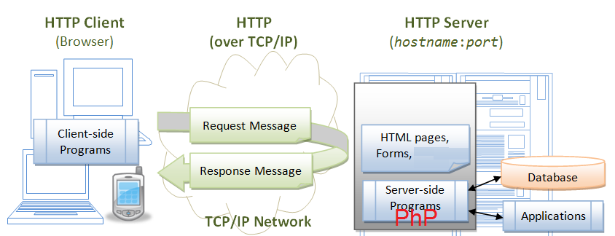
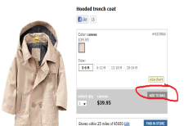
Idea
We have an HTML form that when user clicks on it in their browser a CGI HTTP request is created by the browser and sent to the server in the URL of the action statement of the form for processing ---
Server
e.g. Apache gets request for a PHP file to run and then it knows where its PHP interpreter is and runs the code and Returns the results to the requesting Client
<form action=http://puzzle.sci.csueastbay.edu/~netid/cart.php method=“POST”>
puzzle.sci.csueastbay.edu Server,
Asking it to run cart.php

Slide 3
Recall
In this class we are considering sending data from a client (like from a form) via either CGI GET or POST methods!!!

Slide 4
PHP Form Handling
The PHP superglobals $_GET and $_POST are used to collect form-data.
Example where we send to welcome.php the name and email from a POST form.
<html>
<body>
<form action="welcome.php" method="post">
Name: <input type="text" name="name"><br>
E-mail: <input type="text" name="email"><br>
<input type="submit">
</form>
</body>
</html>

Slide 5
welcome.php
<html>
<body>
<?php
$name=$_POST["name"]; //retrieve the CGI data associated with name
$email=$_POST["email"]; //retrieve the CGI data associated with email
echo "Your name is ".$name."<br/>";
echo "Your email is ".$email."<br/>";
?>
</body>
</html>
What client Sees:
Your name is Lynne Your email is ll@gmail.com
User types into the form Name: Lynne
E-mail: ll@gmail.com

Slide 6
welcome.php
<html>
<body>
<?php
if(isset($_POST["name"]) && isset($_POST["email"])
{
$name=$_POST["name"];
$email=$_POST["email"];
echo "Your name is ".$name."<br/>";
echo "Your email is ".$email."<br/>";
}
?>
</body>
</html>
Check first to see if the data exists in the _POST array

Slide 7
GET method example
<html>
<body>
<form action="welcome.php" method= "get">
Name: <input type="text" name="name"><br>
E-mail: <input type="text" name="email"><br>
<input type="submit">
</form>
</body>
</html>

Slide 8
<html>
<body>
<?php
$name=$_GET["name"];
$email=$_GET["email"];
echo "Your name is ".$name."<br/>";
echo "Your email is ".$email."<br/>";
?>
</body>
</html>

Slide 9
Another Example – with pull down (select) lists

Slide 10
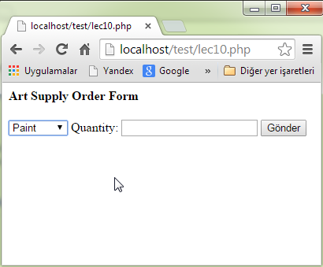
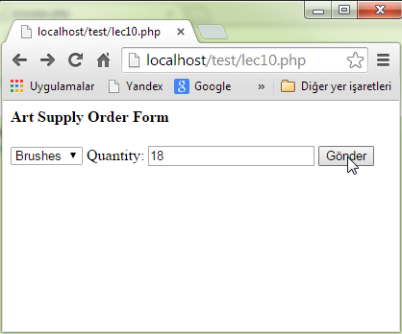
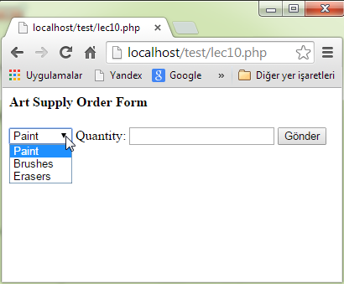
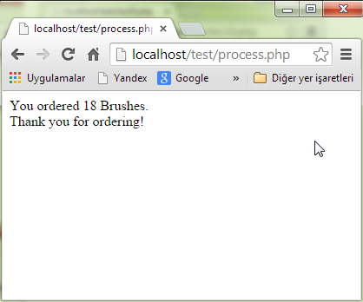

Slide 11
Select Forms:
<html>
<body>
<h4>Art Supply Order Form</h4>
<form action="process.php" method="post">
<select name="item">
<option>Paint</option>
<option>Brushes</option>
<option>Erasers</option>
</select>
Quantity: <input name="quantity" type="text" />
<input type="submit" />
</form>
</body>
</html>

Slide 12
process.php
<html> <body> <?php $quantity = $_POST['quantity']; $item = $_POST['item']; echo "You ordered ". $quantity . " " . $item . ".<br />"; echo "Thank you for ordering!"; ?> </body> </html>

Slide 14
Another Example- with radio buttons

Slide 15
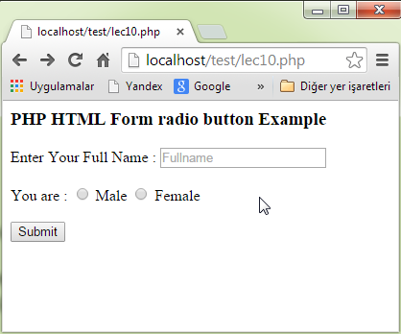
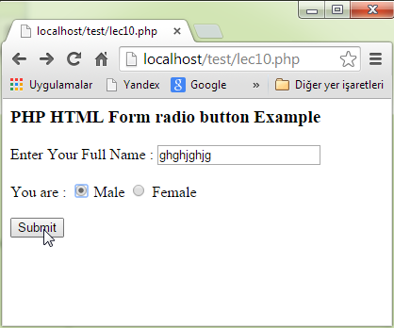
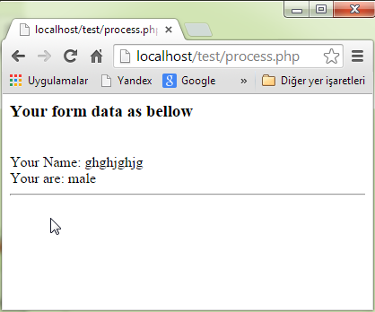

Slide 16
<html>
<body>
<h3>PHP HTML Form radio button Example</h3>
<form name="infoForm" method="POST" action=“example.php">
Enter Your Full Name :
<input name="FullName" type="text" placeholder="Fullname"><br/><br/>
You are :
<input name="YourGender" type="radio" value="male" > Male
<input name="YourGender" type="radio" value="female" > Female
<br/>
<br/>
<input name="BtnSubmit" type="submit" value="Submit">
</form>
</body>
</html>

Slide 17
example.php
<html>
<body>
<?php
if(isset($_POST['BtnSubmit']))
{
echo "<h3>Your form data as bellow</h3>";
echo "</br>Your Name: {$_POST['FullName']}";
echo "</br>Your are: {$_POST['YourGender']}";
echo "<hr>";
}
?>
</body>
</html>

Slide 19
Another example with checkboxes

Slide 20
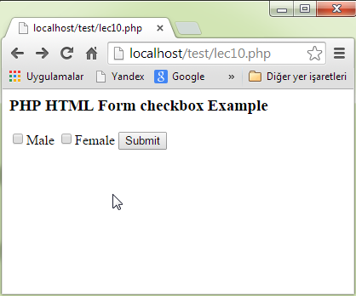
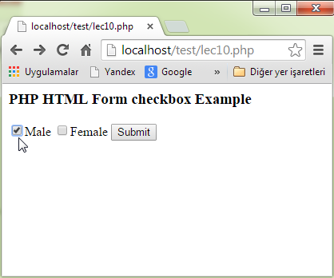
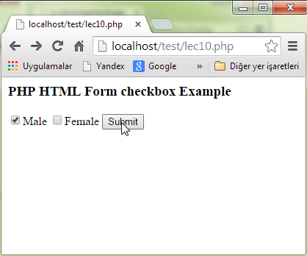
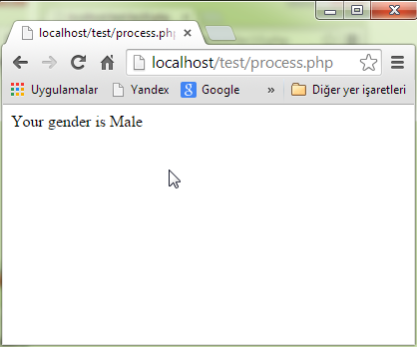

Slide 21
Checkbox example:
<html>
<body>
<h3>PHP HTML Form checkbox Example</h3>
<form action="process.php" method="post">
<input type="checkbox" name="gender" value="Male">Male</input>
<input type="checkbox" name="gender" value="Female">Female</input>
<input type="submit" name="submit" value="Submit"/>
</form>
</body>
</html>

Slide 22
process.php
<html>
<body>
<?php
if (isset($_POST['gender']))
{
echo "Your gender is ";
echo $_POST['gender']; // Displays value of checked checkbox.
}
?>
</body>
</html>

Slide 24
More Examples –with buttons

Slide 25
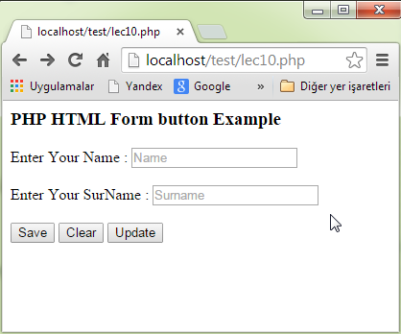
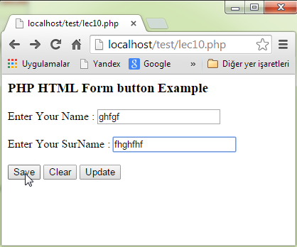
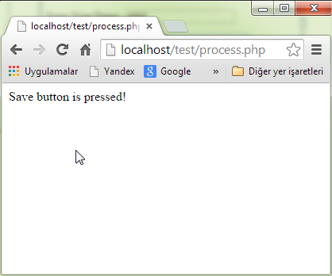

Slide 26
<html>
<body>
<h3>PHP HTML Form button Example</h3>
<form name="infoForm" method="POST" action="process.php">
Enter Your Name :
<input name="FullName" type="text" placeholder="Name"><br/><br/>
Enter Your SurName :
<input name="SurName" type="text" placeholder="Surname"><br/><br/>
<input type="submit" name="save" value="Save">
<input type="submit" name="clear" value="Clear">
<input type="submit" name="update" value="Update">
</form>
</body>
</html>

Slide 27
process.php
<html>
<body>
<?php
if (isset($_POST['save']))
{
echo "Save button is pressed! <br /> ";
}
if (isset($_POST['clear']))
{
echo "Clear button is pressed! <br /> ";
}
if (isset($_POST['update']))
{
echo "Update button is pressed! <br /> ";
}
?>
</body>
</html>

Slide 29
Example with checkboxes

Slide 30
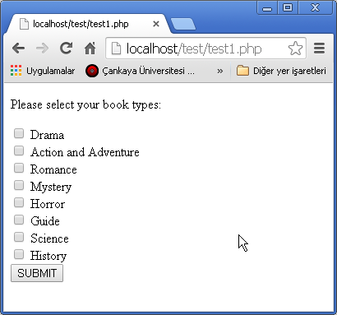
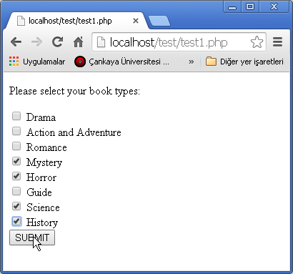
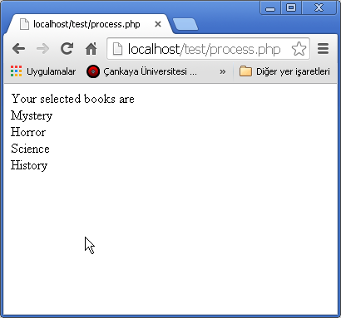

Slide 31
Mulltiple Selection CheckBox:
<!DOCTYPE html>
<html>
<body>
<p> Please select your book types: </p>
<form name="form1" action="process.php" method="POST">
<input type="checkbox" name="book[]" value="Drama"> Drama <br/>
<input type="checkbox" name="book[]" value="Action and Adventure"> Action and Adventure <br/>
<input type="checkbox" name="book[]" value="Romance"> Romance <br/>
<input type="checkbox" name="book[]" value="Mystery"> Mystery <br/>
<input type="checkbox" name="book[]" value="Horror"> Horror <br/>
<input type="checkbox" name="book[]" value="Guide"> Guide <br/>
<input type="checkbox" name="book[]" value="Science"> Science <br/>
<input type="checkbox" name="book[]" value="History"> History <br/>
<input type="submit" value="SUBMIT">
</form>
</body>
</html>

Slide 32
<?php
$bookArray=$_POST['book'];
echo "Your selected books are <br/>";
foreach ($bookArray as $aBook)
{
echo "$aBook <br>";
}
?>

Slide 34
Security???

Slide 35
Security
Option1: Some SIMPLE things to do with PHP
Option2: Use SSL and HTTPS

Slide 36
Option1: Some special ideas
Simple ideas to avoid SOME hacking/attacks possible with forms.

Slide 37
Secure input data
To prevent hackers entering your system, use the following approach while inputting the data from user --- strip any incoming CGI data of spaces, etc…see below
<?php
// define variables and set to empty values
$name = $email = $gender = $comment = $website = "";
if ($_SERVER["REQUEST_METHOD"] == "POST") {
$name = test_input($_POST["name"]);
$email = test_input($_POST["email"]);
$website = test_input($_POST["website"]);
$comment = test_input($_POST["comment"]);
$gender = test_input($_POST["gender"]);
}
function test_input($data) {
$data = trim($data); // avoids the blank spaces at the beginning and at the end
$data = stripslashes($data); // stripes slashes
$data = htmlspecialchars($data); // convers special characters such as &lt
return $data;
}
?>

Slide 38
What is the htmlspecialchars() function? The htmlspecialchars() function converts special characters to HTML entities. This means that it will replace HTML characters like < and > with &lt; and &gt;. This prevents attackers from exploiting the code by injecting HTML or Javascript code (Cross-site Scripting attacks) in forms.
See: http://www.w3schools.com/php/php_form_validation.asp
for an example

Slide 39
<html>
<body>
<form method="post" action="<?php echo htmlspecialchars($_SERVER["PHP_SELF"]);?>">
<p>First name: <input type="text" name="firstname" /></p>
<p>Last name: <input type="text" name="lastname" /></p>
<input type="submit" name="submit" value="Submit" />
</form>
</html>
<?php
if(isset($_POST['firstname']) && isset($_POST['lastname']))
{
echo("First name: " . $_POST['firstname'] . "<br />\n");
echo("Last name: " . $_POST['lastname'] . "<br />\n");
}
?>
SILLY code that displays the form and then the data afterwards as text that was previously typed in --- shows using the htmlspecialchars function
NOTE: $_SERVER[“PHP_SELF”]
Is equal to the php you are currently processing, code you are in

Slide 40
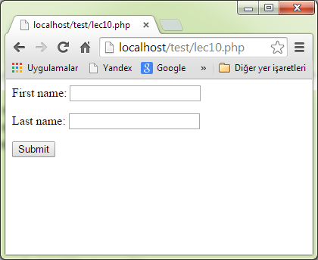
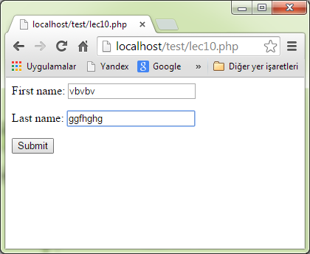
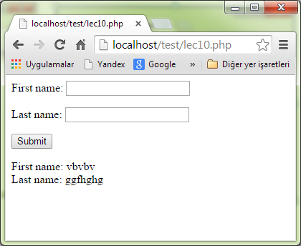

Slide 41
<?php if(isset($_POST['firstname']) && isset($_POST['lastname'])) { echo("First name: " . $_POST['firstname'] . "<br />\n"); echo("Last name: " . $_POST['lastname'] . "<br />\n"); } ?> <html> <body> <form method="post" action="<?php echo htmlspecialchars($_SERVER["PHP_SELF"]);?>">
<p>First name: <input type="text" name="firstname" /></p> <p>Last name: <input type="text" name="lastname" /></p> <input type="submit" name="submit" value="Submit" />
</form> </html>

