Slide 1
Express with Node
L. Grewe

Slide 2
What does Express add to NodeJS
minimal and flexible Node.js web application framework that provides a robust set of features for web and mobile applications. Provides EASIER WAY (than just nodeJS).
What does the this mean?
Note: sometimes Express is thought of as minimalistic (there are other frameworks like Meteor that are more complex)

Slide 3
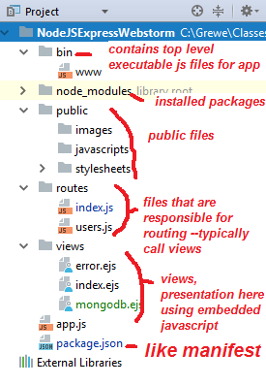
Feature 1
Project structure

Slide 4
FEATURE 1: It adds the project structure we saw before for NodeJS + Express
This kind of multi-folder architecture is sometimes called a “scaffolded app”
Note: even if you do not use an IDE but,
Create a NodeJS project using command line
npm tool you get a similar directory structure
This partitioning (towards MVC pattern) is a good one and helps with breaking up of code
Components which allows for more reuse, easier code, better growth/extensions –and is easier when working with a group.

Slide 5
Getting Express + NodeJS project
OPTION 1: create new NodeJS + Express project in WebStorm
WATCH VIDEO
OPTION 2: (do 1 instead use Webstorm) if not using WebStorm IDE can create new NodeJS + Express project on command line by going to desired directory and typing
npm install express-generator -g express nameOfApp
NOTE: you can’t easily add Express to an existing NodeJS directory ---as it completely changes the filestructre

Slide 6
Feature 2
ROUTING

Slide 7
FEATURE 2: Express also basic routing
Routing is mapping URIs + Request Type -> code/static page
Here are some method calls on the express instance that are related to HTTP request type
how application responds to client request to a particular endpoint, which is a URI (or path) and a specific HTTP request method (GET, POST, and so on).
Example: request for /getAllRoutes might map to the controller code located in controller/getAllRoutes.js

Slide 8
Where is the code for routing located
In a javascript file in the routes directory
In the following project → there are 2 files index.js and users.js that contain routing code

Slide 9
Routing Code-- what is this app object
In your code after requiring the express module, you declare an instance of express object called app
simple index.js file
//require the Express module and call express var express = require('express') var app = express()
//Following declares URI path / will cause the message Hello World to be sent app.get('/', function (req, res) { res.send('Hello World!') })
//application will listen for requests on port number 300 app.listen(3000, function () { console.log('Example app listening on port 3000!') })
Remember this inside a routing file in routes directory

Slide 10
Examining the simple routing code
simple index.js file
//require the Express module and call express var express = require('express') var app = express()
//Following declares URI path / will cause the message Hello World to be sent app.get('/', function (req, res) { res.send('Hello World!') })
//application will listen for requests on port number 300 app.listen(3000, function () { console.log('Example app listening on port 3000!') })
Remember this inside a routing file in routes directory
Require express module→ declare app = express instance→
When request for ‘/’ comes in → with request type = get then send response text ‘Hello World!’

Slide 11
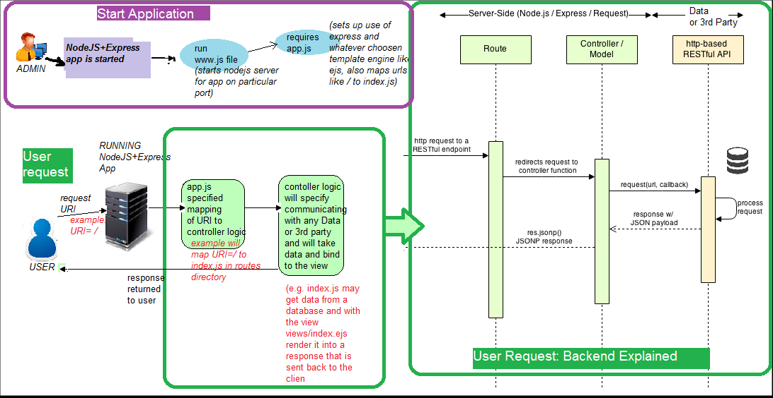
RUNNING: The basic flow of a Node+Express app
1) START APPLICATION: launch app and listens for requests at the specified port in www.js AND sets up routing maps as specified in the required app.js file (which in turn can call in different routing files in routes directory)
2) USER REQUEST COMES IN: using routing information invokes the appropriate controller logic found in routes and this can involve calling other js programs that communicate with Database/Data servers or 3rd party (like ups etc). Then the data (if any) is bound to a template (a view found in views directory) and rendered and the response is delivered to the user.

Slide 12
Here is example of a www.js file
#!/usr/bin/env node /** * Module dependencies. */ var app = require('../app'); //THIS will load the app.js file that sets up routing var debug = require('debug')('nodejsexpresswebstorm:server'); var http = require('http'); /** * Get port from environment and store in Express. */ var port = normalizePort(process.env.PORT || '3000'); app.set('port', port); /** * Create HTTP server. */ var server = http.createServer(app);

Slide 13
www.js file continued
/** * Listen on provided port, on all network interfaces. */ server.listen(port); server.on('error', onError); server.on('listening', onListening); /** * Normalize a port into a number, string, or false. */ function normalizePort(val) { var port = parseInt(val, 10); if (isNaN(port)) { // named pipe return val; } if (port >= 0) { // port number return port; } return false; }

Slide 14
www.js file continued
/** * Event listener for HTTP server "error" event. */ function onError(error) { if (error.syscall !== 'listen') { throw error; } var bind = typeof port === 'string' ? 'Pipe ' + port : 'Port ' + port; // handle specific listen errors with friendly messages switch (error.code) { case 'EACCES': console.error(bind + ' requires elevated privileges'); process.exit(1); break; case 'EADDRINUSE': console.error(bind + ' is already in use'); process.exit(1); break; default: throw error; } } /** * Event listener for HTTP server "listening" event. */ function onListening() { var addr = server.address(); var bind = typeof addr === 'string' ? 'pipe ' + addr : 'port ' + addr.port; debug('Listening on ' + bind); }

Slide 15
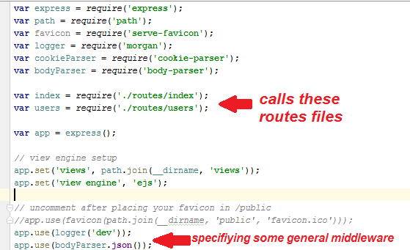
Here is example of app.js file
Notice it loads
(requires) a number of routes files
And later it
Specifies some “middleware” functions it will
execute

Slide 16
Another routing code example
NOTE: for each request type (GET, POST, PUT, DELETE, etc) there is a method call on our express object app
generic example for POST request:
app.post(‘URI’, function(req, res) { res.send('Hello World!') });
Remember this inside a routing file in routes directory

Slide 17
Another Routing example
var cool = require('cool-ascii-faces'); var express = require('express'); var app = express(); var pg = require('pg');
//map URI /nodeMongoDBTest to nodeMongoDBTest.ejs in the sub-directory pages
app.get('/', function(request, response) { response.render('pages/index'); });
//map URI /nodeMongoDBText to the page pages/nodeMongoDBTest
app.get('/nodeMongoDBTest', function(request, response) { response.render('pages/nodeMongoDBTest'); });
//when URI /cool requested call the cool function from the cool module required at top
app.get('/cool', function(request, response) { response.send(cool()); });
//when URI /times requested call the inline function which increments #times run
app.get('/times', function(request, response) {
var result = ''
var times = process.env.TIMES || 5
for (i=0; i < times; i++)
result += i + ' ';
response.send(result);
});
Remember this inside a routing file in routes directory

Slide 18
Decomposing the app.get call
Remember this inside a routing file in routes directory

Slide 19
What is the request and response obejcts in our app.get(‘uri’, function(request,response, next) method
The req object represents the HTTP request and has properties for the request query string,
parameters, body, HTTP headers, and so on.
Request Object req.params.name_of_param For example: app.get('/user/:id', function(req, res) { res.send('user ' + req.params.id); }); But you could just as well have: app.get('/user/:id', function(request, response) { response.send('user ' + request.params.id); }); req.baseUrl, req.body, req.cookies (req.cookies.name_of_cookie), req.hostname, req.path, etc see documentation
Remember this inside a routing file in routes directory

Slide 20
More on the request object
Remember this inside a routing file in routes directory
Body of Request = if you want to see the body of the request for printing it out do the following console.log(JSON.stringify(req.body)); EXAMPLE (handler code): var body = JSON.stringify(req.body); var params = JSON.stringify(req.params); res.send("recieved your request!</br>" + "parameters: " + params + "</br>URL:" + req.url + "body: " + body); will produce
req.body
Contains key-value pairs of data submitted in the request body.
HTML Form say: to: | Response
hi
Express forms

Slide 21
Example passing parameters in URL
Suppose you want to send parameters in URL such as
http://localhost:3000/users/34/books/8989
Where 34 is the id of the user and the book is 8989
app.get('/users/:userId/books/:bookId', function (req, res) {
res.send(req.params) } );
Result is
Remember this inside a routing file in routes directory

Slide 22
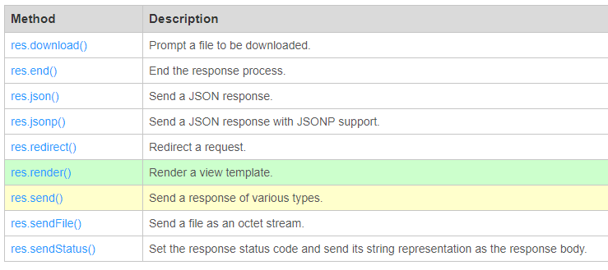
The response object
Has a series of the expected useful methods in building a response like:
res.render, res.send, res.cookie, res.redirect, and many more

Slide 23
What if you want all request types to respond the same way –use the 3 parameter version of handler function that has next as 3rd parameter
app.all('/secret', function (req, res, next) { console.log('Accessing the secret section ...');
next(); // pass control to the next handler
});
Remember this inside a routing file in routes directory

Slide 24
Where is this next handler --- we are not done you must define them in app.*() method
var cb0 = function (req, res, next) {
console.log('CB0');
next(); }
var cb1 = function (req, res, next) {
console.log('CB1');
next(); }
var cb2 = function (req, res) {
res.send('Hello from C!'); }
// DEFINE MULTIPLE handler functions for the URI /example/c app.get('/example/c', [cb0, cb1, cb2]);
Remember this inside a routing file in routes directory

Slide 25
Routing Patterns
acd and abcd.
app.get('/ab?cd', function (req, res) { res.send('ab?cd') })
abcd, abbcd, abbbcd, and so on.
app.get('/ab+cd', function (req, res) { res.send('ab+cd') })
abcd, abxcd, abRANDOMcd, ab123cd, and so on.
app.get('/ab*cd', function (req, res) { res.send('ab*cd') })
/abe and /abcde.
app.get('/ab(cd)?e', function (req, res) { res.send('ab(cd)?e') })
Remember this inside a routing file in routes directory

Slide 26
more Routing Patterns
match anything with an “a” in the route name.
app.get(/a/, function (req, res) { res.send('/a/') })
Remember this inside a routing file in routes directory

Slide 27
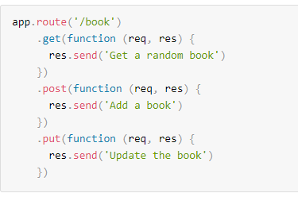
app.route()
You can create chainable route handlers for a route path
Remember this inside a routing file in routes directory

Slide 28
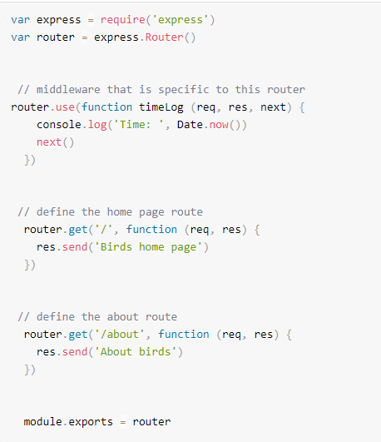
express.Router remember our app object was instance of express()
Remember this inside a routing file in routes directory

Slide 29
Feature 3
TEMPLATE ENGINE

Slide 30
FEATURE 3: Supports Template Engines
templates let you embed backend variables into a file and when requested it renders the file with the variables set to their actual values
uses EJS or Jade/Pug (template engine) and others are supported.
WE WILL HAVE A FUTURE lecture on this

Slide 31
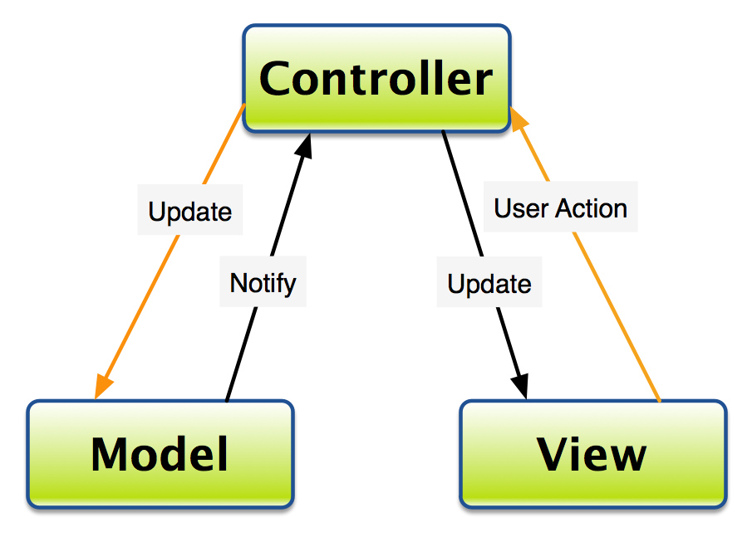
FEATURE 4: Express is “partially” MVC
We can make it more ---and this is the practice of our class

Slide 32
Feature 4: partially MVC
first, if you dont know what MVC is review on CS3340 page or visit the lecture from 6320.
......reminder, MVC is a currently a very desirable pattern to implement in your web framework and we are going to do it
Not strongly MVC
VIEW = in the views directory using some supported template engine like EJS or Jade/Pug.
CONTROLLER = embedded in the code found in the routes directory
MODEL = there is no default setup for Models in Express+NodeJS

Slide 33
How to make it more MVC
Make controllers directory
In a routers file like index.js (in Routes directory) ands code that maps URI to a controller code method
//*****new index.js file var controllerMain = require('../controllers/main’); //this will load the controller file below /* GET home page. */ router.get('/', controllerMain.index); //calls the controller code the function index

Slide 34
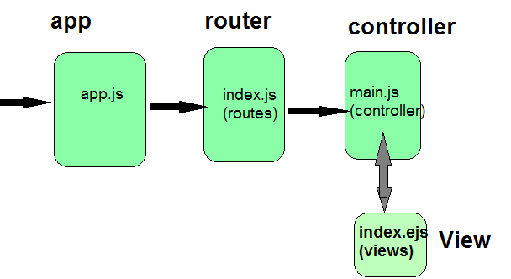
Make the new controller file main.js in controllers directory
/*/* GET home page. */ module.exports.index = function(req, res, next) { res.render('index', { title: 'CS at CSUEB' }); };
NOTE: defining the function with the tag module.exports.index exports the function under the name index. ALSO note that the call in the router will AUTOMATICALLY pass the request and response object
NOTE: pass data from controller --> view via JSON format { title: 'CS at CSUEB'} ...generically this is { variableName: 'value' } to pass more separate by commas, for example
{ title: 'CS at CSUEB' , course: 'Web Development', professor: 'L. Grewe' }

Slide 35
Now the view file in the views directory
Here is example of index.ejs that takes in data of "title" <!DOCTYPE html> <html> <head> <title><%= title %></title> <link rel='stylesheet' href='/stylesheets/style.css' /> </head> <body> <h1><%= title %></h1> <p>Welcome to <%= title %> right now & here</p> </body> </html>
The view accesses data sent from Controller through the variable name. Example <%= title >

Slide 36
Different example of view reading in data
getAllRoutes.ejs view that expects rows of entries (an array) from the Routes database "table" and this data is given to this code in the variable "results"and this code cycles through the rows and displays some of the content (latitude and longitude) <!DOCTYPE html> <html> <head> <title>mLab MongoDB test</title> <link rel='stylesheet' href='/stylesheets/style.css' /> </head> <body> <div class="container"> <h2>Database Results getting Routes </h2> <ul> <% results.forEach(function(r) { %> <li><%= r.name %> - <%= r.frequency %> From:(<%=r.START_Longitude %>, <%=r.START_Latitude %> ) TO:(:(<%=r.END_Longitude %>,<%=r.END_Latitude %>) </li> <% }); %> </ul> </div> </body></html>

Slide 37
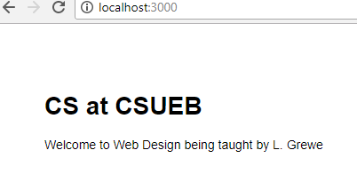
More on sending data from controller to view
Nesting Data
***** in main.js file in controllers directory
/* GET home page. */ module.exports.index = function(req, res, next) { res.render('index', { title: 'CS at CSUEB’,
courseInfo: {
name: 'Web Design’,
professor: 'L. Grewe’
}
}); };
Here is example of index.ejs that takes in data of "title" and nested "courseInfo" <!DOCTYPE html> <html> <head> <title><%= title %></title> <link rel='stylesheet' href='/stylesheets/style.css' /> </head> <body> <h1><%= title %></h1> <p>Welcome to the course <%= courseInfo.name %> which is beging taught by <%= courseInfo.professor %> </p> </body> </html>

Slide 38
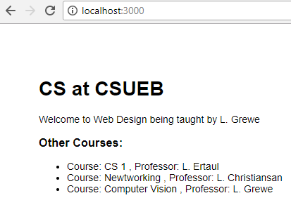
sending array data controller to view
/***** in main.js file in controllers directory /* GET home page. */ module.exports.index = function(req, res, next) {
res.render('index’, {
title: 'CS at CSUEB’,
courseInfo: { name: 'Web Design', professor: 'L. Grewe’ },
otherCourses : [ { name: 'CS 1', professor: 'L. Ertaul’},
{ name: 'Newtworking', professor: 'L. Christiansan’},
{ name: 'Computer Vision', professor: 'L. Grewe' } ]
}); };
Here is example of index.ejs that takes in data of "title" and nested "courseInfo" and the array otherCoursesand displays them
<!DOCTYPE html> <html> <head> <title><%= title %></title> <link rel='stylesheet' href='/stylesheets/style.css' /> </head> <body> <h1><%= title %></h1> <p>Welcome to the course <%= courseInfo.name %> which is beging taught by <%= courseInfo.professor %> </p> <h3> Other Courses: </h3> <ul> <% otherCourses.forEach(function(r) { %> <li> Course: <%= r.name %> , Professor: <%=r.professor %> </li> <% }); %> </ul> </body> </html>
.....typically this data will come from a database query or some kind of dynamic data retrieval but, to show that you can hard code an array in the controller here is an example

Slide 39
Model
When we talk about databaseswill revisit this

Slide 40
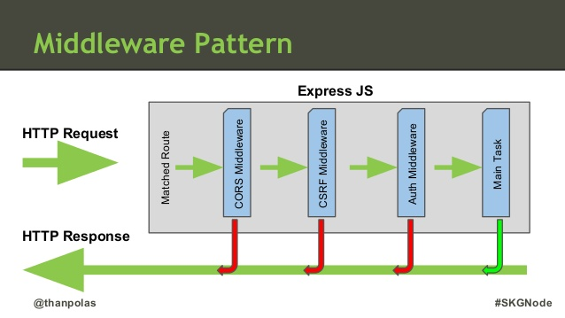
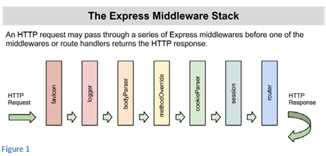
Feature 5
MIDDLEWARE

Slide 41
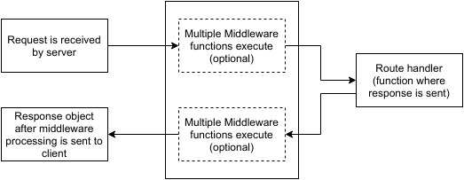
FEATURE 5: Middleware
A number of functions executed PRIOR to the handler

Slide 42
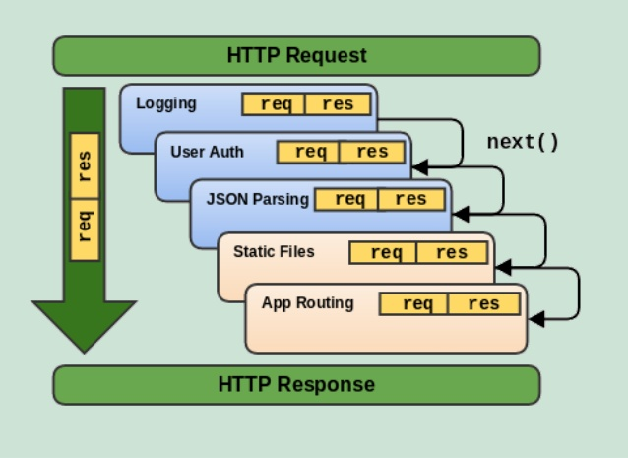
Middleware
function which takes as parameters: req, res and next function

Slide 43
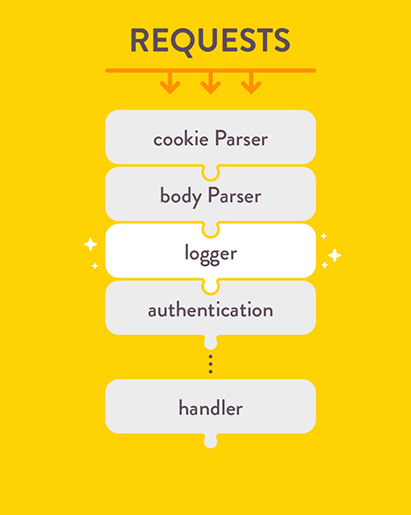
Middleware examples
Has code to process requests & perform other middleware operations:
Cookies
Body parsing
Logging
Authentication
Your code must declare their use
var app = express();
app.use(cookieParser());
app.use(bodyParser());
app.use(logger());
app.use(authentication());
app.get('/', function (req, res) { // ...});
app.listen(3000);

Slide 44
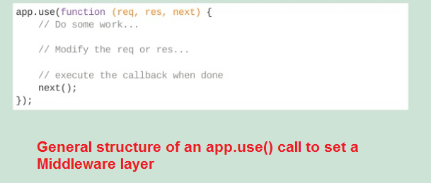
What is app.use() ????
app.use() = specify middleware to execute (can call multiple times)
EXAMPLE 1: middleware that is called ALWAYS regardless of URI request
var express = require('express');
var app = express();
//Simple request time logger
app.use(function(req, res, next){
console.log("A new request received at " + Date.now());
//This function call is very important. It tells that more processing is
//required for the current request and is in the next middleware function/route handler. next(); });
Remember this inside a routing file in routes directory

Slide 45
app.use() example 2
if have a get request for / will first execute myLogger then go to app.get handler function that sends
‘Hello World1’
var express = require('express');
var app = express();
var myLogger = function (req, res, next) { console.log('LOGGED');
next(); }
app.use(myLogger);
app.get('/', function (req, res) { res.send('Hello World!') });
app.listen(3000)

Slide 46
app.use() example 3
var express = require('express');
var app = express();
//Middleware function to log request protocol
app.use('/things', function(req, res, next){
console.log("A request for things received at " + Date.now());
next(); });
//Route handler that sends the response
app.get('/things', function(req, res){ res.send('Things'); });
app.listen(3000);
where you call middleware only if URI is /things
then will go next to app.get handler code which sends ‘Things’ string

Slide 47
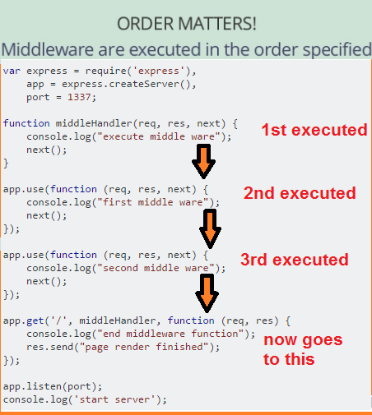
Order in app.use() is important
In order of
appearance of code in route file

Slide 48
A specific middlware example
FORM PROCESSING

Slide 49
Middleware – Form Processing
NEW package.json
{ "name": "nodejsexpresswebstorm", "version": "0.0.0", "private": true, "scripts": { "start": "node ./bin/www" }, "dependencies": { "body-parser": "^1.17.2", "cookie-parser": "~1.4.3", "debug": "~2.6.3", "ejs": "~2.5.6", "express": "~4.15.2", "mongodb": "^2.2.31", "morgan": "~1.8.1", "multer": "^1.3.0", "serve-favicon": "~2.4.2" } }
STEP 1: install body-parsers and multer packages
*** assumming you have already created a basic express applicaiton project *****
install the body-parser(for parsing JSON and url-encoded data) and multer(for parsing multipart/form data) middleware.
GO to your terminal window in application and type
npm install --save body-parser multer

Slide 50
Form Processing – Body parser
This is used to parse the body of requests which have payloads attached to them. To mount body parser, we need to install it using npm install --save body-parser and to mount it, include the following lines in your index.js:
To view all available options for body-parser, visit its github page.
var bodyParser = require('body-parser');
//To parse URL encoded data
app.use(bodyParser.urlencoded({ extended: false }));
//To parse json data
app.use(bodyParser.json());

Slide 51
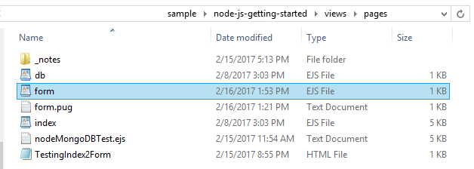
From processing – example
<!DOCTYPE html> <html> <head> Testing Form data</head>
<body>
hello <br><br>
<form action="/processForm", method="POST“>
<div> <label> Say</label>
<input type="text" name="say" value="hi"> <br/>
<label> TO:</label>
<input type="text" name="to" value="express forms">
<input type="submit" value="send greetings">
</div>
</form> </body> </html>
This is the form

Slide 52
The router code (e.g. index.js inside the Routers directory)
//*****new index.js file /** simple index to use following middleware bodyparser= for parsing JSON and url-encoded data multer = for parsing multi-part/form data */ var express = require('express’); var bodyParser = require('body-parser’); var multer = require('multer’); var path = require ('path’); //to work with separtors on any OS including Windows var upload = multer(); var app = express(); app.set('view engine', 'ejs’); app.set('views', path.join(__dirname + '/views’)); //path.join -resolve OS file separators app.use(express.static(path.join(__dirname + '/public'))); app.use(bodyParser.json()); // for parsing application/json app.use(bodyParser.urlencoded({ extended: true })); // for parsing application/x-www-form-urlencoded app.use(upload.array()); // for parsing multipart/form-data app.use(express.static('public’)); var controllerMain = require('../controllers/main’); //this will load the controller file controllerMain.js app.get('/', controllerMain.processForm); //calls the controller code

Slide 53
main.js controller function processForm
Inside the Controllers directory
module.exports.processForm = function(req, res){ console.log(req.body);
var body = JSON.stringify(req.body);
var params = JSON.stringify(req.params);
var value_tofield_formdata = req.body.to;
var value_sayfield_formdata = req.body.say;
res.send("recieved your request!</br>" + "parameters: " + params + "</br>URL:" +
req.url + "<br>body: " + body + "<br>the -to- form field = " +
value_tofield_formdata + "<br> the -say- form field = " +
value_sayfield_formdata);
});
//ANY GET request to /form render the form.ejs file from STEP 2
app.get('/form', function(req, res){ console.log(req.body);
res.render('pages/form’);
});

Slide 54
Running it
Output prints out data that is sent in body

Slide 55
More about form processing
req.params.name_of_param
The req object represents the HTTP request and has properties for the request query string.
For example:
app.get('/user/:id', function(req, res) { res.send('user ' + req.params.id);
req.baseUrl, req.body, req.cookies (req.cookies.name_of_cookie),
req.hostname, req.path, etc see documentation
NOTE: if you want to see the body of the request for printing it out do the following
console.log(JSON.stringify(req.body));
if you do the following will brint out a "Object"
console.log(req.body);
For example the following handler code:
var body = JSON.stringify(req.body); var params = JSON.stringify(req.params);
res.send("recieved your request!</br>" + "parameters: " + params + "</br>URL:" + req.url + "body: " + body);
will produce S

Slide 56
Another middleware example Authentication
A super simple example

Slide 57
Authentication
this is the process of confirming some person's identity
HOW? there are many ways including some very popular 3rd party standard you can get software for like OAuth. There are services like Google login etc that can also be used
WHAT ARE WE DOING HERE? -- showing some simple code that:
1) Sign UP: a capability that lets the user specify a unique ID and a password. This data is read from a signup.ejs form data and compares to what has been done before..... This information is stored in the session --you would want in reality a BETTER SOLUTION --like using a database
2) Log IN: if the user has specified thier userid and password, they can bring up /login (login.ejs) form to log in. It compares the userid with the session information and if present lets them login
3) Protected Page: the user can access the /protectedpage url if the user has logged in. If not they are given an error message.

Slide 58
STEP 1: as using sessions and cookies must install modules
GO TO application directory and type
npm install --save cookie-parser
npm install --save express-session

Slide 59
STEP 2: create various forms/pages: signup.ejs, login.ejs, protected_page.ejs and put in views/pages directory
signup.ejs <!DOCTYPE html> <html> <head> <title>Signup Form</title> </head> <body> Sign UP Form <br><br> <form action="/login", method="POST") <div> <label> UserID</label> <input type="text" name="id" value="enter id"><br/> <label> Password:</label> <input type="text" name="password" value="enter password"> <input type="submit" value="Sign Up"> </div> </form> </body> </html>

Slide 60
login.ejs <!DOCTYPE html> <html> <head> Login Form </head> <body> Login Form <br><br> <form action="/login", method="POST") <div> <label> UserID</label> <input type="text" name="id" value="enter id"> <br/> <label> Password:</label> <input type="text" name="password" value="enter password"> <input type="submit" value="Log in"> d</div> </form> </body> </html>
protected_page.ejs --grabs varible id sent to it <!DOCTYPE html> <html> <head> <title>Protected page</title> </head> <body> Protected Page <br><br> Hey <%= JSON.stringify(id) %> </body>

Slide 61
Router file index.js
var cool = require('cool-ascii-faces’); var express = require('express’); var app = express(); var pg = require('pg’); var bodyParser = require('body-parser’); var multer = require('multer’); var path = require ('path’); //to work with separtors on any OS including Windows var session = require('express-session’); var cookieParser = require('cookie-parser’); var upload = multer(); //more code then ********** //process any cookie or session info app.use(cookieParser()); app.use(session({secret: "Your secret key"})); //start session with a session variable secret app.use(bodyParser.json()); // for parsing application/json app.use(bodyParser.urlencoded({ extended: true })); // for parsing application/x-www-form-urlencoded app.use(upload.array()); // for parsing multipart/form-data //Call controllers app.get(‘/signup', controllerMain.signupRepeat); app. post(‘/signup', controllerMain.singup); app.get(‘/login', controllerMain.loginRepeat); app.post(‘/login', controllerMain.login); app.post(‘/logout', controllerMain.logout); app.get(‘/protected_page’, checkSignIn, controllerMain.protectedpage);

Slide 62
What is this checkSignIn
//FUNCTION used below to check if logged in, will be session variable called user
function checkSignIn(req, res, next){
if(req.session.user){
next(); //If session exists, proceed to page }
else {
var err = new Error("Not logged in!");
console.log(req.session.user);
next(err); //Error, trying to access unauthorized page! }
}
this is function inside index.js route file
It is a function defined in same route file index.j’s and it is used in the following code
app.get(‘/protected_page’, checkSignIn, controllerMain.protectedpage);
which means only execute the controller function only if this function succeeds

Slide 63
controllerMain.js → signupRepeat and loginRepeat function
//this function calls the static page signup
// because we do not allow get requests to get
module.exports.signupRepeat = function(req, res){
res.render('pages/signup', {id: req.session.user.id})
});
//this function calls the static page login
// because we do not allow get requests to get
module.exports.loginRepeat = function(req, res){
res.render('pages/login', {id: req.session.user.id})
});
this is function inside controllerMain.js file in controllers directory

Slide 64
controllerMain.js → signup function
//Handler for POST URI /signup that expects in the req object data of id and password
// sent to it. If not it sends 400 status. If both are sent then (stupidly—this
// is a simple example) checks if have seen id before (in Users[]) tells user
// to choose another id. Otherwise, adds user id and password to a Users[] array..
var Users = [];
module.exports.signup =
function(req, res){
if(!req.body.id || !req.body.password)
{ res.status("400"); res.send("Invalid details!"); }
else
{ Users.filter(function(user){
if(user.id === req.body.id){
res.render('signup’,
{message: "User Already Exists! Login or choose another user id"});
}
});
var newUser = {id: req.body.id, password: req.body.password};
Users.push(newUser);
console.log(JSON.stringify(newUser));
req.session.user = newUser;
res.redirect('/protected_page’);
}
});
this is function inside controllerMain.js file in controllers directory

Slide 65
controllerMain.js → login function
//Handler for POST URI /login that expects results from html form login.ejs
// including data of id and password. If present checks if the user has
// previously signed up and both user id and password match with what was specified
// and stored in Users[] array. If so redirects to /protected_page URI. If id/password
// do not match redirects to login.ejs form in views/pages
module.exports.login =
function(req, res){
console.log(Users);
if(!req.body.id || !req.body.password){
res.render('pages/login', {message: "Please enter both id and password"});
}
else{
Users.filter(function(user){
if(user.id === req.body.id && user.password === req.body.password){
req.session.user = user;
res.redirect('/protected_page’);
}
});
res.render('pages/login', {message: "Invalid credentials!"});
}
});
this is function inside controllerMain.js file in controllers directory
Remember Users[]
array is previously defined in this controller file

Slide 66
controllerMain.js → protectedpage function
this is function inside controllerMain.js file in controllers directory
//this function calls the protected_page.ejs view
// and passes the user’s id stored as a session variable
module.exports.protectedpage = function(req, res){
res.render('pages/protected_page', {id: req.session.user.id})
});

Slide 67
controllerMain.js → logout function
//this function calls the login URI
// and first destroys the session
module.exports.logout = function(req, res){
req.session.destroy( function(){
console.log(“user logged out”);
});
res.render(‘/login’);
});
this is function inside controllerMain.js file in controllers directory

Slide 68
Running it
For ease both login and signup go to same protected page

Slide 69
FEATURE 6
Specification of static files location (for potentially faster and direct serving)

Slide 70
FEATURE 6: separates static files & serves them directly through URIs
below indicates the public subdirectory in main application directory contains the static files
app.use(express.static('public'))
Now, you can load the files that are in the public directory: (assuming listing at port 3000)
http://YOURSERVER:3000/images/kitten.jpg
http://YOURSERVER:3000/css/style.css
http://YOURSERVER:3000/js/app.js
http://YOURSERVER:3000/images/bg.png
http://YOURSERVER:3000/hello.html
This code is in the www.js file –the main app executable code
Express looks up the files relative to the static directory, so the name of the static directory is not part of the URL.

Slide 71
More static files
To use multiple static assets directories, call the express.static middleware function multiple times:
app.use(express.static('public'));
app.use(express.static('files'));
Virtual URI:
To create a virtual path prefix (where the path does not actually exist in the file system) for files that are served by the express.static function, specify a mount path for the static directory, as shown below:
app.use('/static', express.static('public'))
Now you can execute URIs
http://localhost:3000/static/images/kitten.jpg
This code is in the www.js file –the main app executable code

Slide 72
There are more features
That for your future reading or reading as you need.

