Slide 1
Git – versioning and managing your software
L. Grewe

Slide 2
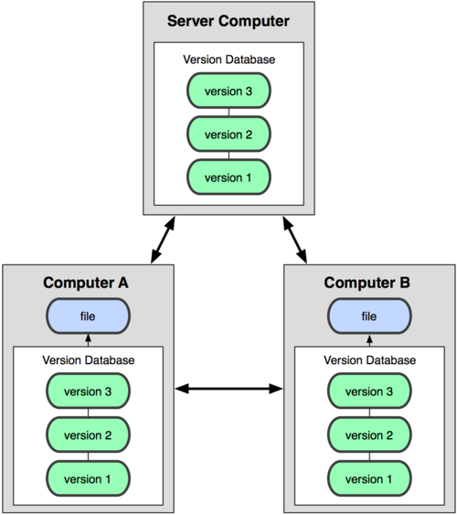
What is Git?
GIT = is a distributed revision control system for software.
there are a number of free resources to use GIT and host remotely your code - GitHub and Bitbucket are popular
you can also buy commercial versions
Created by Linus Torvalds for work on the Linux kernel ~2005
Actually implements a replicated versioned file system

Slide 3
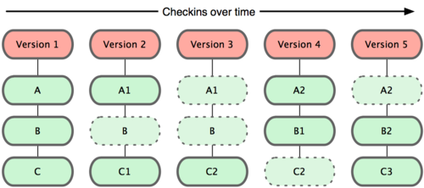
The concept
Git maintains versions of software over time

Slide 4
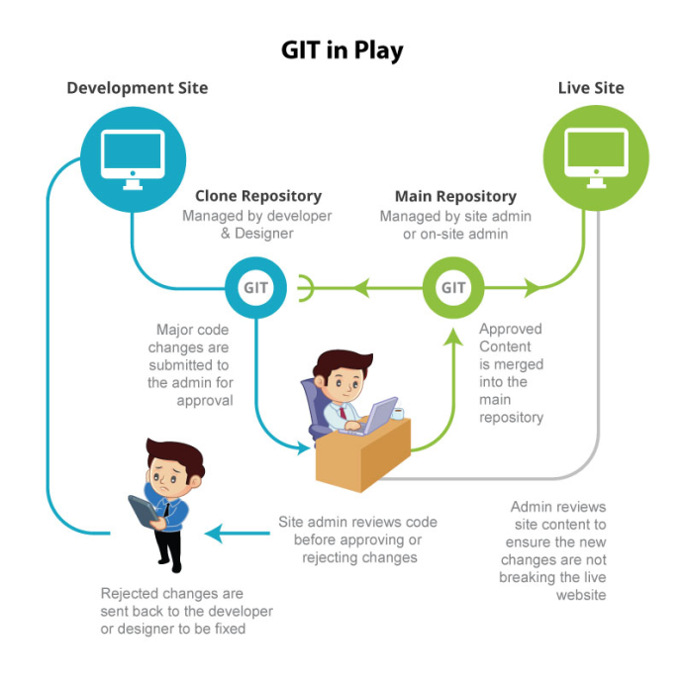
The concept
you have code on your local development machine (local git repository) that you can create versions of and commit to a remote Git repository.
repository = a location storing and mantaining versioned code

Slide 5
The concept

Slide 6
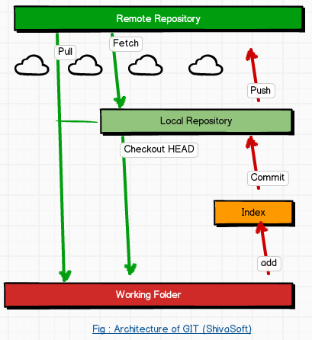
Another view

Slide 7
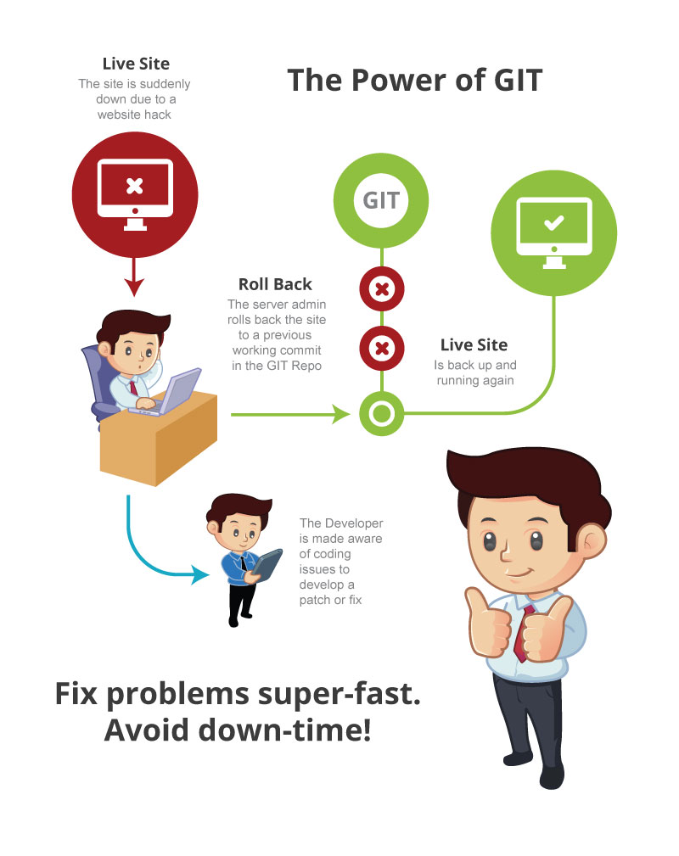
Another powerful use --rollback
Scenario: there is a bug in the code that was committed ---you need to QUICKLY go back

Slide 8
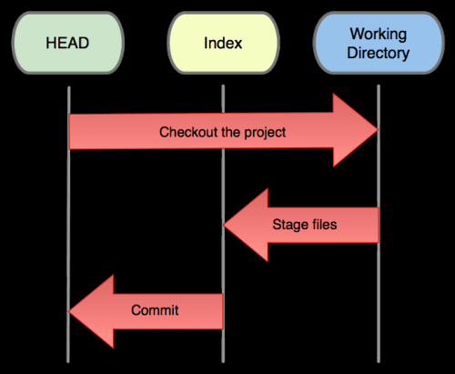
3 roles of Git
The HEAD (master) = last commit snapshot, pointer to the current branch
The Index = proposed next commit snapshot
The Working Directory = sandbox (local machine)

Slide 9
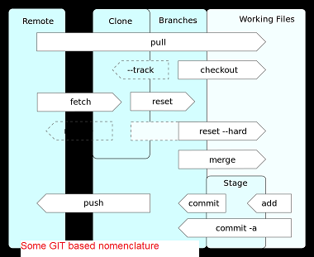
Common operations/ nominclature
Operations to submit/get code
Operations to revert code

Slide 10
Operations to submit/get code
commit = the code is read to submit to repository
push = pushes it to remote repository
pull = gets current code from remote repository
merge = if you are trying to push code that has been pushed more recently than you pulled it by another person -- the Git system will ask you to merge the files and clean up any descrepencies.
scenario - you and Jill pull down the current code and you are both working on a file called doit.java. Jill pushes her changed code first. Then you try to push your code??? you could have changed the code in the same place --what is the system to do. You need to go through the process of merging the code and figuring out what conflicts might exist

Slide 11
Operations to revert/undo to previous
checkout = if you want to revert to a previous version BEFORE you have committed any changes
revert = if you want to undo a certain commit
Sometimes you'll want to undo a certain commit. E.g. when you notice that your changes were wrong, when you introduced a bug, or simply when the customer has decided he doesn't want this anymore
reset = if you want to go to a previous version but, not remove the commits ---basically it resets the HEAD(master) to an older branch

Slide 12
Groups of Git commands
Setup and branch management
init, checkout, branch
Modify
add, delete, rename, commit
Get information
status, diff, log
Create reference points
tag, branch

Slide 13
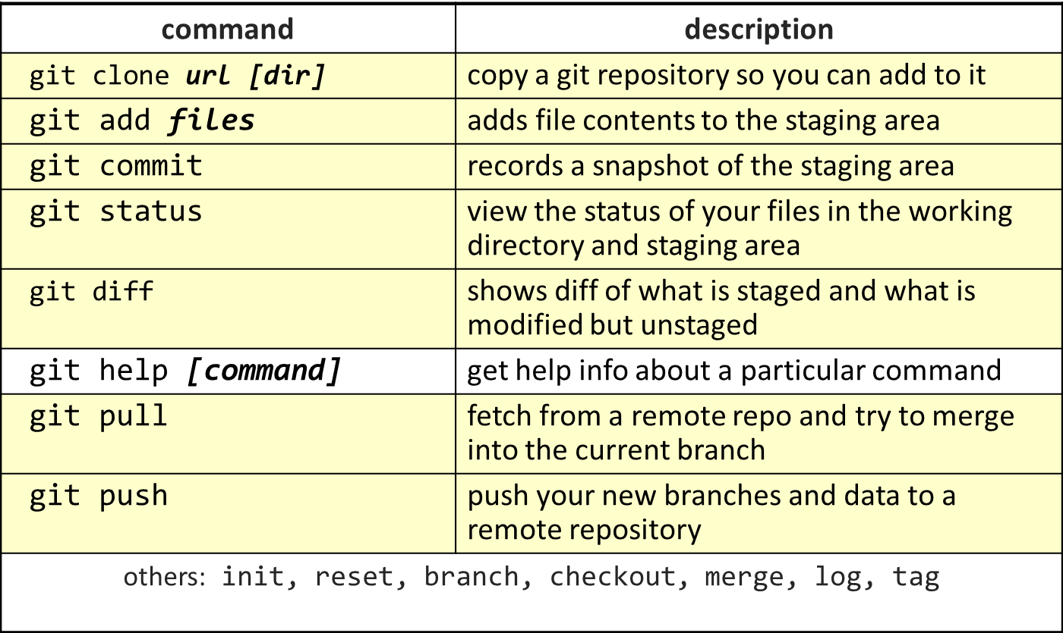
Some of the operations

Slide 14
Branching
The next step

Slide 15
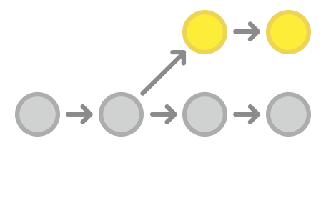
Branching the concept
Sometimes you want to have two different paths the development of your software can go.
Example: maybe you want to have a version for your corporate customers and a different version for your military customers
It lets you create isolated development environments within a single repository.

Slide 16
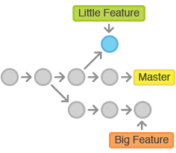
Another use of branches
Want to add a new feature or fix a
you can spawn a new branch to encapsulate your changes.
makes sure unstable code is never committed to the main code base, and it gives you the chance to clean up your feature’s history before merging it into the main branch.

Slide 17
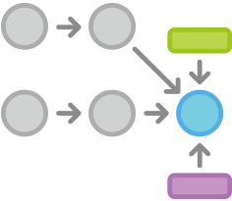
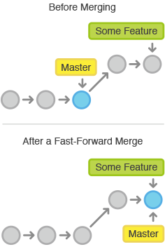
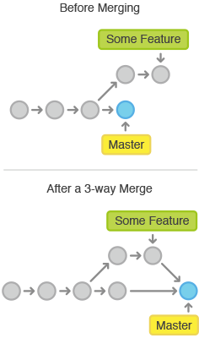
You can merge a branch into the master
Using the merge command you can merge a branch back into the master
Different kinds of merging

Slide 18
Lets look at some operations

Slide 19
Branches – the master is your first branch
NOTE: we are showing you the command line interface for git.. Note you can use GUI GIT tools for local repositories like SourceTree or others.
master
A
> git commit –m ‘my first commit’
Notes:
Now lets see what this visually looks like.
On my first commit I have A.
The default branch that gets created with git is a branch names Master.
This is just a default name. As I mentioned before, most everything in git is done by convention. Master does not mean anything special to git.

Slide 20
Adding commits to master
master
A
B
C
NOTE: we are showing you the command line interface for git.. Note you can use GUI GIT tools for local repositories like SourceTree or others.
> git commit *****
Notes:
We make a set of commits, moving master and our current pointer (*) along

Slide 21
Creating a New Branch and having master point to it
NOTE: we are showing you the command line interface for git.. Note you can use GUI GIT tools for local repositories like SourceTree or others.
master
A
B
C
At end of checkout master (start) points to bug123 branch
bug123
> git branch bug123 > git checkout bug123
OR short cut
> git checkout –b bug123
Notes:
Suppose we want to work on a bug. We start by creating a local “story branch” for this work.
Notice that the new branch is really just a pointer to the same commit (C) but our current pointer (*) is moved.

Slide 22
Continuing commits –will be where the head is pointing to –which is our bug123 branch
master
The commits are going to bug123
A
B
C
D
E
bug123
> git commit ******
Notes:
Now we make commits and they move along, with the branch and current pointer following along.

Slide 23
Lets point back to master
master
A
B
C
D
E
bug123
> git checkout master
Notes:
We can “checkout” to go back to the master branch.
This is where I was freaked out the first time I did this. My IDE removed the changes I just made. It can be pretty startling, but don’t worry you didn’t lose anything.

Slide 24
Now we want to merge bug123 into our head (current pointing to master)
master
A
B
C
D
E
bug123
> git merge bug123
Notes:
And then merge from the story branch, bringing those change histories together.

Slide 25
The results of merging
master
A
B
C
D
E
Now lets delete our branch bug123
> git branch -d bug123
Notes:
And since we’re done with the story branch, we can delete it. This all happened locally, without affecting anyone upstream.

Slide 26
Another use scenario
Let’s consider another scenario. Here we created our bug story branch back off of (C). But some changes have happened in master (bug 123 which we just merged) since then.
And we made a couple of commits in bug 456.

Slide 27
Our starting place
master
A
B
C
D
E
F
G
bug456
Notes:
Let’s consider another scenario. Here we created our bug story branch back off of (C). But some changes have happened in master (bug 123 which we just merged) since then.
And we made a couple of commits in bug 456.

Slide 28
Check out master so we can merge next
master
A
B
C
D
E
F
G
bug456
> git checkout master
Notes:
Again, to merge, we checkout back to master which moves our (*) pointer.

Slide 29
Merge bug456 branch into head (master)
master
A
B
C
D
E
H
And now we merge, connecting the new (H) to both (E) and (G). Note that this merge, especially if there are conflicts, can be unpleasant to perform.
F
G
bug456
> git merge bug456
Notes:
And now we merge, connecting the new (H) to both (E) and (G). Note that this merge, especially if there are conflicts, can be unpleasant to perform.

Slide 30
The results
master
A
B
C
D
E
H
F
G
Cleanup- delete branch bug456
> git branch -d bug456
Notes:
Now we delete the branch pointer.
But notice the structure we have now. This is very non-linear. That will make it challenging to see the changes independently. And it can get very messy over time.

Slide 31
Working in teams with Git
How it can help you….

Slide 32
Working as a team
Tom’s Repo
Matt’s Repo
A
B
C
A
B
C
Everyone has initially the same code on their local machines –checked out from remote master repository
My Local Repo
Tracey’s Repo
A
B
C
A
B
C
Notes:
Since everyone on the team has a complete copy of the repository you can do things like this.
But no one wants to keep track of changes this way.

Slide 33
Here we are working and we are sharing the remote repository
Tom’s Repo
Matt’s Repo
A
B
C
D
A
B
C
D
Remote Repo
A
B
C
D
My Local Repo
Tracey’s Repo
A
B
C
D
A
B
C
D
Notes:
There really is nothing special about the remote server. You can have more than one. But it enables a nice integration location, just like you are used to in the centralized version control

Slide 34
What will we do….
The next step

Slide 35
What we will use: BitBucket for remote GIT, eGit for support in Eclipse, local client SourceTree
https://bitbucket.org/ for details (try setting up the tutorial example and download SourceTree as part of it). SourceTree can be found directly at http://sourcetreeapp.com/
See class website for tips on how to setup and of course the websites for each product.

Slide 36
ADVICE: Git has a lot of commands
Learn a core subset of them
Use GUI tools (we use eGit in Eclipse with Bitbucket online remote Git repository)
Then learn the rest as you need them

Slide 37
Have you heard of SVN –what is the difference with Git
….hmmmmm

Slide 38
SVN vs. Git
SVN:
central repository approach – the main repository is the only “true” source, only the main repository has the complete file history
Users check out local copies of the current version
Git:
Distributed repository approach – every checkout of the repository is a full fledged repository, complete with history
Greater redundancy and speed
Branching and merging repositories is more heavily used as a result
Conclusion –use Git

Slide 39
Who needs Git?
http://www.geekherocomic.com/2009/01/26/who-needs-git/

