Slide 1
Google Maps API
L. Grewe

Slide 2
Google Maps
Largest Mapping API
One of the most popular web services
Used in many web “mashup” applications
Used on many platforms – also in mobile devices

Slide 3
Google Maps API

Slide 4
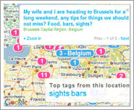
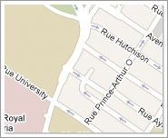
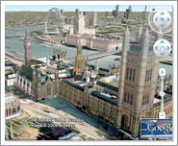
Google Maps API -javascript
Multiple Possibilities
Maps JavaScript API
(http://code.google.com/apis/maps/documentation/javascript/ )
Static Maps API
(http://code.google.com/apis/maps/documentation/staticmaps/ )
Maps API for Flash
Google Earth (3d) API (http://code.google.com/apis/earth/)

Slide 5
Google Maps / GEO Apis

Slide 6
A basic Map in a Web-page

Slide 7
Features of Maps API
Keyless
Designed for multiple platforms including mobile
Styled Maps
Markers
Polygons/Polylines
Geocoding/Driving Directions
Elecvation
Fusion Tables integration

Slide 8
Static Maps
Have no dynamic component but, will display a location – useful for showing where a fixed location is (location of company, etc).
EXAMPLE – Sao Paulo, Brazil with size and zoom given
http://maps.google.com/maps/api/staticmap?sensor=false&size=500x300&zoom=9&center=Sao+Paulo+Brazil

Slide 9
Stylized Static Maps
Append Style information to URL of static map (same location as previous)
http://maps.google.com/maps/api/staticmap?sensor=false&size=500x300&zoom=9&center=Sao+Paulo+Brazil&style=feature:water|saturation:100|hue:0xff5e00|gamma:0.58&style=feature:landscape|invert_lightness:true&style=element:labels|visibility:off&style=feature:poi|hue:0x0800ff|lightness:-70&style=feature:administrative|element:geometry|visibility:off

Slide 10
Dynamic Maps with Google JavaScript Map API
Hello World Example
<!DOCTYPE html> <html> <head> <meta name="viewport" content="initial-scale=1.0, user-scalable=no" /> <style type="text/css"> html { height: 100% } body { height: 100%; margin: 0px; padding: 0px } #map_canvas { height: 100% } </style> <script type="text/javascript" src="http://maps.google.com/maps/api/js?sensor=set_to_true_or_false"> </script> <script type="text/javascript"> function initialize() { var latlng = new google.maps.LatLng(-34.397, 150.644); var myOptions = { zoom: 8, center: latlng, mapTypeId: google.maps.MapTypeId.ROADMAP }; var map = new google.maps.Map(document.getElementById("map_canvas"), myOptions); } </script> </head> <body onload="initialize()"> <div id="map_canvas" style="width:100%; height:100%"></div> </body> </html>

Slide 11
HelloWorld Map explained
Create new instance of LatLng object
function initialize() { var latlng = new google.maps.LatLng(-34.397, 150.644); var myOptions = { zoom: 8, center: latlng, mapTypeId: google.maps.MapTypeId.ROADMAP }; var map = new google.maps.Map(document.getElementById("map_canvas"), myOptions); }
Setup Options for map will create
Create new instance of a Google Map with our options and associated with a div tag in our html body

Slide 12
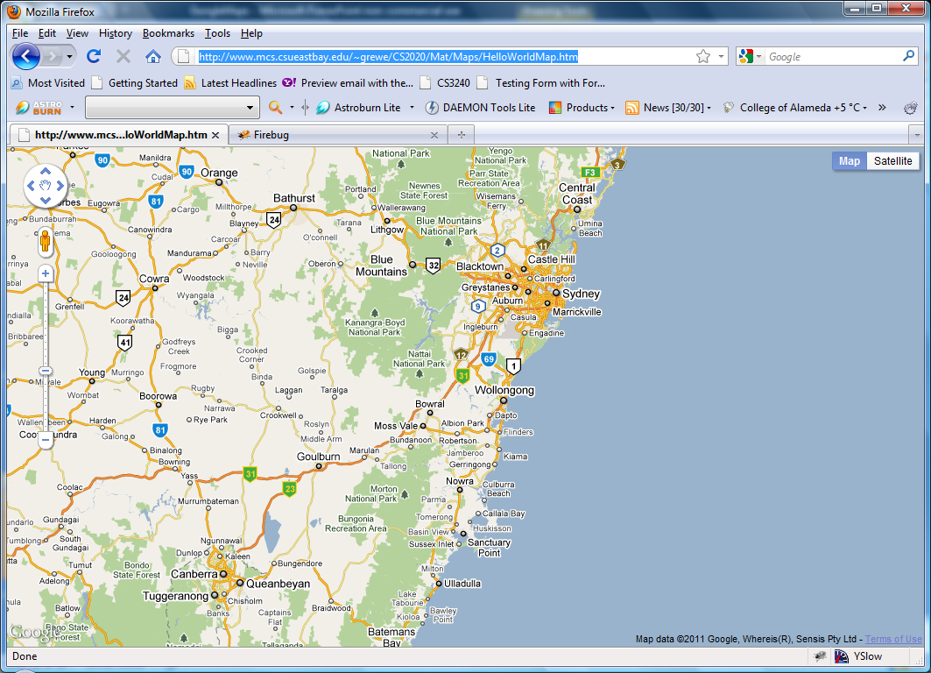
HelloWorld Map example
See course website for other examples
http://www.mcs.csueastbay.edu/~grewe/CS2020/Mat/Maps/HelloWorldMap.htm

Slide 13
Markers
Markers are like map pins showing the location of places of interest in your map.
var map; function initialize() { var myLatlng = new google.maps.LatLng(-25.363882,131.044922); var myOptions = { zoom: 4, center: myLatlng, mapTypeId: google.maps.MapTypeId.ROADMAP } map = new google.maps.Map(document.getElementById("map_canvas"), myOptions); var marker = new google.maps.Marker({ position: myLatlng, map: map, title:"Hello World!" }); }

Slide 14
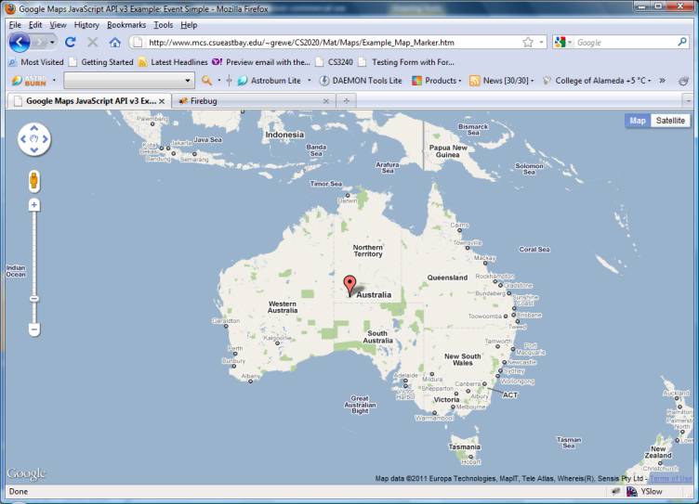
Markers example
See course website for examples and more details on markers
http://www.mcs.csueastbay.edu/~grewe/CS2020/Mat/Maps/Example_Map_Marker.htm

Slide 15
Markers Example with Events – open an InfoWindow (bubble)
var myLatlng = new google.maps.LatLng(-25.363882,131.044922);
var myOptions = {
zoom: 4,
center: myLatlng,
mapTypeId: google.maps.MapTypeId.ROADMAP
}
var map = new google.maps.Map(document.getElementById("map_canvas"), myOptions);
var contentString = '<div id="content">'+
'<div id="siteNotice">'+
'</div>'+
'<h1 id="firstHeading" class="firstHeading">Uluru</h1>'+
'<div id="bodyContent">'+
'<p><b>Uluru</b>, also referred to as <b>Ayers Rock</b>, is a large ' +
'sandstone rock formation in the southern part of the '+
'Northern Territory, central Australia. It lies 335 km (208 mi) '+
'south west of the nearest large town, Alice Springs; 450 km '+
'(280 mi) by road. Kata Tjuta and Uluru are the two major '+
'features of the Uluru - Kata Tjuta National Park. Uluru is '+
'sacred to the Pitjantjatjara and Yankunytjatjara, the '+
'Aboriginal people of the area. It has many springs, waterholes, '+
'rock caves and ancient paintings. Uluru is listed as a World '+
'Heritage Site.</p>'+
'<p>Attribution: Uluru, <a href="http://en.wikipedia.org/w/index.php?title=Uluru&oldid=297882194">'+
'http://en.wikipedia.org/w/index.php?title=Uluru</a> (last visited June 22, 2009).</p>'+
'</div>'+
'</div>';
var infowindow = new google.maps.InfoWindow({
content: contentString
});
var marker = new google.maps.Marker({
position: myLatlng,
map: map,
title:"Uluru (Ayers Rock)"
});
google.maps.event.addListener(marker, 'click', function() {
infowindow.open(map,marker);
});
Create Map
String to be content to be in
“bubble” overlay (InfoWindow) that
will be displayed (opened) when user
clicks on a marker
Create “bubble” InfoWindow
Create Marker
Add Event Listner – when user clicks on marker open the InfoWindow (“bubble”)

Slide 16
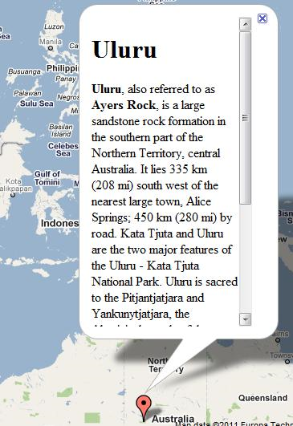
Markers Example with Events – open an InfoWindow (bubble)
Try it at:
http://www.mcs.csueastbay.edu/~grewe/CS2020/Mat/Maps/Example_Map_Marker_InfoWindowOverlay.htm

Slide 17
Stylized Maps
Control look of maps
Change size, color, and visibility of
Points of Interest
Labels
Roads
Water
Borders
and more
Clean up interface
Match the color scheme of your site
Be artistic

Slide 18
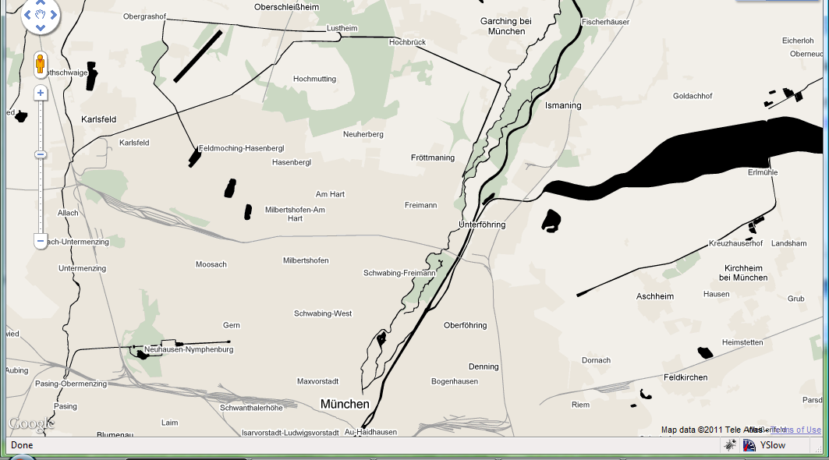
Example Stylized Maps from Google
Black with no roads, http://manomarks.net/stylemap2.html

Slide 19
Code
<!DOCTYPE html> <html> <head> <link href="http://code.google.com/apis/maps/documentation/javascript/examples/standard.css" rel="stylesheet" type="text/css" />
<script type="text/javascript" src="http://maps.google.com/maps/api/js?sensor=false"></script>
<script>
var map; var munich = new google.maps.LatLng(48.198238,11.610663);
var MY_MAPTYPE_ID = 'noroads'; f
unction initialize() { var stylez = [ { featureType: "road", elementType: "all", stylers: [ { visibility: "off" } ] }, { featureType: "poi", elementType: "all", stylers: [ { visibility: "off" } ] }, { featureType: "water", elementType: "all", stylers: [ { saturation: -100 }, { lightness: -100 }, { gamma: 8.79 } ] } ];
var mapOptions = { zoom: 12, center:munich, mapTypeControlOptions: { mapTypeIds: [google.maps.MapTypeId.ROADMAP, MY_MAPTYPE_ID] }, mapTypeId: MY_MAPTYPE_ID };
map = new google.maps.Map(document.getElementById("map_canvas"), mapOptions);
var styledMapOptions = { name: "No Roads" };
var nrMapType = new google.maps.StyledMapType(stylez, styledMapOptions);
map.mapTypes.set(MY_MAPTYPE_ID, nrMapType); }
</script>
</head>
<body onload="initialize()"> < div id="map_canvas" style="width:full; height:100%"></div>
</body> </html>

Slide 20
Example Stylized Maps from Google
Land and Water only http://gmaps-samples-v3.googlecode.com/svn/trunk/styledmaps/examples/style2.html

Slide 21
code
<html> <head> <title>Styles</title>
<script type="text/javascript" src="http://maps.google.com/maps/api/js?sensor=false"></script> <
script type="text/javascript">
var maps; var geocoder;
function init() {
var styles = { 'Dark': [ { featureType: "all", elementType: "all", stylers: [ { invert_lightness: true } ] },{ featureType: "administrative", elementType: "labels", stylers: [ { visibility: "off" } ] },{ featureType: "landscape", elementType: "all", stylers: [ { visibility: "off" } ] },{ featureType: "poi", elementType: "all", stylers: [ { visibility: "off" } ] },{ featureType: "road", elementType: "all", stylers: [ { visibility: "off" } ] },{ featureType: "transit", elementType: "all", stylers: [ { visibility: "off" } ] },{ featureType: "water", elementType: "labels", stylers: [ { visibility: "off" } ] },{ featureType: "water", elementType: "geometry", stylers: [ { lightness: 50 } ] } ] };
for (var s in styles) { var opt = { mapTypeControlOptions: { mapTypeIds: [s] }, disableDefaultUI: true, navigationControl: true, center: new google.maps.LatLng(37.7749295, -122.4194155), zoom: 8, mapTypeId: s };
var div = document.getElementById('map');
var map = new google.maps.Map(div, opt);
var styledMapType = new google.maps.StyledMapType(styles[s], {name: s});
map.mapTypes.set(s, styledMapType); }
}
</script>
<style> body { margin: 0px; padding: 0px; } #map { width: 500px; height: 180px; border: 1px solid black; margin: 0px; padding: 0px; } </style>
</head>
<body onload="init()" id="body"> <div id="map"></div> </body> </html>

Slide 22
Fusion Tables
What are they
How to create and use

Slide 23
Google Maps – Fusion Tables
Data management web application allowing easy host, manage, collaboration on, visualization and publishing of data tables online

Slide 24
Fusion Tables –uploading data
Connect to google and go to fusion tables
Public files can be seen by all.
You can have your own tables

Slide 25
Fusion Tables - visualization
Tools lets you “see” / visualize data

Slide 26
Fusion Table Layer
JavaScript code:
layer = new google.maps.FusionTablesLayer
(someid, {
query: “SELECT address FROM someid WHERE ridership > 5000”}
);
Layer.setMap(map);

Slide 27
Fusion Tables Demos from Google
Bounding Box search
http://gmaps-samples.googlecode.com/svn/trunk/fusiontables/rectangle_example.html

Slide 28
Fusion Tables Demos from Google
Radius Search
http://gmaps-samples.googlecode.com/svn/trunk/fusiontables/circle_example.html

Slide 29
Fusion Tables Demos from Google
Congressional Areas
http://www.google.com/fusiontables/DataSource?dsrcid=290985

Slide 30
Mobile Features

Slide 31
Google Latitude
A mobile app that lets you see where
your friends are on a map and share your
Real location with whomever you choose.
Location continuously & automatically updated
Add friends with whom you share location
Share best available or city-level location
Change privacy settings at any time
Android, BlackBerry, Symbian, Windows Mobile, or
iPhone*
29 countries, 42 languages
8 million+ accounts created & 3 million+ active users

Slide 32
Google Latitude API
Use features of Google Latitude in your app
A simple and secure way for users to use their location in new ways by sharing it with 3rd party developers, apps, and services in addition to their friends.
Why use the Latitude API?
What would you offer your users if they shared their real location with you?
Latitude pushes users’ real location to the cloud so any service – mobile or desktop – can leverage it for location-based features without building a mobile app.
Create smarter features based on users’ location history if enabled

Slide 33
Mobile Apps---use your imagination

