Slide 1
PowerPoint Presentation to Accompany
GO! with Microsoft® Windows 7
Chapter 10
Controlling Computer Security and
Troubleshooting Your Computer

Slide 2
Objectives
Protect Your Computer from Viruses and Spyware
Secure Internet Explorer
Set Parental Controls
Encrypt Files with Encryption File System

Slide 3
Objectives
Troubleshoot Computer Problems
Find and Use Help from Others
Manage Hardware Devices
Remove Malware from Your Computer

Slide 4
Protect Your Computer from Viruses and Spyware
Malware
Shortened term for malicious software
Computer software that intentionally harms your computer
Infected
A computer that has had malware run on it

Slide 5
Protect Your Computer from Viruses and Spyware
Viruses
Malware that spreads from computer to computer
Spyware
Malware that collects personal information, displays advertisements, or changes browser settings

Slide 6
Protect Your Computer from Viruses and Spyware
Worm
Malware that spreads to every computer on a network
Trojan Horse
Malware that hides inside legitimate programs

Slide 7
Protect Your Computer from Viruses and Spyware
Poisoned Web Site
A Web site that spreads a virus
Security Holes
Vulnerabilities in an operating system or program that allow malware to infect a computer without your knowledge

Slide 8
Protect Your Computer from Viruses and Spyware
Patch
A small repair to an operating system or program that closes a security hole
Antivirus Program (Virus Checker)
Scans your computer for known viruses
Attempts to disable and remove viruses from your computer

Slide 9
Protect Your Computer from Viruses and Spyware
Virus Definition
Information needed by the antivirus program to find and remove a virus
Zero-day Exploit
Attack launched shortly after a security hole is publicized

Slide 10
Protect Your Computer from Viruses and Spyware
Peer-to-peer file sharing sites
Allows users to share music, video, and software
Often contain viruses on these sites
Windows Defender
Antispyware included with all versions of Windows 7

Slide 11
Protect Your Computer from Viruses and Spyware
Microsoft Security Essentials (MSE)
Guards against viruses, spyware, Trojans, rootkits, and other malware
Free download
Rootkits
Malware that establishes administrator-level access to a computer

Slide 12
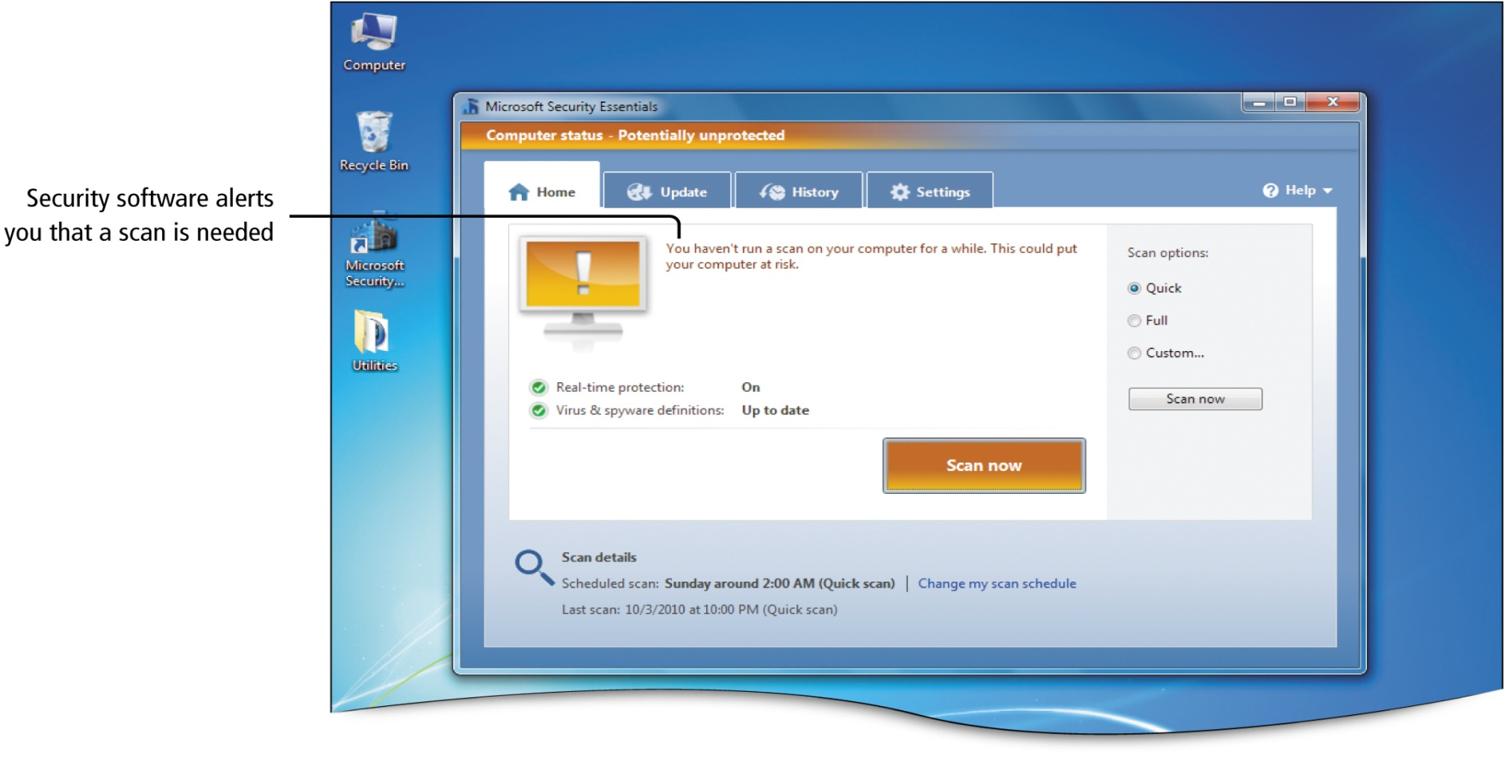
Protect Your Computer from Viruses and Spyware
Notes:
Figure 10.4

Slide 13
Protect Your Computer from Viruses and Spyware
Keystroke Logger
Records your keystrokes and sends them to someone else
Adware
Tracks visited Web sites and delivers advertising matched to your interests

Slide 14
Protect Your Computer from Viruses and Spyware
Antispyware program (spyware checker)
Scans for and attempts to remove spyware

Slide 15
Protect Your Computer from Viruses and Spyware
Installing and Configuring Microsoft Security Essentials to Protect Your Computer from Malware
Microsoft Security Essentials
Free download
Runs by default once installed on a computer running Windows 7
Protects your computer from spyware, adware, rootkits, Trojans, and viruses
Prevents certain Web sites from performing dangerous actions

Slide 16
Protect Your Computer from Viruses and Spyware
Installing and Configuring Microsoft Security Essentials to Protect your Computer from Malware
By default, downloads definitions and runs a quick scan daily
Quick Scan
Checks hard disk areas most likely to contain malware

Slide 17
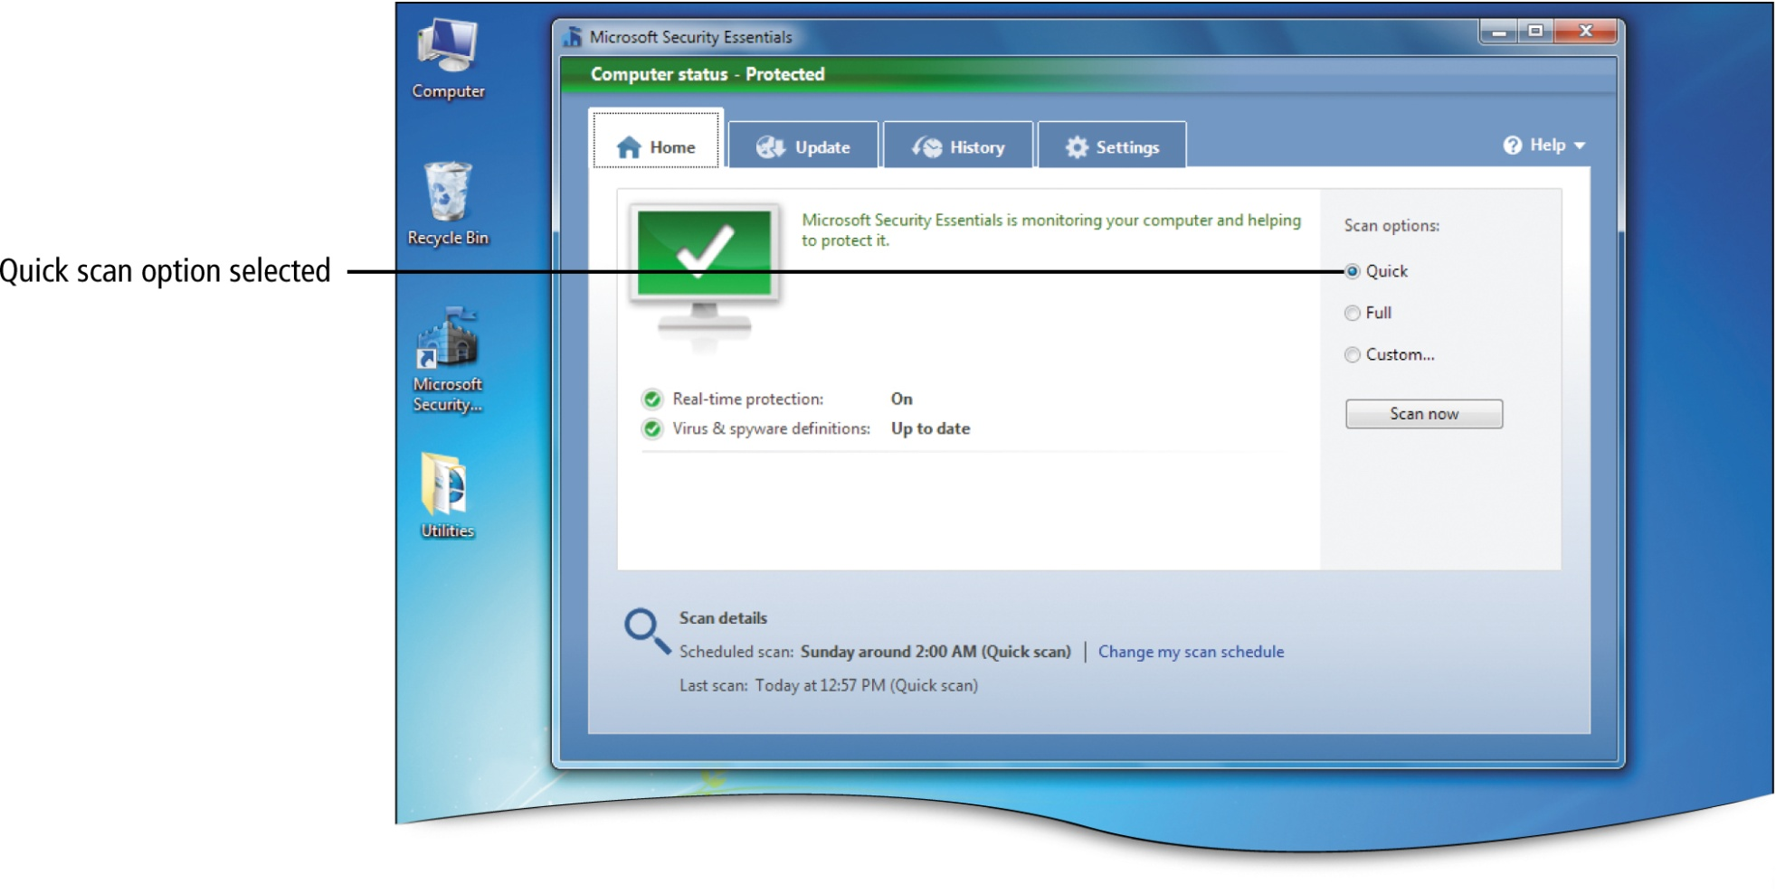
Protect Your Computer from Viruses and Spyware
Notes:
Figure 10.8

Slide 18
Protect Your Computer from Viruses and Spyware
Full Scan
Checks every file on your hard disk(s)
Custom Scan
Searches only drives and or folders that you select

Slide 19
Protect Your Computer from Viruses and Spyware
Quarantine Area
A location on your computer from which a program can not run
If malware is detected, it is placed here and can later be deleted
Microsoft SpyNet
Online community that collects information about decisions you and others make concerning spyware

Slide 20
Secure Internet Explorer
Web Content
Anything you download and use on a Web page such as an HTML code, pictures, small programs, and animations
Script
A program that runs in the browser to add interactive content to the Web page

Slide 21
Secure Internet Explorer
ActiveX Control
Allows another program to run from within the browser
A poisoned Web page may use an ActiveX control to install malware of take control of your computer
Unsigned ActiveX Control
Source cannot be verified

Slide 22
Secure Internet Explorer
Intranet
Web site that serves the local network, but is not available to the general Internet user
Drive-by download
A program installed from a poisoned Web site, without your knowledge, caused by just visiting the site
Common method to install malware on computers

Slide 23
Secure Internet Explorer
Internet Explorer
Protected mode
Displays a message when any program is about to be installed while you are browsing

Slide 24
Secure Internet Explorer
Managing Privacy with Internet Explorer
Cookie
Small text file that saves information about you and your preferences
Third-party cookie
Cookie created by a Web site other than the one you are viewing
Privacy Summary
Displayed in the Privacy Policy dialog box; displays options for allowing cookies

Slide 25
Secure Internet Explorer
Using Pop-up Blockers and SmartScreen Filters to Protect Your Sytems
IP Address
Short for Internet Protocol
Address that identifies a computer connected to a network or the Internet

Slide 26
Secure Internet Explorer
SmartScreen Filter
Determines if a Web site is a phishing site
Secure http (https)
Encrypts data sent between you and a Web server

Slide 27
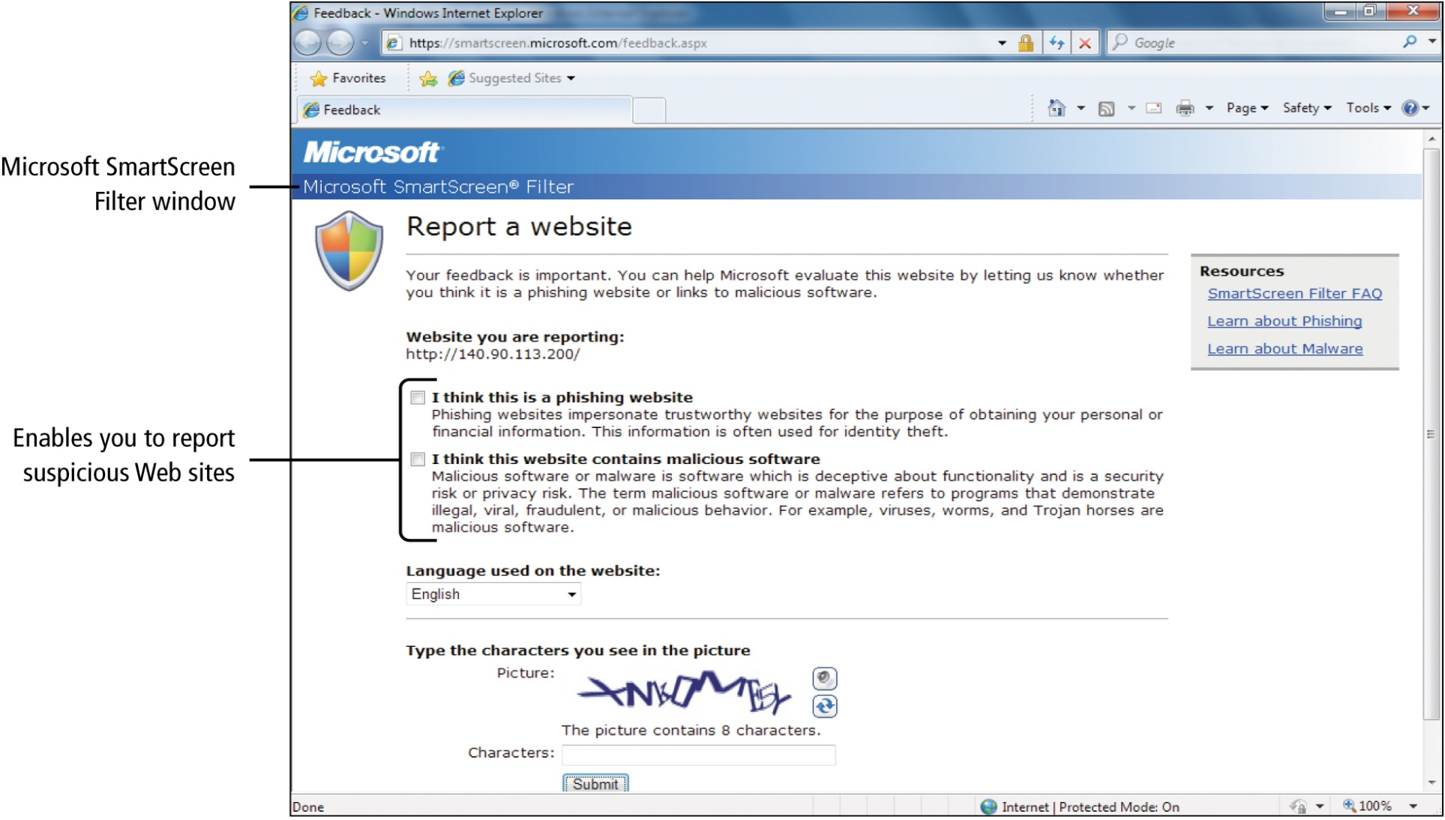
Secure Internet Explorer
Notes:
Figure 10.16

Slide 28
Set Parental Controls
Set Parental Controls
Block Web sites
Set times a child can log on
Control which programs a child can open
Provide an activity report of a child’s computer use

Slide 29
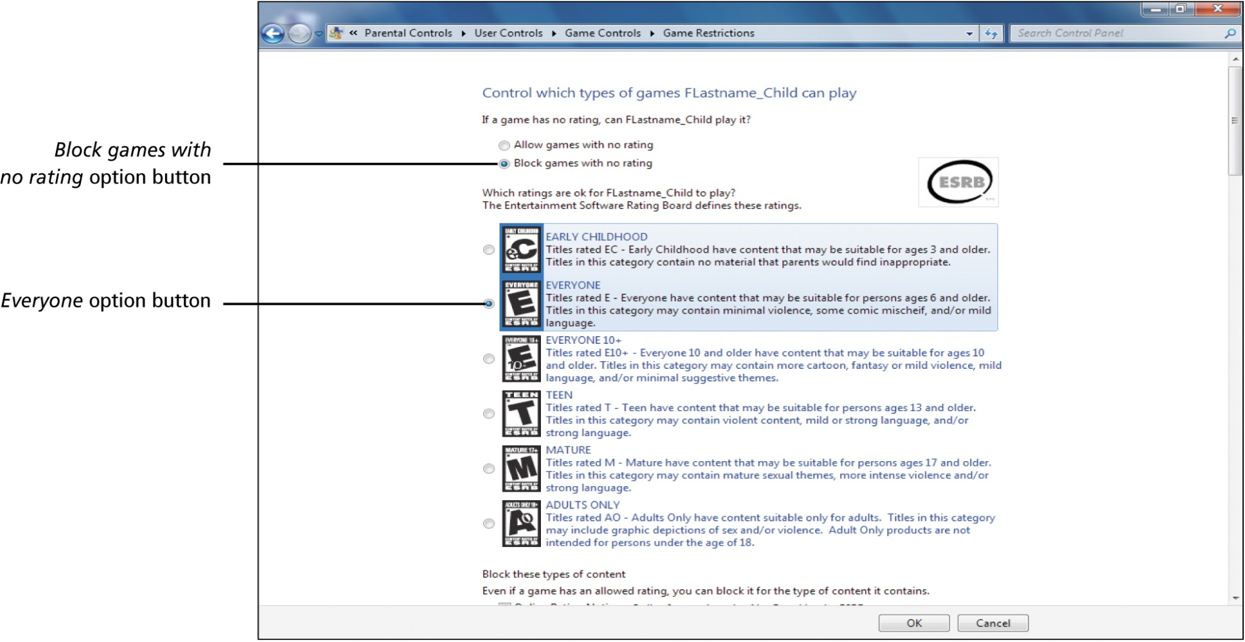
Set Parental Controls
Notes:
Figure 10.21

Slide 30
Encrypt Files with Encryption File System
Encryption File System (EFS)
Allows you to store information on your hard disk in an encrypted format
Not included in the Home Premium edition of Windows 7
Decrypted
File is converted back into its original form
Will be encrypted again when it is closed

Slide 31
Troubleshoot Computer Problems
Event Viewer
Displays detailed information about significant events on your computer
Event log
Record of important events that have happened on your computer
Control Panel, System and Security, Administrative Tools, View event logs

Slide 32
Troubleshoot Computer Problems
Event Viewer
Five event types
Error
Warning
Information
Audit Success
Audit Failure

Slide 33
Find and Use Help from Others
Windows Help and Support
Provides information
Performing maintenance tasks
Solving problems
Start Menu, Help and Support

Slide 34
Find and Use Help from Others
Discussion Forums
Individuals with common interests share information
Thread
A list of discussion topics
Post
Individual message regarding a thread

Slide 35
Find and Use Help from Others
Windows Remote Assistance
Enables two computers to establish a direct connection
Remote Assistance Novice
Displays on the screen of the user needing help
Remote Assistance Expert
Displays on the screen of the user providing help

Slide 36
Manage Hardware Devices
Plug and Play Device (PnP Device)
Windows 7 recognizes the device as soon as it is connected

Slide 37
Manage Hardware Devices
Notes:
Figure 10.34

Slide 38
Manage Hardware Devices
Installing a Plug and Play Device
Windows 7 looks for correct driver
You may have to choose driver if more than one is found
If no driver is found
Install from CD
Download from Internet

Slide 39
Manage Hardware Devices
Configuring Devices Using the Control Panel
Change keyboard settings
Configure sound quality of speakers
Change mouse settings
AutoPlay settings for CD/DVD ROM

Slide 40
Manage Hardware Devices
Adding a Local Printer
Local printer
Plugged directly into your computer
Add Printer wizard
If Plug and Play does not find driver
Default printer
Receives all print commands unless you specify otherwise when printing

Slide 41
Manage Hardware Devices
Device Manager
Provides access to all your computer hardware devices
View information about each device
Identify problems
Change settings

Slide 42
Remove Malware from Your Computer
Antivirus or Antispyware programs
Run regular scans
Symptoms that malware has infected your computer
Slow performing computer
Pop-up ads display while not on the Internet
New icons in your Notification Area for programs you have not installed
Victim of theft identity
Restore System Settings

Slide 43
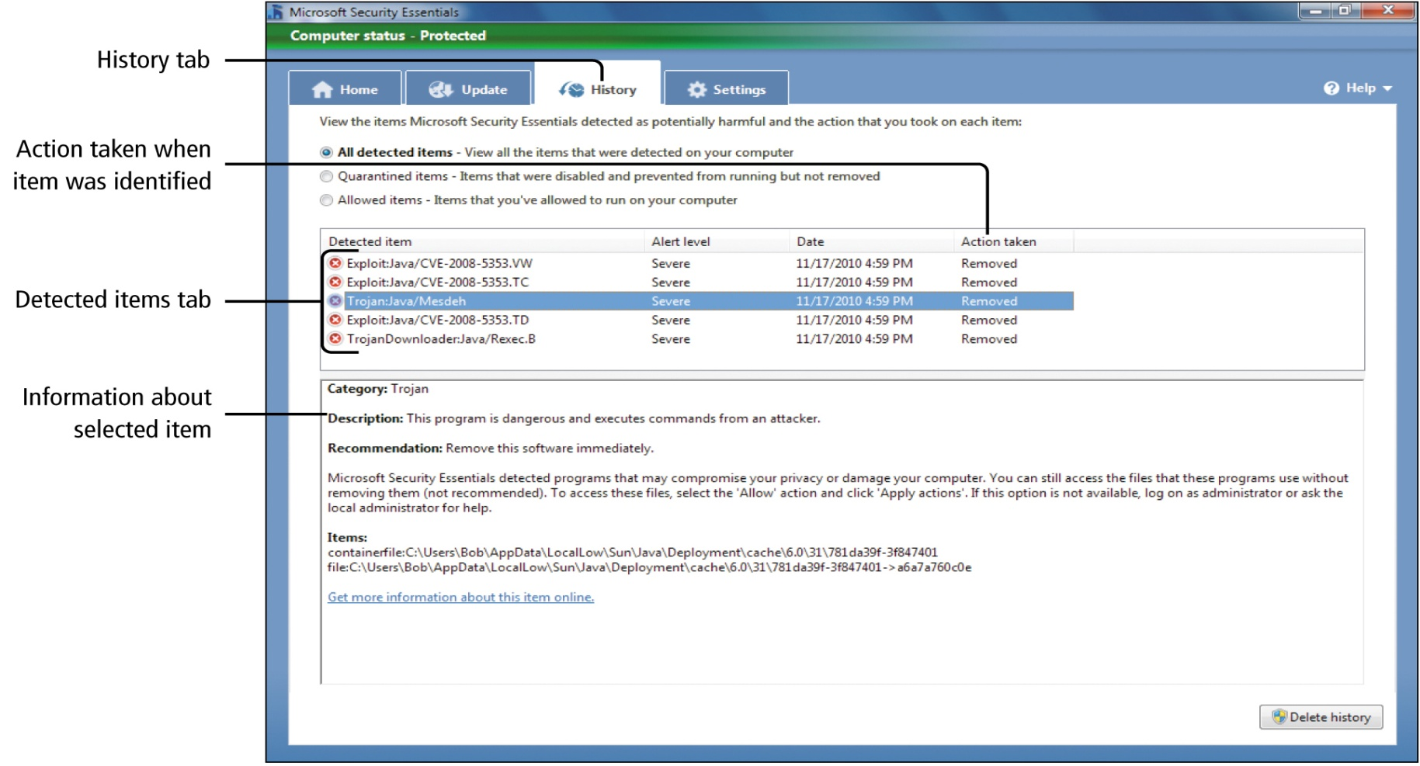
Remove Malware from Your Computer
Notes:
Figure 10.43

Slide 44
Remove Malware from Your Computer
Safe Mode
Startup option where only the most basic operating system processes are started
Many malware programs will not start in this mode
Press and hold F8 after turning your computer on
Removal Tool
Program that removes a specific malware program

Slide 45
Remove Malware from Your Computer
Bootable CD ROM (Boot Disk)
Contains its own operating system
Computer boots from this disk instead of the hard drive
Useful bootable CD ROM disks include Knoppix http://www.knoppix.org and the Ultimate Boot Disk from http://www.ultimatebootcd.com

Slide 46
Remove Malware from Your Computer
Windows Registry
Stores the settings used by Windows 7 and the applications on your computer
Computer boots from this disk instead of the hard drive

Slide 47
Remove Malware from Your Computer
Registry Editor
Used to view and edit the Windows Registry file
Hives
The five major areas of the Registry
Keys
Folders within each hive

Slide 48
Remove Malware from Your Computer
Restoring Internet Explorer
Home page
Delete temporary Internet files
Delete cookies
Clear AutoComplete
Delete browsing history

Slide 49
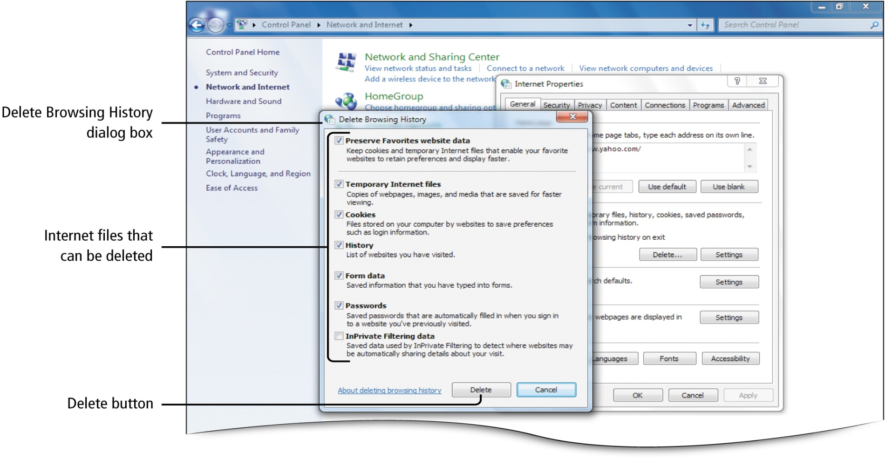
Remove Malware from Your Computer
Notes:
Figure 10.47

Slide 50
Covered Objectives
Protect Your Computer from Viruses and Spyware
Secure Internet Explorer
Set Parental Controls
Encrypt Files with Encryption File System

Slide 51
Covered Objectives
Troubleshoot Computer Problems
Find and Use Help from Others
Manage Hardware Devices
Remove Malware from Your Computer

Slide 52
All rights reserved. No part of this publication may be reproduced, stored in a retrieval system, or transmitted, in any form or by any means, electronic, mechanical, photocopying, recording, or otherwise, without the prior written permission of the publisher. Printed in the United States of America.

