Slide 1
PowerPoint Presentation to Accompany
GO! with Microsoft® Windows 7
Chapter 9
Monitoring and Tracking
System Performance

Slide 2
Objectives
Manage Applications by Using Task Manager
Manage Processes by Using Task Manager
View Services by Using Task Manager
Track Performance by Using Task Manager

Slide 3
Objectives
Track Performance by Using the Performance and Reliability Monitors
View Disks by Using Disk Management
Manage Services by Using the Services Window

Slide 4
Manage Applications by Using Task Manager
Task Manager
Windows 7 tool that displays applications currently running
Programs
Processes
Services

Slide 5
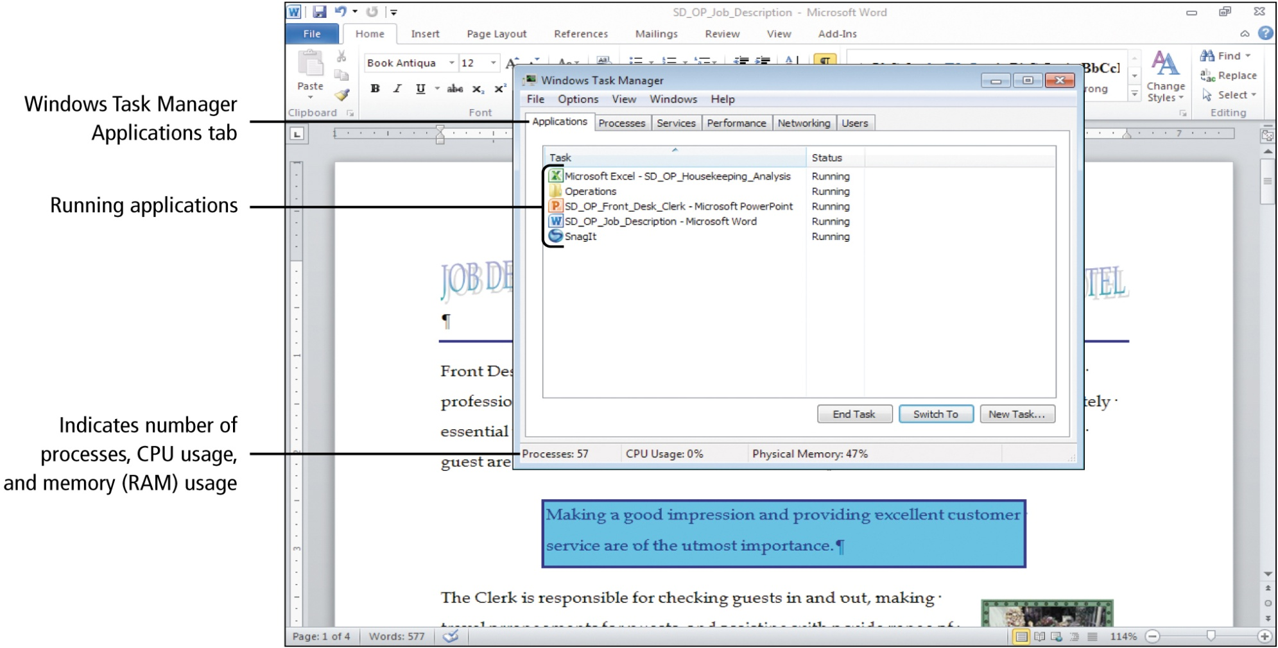
Manage Applications by Using Task Manager
Notes:
Figure 9.2

Slide 6
Manage Applications by Using Task Manager
Process
A file that is part of a running program and performs a specific task such as starting the program
Services
Programs or processes that run in the background

Slide 7
Manage Applications by Using Task Manager
Nonresponsive program
A program that is open but has stopped responding to commands
Can be closed in task manager

Slide 8
Manage Applications by Using Task Manager
Task Manager
Right-click an empty area of the taskbar
Click Start Task Manager on shortcut menu, Applications tab

Slide 9
Manage Processes by Using Task Manager
Viewing Processes by Using Task Manager
Every program on the Applications tab has at least one corresponding process on the Processes tab
Can help to identify malware running on your computer
Always more processes running than applications
Many processes run in the background

Slide 10
Manage Processes by Using Task Manager
System Idle Process
Indicates the amount of CPU capability not being used
Memory (Private Working Set)
Refers to the amount of memory that must be reserved by each process, which is not necessarily the amount of memory currently being used by that process

Slide 11
Manage Processes by Using Task Manager
Threads
Tasks that are processed simultaneously
Higher the thread count, the more resources the CPU must devote to managing the threads
CPU Time
Measures the actual time the processor spends working on a task

Slide 12
Manage Processes by Using Task Manager
Managing Processes by Using Task Manager
Change settings and properties
Dedicate more processor time to a process
End processes that do not display a window or an icon in Notification Area

Slide 13
View Services by Using Task Manager
Windows Task Manager
Display system’s services
Sort the list of services
View the process that is using a specific service

Slide 14
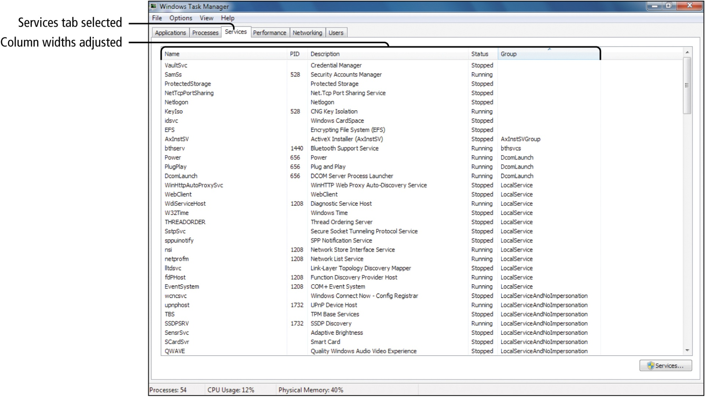
View Services by Using Task Manager
Notes:
Figure 9.15

Slide 15
View Services by Using Task Manager
Process Identifier (PID)
Unique number assigned to each process while it runs
A single process may use several services
Enables each service to focus on small, specific tasks

Slide 16
Track Performance by Using Task Manager
Windows Task Manager
Performance tab
Capture and chart statistics
CPU Usage and Memory panes provide a graphical representation of the performance statistics
CPU Usage History and Physical Memory Usage History panes chart performance statistics over time at one-second intervals

Slide 17
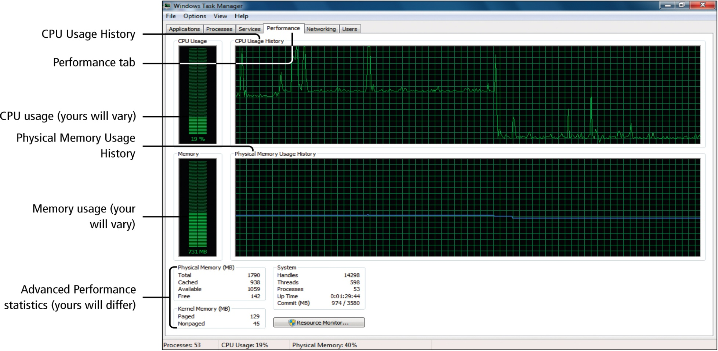
Track Performance by Using Task Manager
Notes:
Figure 9.19

Slide 18
Track Performance by Using Task Manager
Tracking Network Performance Using Task Manager
Networking tab
Tracks the resources used by your computer to communicate with your local network
Determine when data is being sent from your computer

Slide 19
Track Performance by Using Task Manager
Network Interface Card (NIC)
Also called a network adapter
Enables a computer to connect and communicate with a network

Slide 20
Track Performance by Using the Performance and Reliability Monitors
Real Time
Actual time something takes place
Resource Monitor
Provides performance measurements
CPU usage
Hard disk drive usage
Network usage
Memory usage

Slide 21
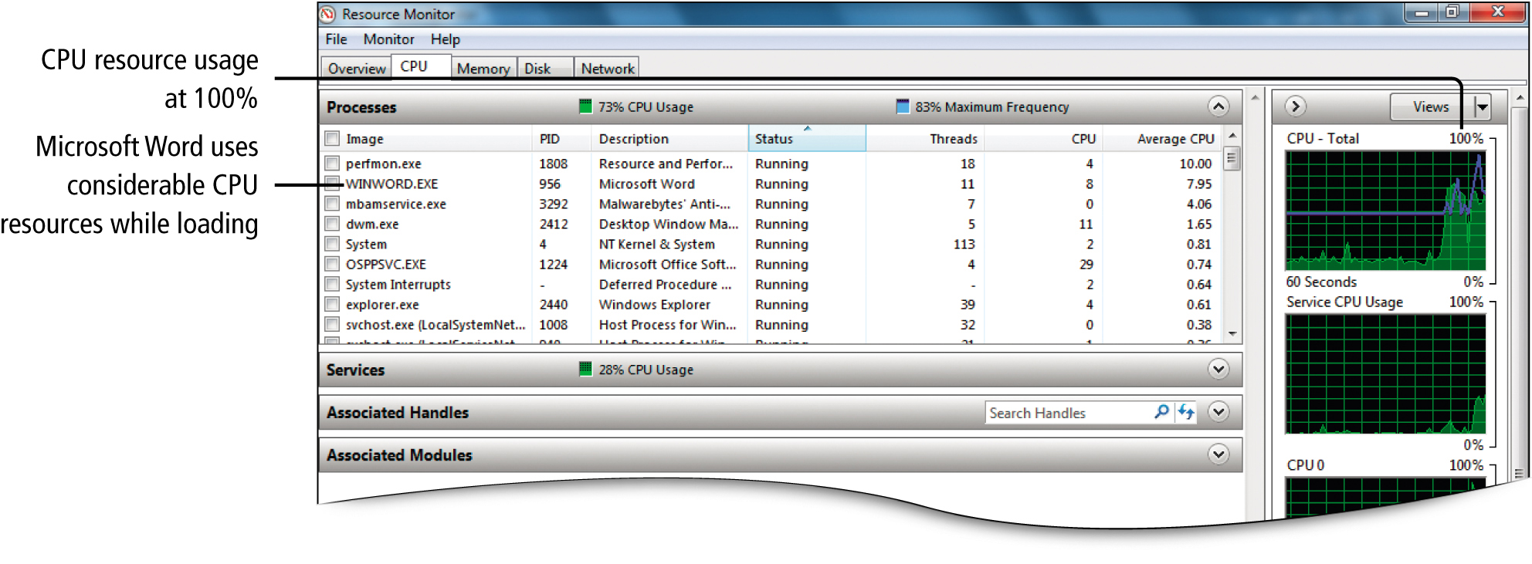
Track Performance by Using the Performance and Reliability Monitors
Notes:
Figure 9.25

Slide 22
Track Performance by Using the Performance and Reliability Monitors
Performance Monitor
Focuses on computer performance
Creates charts that can be modified and saved as image files

Slide 23
Track Performance by Using the Performance and Reliability Monitors
Creating a System Diagnostics Report
System Diagnostics Report
Pre-built report that summarizes computer’s overall performance
Can be saved as an HTML document for easy sharing

Slide 24
Track Performance by Using the Performance and Reliability Monitors
Using the Reliability Monitor
Provides data about a computer’s overall reliability
Control Panel, System and Security, Review your computer’s status, Maintenance, Check for solutions to problem reports, View reliability history

Slide 25
Track Performance by Using the Performance and Reliability Monitors
Reliability
Likelihood your computer will work as intended
Tracks events that affect system reliability over the lifetime of the system
System Stability Index
Between 1 and 10
Determined by how many system errors have occurred
10 indicates highest reliability

Slide 26
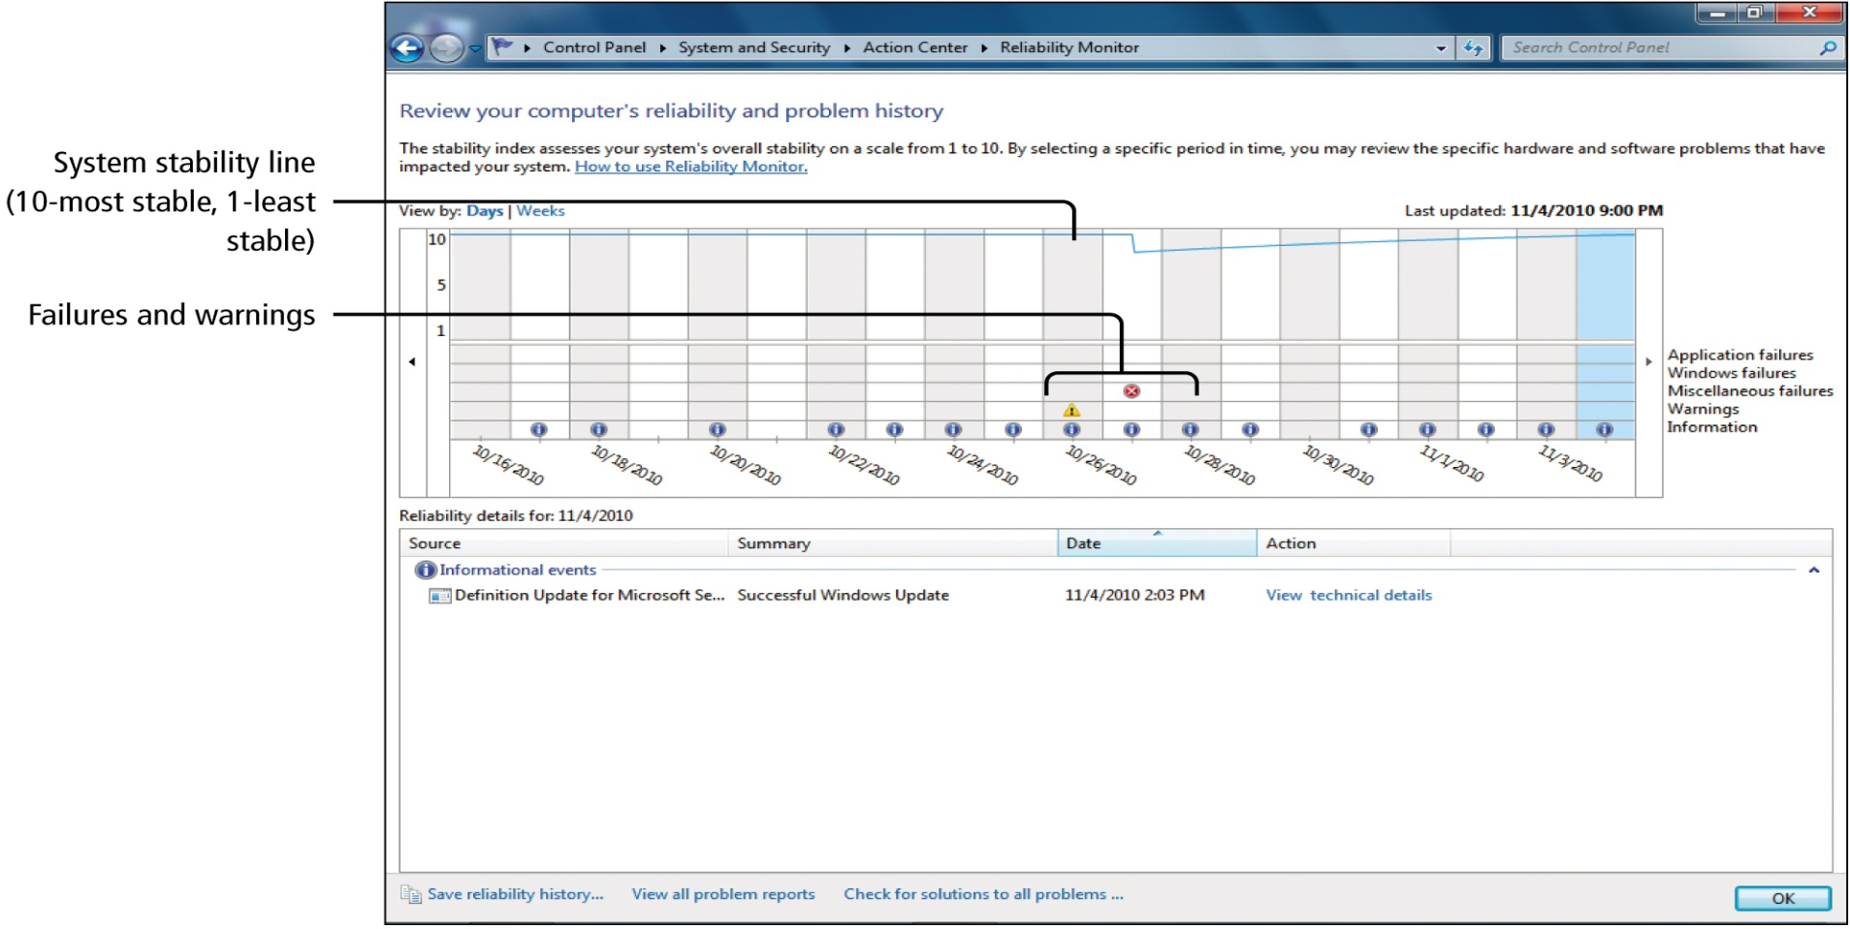
Track Performance by Using the Performance and Reliability Monitors
Notes:
Figure 9.33

Slide 27
View Disks by Using Disk Management
Partition
A part of a hard disk that functions like a separate disk
Volume
Storage area on a hard disk that is formatted with a file system
Assigned a drive letter

Slide 28
View Disks by Using Disk Management
Disk Management
Windows 7 tool
View arrangement of disk drives on a computer
Perform partitioning and formatting tasks

Slide 29
View Disks by Using Disk Management
Computer Management
Collection of tools
Monitor system events
Configure hard disks
Manage system performance
Single location for common administrative tasks

Slide 30
View Disks by Using Disk Management
Physical Drive
An actual drive such as a hard drive, USB drive, or a CD/DVD drive
Format
Prepares the disk to store data
Formatting the disk will erase the contents of the disk; any data stored there will be lost

Slide 31
View Disks by Using Disk Management
Destructive Partitioning
Erases data when partitions are deleted
Extend Volume/Shrink Volume
Used to resize partitions without losing data

Slide 32
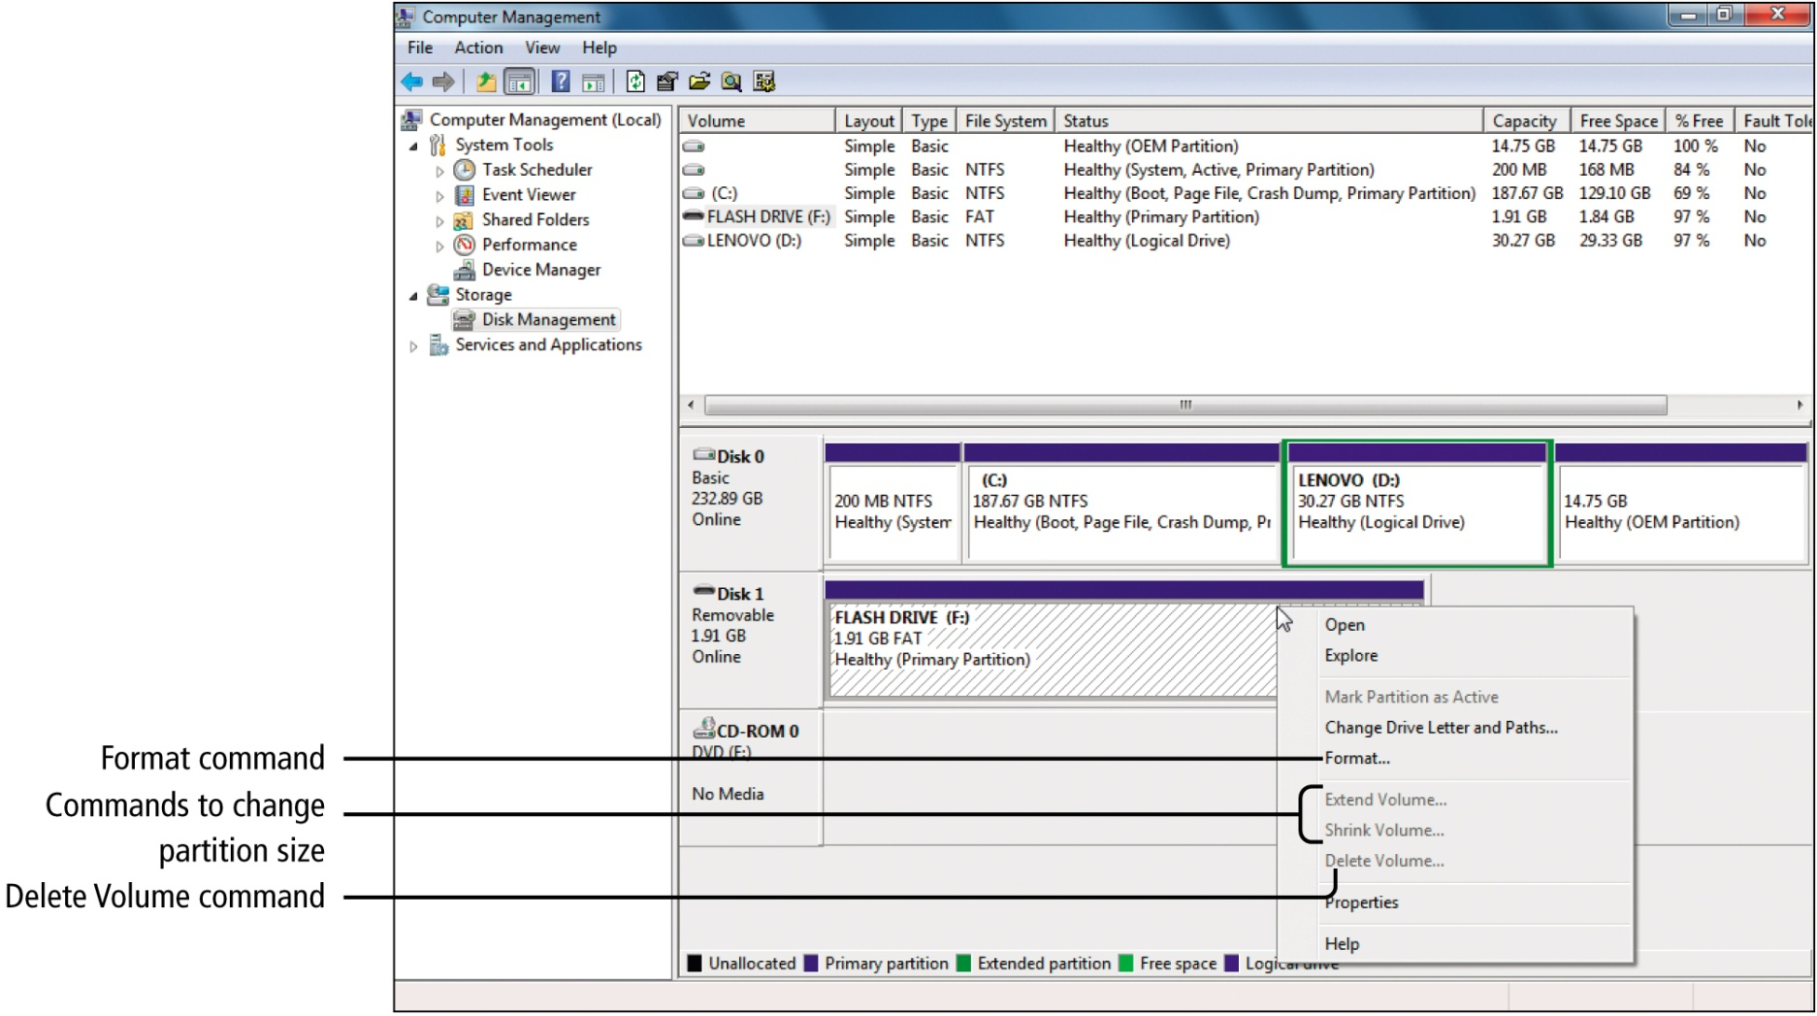
View Disks by Using Disk Management
Notes:
Figure 9.37

Slide 33
Manage Services by Using the Services Window
Services Window
Windows 7 tool
Services are low level programs that typically run in the background waiting to be called on by processes
Lists all services
Provides a way to change their settings

Slide 34
Covered Objectives
Manage Applications by Using Task Manager
Manage Processes by Using Task Manager
View Services by Using Task Manager
Track Performance by Using Task Manager

Slide 35
Covered Objectives
Track Performance by Using the Performance and Reliability Monitors
View Disks by Using Disk Management
Manage Services by Using the Services Window

Slide 36
All rights reserved. No part of this publication may be reproduced, stored in a retrieval system, or transmitted, in any form or by any means, electronic, mechanical, photocopying, recording, or otherwise, without the prior written permission of the publisher. Printed in the United States of America.

