Slide 1
PowerPoint Presentation to Accompany
GO! with Microsoft® Windows 7
Chapter 8
Maintaining Your Computer and
Optimizing Its Performance

Slide 2
Objectives
Maintain Your Computer’s Hard Disk Drive
View Windows Update Settings
Schedule Maintenance Tasks by Using Task Scheduler

Slide 3
Objectives
Locate System Information
Install and Uninstall Programs
Optimize Computer Performance

Slide 4
Maintain Your Computer’s Hard Disk Drive
Using Disk Cleanup
A program within Windows 7 that
Removes temporary files
Empties the Recycle Bin
Removes other items that are no longer needed
Increases free disk space

Slide 5
Maintain Your Computer’s Hard Disk Drive
Using Disk Cleanup
Start, Control Panel, System and Security, Administrative Tools, Free up disk space, Disk Cleanup: Drive Selection, Drives, select desired drive

Slide 6
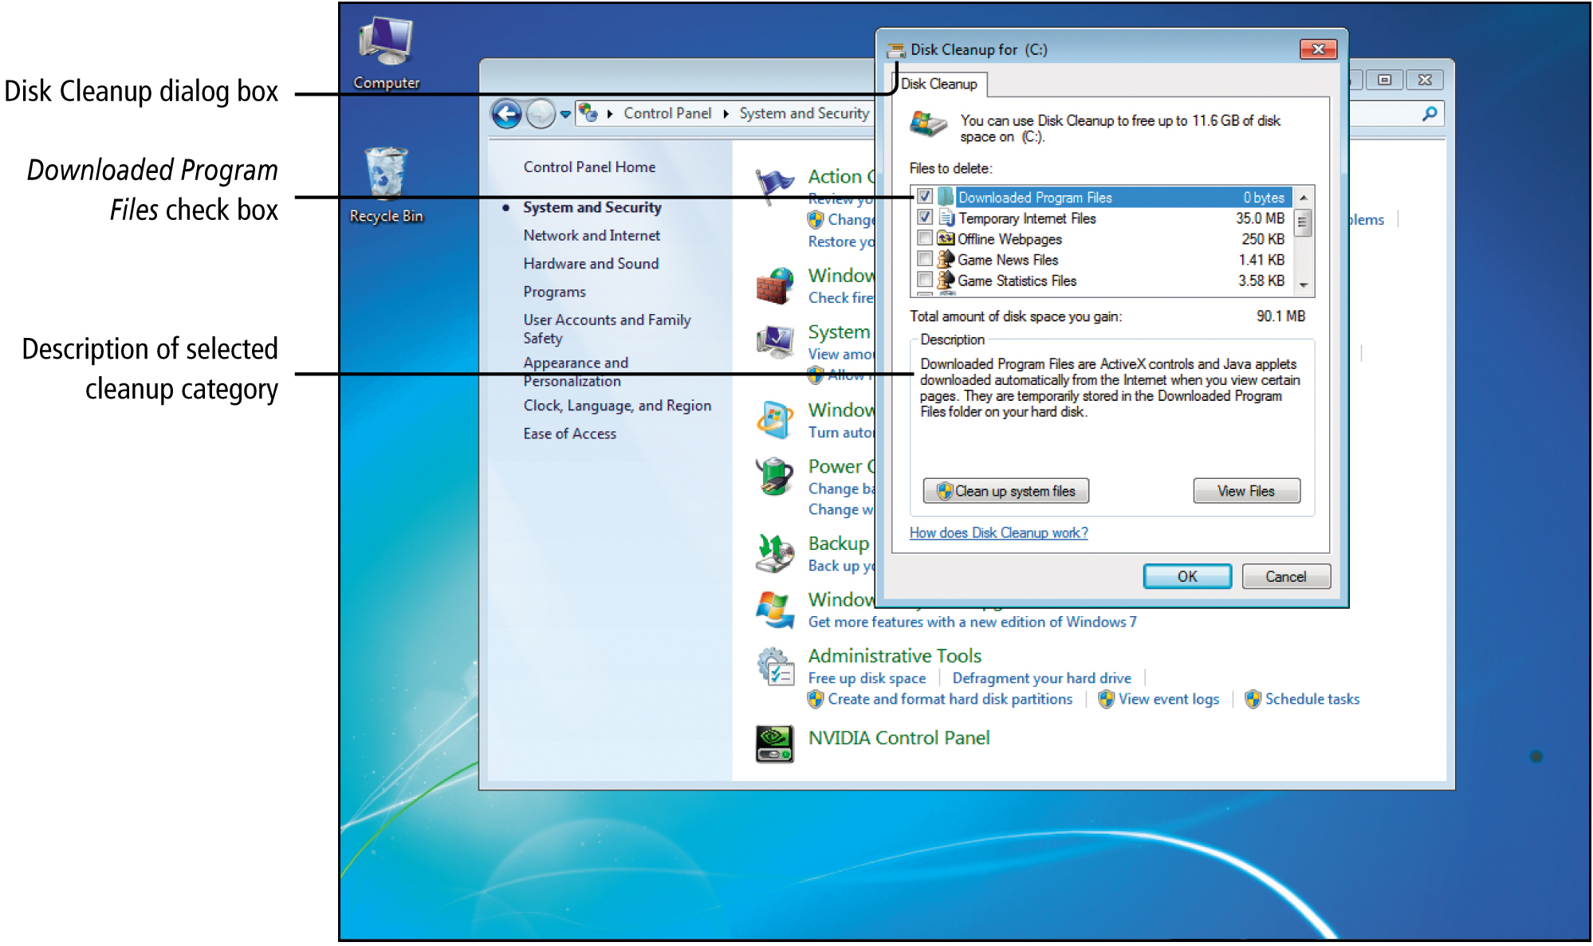
Maintain Your Computer’s Hard Disk Drive
Notes:
Figure 8.2

Slide 7
Maintain Your Computer’s Hard Disk Drive
File system
Method used to store files on a disk drive
New Technology File System (NTFS)
Typically used by Windows 7
File Allocation Table (FAT)
Typically used by USB drives

Slide 8
Maintain Your Computer’s Hard Disk Drive
Sector
A block of space on a drive
Cluster
Sectors group together to form clusters
Smallest area in which data can be written on a disk using NTFS or FAT
Holds 4 KB

Slide 9
Maintain Your Computer’s Hard Disk Drive
Kilobyte (KB)
Approximately 1000 bytes
Byte
Typically stores a single character, such as a digit or letter
Used to measure storage sizes on computers

Slide 10
Maintain Your Computer’s Hard Disk Drive
Fragment
A piece of a file that has been split apart
Fragmented file
A file whose fragments are stored in separate blocks of the disk drive
Using Disk Defragmenter
Display the Computer window, Right-click your hard disk drive, click Properties, Tools tab, Defragment now button

Slide 11
Maintain Your Computer’s Hard Disk Drive
Disk defragmentation (Defragging)
Process that consolidates fragmented files into contiguous blocks on the hard drive
The process rearranges data on your hard disk by rearranging each fragmented file into a single location and rearranging unused spaces into one large block

Slide 12
Maintain Your Computer’s Hard Disk Drive
Using Disk Defragmenter
Automatically runs on a weekly schedule
Process may take hours

Slide 13
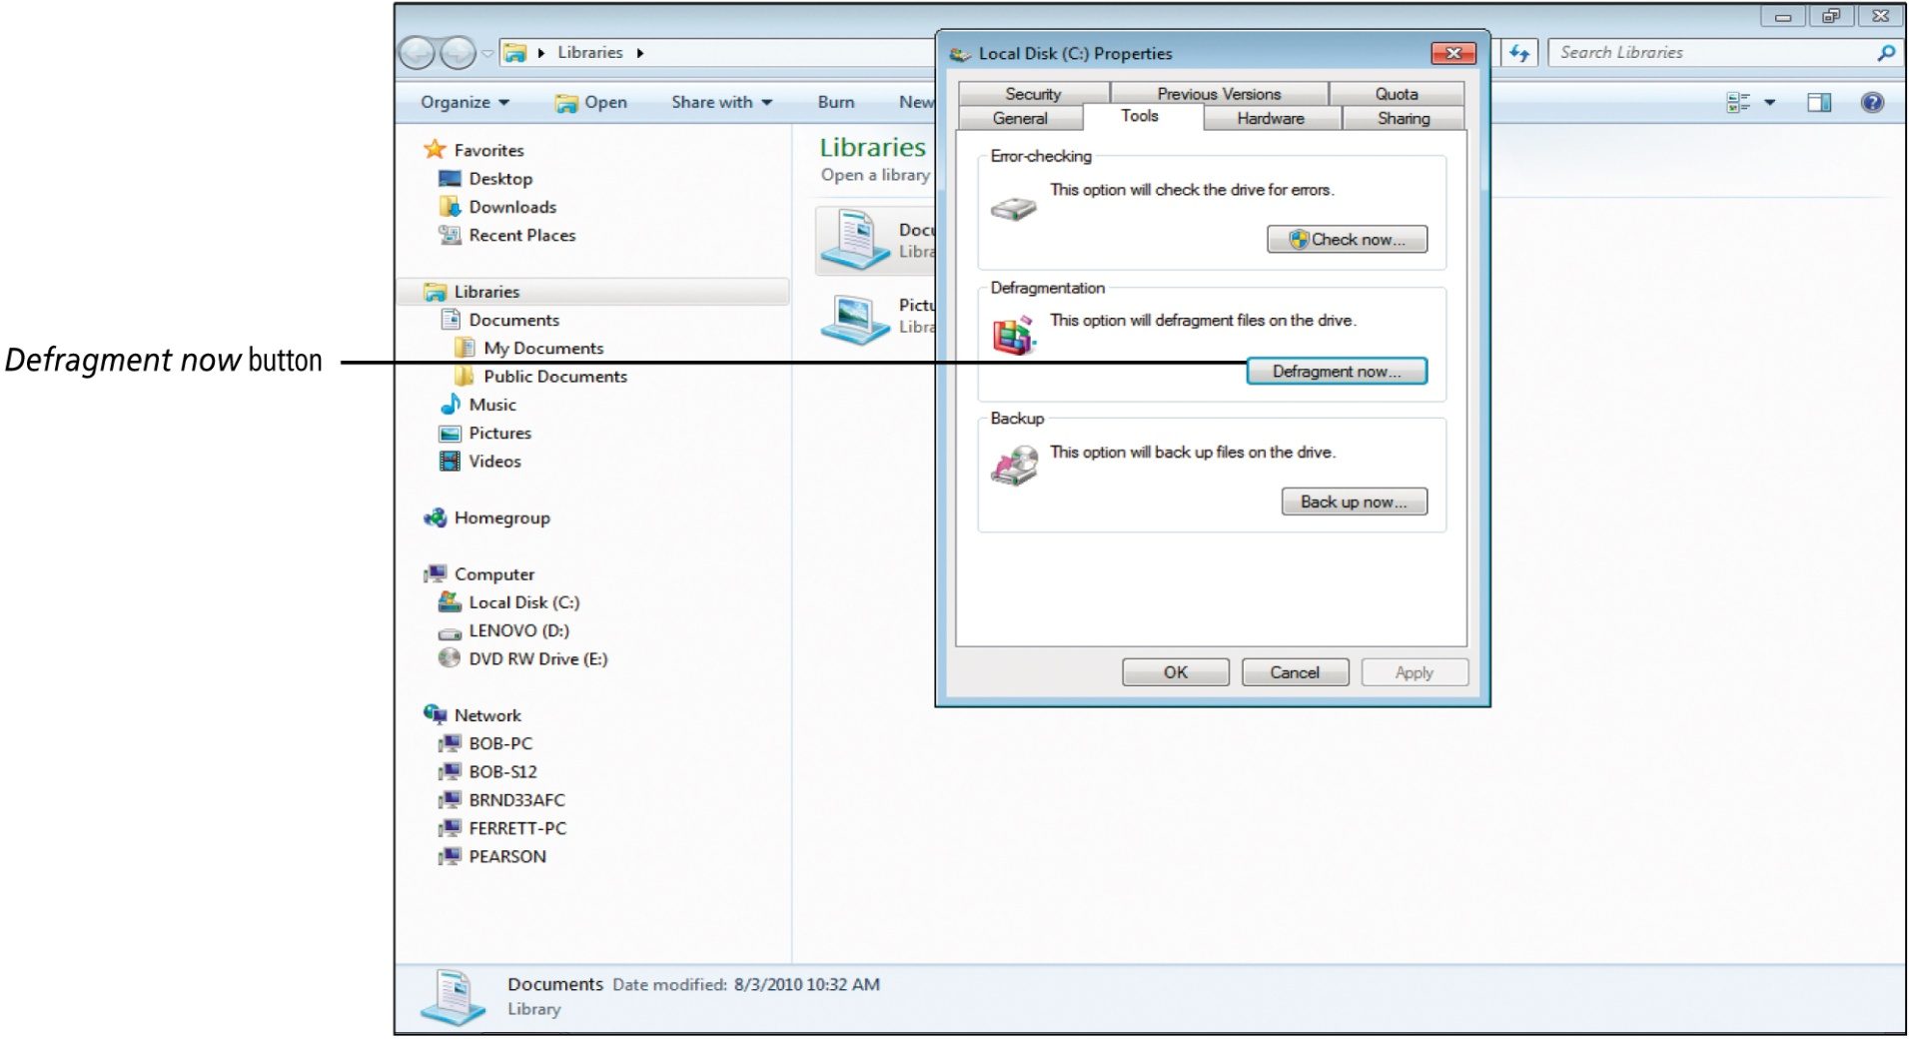
Maintain Your Computer’s Hard Disk Drive
Notes:
Figure 8.7

Slide 14
Maintain Your Computer’s Hard Disk Drive
Detecting and Repairing Errors on Disks
Bad sector
A sector that has been damaged and can not be used
Firmware
Prevents a USB flash drive from using bad sectors

Slide 15
Maintain Your Computer’s Hard Disk Drive
Check Disk program
Scans disk for bad sectors
Attempts to repair them
Corrupted file
File no longer works properly, accidentally damaged by a hardware or software failure

Slide 16
Maintain Your Computer’s Hard Disk Drive
Check Disk program
Start menu, Computer, right-click desired drive, Properties, Tools tab, Error checking, Check now

Slide 17
View Windows Update Settings
Viewing Windows Update Settings
Update
An addition to Windows 7 that helps prevent or fix problems or improves the performance of your computer
Updates are categorized
Important (usually security related)
Recommended (usually improve performance)
Optional (usually install new software or features)

Slide 18
View Windows Update Settings
Viewing Windows Update Settings
Start menu, Control Panel, System and Security, Action Center, Review your computer’s status and resolve issues, Security, Windows update, View update history

Slide 19
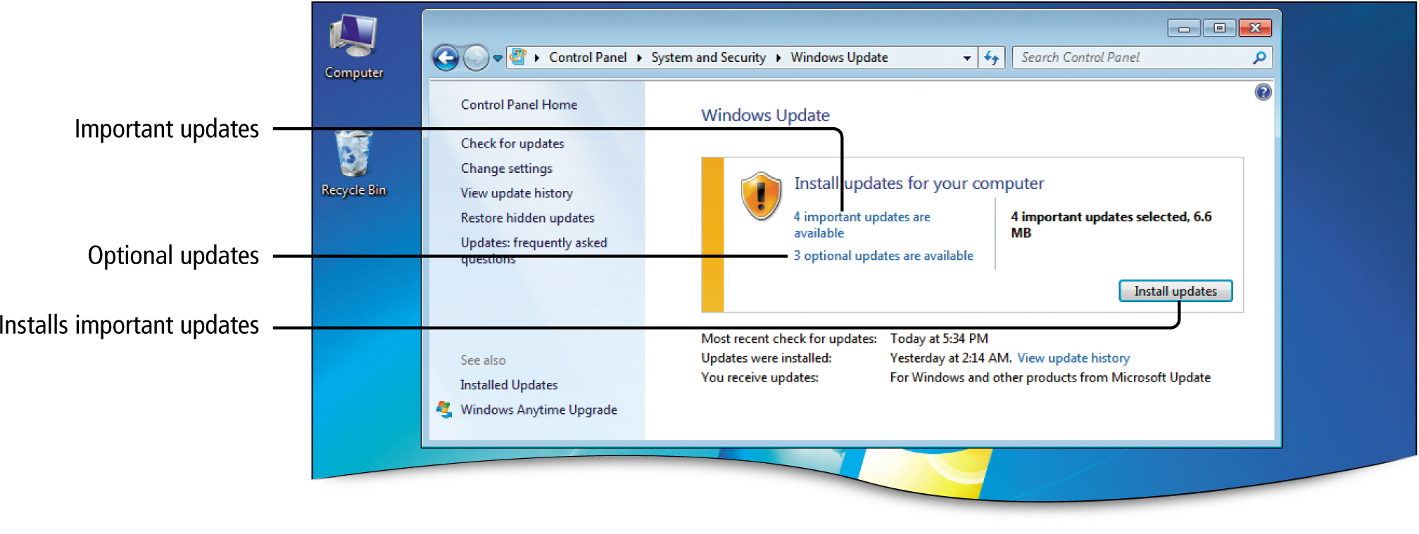
View Windows Update Settings
Notes:
Figure 8.13

Slide 20
View Windows Update Settings
Windows Update
Requires an Internet connection
Checks for updates
Downloads updates
Installs updates
. Windows Update
Updates are provided to all user accounts on a computer
Recommended updates
Ensures recommended updates are included

Slide 21
Schedule Maintenance Tasks by Using Task Scheduler
Scheduling Disk Cleanup with Task Scheduler
Task Scheduler
Schedules regular hard disk maintenance tasks
Disk Cleanup is not, by default, set to run periodically
User can set it up to run new tasks regularly using the Create Basic Task Wizard

Slide 22
Schedule Maintenance Tasks by Using Task Scheduler
Create Basic Task Wizard
Start Menu, Control Panel, System and Security, Administrative Tools, Schedule Tasks, Actions Pane, Create Basic Task

Slide 23
Schedule Maintenance Tasks by Using Task Scheduler
Using Advanced Task Scheduler Features
Tasks can be set to run in response to an event
Tasks can be set to run only when certain conditions are present

Slide 24
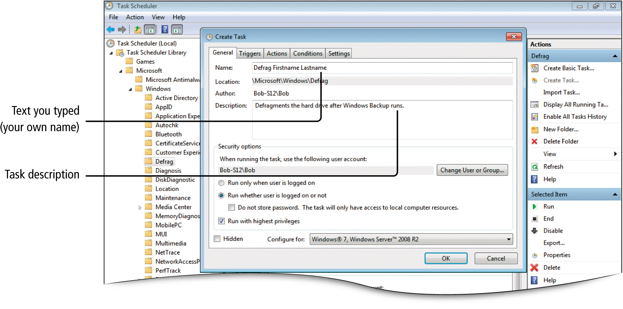
Schedule Maintenance Tasks by Using Task Scheduler
Notes:
Figure 8.22

Slide 25
Locate System Information
Central Processing Unit (CPU)
Main integrated chip in your computer
Processes your data and program instructions

Slide 26
Locate System Information
Benchmarks
Standardized tests for measuring a computer’s performance
Benchmarking
The process of running benchmark tests
System
Windows 7 tool that displays basic information about your computer

Slide 27
Locate System Information
CPU Meter
Right-click on desktop, Gadgets, CPU Meter
Windows gadget that shows how hard your computer is working
Also shows the amount of random access memory (RAM) currently being used

Slide 28
Locate System Information
Notes:
Figure 8.26

Slide 29
Locate System Information
Architecture
Data-handing capacity of a microprocessor
Dual-core
Two separate CPUs sharing processing tasks
Clock rate
Rate of speed the CPU performs
Measured in megahertz (MHz) or gigahertz (GHz)

Slide 30
Locate System Information
Windows Experience Index
Tests five components that affect computer performance
Rates on a scale of 1 to 7.9, with 7.9 being highest

Slide 31
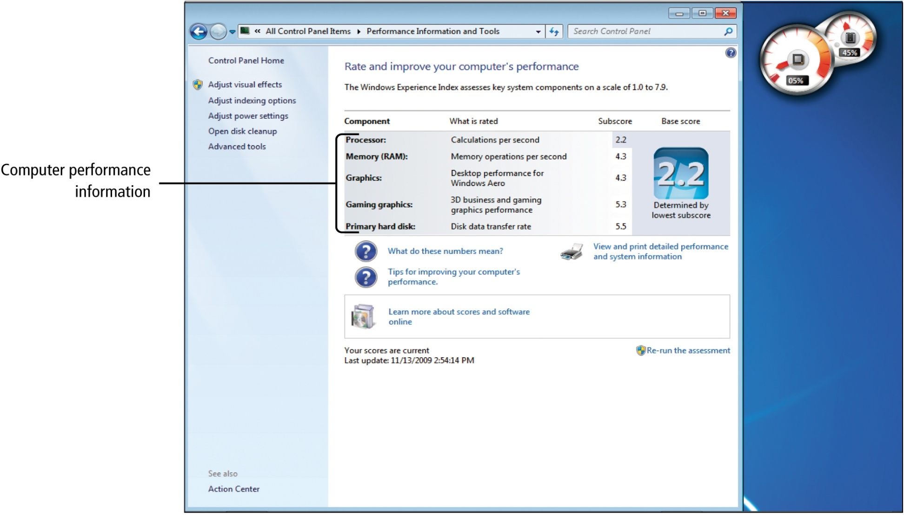
Locate System Information
Notes:
Figure 8.28

Slide 32
Locate System Information
Bottleneck
A slow computer component
Restricts the flow of data
Slows the performance of the entire computer

Slide 33
Locate System Information
Viewing System Information
Start button, type system, Programs, System Information
System Information about your computers:
Hardware configuration
Computer components
Operating system software
IT Professional
Someone who works in the field of Information Technology

Slide 34
Locate System Information
Display adapter (graphics card)
Separate integrated circuit board dedicated to processing graphics
Driver
Software that enables programs to communicate with computer hardware devices e.g. a graphics card

Slide 35
Locate System Information
Startup Program
A program that starts automatically when your computer starts

Slide 36
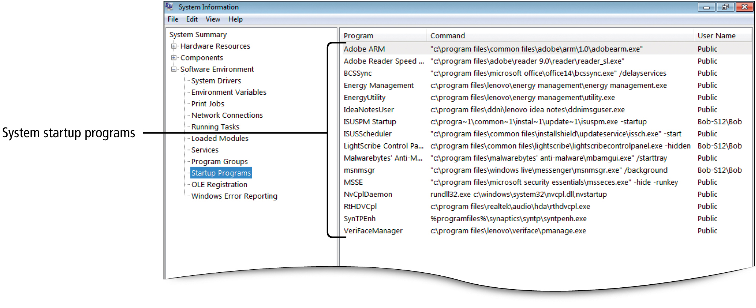
Locate System Information
Notes:
Figure 8.32

Slide 37
Install and Uninstall Programs
Installing and Uninstalling Programs
Setup program (install program)
Prepares a software package to run on a computer
Executable file (.exe extension)
A file that starts a program
Typically includes an uninstall option

Slide 38
Install and Uninstall Programs
Installing and Uninstalling Programs
A product key may be needed
A license agreement may be displayed
Installing and Uninstalling Programs
Reasons to uninstall a program
Program no longer being used
Free up disk space on the hard drive

Slide 39
Install and Uninstall Programs
Installing and Uninstalling Programs
Uninstall
Display the Control Panel
Programs
Uninstall a program
Select the program you wish to uninstall

Slide 40
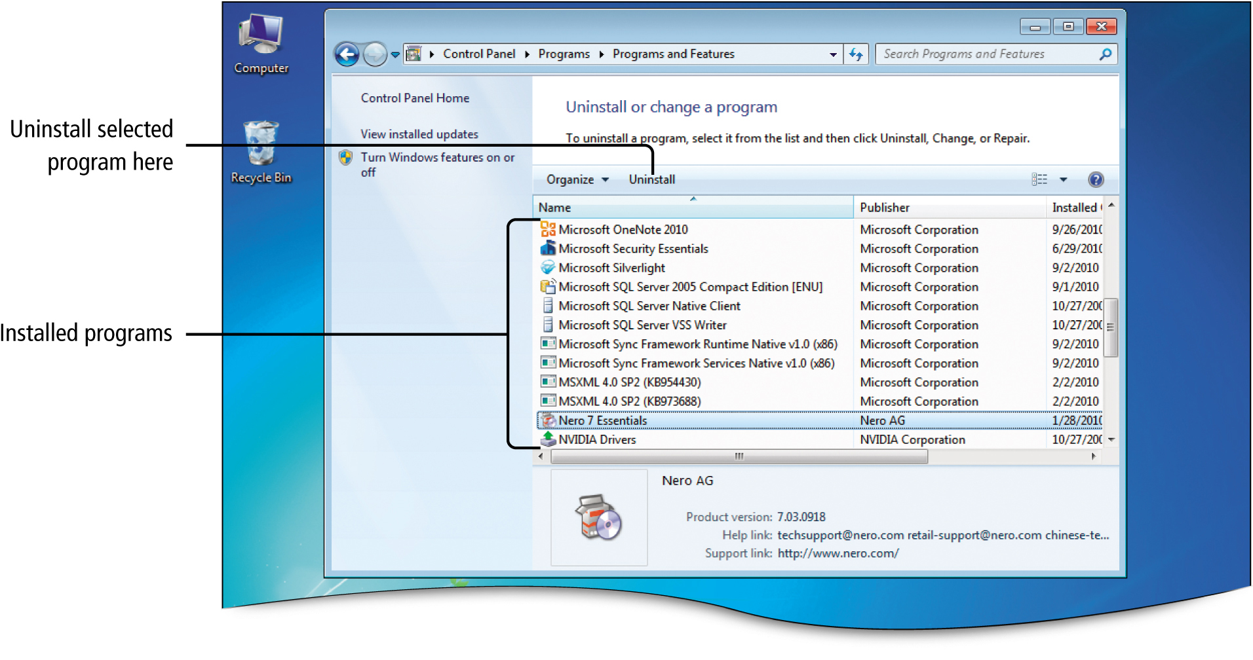
Install and Uninstall Programs
Notes:
Figure 8.37

Slide 41
Install and Uninstall Programs
Installing and Uninstalling Programs
Registry
A repository for information about your computer’s configuration

Slide 42
Optimize Computer Performance
Managing Startup Programs
Removing unneeded startup programs can free resources for other needs
Some are needed by Windows 7 to keep your computer running correctly
Virus Checker
Software that scans your computer for viruses and other malware

Slide 43
Optimize Computer Performance
Managing Startup Programs
Start menu, All Programs, locate desired program, right-click, Send to, Desktop (create shortcut), Startup folder, right-click, Open, drag the shortcut into the Startup folder
Start menu, Control Panel, System and Security, Administrative Tools, double-click System Configuration, Startup tab, Delete shortcut

Slide 44
Optimize Computer Performance
Changing Performance Options
Start button, Control Panel, System and Security, System, Advanced system settings, System Properties, Advanced tab, Performance, Settings
Disable/enable Windows 7 features that affect your computer’s performance

Slide 45
Optimize Computer Performance
Changing Performance Options
Visual effects
Transparent objects, animated objects, shadows under objects
Adjust for best performance
Clears all visual effect check boxes

Slide 46
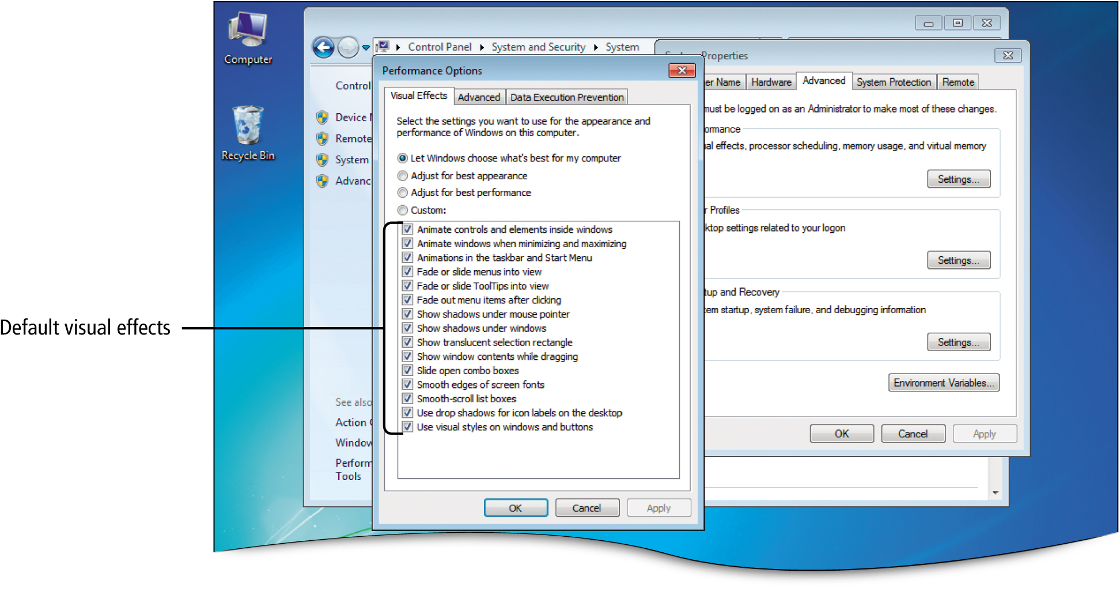
Optimize Computer Performance
Notes:
Figure 8.40

Slide 47
Optimize Computer Performance
Changing Performance Options
Virtual Memory
Using a part of the hard disk as though it were RAM
Slows performance some

Slide 48
Optimize Computer Performance
Changing Performance Options
Data Execution Prevention (DEP)
Monitors programs to be sure they are using memory safely
Helps prevent damage from viruses and malware

Slide 49
Optimize Computer Performance
Changing Performance Options
Upgrading
Process of buying new computer components or software programs to increase computer performance

Slide 50
Optimize Computer Performance
Increasing Memory with ReadyBoost
ReadyBoost
Enables certain USB flash drives to be used as computer memory
Encrypts data saved to the USB flash drive
Keeps a backup of data saved to the USB flash drive on the hard disk

Slide 51
Optimize Computer Performance
Increasing Memory with ReadyBoost
Start Menu, Computer, right-click the desired USB drive, Properties
Click Speed up my system in the AutoPlay dialog box when you insert the USB drive

Slide 52
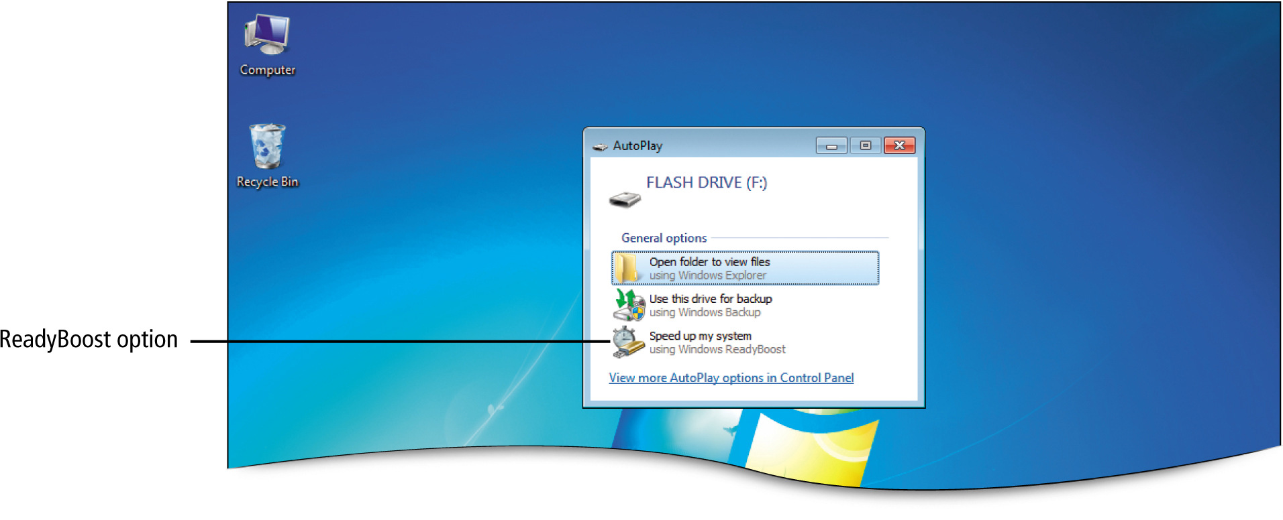
Optimize Computer Performance
Notes:
Figure 8.42

Slide 53
Optimize Computer Performance
Encryption
Process of encoding data so that others cannot view it
Process of encoding data so that others cannot view it

Slide 54
Covered Objectives
Maintain Your Computer’s Hard Disk Drive
View Windows Update Settings
Schedule Maintenance Tasks by Using Task Scheduler

Slide 55
Covered Objectives
Locate System Information
Install and Uninstall Programs
Optimize Computer Performance

Slide 56
All rights reserved. No part of this publication may be reproduced, stored in a retrieval system, or transmitted, in any form or by any means, electronic, mechanical, photocopying, recording, or otherwise, without the prior written permission of the publisher. Printed in the United States of America.
56

