Slide 1
PowerPoint Presentation to Accompany
GO! with Microsoft® Windows 7
Chapter 7
Backing Up Your Computer and
Setting Up a Home Network

Slide 2
Objectives
Back Up and Restore Files and Folders
Back Up and Restore Your Entire Computer
Configure System Restore and Recover Using Restore Points

Slide 3
Objectives
Use the Network and Sharing Center to Set Up a Home Network
Secure and Troubleshoot a Home Network
Use Homegroup to Share Files and Printers on a Home Network

Slide 4
Back Up and Restore Files and Folders
Backing Up Files and Folders
Backing Up – Creation of extra copies of your files
External hard drive (portable hard drive)
CD or DVD
Online backup service
Remote backup service
Managed backup service
Provides a system for backing up your computer files over the Internet on a scheduled basis and then storing the data securely on their computers

Slide 5
Back Up and Restore Files and Folders
Set up backup wizard
Windows 7 feature that walks you through the process of backing up your data
Start, Control Panel, System and Security, Back up your computer, Set up backup, Save backup on, What do you want to backup, Data files, Save settings and run backup, Close

Slide 6
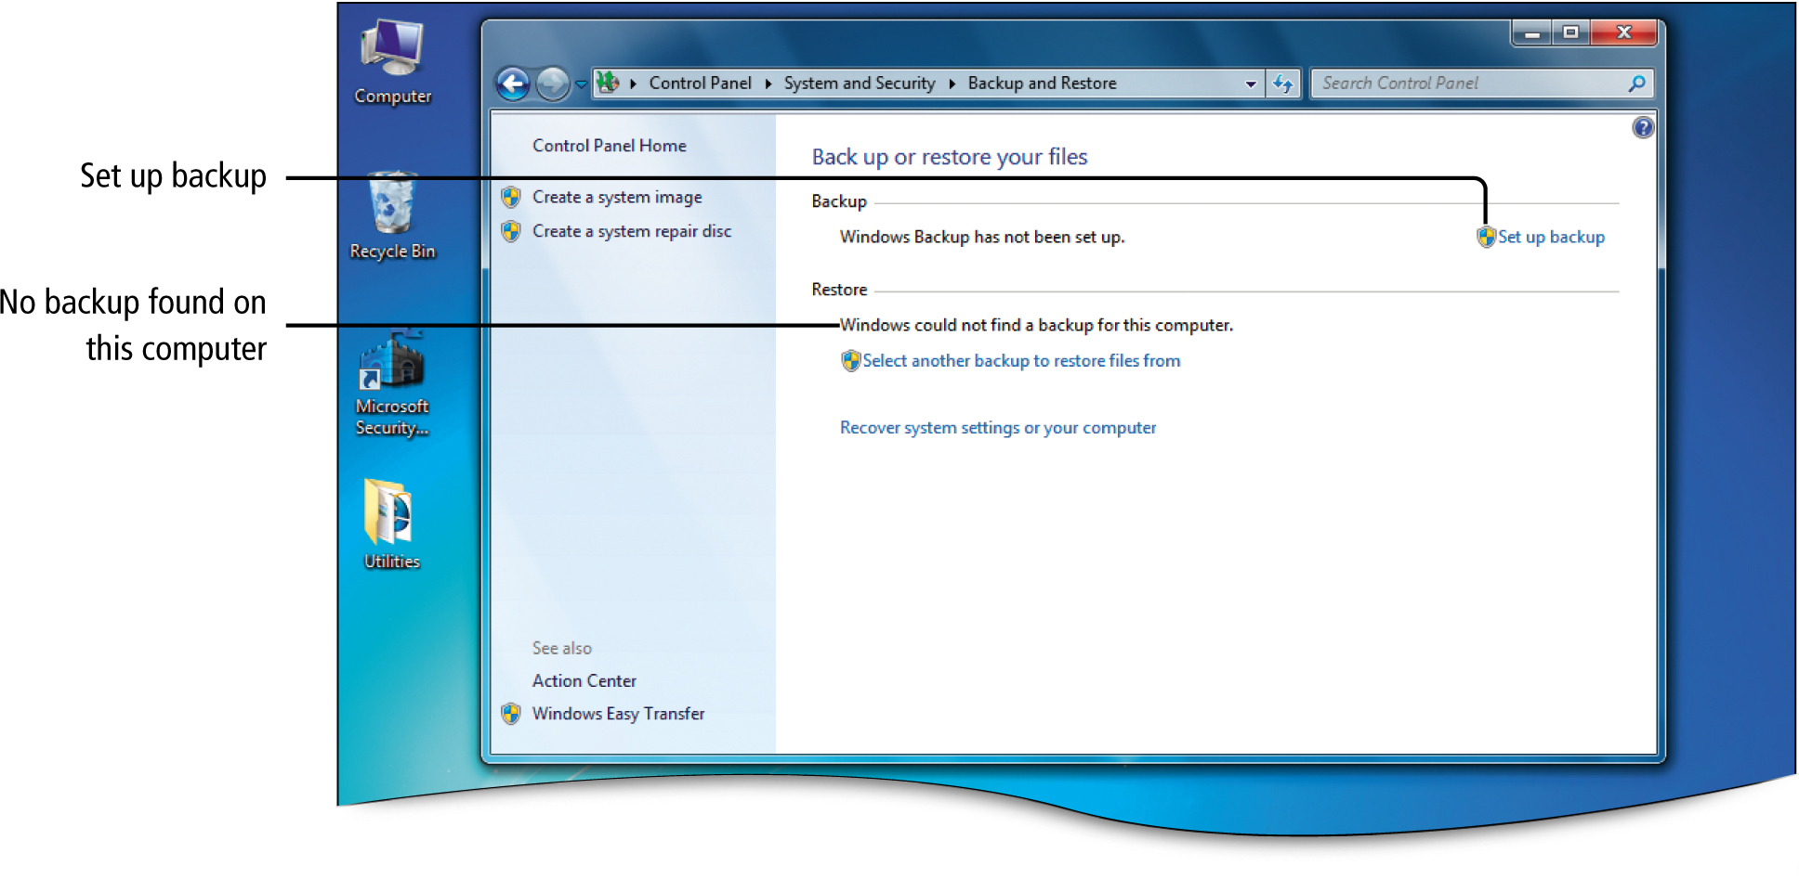
Back Up and Restore Files and Folders
Notes:
Figure 7.2

Slide 7
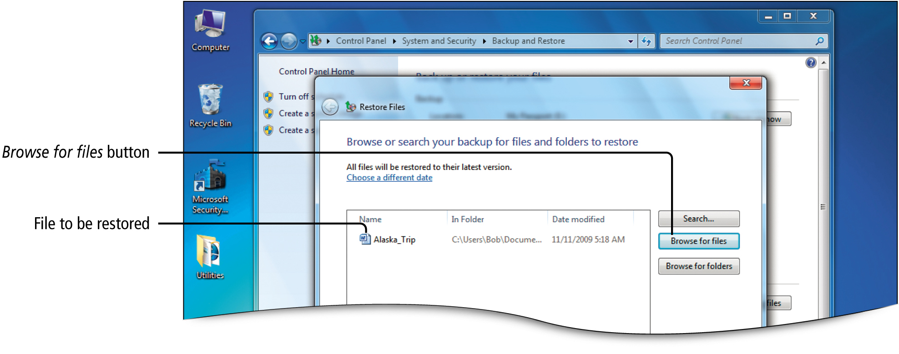
Back Up and Restore Files and Folders
Notes:
Figure 7.7

Slide 8
Back Up and Restore Files and Folders
Restoring a File
Moving a backup file from your backup device to your computer
Start, Control Panel, System and Security, Backup your computer, Backup and Restore window, Restore my files, Browse for files, Browse the backup for files, file list, Restore files, Where do you want to restore your files, Restore

Slide 9
Back Up and Restore Your Entire Computer
System Image
Backup image that contains copies of programs, system settings, and files
Used to restore the contents of your computer
Complete restoration of your computer

Slide 10
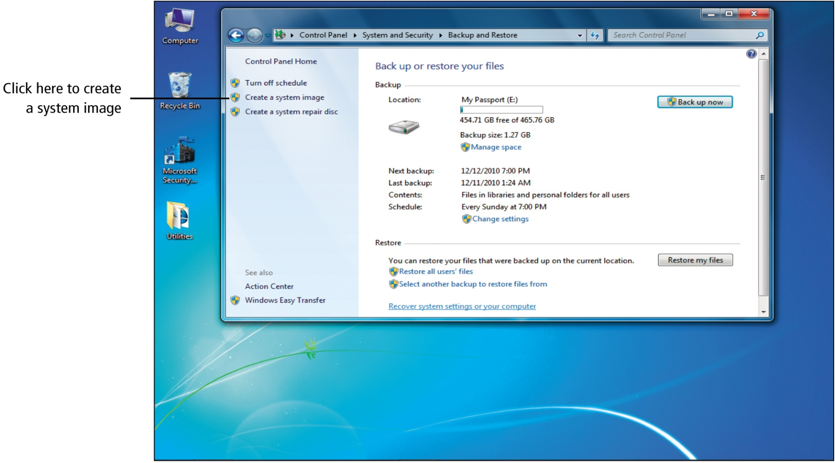
Back Up and Restore Files and Folders
Notes:
Figure 7.9

Slide 11
Back Up and Restore Your Entire Computer
External hard drive is best choice
Would take several CDs or DVDs
Process depends on whether you have a Windows 7 installation disc
Backup and Restore window, Create a System Image, Follow steps in the Wizard

Slide 12
Configure System Restore and Recover Using Restore Points
Configuring and Recovering Using Restore Points
System Restore
Restores system files, not data files, to an earlier point in time
Allows you to undo system changes to your computer without affecting personal files such as e-mail, documents and photos
Driver
Program that allows a hardware device to work with your computer
Can cause unexpected change to your computer

Slide 13
Configure System Restore and Recover Using Restore Points
System Protection feature
Creates and saves restore points
Restore point
Like a snapshot of your computer’s settings
Created by default
Can be created manually
Control Panel, System and Security, System, System protection, Systems Properties dialog box, System Restore

Slide 14
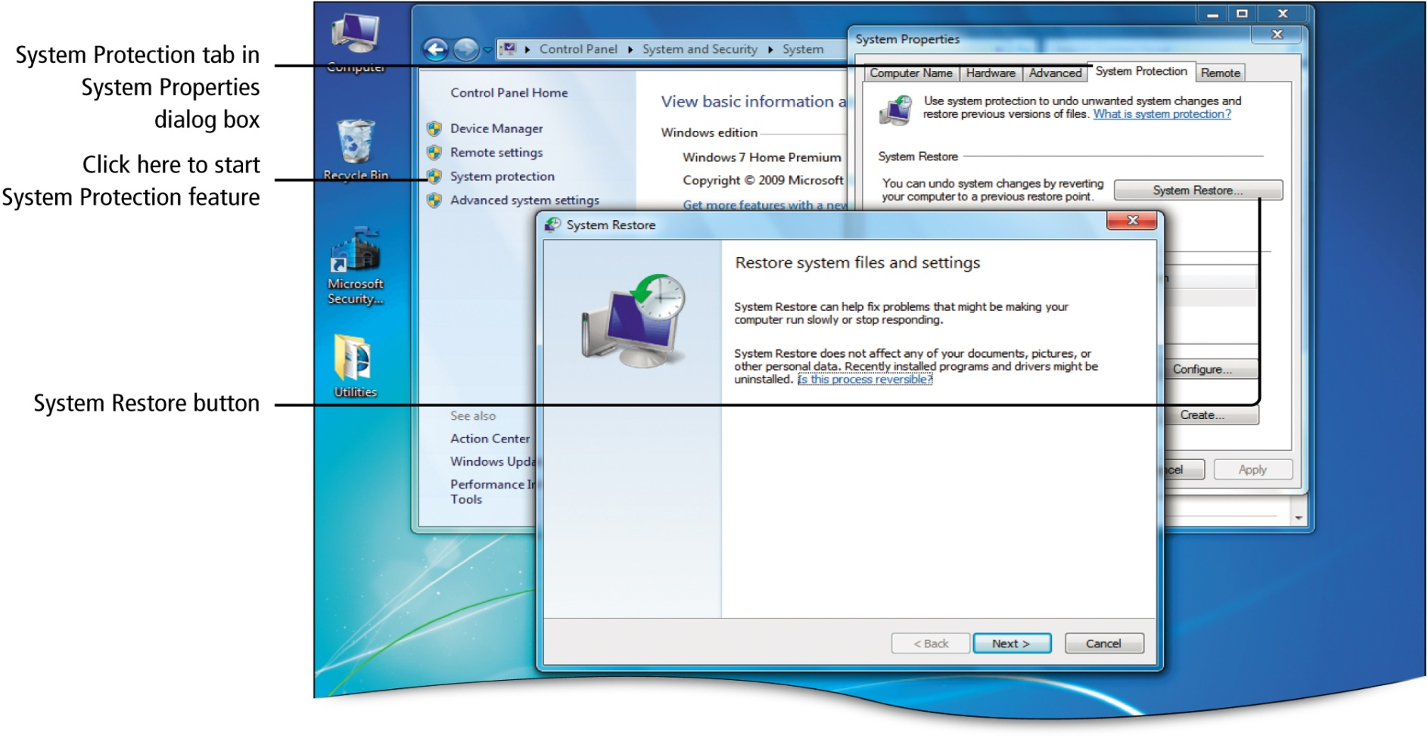
Configure System Restore and Recover Using Restore Points
Notes:
Figure 7.10

Slide 15
Configure System Restore and Recover Using Restore Points
Restoring Previous Versions and Shadow Copies
Previous versions
Back up copies
Shadow copies
Change logs of files and folders saved as part of a restore point

Slide 16
Configure System Restore and Recover Using Restore Points
Restoring Previous Versions and Shadow Copies
Right-click file or folder, click Properties, Previous Versions tab, select, Restore button

Slide 17
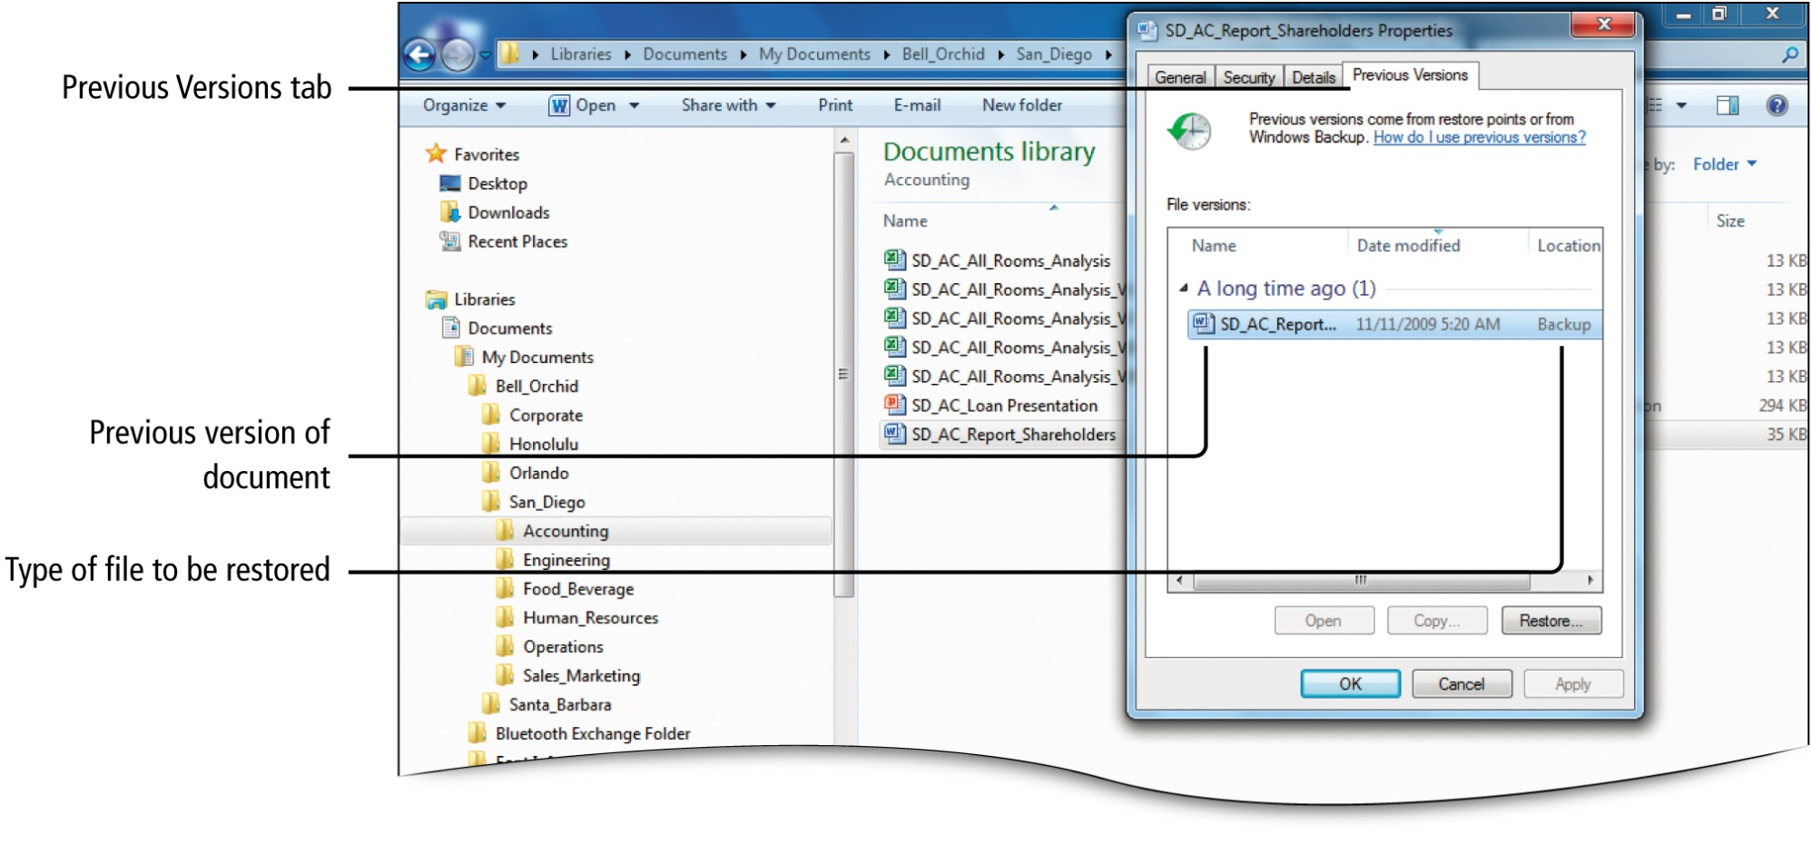
Configure System Restore and Recover Using Restore Points
Notes:
Figure 7.12

Slide 18
Use the Network and Sharing Center to Set Up a Home Network
A network is a group of computers or other devices
LAN – Local area network
Relatively limited area

Slide 19
Use the Network and Sharing Center to Set Up a Home Network
Two common network arrangements
Client/server network
Server stores account logon information. A computer that provides shared resources such as files or printers.
Client computers request the services of the server
Peer-to-peer network
Computers connect directly without the need of a server

Slide 20
Use the Network and Sharing Center to Set Up a Home Network
Identifying Network Needs and Solutions
Wired network
Communicates with the network with phone wires or cables
Less expensive, fast, reliable, easy to secure
Wireless network
Communicated with the network via radio signals
Relatively inexpensive

Slide 21
Use the Network and Sharing Center to Set Up a Home Network
Power line network
Uses a building’s existing electrical wires
Special devices connect each device to the building’s wall plugs

Slide 22
Use the Network and Sharing Center to Set Up a Home Network
Installing a Wired Network in Your Home
Network traffic
Signals sent through the network so devices on the network can communicate
Router
Sends information between two networks
Find the quickest path for sending information
Can be wired or wireless

Slide 23
Use the Network and Sharing Center to Set Up a Home Network
Installing a Wired Network in Your Home
Network Interface Card (NIC)
Connects a device to a wired network
Enables computer to connect to and communicate with a network
Switch
Connects two or more computers to a network

Slide 24
Use the Network and Sharing Center to Set Up a Home Network
Installing a Wired Network in Your Home
Ethernet
Networking standard that uses cables to provide network access
Sends signals using three speeds
Mbps
Megabits per second

Slide 25
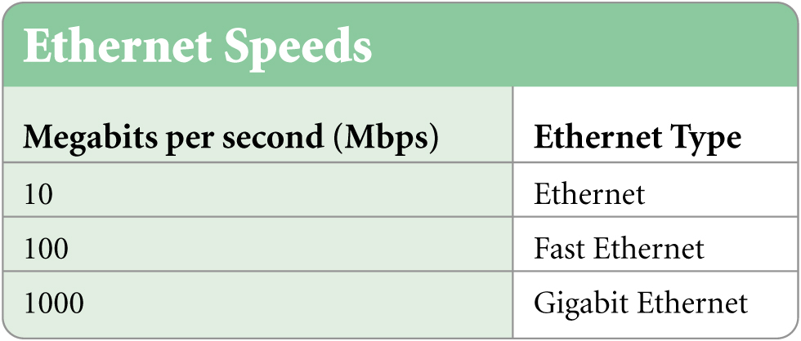
Use the Network and Sharing Center to Set Up a Home Network

Slide 26
Use the Network and Sharing Center to Set Up a Home Network
Installing a Wired Network in Your Home
RJ-45 connector
Looks similar to a phone jack
Ethernet cables have an RJ-45 connector on each end.
Used to connect each computer’s network adapter to the router or switch

Slide 27
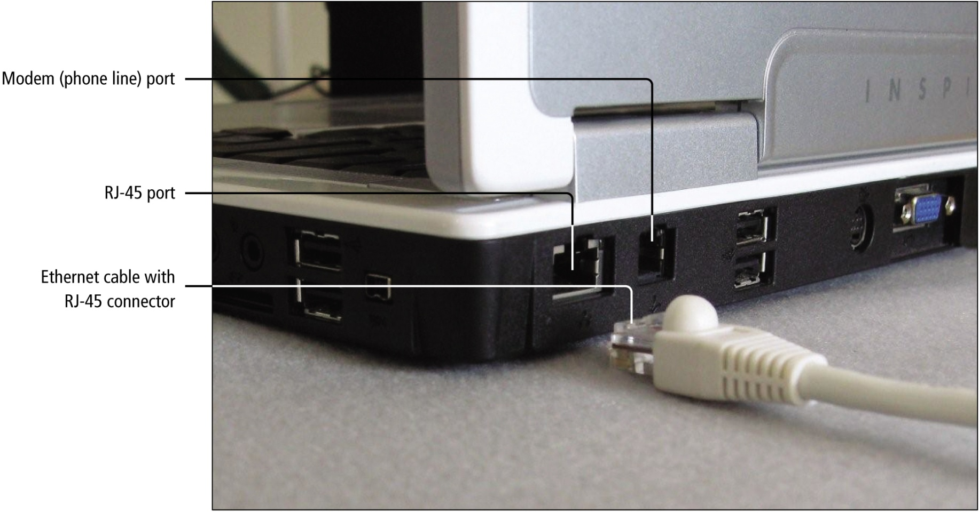
Use the Network and Sharing Center to Set Up a Home Network
Notes:
Figure 7.15

Slide 28
Use the Network and Sharing Center to Set Up a Home Network
Installing a Wired Network in Your Home
Ethernet cable
Cat5 cable for Fast Ethernet
Cat6 cable for Gigabit Ethernet
Connecting wired network hardware
Install a network interface card, connect each computer’s network adapter to the router, turn on the router, restart computer, select Home, Work, or Public network.

Slide 29
Use the Network and Sharing Center to Set Up a Home Network
Installing a Wired Network in Your Home
Hub
Connect two or more computers to an Ethernet network
Allows you to expand the number of computers that connect to your network

Slide 30
Use the Network and Sharing Center to Set Up a Home Network
Using Windows Connect Now to Install a Wireless Network in Your Home
Radio waves send and receive signals between devices in a wireless network
Wireless access point
Serves as the central connection of a wireless network that manages network traffic
Wireless router
Serves as the wireless access point

Slide 31
Use the Network and Sharing Center to Set Up a Home Network
Using Windows Connect Now to Install a Wireless Network in Your Home
For a computer to communicate using radio waves, must have a wireless network adapter
802.11 (also known as Wi-Fi)
Standards for wireless networks
Be sure wireless network adapters support the same 802.11 standard used by the wireless router

Slide 32
Use the Network and Sharing Center to Set Up a Home Network
Using Windows Connect Now to Install a Wireless Network in Your Home
Windows Connect Now
Windows 7 feature for setting up a wireless network
Enables wireless routers to be configured using a USB device

Slide 33
Use the Network and Sharing Center to Set Up a Home Network
Using Windows Connect Now to Install a Wireless Network in Your Home
Service Set Identifier (SSID)
Unique name for your network
Passphrase
String of characters used to control access to a network
For more information
Close any open programs. Click Start, click Help and Support, in the Search Help box type Windows Connect Now and press Enter

Slide 34
Use the Network and Sharing Center to Set Up a Home Network
Connecting to a Wireless Network and Managing Wireless Network Connections
To use a wireless network, first initiate a connection from computer
Control Panel
Network and Internet
Click Connect to a network. Displays all available wireless networks

Slide 35
Use the Network and Sharing Center to Set Up a Home Network
Connecting to a Wireless Network and Managing Wireless Network Connections
Unsecured network
No passphrase required to connect
Security-enabled network
Requires a passphrase to connect

Slide 36
Use the Network and Sharing Center to Set Up a Home Network
Connecting to a Wireless Network and Managing Wireless Network Connections
Unnamed network (also called hidden network)
Must enter the network name and a passphrase to connect

Slide 37
Use the Network and Sharing Center to Set Up a Home Network
Connecting to a Wireless Network and Managing Wireless Network Connections
Connecting to a network, click desired network, click Connect
Disconnecting, click Network icon on right end of taskbar, right-click network, click Disconnect

Slide 38
Use the Network and Sharing Center to Set Up a Home Network
Connecting to a Wireless Network and Managing Wireless Network Connections
Manage Wireless Networks window
Control Panel, Click Network and Internet, Click Network and Sharing Center, click Manage wireless networks
Allows you to change how you connect to a wireless network

Slide 39
Use the Network and Sharing Center to Set Up a Home Network
Connecting Your Network to the Internet
Internet Service Provider (ISP)
Organization that provides access to the Internet for a fee

Slide 40
Use the Network and Sharing Center to Set Up a Home Network
Access to the Internet
Dial-up Internet access uses a phone line
Also uses a modem which is a device that enables computer information to be transmitted and received over a phone line
DSL send digital signals over phone lines, but is much faster than dial-up. Can make phone calls while using.
Cable uses coaxial cables used to deliver cable television

Slide 41
Use the Network and Sharing Center to Set Up a Home Network
Access to the Internet
Broadband connection
A high-speed Internet connection
256 kilobytes per second (kbps) or faster
Requires a broadband modem that works with your ISP
Wide Area Network (WAN)
Network that connects geographically separated locations using telecommunication services

Slide 42
Secure and Troubleshoot a Home Network
Protecting Your Computer Using Windows Firewall
Firewall
Software or hardware that protects a computer from hackers and malicious software
Hacker
Person who uses computer expertise to gain access to computer systems without permission

Slide 43
Secure and Troubleshoot a Home Network
Protecting Your Computer Using Windows Firewall
Exception
A program that will not be blocked by the firewall
Incoming connection
Traffic sent from the Internet to your computer
To check firewall status
Close any open programs. Control Panel, Systems and Security, Windows Firewall,
To make an exception
Allow a program or feature through Windows Firewall, change settings, Allow another program, add program

Slide 44
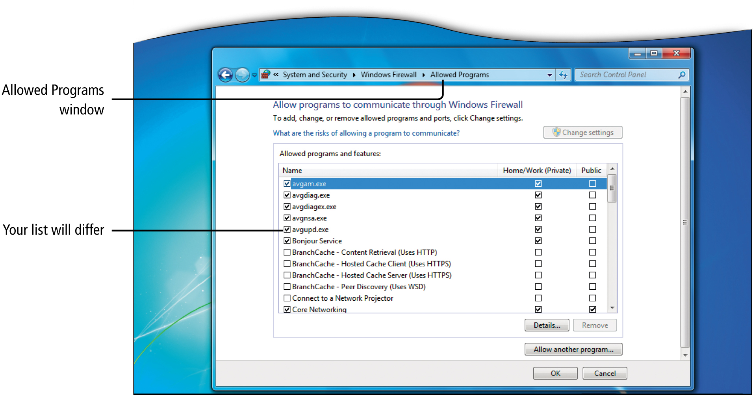
Secure and Troubleshoot a Home Network
Notes:
Figure 7.26

Slide 45
Secure and Troubleshoot a Home Network
Protecting Your Computer Using Windows Firewall
Inbound traffic
Data sent to your computer by other computers on the Internet
Outbound traffic
Data sent from your computer to other computers on the Internet

Slide 46
Secure and Troubleshoot a Home Network
Securing a Wireless Network
Without security, unauthorized users can access information on your computer
Strong passphrase
Encryption
Used to scramble network traffic
Configure wireless router to not broadcast its SSID or default network name

Slide 47
Secure and Troubleshoot a Home Network
Troubleshooting Network Problems
Troubleshoot
Analyze the problem
Determine possible causes
Implement solutions

Slide 48
Secure and Troubleshoot a Home Network
Troubleshooting Network Problems
Network discovery
Is a network setting
Controls how you see other computers on your network
Controls whether other computers on your network can see your computer

Slide 49
Secure and Troubleshoot a Home Network
Troubleshooting Network Problems
Gateway
Connects two different networks
Network and Sharing Center

Slide 50
Use Homegroup to Share Files and Printers on a Home Network
Using Homegroup to Share Files and Printers on a Home Network
Shared Resource
Device connected to one computer that can be accessed by another computer on the network
Homegroup
Group of computers that share files and printers

Slide 51
Use Homegroup to Share Files and Printers on a Home Network
Using Homegroup to Share Files and Printers on a Home Network
Connecting a printer
Start, Devices and Printers
Share a specific folder
In Windows Explorer, right-click folder, Share with

Slide 52
Use Homegroup to Share Files and Printers on a Home Network
Using Homegroup to Share Files and Printers on a Home Network
Control Panel, Network, Internet, HomeGroup

Slide 53
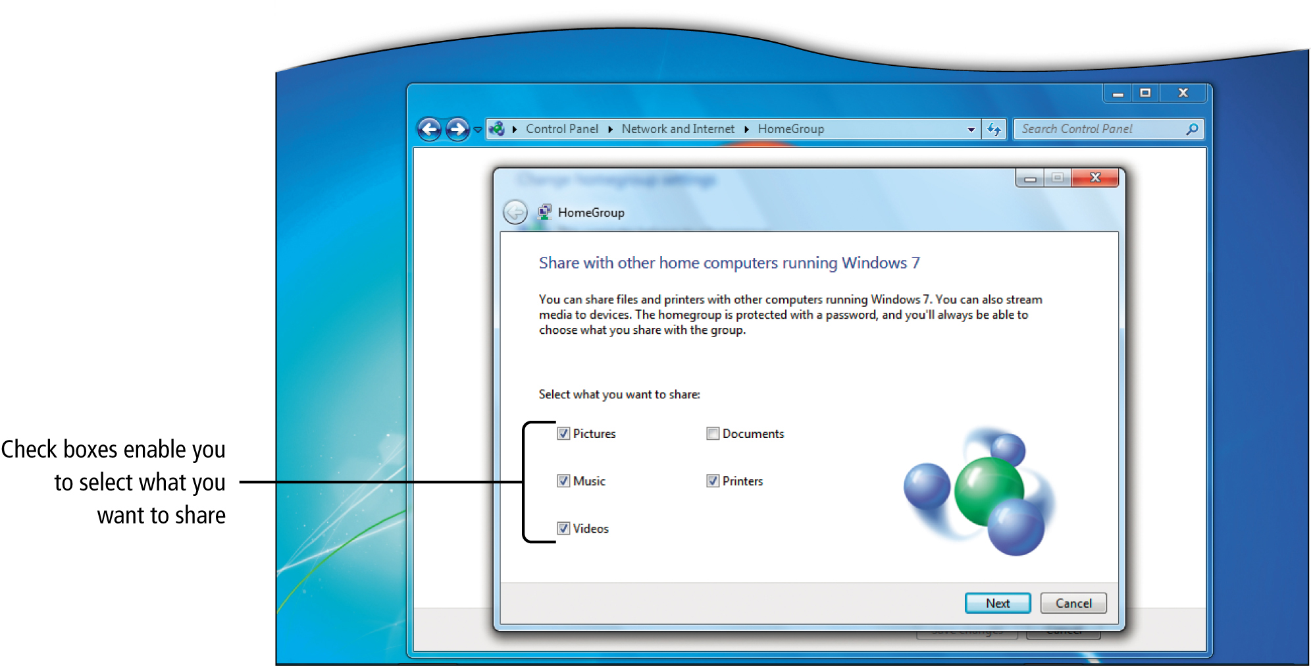
Use Homegroup to Share Files and Printers on a Home Network
Notes:
Figure 7.30

Slide 54
Covered Objectives
Back Up and Restore Files and Folders
Back Up and Restore Your Entire Computer
Configure System Restore and Recover Using Restore Points

Slide 55
Covered Objectives
Use the Network and Sharing Center to Set Up a Home Network
Secure and Troubleshoot a Home Network
Use Homegroup to Share Files and Printers on a Home Network

Slide 56
All rights reserved. No part of this publication may be reproduced, stored in a retrieval system, or transmitted, in any form or by any means, electronic, mechanical, photocopying, recording, or otherwise, without the prior written permission of the publisher. Printed in the United States of America.

