Slide 1
PowerPoint Presentation to Accompany
GO! with Microsoft® Windows 7
Chapter 6
Using Windows Live Essentials
and Windows Media Center

Slide 2
Objectives
Download Windows Live Essentials Photo Gallery and Movie Maker
Locate, View, and Share Photos Using Windows Live Photo Gallery
Add, Tag, Rate, and Edit Photos Using Windows Live Photo Gallery
Use Windows Live Movie Maker to Create a Movie Using Photos

Slide 3
Objectives
Create a Movie Using Video Clips
Navigate and Configure Windows Media Center
Use Windows Media Center to Play Media From Your Computer
Use Windows Media Center to View Sports, Internet TV, and Live TV

Slide 4
Download Windows Live Essentials Photo Gallery and Movie Maker
Windows Live Essentials
Can be downloaded from Microsoft Web site for free
Includes tools for working with photos and videos, creating e-mail accounts, and customizing your Web browser
Download all programs or only the ones you need

Slide 5
Download Windows Live Essentials Photo Gallery and Movie Maker
Downloading Photo Gallery and Movie Maker
Start, All Programs, Accessories folder, Getting Started
Go online to get Windows Live Essentials
Download Photo Gallery and Movie Maker

Slide 6
Download Windows Live Essentials Photo Gallery and Movie Maker
Creating a Windows Live ID
Needed to get the most from Windows Live Essentials programs
You already have a Windows Live ID if you use
Hotmail
Xbox Live
Messenger

Slide 7
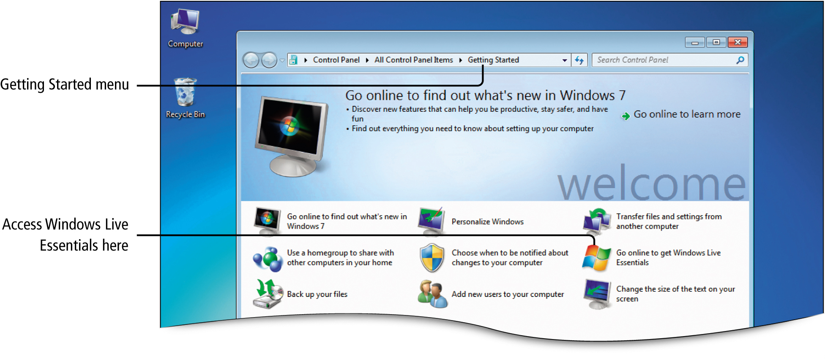
Download Windows Live Essentials Photo Gallery and Movie Maker
Notes:
Figure 6.2

Slide 8
Locate, View, and Share Photos using Windows Live Photo Gallery
Adding Photos to Windows Live Photo Gallery
Photos
Images with continuous color
Photo and video organizer
View, manage, and edit digital pictures
View photos by folder location

Slide 9
Locate, View, and Share Photos using Windows Live Photo Gallery
Photo and Graphic Image Formats
.bmp (bitmap)
Can display millions of colors
Tags can not be added
.gif (Graphic Interchange Format)
Best used for black and white line drawings and clip art
Not supported by Photo Gallery

Slide 10
Locate, View, and Share Photos using Windows Live Photo Gallery
.jpg, .jpeg (Joint Photographic Experts Group)
Used for photos and other continuous tone images on the Web
.png (Portable Network Graphics)
Combines the features of .gifs and .jpegs on the Web
.tif, .tiff (Tagged Image File Format)
Used primarily for traditional print graphics
Not used for Web pages

Slide 11
Locate, View, and Share Photos using Windows Live Photo Gallery
Resolution
The number of pixels used
Pixel
Smallest element used in a picture
The larger number of pixels, higher resolution of the photo

Slide 12
Locate, View, and Share Photos using Windows Live Photo Gallery
View Photos Individually
Zoom in/Zoom out
Use the slider at the bottom of the screen
Rotate
Rotate left and rotate right buttons on the navigation bar
Fit to Window
On navigation bar, returns picture to original size

Slide 13
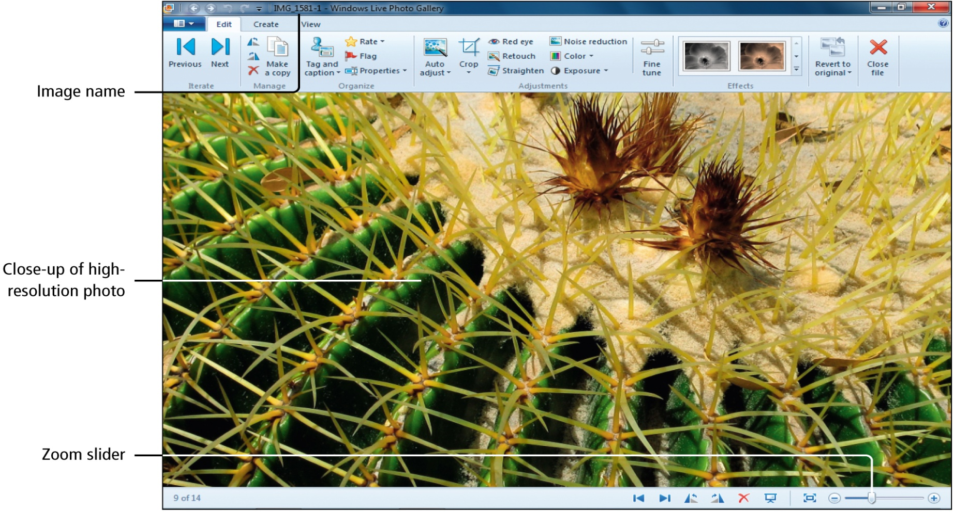
Locate, View, and Share Photos using Windows Live Photo Gallery
Notes:
Figure 6.10

Slide 14
Locate, View, and Share Photos using Windows Live Photo Gallery
View Photos as a Slideshow
Click first photo in the gallery, navigation bar, Slide show button

Slide 15
Locate, View, and Share Photos using Windows Live Photo Gallery
Downloading Photos Directly from a Digital Camera
Card reader (memory card reader, flash memory reader)
Reads and writes data to a flash memory card
USB cable
Downloads pictures directly from a digital camera

Slide 16
Locate, View, and Share Photos using Windows Live Photo Gallery
Downloading Photos Directly from a Digital Camera
Insert memory card from your camera directly into the computer’s cared reader
Turn camera off, plug the USB cable into your camera, plug the USB cable into a USB port on your computer

Slide 17
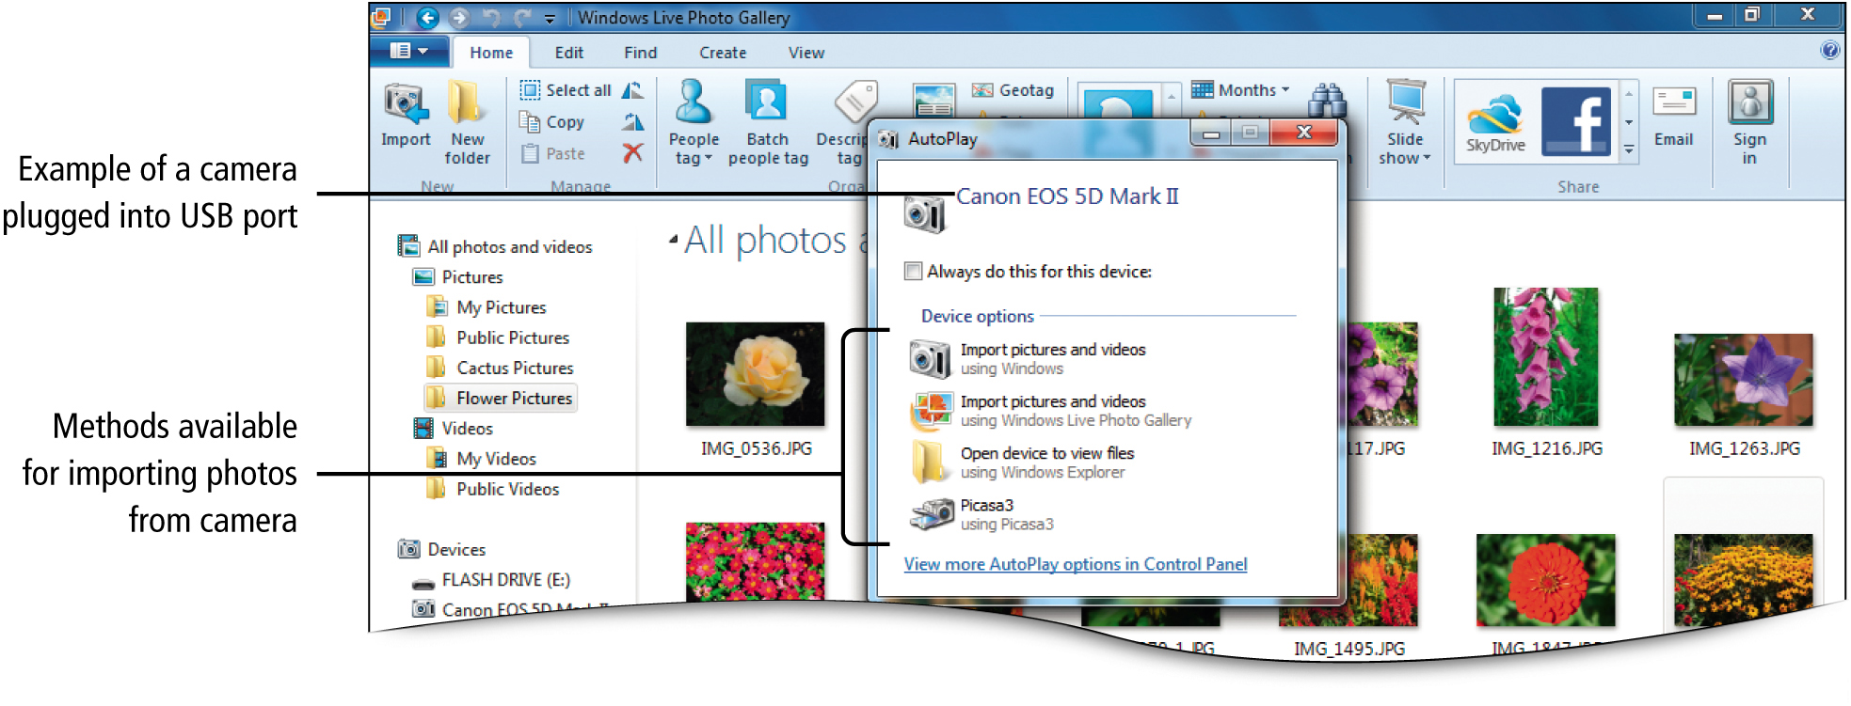
Locate, View, and Share Photos using Windows Live Photo Gallery
Notes:
Figure 6.12

Slide 18
Add, Tag, Rate, and Edit Photos Using Windows Live Photo Gallery
Viewing Detailed Camera Information and Adding Tags
Add metadata to a digital photo
Tag, title, rating, file name, file size
Helps organize files
Speeds up searches

Slide 19
Add, Tag, Rate, and Edit Photos Using Windows Live Photo Gallery
Viewing Detailed Camera Information and Adding Tags
Right-click photo, Properties, Details tab, scroll to display Image and Camera information
Gallery, View tab, Tag and caption pane, Descriptive tags, Add descriptive tags

Slide 20
Add, Tag, Rate, and Edit Photos Using Windows Live Photo Gallery
Adding Ratings to Photos
Uses a 5-star system
Info pane, Information, choose number of stars
Using Metadata to Filter Photos
Caption
Text that accompanies images or video
Info pane, Descriptive tags, Add descriptive tags

Slide 21
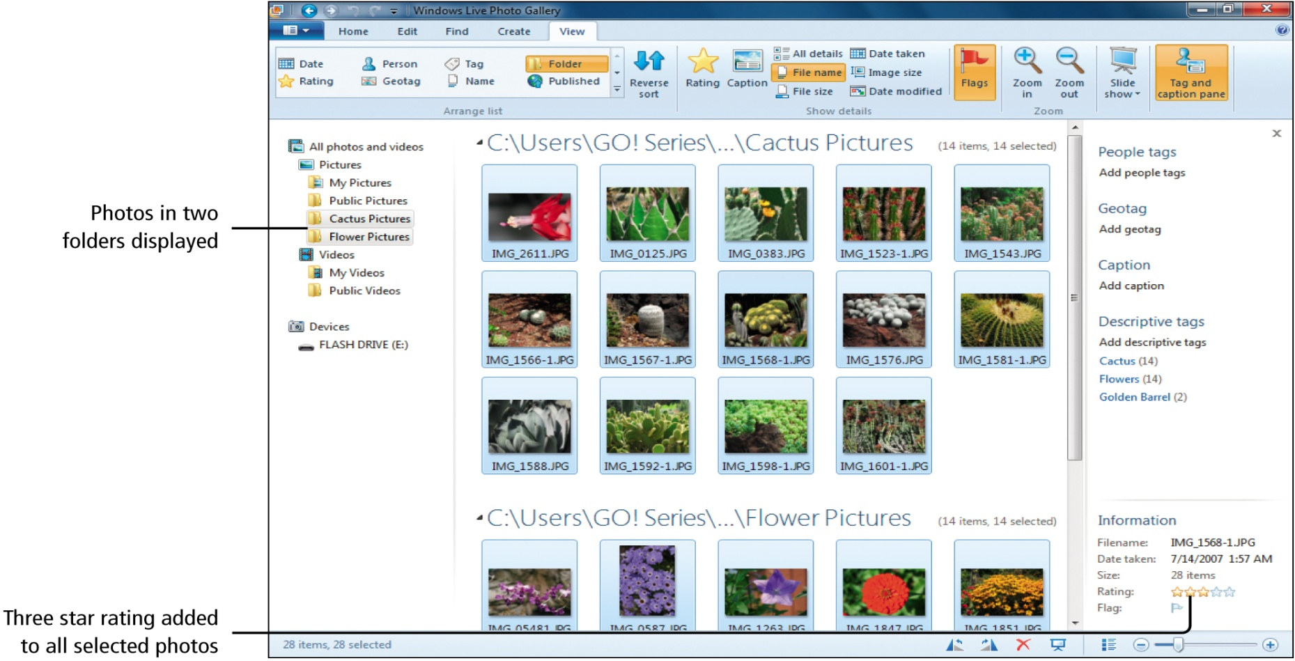
Add, Tag, Rate, and Edit Photos Using Windows Live Photo Gallery
Notes:
Figure 6.17

Slide 22
Add, Tag, Rate, and Edit Photos Using Windows Live Photo Gallery
Using Auto Adjust to Modify a Photo
Auto Adjust
Automatic adjustment tool that allows you to adjust the exposure of a photo
Choose photo, Edit tab, Adjustments group, Auto adjust button

Slide 23
Add, Tag, Rate, and Edit Photos Using Windows Live Photo Gallery
Adjusting Exposure and Color
Brightness
Temperature
Make the photo warmer or cooler
Tint
Change the level of green or red in the photo
Saturation
Change the photo’s color intensity

Slide 24
Add, Tag, Rate, and Edit Photos Using Windows Live Photo Gallery
Adjusting Exposure and Color
Select photo, Edit tab, Adjustments group, Exposure button arrow, Choose exposure adjustment
Select photo, Edit tab, Adjustments group, Color button arrow,

Slide 25
Add, Tag, Rate, and Edit Photos Using Windows Live Photo Gallery
Cropping a picture
Crop
Remove unwanted parts of a photo
Select photo, Edit tab, Adjustments group, Crop button arrow

Slide 26
Add, Tag, Rate, and Edit Photos Using Windows Live Photo Gallery
Printing and E-mailing photos
Color printers
E-mail as attachment
Compress
Reduce the size of a file
Select photo, blue File tab, Print, Print
Home tab, Share group, Email

Slide 27
Add, Tag, Rate, and Edit Photos Using Windows Live Photo Gallery
Burning Photos to a CD
Another way to distribute photos
Can be used to back up photos
Select photos, File tab, Burn, Burn a CD or Burn a DVD

Slide 28
Use Windows Live Movie Maker to Create a Movie Using Photos
Windows Live Movie Maker
Combines audio, video, and still images into a file that can be saved as a movie
Called Digital Video Editing
Project
A file keeps track of the files used in the movie

Slide 29
Use Windows Live Movie Maker to Create a Movie Using Photos
Movie file
Where your movie file is stored after editing
Has a .wmv extension

Slide 30
Use Windows Live Movie Maker to Create a Movie Using Photos
Creating a Movie Project Using Windows Live Movie Maker
AutoMovie Themes
Titles and credits
Special effects
Music
Select photos, Create tab, Share group, Movie button

Slide 31
Use Windows Live Movie Maker to Create a Movie Using Photos
Transition
The manner in which the movie moves from one clip to another
Pan-and-zoom effect
Moves picture horizontally or vertically
Zooms in and out

Slide 32
Use Windows Live Movie Maker to Create a Movie Using Photos
Editing a Movie in Movie Maker
Click slide, Edit tab, Home tab, Format tab

Slide 33
Use Windows Live Movie Maker to Create a Movie Using Photos
Windows Live Movie Maker Screen Elements
Ribbon
Provides access to Movie Maker commands
Movie Maker tab found on the left side of the Ribbon
Preview Monitor
Previews the movie

Slide 34
Use Windows Live Movie Maker to Create a Movie Using Photos
Windows Live Movie Maker Screen Elements
Storyboard
Shows a simple sequence of the files that make up the project
Playback indicator
Shows the current location in the presentation

Slide 35
Use Windows Live Movie Maker to Create a Movie Using Photos
Saving a Movie to the Computer
File can be edited by opening the project again
Choose resolution format
Movie Maker tab, Save movie, Recommended for this project, navigate to folder, Save

Slide 36
Create a Movie Using Video Clips
Video clip
Short video presentation
Frame
A single image in a series of consecutive images

Slide 37
Create a Movie Using Video Clips
Frame rate
Number of frames displayed per second
fps
Frames per second
Higher frame rates produce smoother movement in the video

Slide 38
Create a Movie Using Video Clips
Adding Video Clips to Windows Live Movie Maker
Blue File tab, Include folder, Pictures Library location dialog box, Add

Slide 39
Create a Movie Using Video Clips
Adding Transitions and Editing Video Clips
Set starting and ending points for video
Apply transitions one clip at a time
Movie project open, Edit tab, Editing group

Slide 40
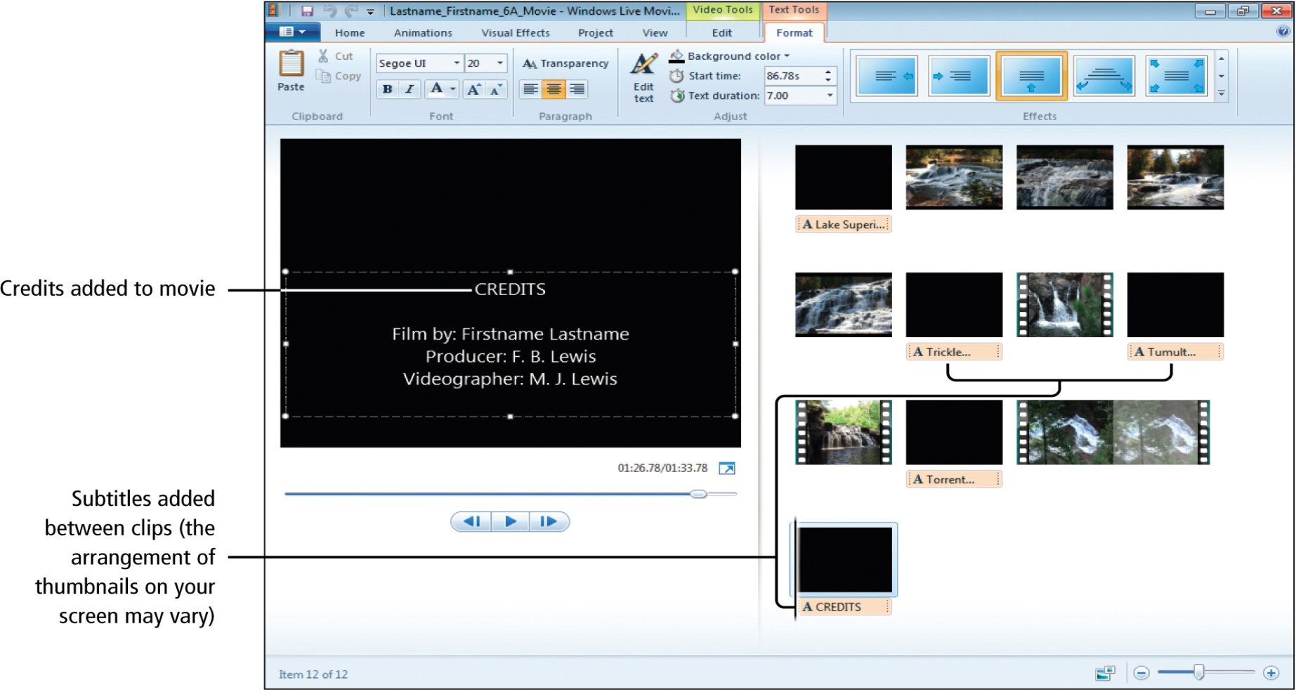
Create a Movie Using Video Clips
Notes:
Figure 6.39

Slide 41
Create a Movie Using Video Clips
.wmv (Windows Media Video)
Format used for movies that can be played using Windows Media Player
Windows DVD Maker
Comes with most versions of Windows 7
Allows you to watch your movies on a television

Slide 42
Create a Movie Using Video Clips
Creating a Movie DVD
Place blank DVD in DVD drive, with movie project open, Movie Maker tab, Save movie, Burn a DVD

Slide 43
Navigate and Configure Windows Media Center
Windows Media Center
Allows you to use your computer as your home entertainment hub
Watching Internet and live TV
Viewing slides of your own photos
Playing songs in your music library or CDs or DVDs

Slide 44
Navigate and Configure Windows Media Center
10-foot interface
Use a remote control interact with Windows Media Center on a TV.
2-foot interface
Use a keyboard and mouse to interact with Windows Media Center on a computer.

Slide 45
Navigate and Configure Windows Media Center
Navigating Windows Media Center
Start, All Programs, Windows Media Center
Main screen
Two intersecting menus

Slide 46
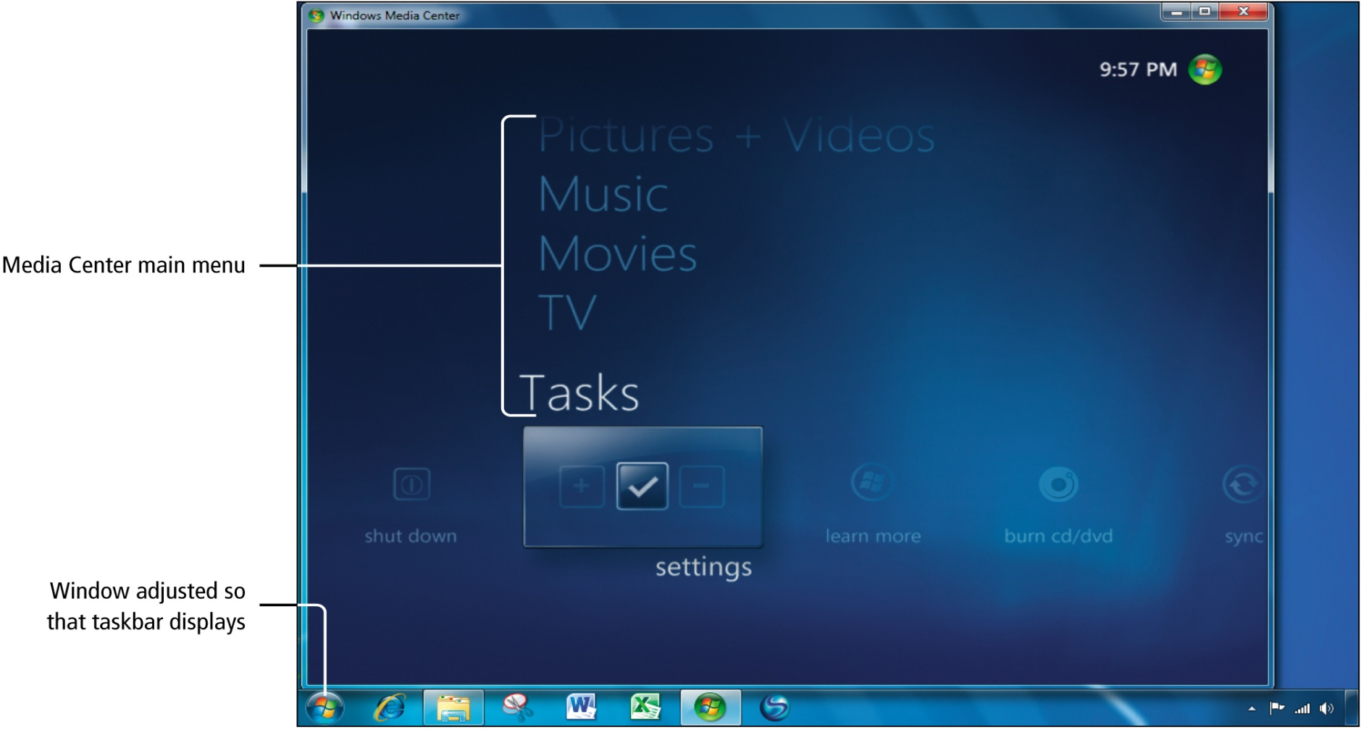
Navigate and Configure Windows Media Center
Notes:
Figure 6.45

Slide 47
Navigate and Configure Windows Media Center
Configuring Windows Media Center
Parental Controls
Slide Show Screen Saver
Media Center displayed, Tasks category, settings

Slide 48
Use Windows Media Center to Play Media from Your Computer
Play CDs or DVDs
Play ripped music or videos
Run a slide show of saved pictures
Play games

Slide 49
Use Windows Media Center to Play Media from Your Computer
Playing Games Using Media Center
Media Center, Extras category, extras library

Slide 50
Use Windows Media Center to Play Media from Your Computer
Playing Music Using Media Center
Play a CD
Music category
Sort CDs
Year
Album
Genre
Songs
Other details

Slide 51
Use Windows Media Center to Play Media from Your Computer
Playing Music Using Media Center
Media Center, Music category, Music commands, music library
Playing a DVD Using Media Center
Media Center, movies category, play dvd
Viewing a Picture Slideshow Using Media Center
Media Center, Pictures + Video, picture library

Slide 52
Use Windows Media Center to View Sports, Internet TV, and Live TV
Setting Up and Using the Internet in Media Center
Your computer can receive live TV
High-speed Internet connection required
Media Center, Tasks, settings, General, Windows Media Center Setup

Slide 53
Use Windows Media Center to View Sports, Internet TV, and Live TV
Setting Up Television in Media Center
Requires an available cable connection and a tuner installed in your computer
Media Center, TV, live tv setup

Slide 54
Covered Objectives
Download Windows Live Essentials Photo Gallery and Movie Maker
Locate, View, and Share Photos Using Windows Live Photo Gallery
Add, Tag, Rate, and Edit Photos Using Windows Live Photo Gallery

Slide 55
Covered Objectives
Use Windows Live Movie Maker to Create a Movie Using Photos
Create a Movie Using Video Clips

Slide 56
Covered Objectives
Navigate and Configure Windows Media Center
Use Windows Media Center to Play Media From Your Computer
Use Windows Media Center to View Sports, Internet TV, and Live TV

Slide 57
All rights reserved. No part of this publication may be reproduced, stored in a retrieval system, or transmitted, in any form or by any means, electronic, mechanical, photocopying, recording, or otherwise, without the prior written permission of the publisher. Printed in the United States of America.
57

