Slide 1

PowerPoint Presentation to Accompany
GO! with Windows 7 Comprehensive
Chapter 5
Exploring the World Wide Web
with Internet Explorer 8

Slide 2
Objectives
Use Tabbed Browsing
Organize Favorites
Manage Browsing History and Browse with inPrivate
Print, Zoom, and Change the Text Size of Webpages
Save Webpage Information

Slide 3
Objectives
Manage Add-ons
Search the Internet
Subscribe to and View an RSS Feed
Use Web Slices, Accelerators, and Suggested Sites
Block Pop-up Windows and Use the Information Bar

Slide 4
Objectives
Protect Against Malware
Protect Your Data

Slide 5
Use Tabbed Browsing
Web browser – software program used to display Webpages and navigate the Internet
Internet Explorer 8 – web browser software developed by Microsoft Corporation that is included with Windows 7

Slide 6
Use Tabbed Browsing
Browsing – describes the process of using a computer to view Web pages
Surfing – describes the process of navigating the Internet either for something in particular or anything that is of interest and quickly moving from one item to another

Slide 7
Use Tabbed Browsing
Blog
  Short for weblog
  An online journal or column used to publish personal or company information in an informal manner
  For example the company that owns Microsoft Word maintain a blog with information about using Word

Slide 8
Use Tabbed Browsing
Tabbed browsing – a feature of Internet Explorer that enables the opening of multiple web sites in a single browser window
  Open each new webpage in a new tab
  Switch among open Webpages by clicking the tabs at the upper portion of the screen
  Advantage is that there are fewer items on the taskbar

Slide 9
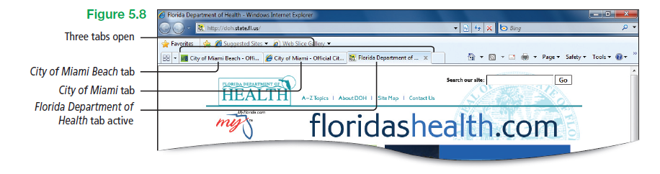
Use Tabbed Browsing
Tab row – displays a tab for each opened webpage
Notes:
Figure 5.8

Slide 10
Use Tabbed Browsing
Home page
  On your computer, refers to whatever webpage you have selected—or is set by default—to display on your computer when you start Internet Explorer
  On a website, refers to the starting point for the remainder of the pages on that site

Slide 11
Use Tabbed Browsing
Address bar
  The area at the top of the Internet Explorer window that displays a URL
  The area where you can type a URL
URL
  Uniform Resource Locator
  An address that uniquely indentifies a location on the Internet

Slide 12
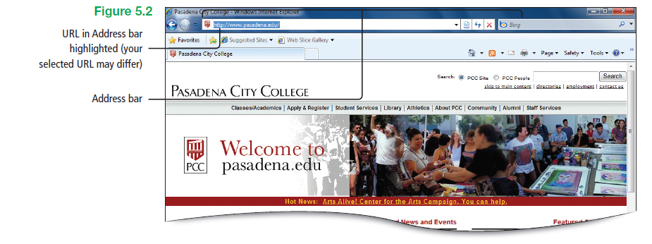
Use Tabbed Browsing
Notes:
Figure 5.2

Slide 13
Use Tabbed Browsing
Protocol prefix – beginning part of a URL
  http prefix is most common
  Followed by a colon and the separators //

Slide 14
Use Tabbed Browsing
HTTP
  HyperText Transfer Protocol
  Represents the set of communication rules used by your computer to connect servers on the Web
  Internet Explorer defaults to the http prefix, so it is not necessary to type it

Slide 15
Use Tabbed Browsing
Domain name – an organization’s unique name on the Internet; it consists of a chosen name combined with a top level domain
Two types of top level domains
  Generic top level domains (i.e., .com; .org)
  Country codes (i.e., .ca; .cn; .uk)

Slide 16
Use Tabbed Browsing
Recent pages – button that displays a list of recently accessed locations
  Current location is indicated by a check mark
  Jump to a recently accessed location quickly by clicking an item on the list
  List is limited to the current session (locations accessed since starting Internet Explorer)

Slide 17
Use Tabbed Browsing
Parts of the Internet Explorer window
  Add to Favorites Bar button
  Address bar
  Back and Forward buttons
  Bing search box
  Command bar
  Favorites Bar
  Favorites button
  New Tab button
  Quick Tabs button
  Recent Pages button
  Refresh button
  Status bar
  Stop button
  Suggested Sites button
  Tab List button
  Tab row
  Web Slice Gallery button

Slide 18
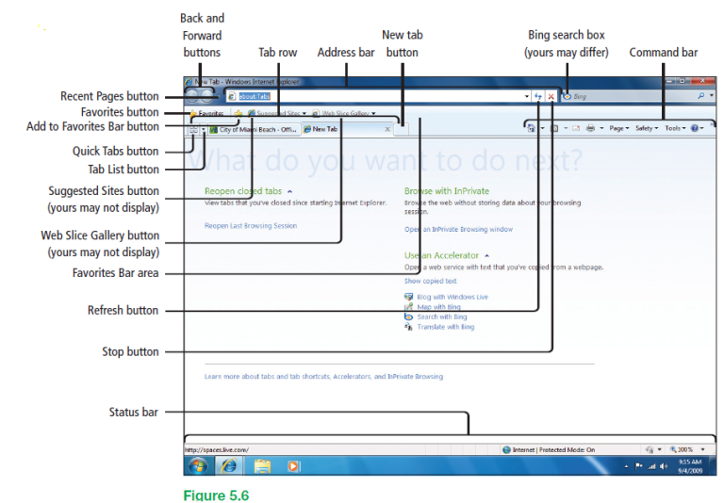
Use Tabbed Browsing
Notes:
Figure 5.6

Slide 19
Use Tabbed Browsing
Quick Tabs – feature that provides a thumbnail view of all open tabs
  From this view, you can click any thumbnail to open a webpage or click the CloseTab button to close a webpage
  Quick Tabs button displays only when you have more than one webpage open

Slide 20
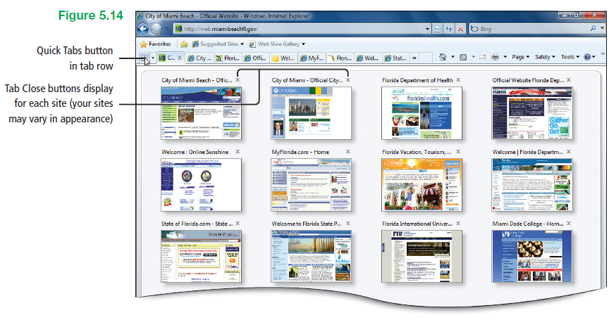
Use Tabbed Browsing
Notes:
Figure 5.14

Slide 21
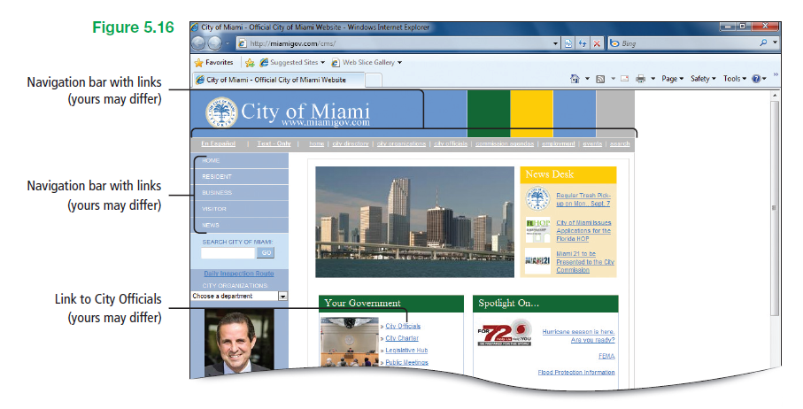
Use Tabbed Browsing
Navigation bar – groups of links

Slide 22
Organize Favorites
Favorites Center – list of links to websites that are saved in the web browser
  Used for saving a website as a favorite and allows returning to it quickly
  Used to create a folder to organize favorite links into groups that are meaningful

Slide 23
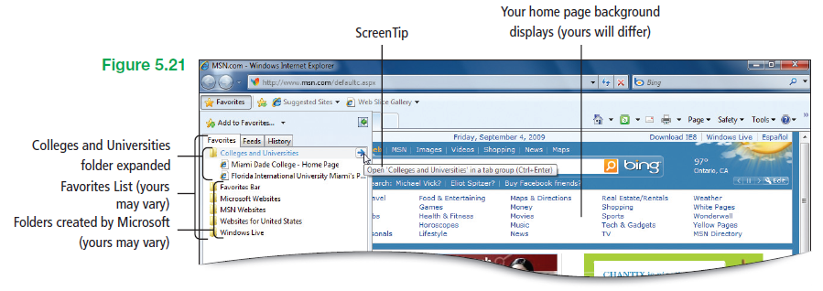
Organize Favorites
Notes:
Figure 5.21

Slide 24
Organize Favorites
Favorites bar
  Toolbar that displays directly below the Address bar
  Used to add or drag web addresses frequently visited
  Used to monitor RSS feeds and store Web slices

Slide 25
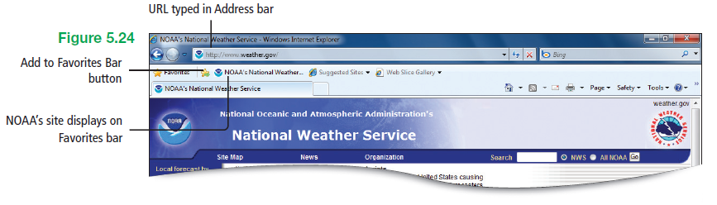
Organize Favorites
Notes:
Figure 5.24

Slide 26
Manage Browsing History and Browse with InPrivate
Browsing history – information stored by Internet Explorer about the websites visited
  Temporary Internet files – copies of webpages, images, and media downloaded from the Web
  Cookies – small text files that websites put on a computer to store information about user’s preferences

Slide 27
Manage Browsing History and Browse with InPrivate
Browsing history
  History of websites visited
  Information entered into websites or the Address bar
    Includes user’s name
    Address if entered it into a site
    URLs that have been visited before
  Saved Web passwords

Slide 28
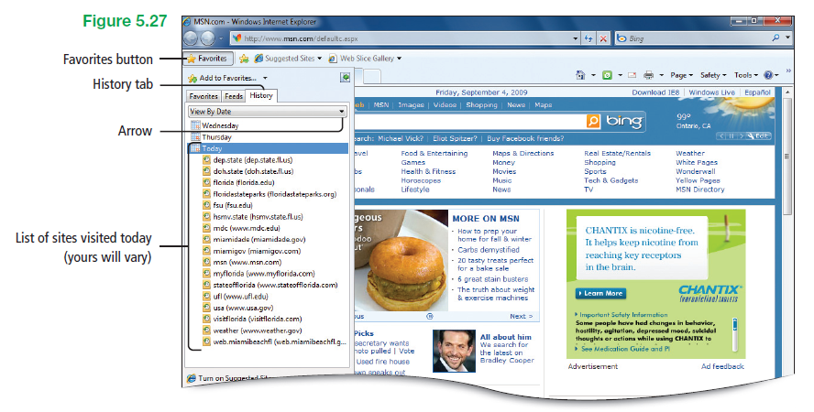
Manage Browsing History and Browse with InPrivate
Notes:
Figure 5.27

Slide 29
Manage Browsing History and Browse with InPrivate
InPrivate Browsing – a feature in Internet Explorer 8 that allows browsing the Web without storing data about the browsing session
  Prevents anyone else who might be using the computer from seeing what sites were previously visited

Slide 30
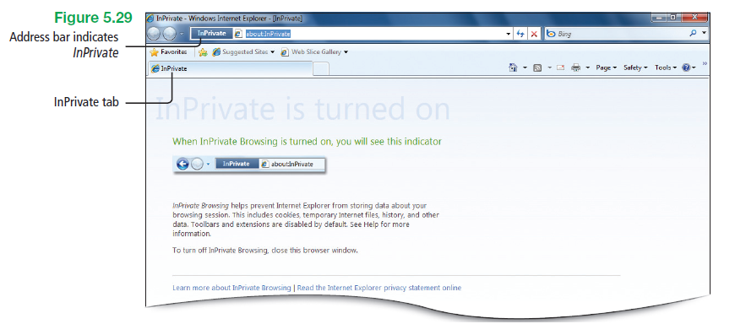
Manage Browsing History and Browse with InPrivate
Notes:
Figure 5.29

Slide 31
Print, Zoom, and Change the Text Size of Webpages
Portal – a website that displays news, content, and links that are of interest to a specific audience
  For example individuals who need information about Florida

Slide 32
Print, Zoom, and Change the Text Size of Webpages
Parts of the Print Preview window
  Adjust margin buttons
  Change Print Size
  First Page arrow
  Landscape
  Last Page arrow
  Next Page arrow
  Page indicator
  Page Setup
  Portrait
  Previous Page arrow
  Print Document
  Show multiple pages
  Turn headers or footers on or off
  View Full Page
  View Full Width

Slide 33
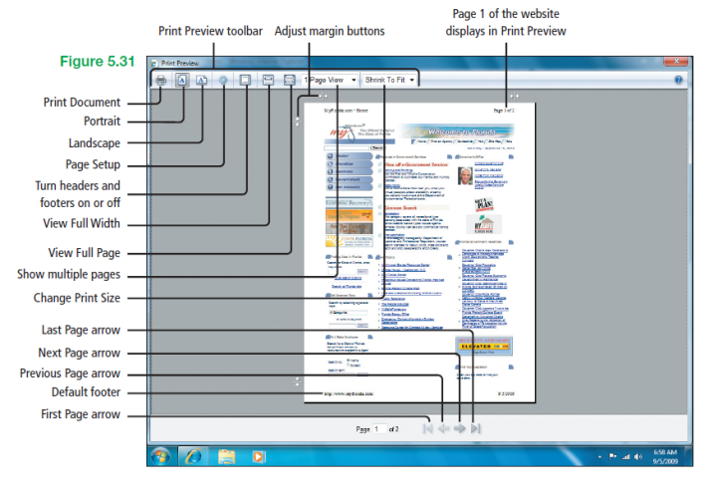
Print, Zoom, and Change the Text Size of Webpages
Notes:
Figure 5.31

Slide 34
Save Webpage Information
Save website information
  Entire webpage
  An image on a webpage
  Selected text from a webpage
Refer to information later without accessing the Internet

Slide 35
Manage Add-ons
Add-on – program that adds features to a web browser such as Internet Explorer
  Most come from the Internet
  Most require permission to install them on the computer
  For example additional toolbars, animated mouse pointers, interactive content

Slide 36
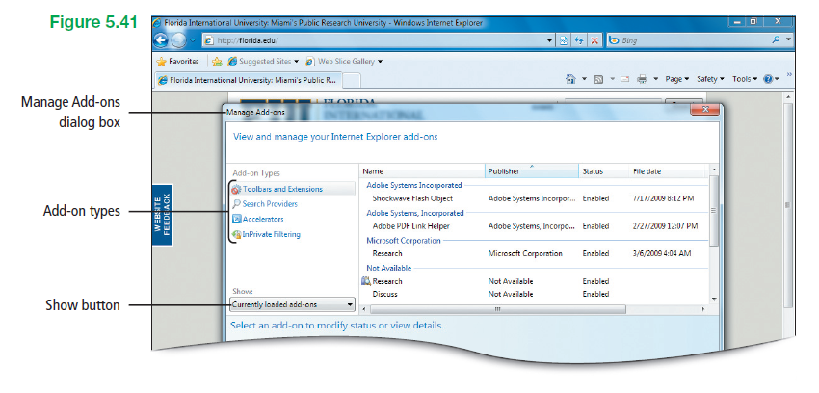
Manage Add-ons
Notes:
Figure 5.41

Slide 37
Manage Add-ons
Digital signature – electronic security mark that can be added to files
  Enables verifying the publisher of a file
  Helps to verify that the file has not been changed since it was digitally signed
  If (Not verified) displays in the Publisher column, the add-on itself is not digitally signed

Slide 38
Manage Add-ons
ActiveX – technology for creating interactive web content
  An ActiveX control is a type of add-on
  For example animation sequences, credit card transactions, spreadsheet calculations

Slide 39
Manage Add-ons
Information bar – commonly displays information about downloads, blocked pop-up windows, and installing ActiveX controls
  Usually displayed as a yellow bar
  Displays below the Address bar

Slide 40
Search the Internet
Search term – a word or phrase that describes the topic about which information is wanted
  Can be typed directly in the Address bar
  Easiest method of searching for information on the Internet without navigating to a specific website

Slide 41
Search the Internet
Search provider – a website that provides search capabilities on the Web
  Default search provider in Internet Explorer 8 is Microsoft’s Bing
  Can be easily changed and switched among providers

Slide 42
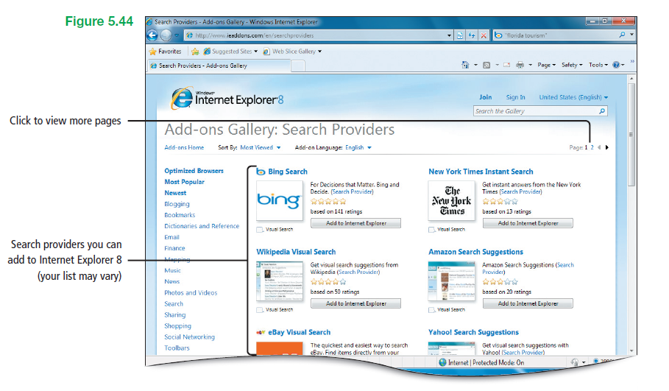
Search the Internet
Notes:
Figure 5.44

Slide 43
Search the Internet
Sponsored links – paid advertisements shown as links, typically for products and services related to a search term
  Used by search sites such as Bing, Google, and others to earn revenue

Slide 44
Subscribe to and View an RSS Feed
RSS
  Acronym for Really Simple Syndication
  A syndication format popular for aggregating updates to blogs and news sites

Slide 45
Subscribe to and View an RSS Feed
RSS – contains frequently updated content published by a website
  Also known as an XML feed, syndicated content, or a web feed
  Feed consists of a list of news articles from a specific site, each with a headline and summary information, usually a date and time stamp, and a link to the full article for each item

Slide 46
Subscribe to and View an RSS Feed
RSS viewer
  Also referred to as a feed reader
  A program that displays subscribed RSS feeds
  One is provided with Internet Explorer 8

Slide 47
Subscribe to and View an RSS Feed
RSS feeds
  Feeds are different than a website
  Feeds are usually free
  Other programs can display a feed
  Come in two common formats
    RSS
    Atom

Slide 48
Use Web Slices, Accelerators, and Suggested Sites
Web Slice – a specific portion—a slice—of a webpage to which one can subscribe
  Enables seeing updated content from available sites
  Displays as a link on the Favorites bar
  When updated, the link displays in bold
  For example the current temperature

Slide 49
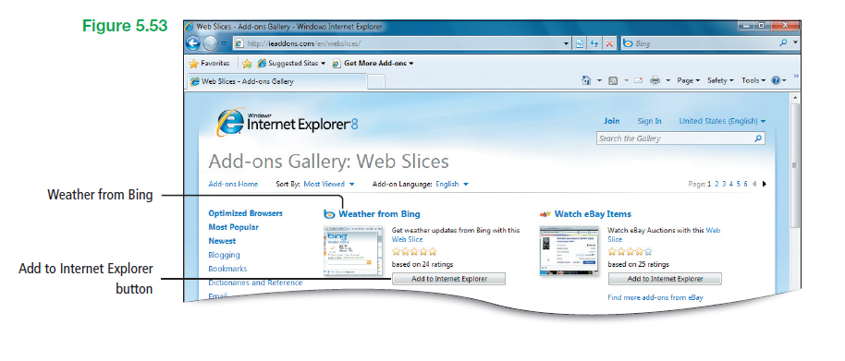
Use Web Slices, Accelerators, and Suggested Sites
Notes:
Figure 5.53

Slide 50
Use Web Slices, Accelerators, and Suggested Sites
Accelerators – feature that displays a blue Accelerator icon when selecting text from any webpage
  When clicked, enables accomplishing tasks such as finding a map, defining a word, or e-mailing content to others

Slide 51
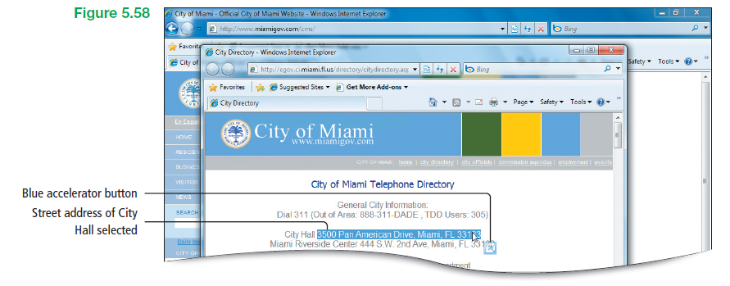
Use Web Slices, Accelerators, and Suggested Sites
Notes:
Figure 5.58

Slide 52
Use Web Slices, Accelerators, and Suggested Sites
Suggested Sites – an optional online service that suggests other websites of interest based on the previously visited websites
  Activated by clicking on Favorites bar, and clicking Turn on Suggested Sites
  Alternately activated from the Tools menu, and then clicking Suggested Sites

Slide 53
Block Pop-up Windows and Use the Information Bar
Pop-up – small web browser window that displays on top of the website being viewed
  Usually created by advertisers
Pop-up Blocker – feature in Internet Explorer that enables limiting or blocking most pop-ups

Slide 54
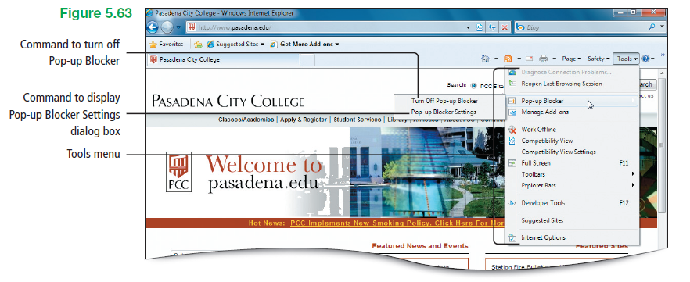
Block Pop-up Windows and Use the Information Bar
Notes:
Figure 5.63

Slide 55
Protect Against Malware
Protected mode – makes it more difficult for malicious software to be installed on computer by preventing a downloaded program from making any direct changes to the system
  Helps protect a computer by restricting where files can be saved without consent

Slide 56
Protect Against Malware
Protected mode
  Allows installation of wanted ActiveX controls or add-ons when logged on as administrator
  On by default and indicated in the status bar

Slide 57
Protect Against Malware
Windows Defender – spyware scanning and removal tool included with Windows 7
  By default, when enabled, scans computer for spyware automatically daily at 2:00 a.m.
  During scan, Defender takes automatic action on various items, depending on preferences

Slide 58
Protect Against Malware
Windows Defender
  If Defender finds spyware, users are prompted with options to deal with each threat by selecting Ignore, Quarantine, Remove, or Always Allow
  Constantly updates its definitions so that it can find new spyware threats that emerge on the Internet

Slide 59
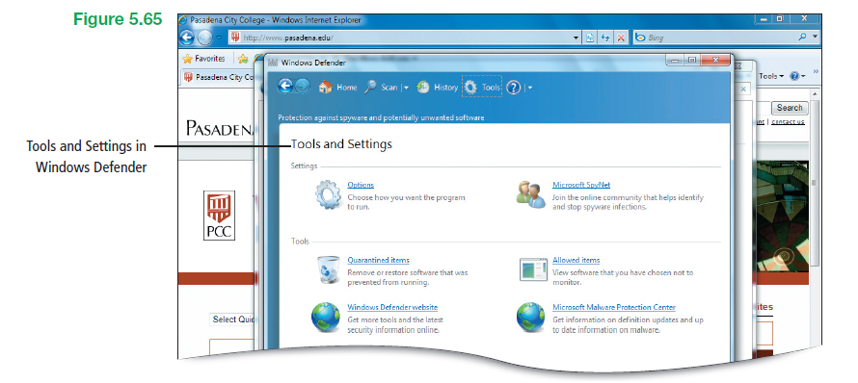
Protect Against Malware
Notes:
Figure 5.65

Slide 60
Protect Your Data
Certificate – a digital document that verifies the identity of a person or indicates the security of a website
  Issued by trusted companies known as Certification Authorities
  Used to make secure transactions on the Internet possible

Slide 61
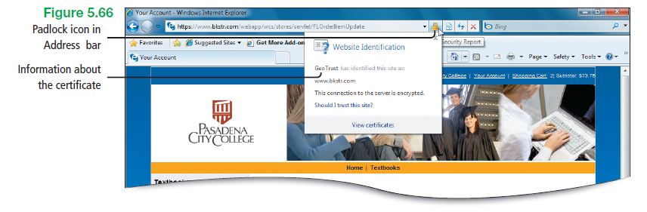
Protect Your Data
Notes:
Figure 5.66

Slide 62
Protect Your Data
Phishing – technique used to trick computer users into revealing personal or financial information through an e-mail message or website
  Message or site appears to come from trusted source, but actually directs recipients to provide information to a fraudulent website

Slide 63
Protect Your Data
SmartScreen Filter – feature in Internet Explorer that helps direct phishing websites and websites that distribute malware
  Runs in the background and protects users by comparing the addresses of websites visited against a list of sites reported to Microsoft as legitimate

Slide 64
Protect Your Data
SmartScreen Filter
  Analyzes the sites visited to see if they have characteristics common to a phishing site

Slide 65
Covered Objectives
Use Tabbed Browsing
Organize Favorites
Manage Browsing History and Browse with inPrivate
Print, Zoom, and Change the Text Size of Webpages
Save Webpage Information

Slide 66
Covered Objectives
Manage Add-ons
Search the Internet
Subscribe to and View an RSS Feed
Use Web Slices, Accelerators, and Suggested Sites
Block Pop-up Windows and Use the Information Bar

Slide 67
Covered Objectives
Protect Against Malware
Protect Your Data

Slide 68
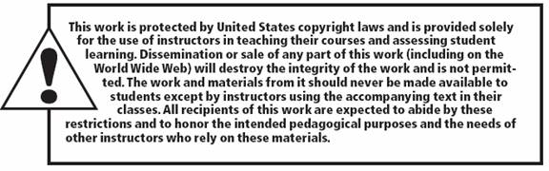
All rights reserved. No part of this publication may be reproduced, stored in a retrieval system, or transmitted, in any form or by any means, electronic, mechanical, photocopying, recording, or otherwise, without the prior written permission of the publisher. Printed in the United States of America.

