Slide 1

PowerPoint Presentation to Accompany
GO! with Windows 7 Comprehensive
Chapter 4
Personalizing Your Windows 7 Environment
and Using Windows Media Player

Slide 2
Objectives
Personalize the Desktop and Screen Saver
Personalize the Start Menu
Personalize the Taskbar
Personalize the Desktop by Adding Gadgets
Personalize the Ease of Access Center and Use the Problem Steps Recorder

Slide 3
Objectives
Explore Windows Media Player
Play Music Using Media Player
Rip a CD
Burn a CD
Watch Videos Using Windows Media Player

Slide 4
Personalize the Desktop and Screen Saver
Desktop
  Simulates the top of an actual desktop and acts as your work area in Windows 7
  Main screen area you see after you turn on your computer and log on
  Includes the taskbar at the bottom and the Start button in the lower left corner

Slide 5
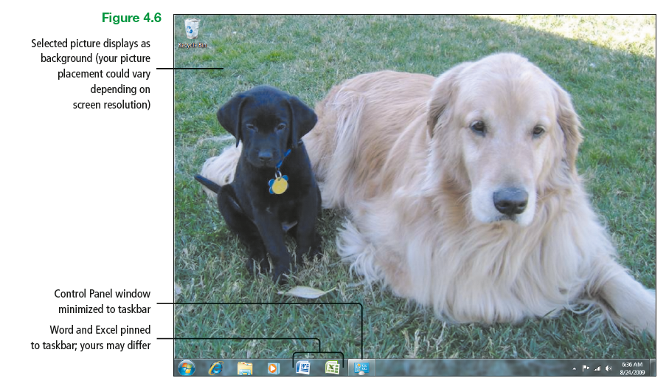
Personalize the Desktop and Screen Saver
Notes:
Figure 4.6

Slide 6
Personalize the Desktop and Screen Saver
Screen saver – moving picture or pattern that displays on screen after a specified period of inactivity
Desktop background
  Sometimes referred to as the wallpaper
  One of the easiest ways to personalize your computer environment

Slide 7
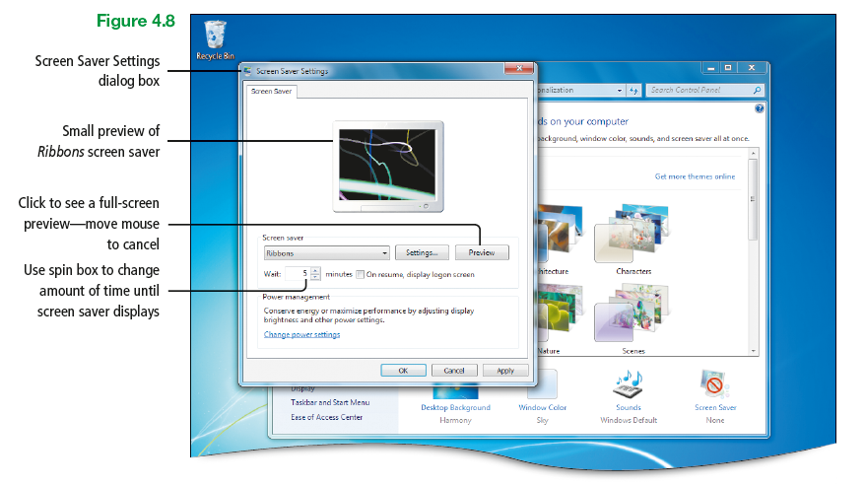
Personalize the Desktop and Screen Saver
Notes:
Figure 4.8

Slide 8
Personalize the Desktop and Screen Saver
Theme
  Combination of pictures, colors, and sounds on your computer
  Includes a desktop background, a screen saver, a window border color, and a sound theme

Slide 9
Personalize the Desktop and Screen Saver
Browsing – describes the process of navigating within Windows 7 to look for a specific program, file, e-mail, Control Panel feature, or Internet favorite

Slide 10
Personalize the Desktop and Screen Saver
Aero – desktop experience that features a translucent glass design for windows, attractive graphics, taskbar previews of open windows, and the Aero features, such as Snap and Aero Peek

Slide 11
Personalize the Desktop and Screen Saver
Spyware – software that sends information about your web surfing habits to a website without your knowledge

Slide 12
Personalize the Start Menu
Start menu – list of choices that provides access to a computer’s programs, folders, and settings
  Useful for controlling programs and files that appear there
  Useful for performing common tasks (i.e., starting programs, opening commonly used programs, turning off computer)

Slide 13
Personalize the Start Menu
Programs list – left side of the Start menu that displays recently used programs on the bottom, programs pinned to the Start menu at the top, and a button to display all the programs on a computer

Slide 14
Personalize the Start Menu
Common folders and features – right side of the Start menu that provides quick access to the folders and features used most often
Search box – area on the Start menu from which one can search for programs, files, folders, and e-mail messages

Slide 15
Personalize the Start Menu
Shut down button – displays a menu for switching users, logging off, restarting, or shutting down

Slide 16
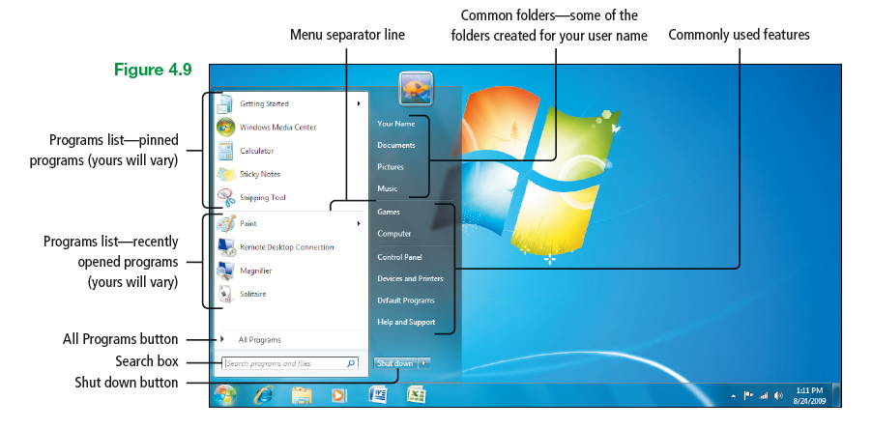
Personalize the Start Menu
Notes:
Figure 4.9

Slide 17
Personalize the Taskbar
Taskbar – area along the lower edge of the desktop that contains the Start button, a button for all open programs, and the notification area
  Can be moved, hidden, and resized
  Can be made more efficient if toolbars are added

Slide 18
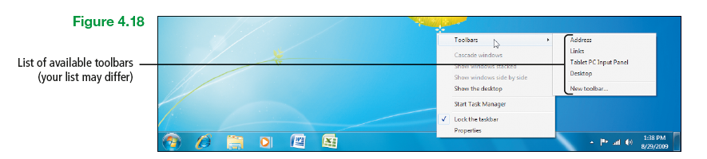
Personalize the Taskbar
Notes:
Figure 4.18

Slide 19
Personalize the Taskbar
Notification area – area at the right end of the taskbar that contains some programs and notifications
  Also referred to as the system tray or the status area

Slide 20
Personalize the Taskbar
Notification – small pop-up window providing information about status, progress, and detection of new devices
  May display from time to time
  Examples include incoming e-mail, updates, network connectivity

Slide 21
Personalize the Taskbar
Action Center – lists important messages about security and maintenances settings on your computer that need your attention
  Central place to view alerts and take actions
  An example would be to view and install updates

Slide 22
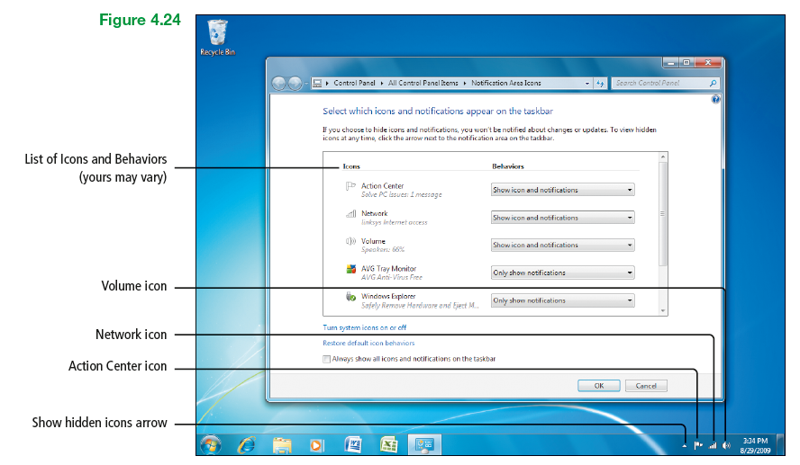
Personalize the Taskbar
Notes:
Figure 4.24

Slide 23
Personalize the Desktop by Adding Gadgets
Gadget – mini-program that offers information and provides easy access to frequently used tools
  Also known as a desktop gadget
  Can display continuously updated information and enable performing common tasks without opening a window

Slide 24
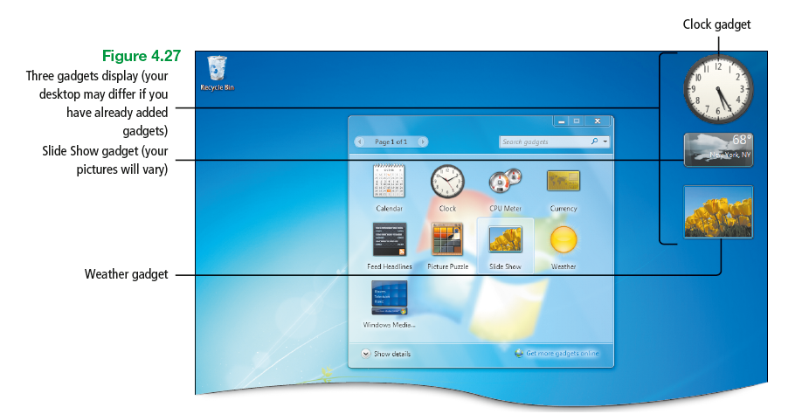
Personalize the Desktop by Adding Gadgets
Notes:
Figure 4.27

Slide 25
Personalize the Desktop by Adding Gadgets
Feeds
  Also known as RSS feeds, XML feeds, syndicated content, or web feeds
  Contain frequently updated content published by a website

Slide 26
Personalize the Desktop by Adding Gadgets
RSS
  Acronym for Really Simple Syndication
  Syndication format popular for collecting updates to blogs and news sites
  Syndication format – publishing format that views headlines of the latest updates from blogs and websites all from within a single newsreader program

Slide 27
Personalize the Ease of Access Center and Use the Problem
Steps Recorder
Ease of Access Center – centralized location for accessibility settings and programs that can make a computer easier and more comfortable to use

Slide 28
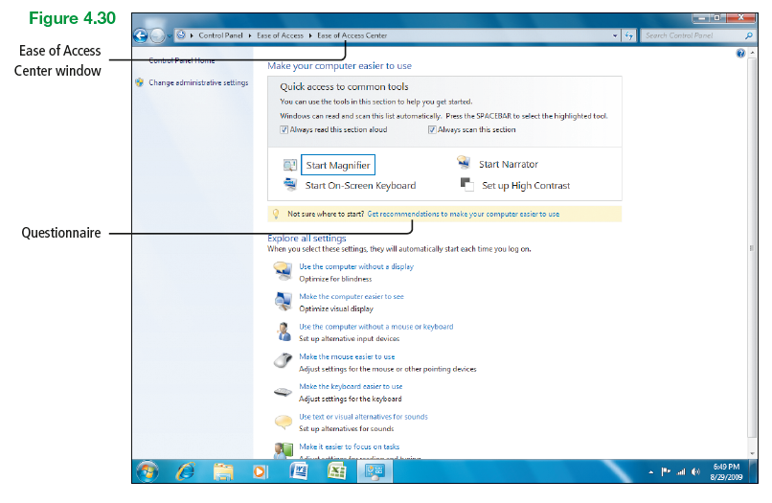
Personalize the Ease of Access Center and Use the Problem
Steps Recorder
Notes:
Figure 4.30

Slide 29
Personalize the Ease of Access Center and Use the Problem
Steps Recorder
Magnifier – screen enlarger that magnifies a portion of the screen
  Helpful for computer users with impaired vision and for those who require occasional screen magnification for performing various tasks

Slide 30
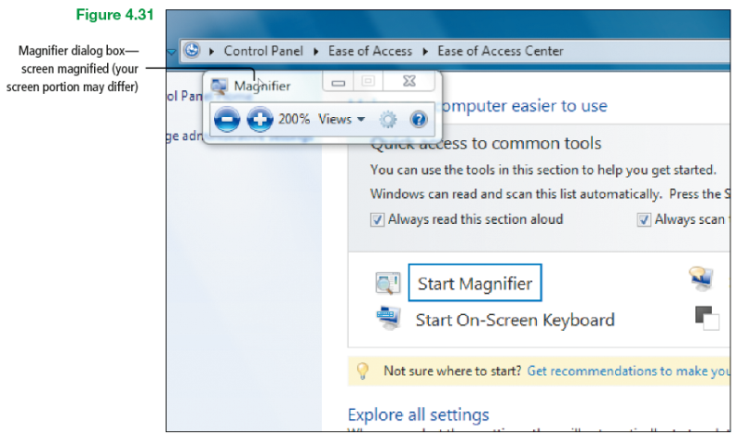
Personalize the Ease of Access Center and Use the Problem
Steps Recorder
Notes:
Figure 4.31

Slide 31
Personalize the Ease of Access Center and Use the Problem
Steps Recorder
Problem Steps Recorder – captures steps performed on a computer including a text description of where clicked and a picture of the screen during each click
  The picture of the screen during each click is referred to as a screenshot

Slide 32
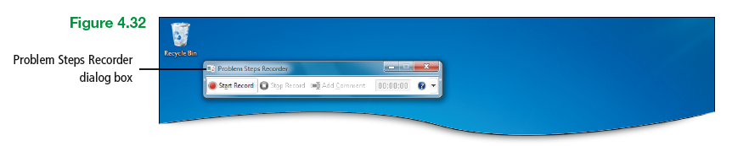
Personalize the Ease of Access Center and Use the Problem
Steps Recorder
Notes:
Figure 4.32

Slide 33
Explore Windows Media Player
Windows Media Player – feature of Windows 7 that provides an easy-to-use way to play digital media files, organize digital media collection, burn CDs, rip music from CDs, sync digital media files to a portable device, and shop for digital media content from online stores

Slide 34
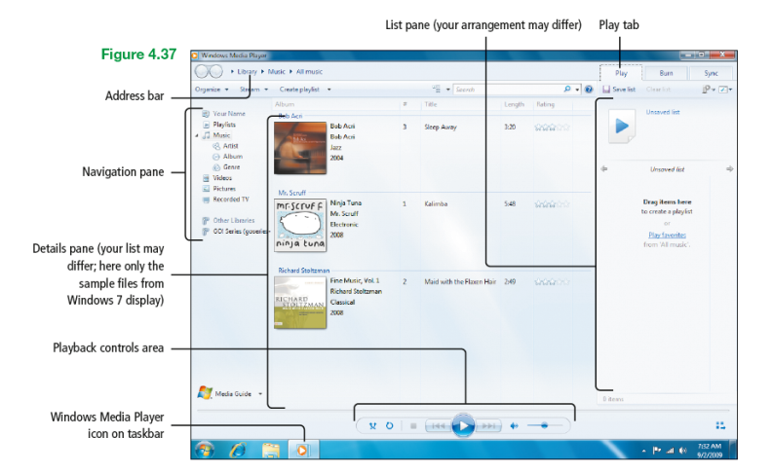
Explore Windows Media Player
Notes:
Figure 4.37

Slide 35
Explore Windows Media Player
Burn (a CD) – copy files to a recordable CD or DVD
Rip – copy digital media content from an audio CD
Sync – process of maintaining digital media files on your portable device based on specific rules

Slide 36
Explore Windows Media Player
Portable device – any mobile electronic device that can exchange files or other data with a computer or device
  Examples are Smartphone and portable music player

Slide 37
Play Music Using Media Player
Now Playing mode – minimizing the Media Player window and letting it play in the background while performing other tasks on a computer

Slide 38
Play Music Using Media Player
Player Library mode
  Gives comprehensive control over the numerous features of the Media Player
  Within this mode, one can alter the Media Player window to display interesting visuals that are integrated with the music

Slide 39
Play Music Using Media Player
Graphic equalizer
  Enables adjustment of the bass and treble that are heard
  Sliders on left control the bass
  Sliders on right control the treble

Slide 40
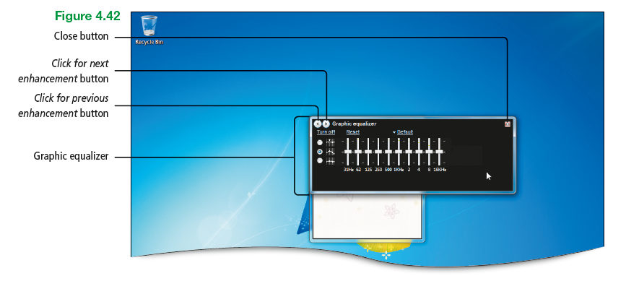
Play Music Using Media Player
Notes:
Figure 4.42

Slide 41
Play Music Using Media Player
Visualizations
  Splashes of colors and geometric shapes
  Available from three categories: Alchemy, Bars and Waves, and Battery
  More are available from the Web
  Change patterms with the rhythm and intensity of the music

Slide 42
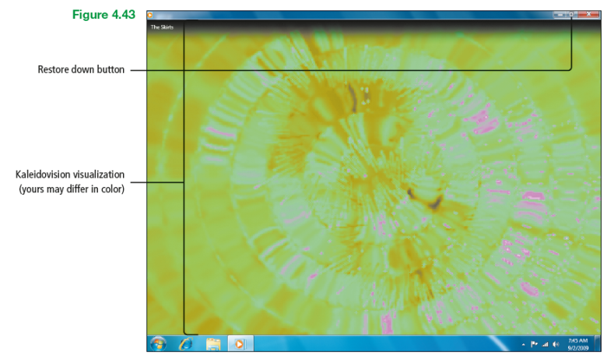
Play Music Using Media Player
Notes:
Figure 4.43

Slide 43
Play Music Using Media Player
Skin – user interface that displays an alternative appearance and customized functionality for software such as Windows Media Player

Slide 44
Play Music Using Media Player
Skin mode
  Display mode in which user interface is displayed as a skin
  Displays a small Media Player window that includes a menu, video area, and playback controls

Slide 45
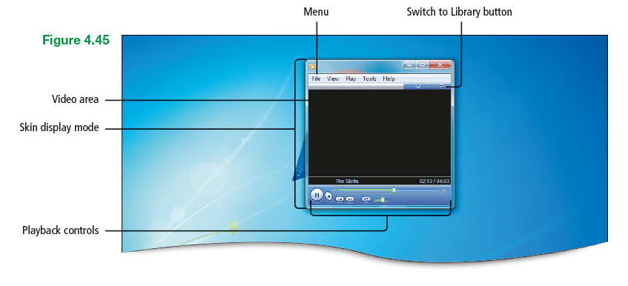
Play Music Using Media Player
Notes:
Figure 4.45

Slide 46
Play Music Using Media Player
Playlist
  List of digital media items that are created and saved
  Used to group items that frequently are listened to

Slide 47
Play Music Using Media Player
Auto playlist – continuously updates automatically based on the music in the Player Library
Regular playlist – list saved that contains one or more digital files
  Any combination of songs, videos, or pictures in the Player Library

Slide 48
Rip a CD
Rip a CD – add songs to a computer from CDs
  Copy digital media tracks from a music CD to a format that can be played on a computer
  Copy entire CDs or selected

Slide 49
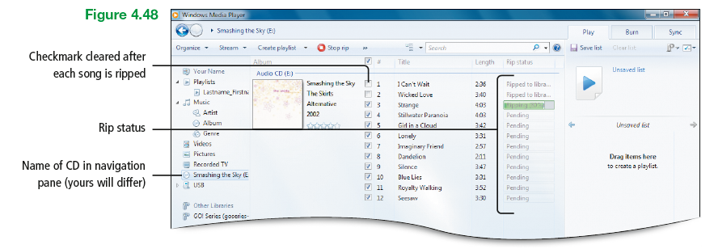
Rip a CD
Notes:
Figure 4.48

Slide 50
Rip a CD
Bit rate – amount of information saved per second
  The higher the bit rate, the better the sound, and the larger the files

Slide 51
Rip a CD
Copyright issues
  Commercial CDs are almost always protected by copyright laws
  Most people agree that ripping CDs that one owns, and are for making these copies for personal use is legal
  Creating CDs for someone else, trading, or make the files available on the Internet is a violation of copyright laws

Slide 52
Burn a CD
Burn a CD – write files to CDs and DVDs
  Data CDs or music CDs can be burned
  CD-Rs are CDs that can be written to one time
  CD-RWs are rewritable discs that can be used over and over again

Slide 53
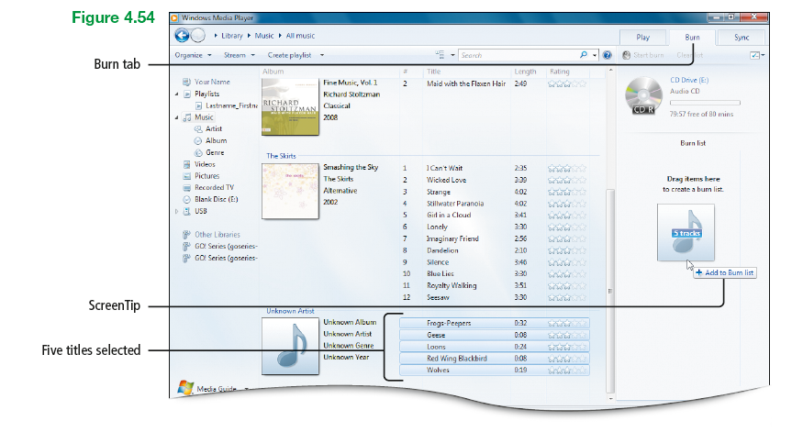
Burn a CD
Notes:
Figure 4.54

Slide 54
Watch Videos Using Windows Media Player
Windows Media Player
  Provides a basic method for viewing pictures and videos
  Allows playlists to be built that include a combination of videos and pictures

Slide 55
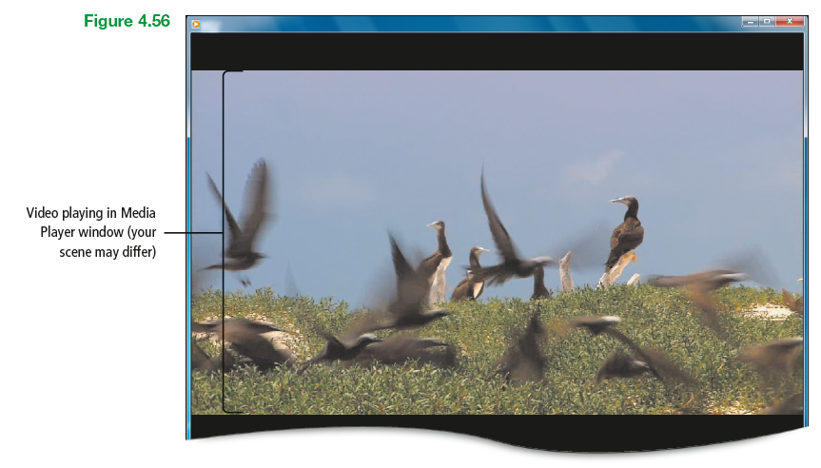
Watch Videos Using Windows Media Player
Notes:
Figure 4.56

Slide 56
Covered Objectives
Personalize the Desktop and Screen Saver
Personalize the Start Menu
Personalize the Taskbar
Personalize the Desktop by Adding Gadgets
Personalize the Ease of Access Center and Use the Problem Steps Recorder

Slide 57
Covered Objectives
Explore Windows Media Player
Play Music Using Media Player
Rip a CD
Burn a CD
Watch Videos Using Windows Media Player

Slide 58
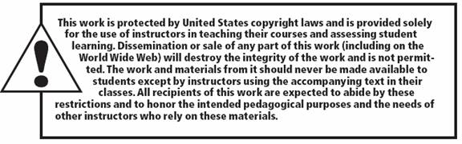
All rights reserved. No part of this publication may be reproduced, stored in a retrieval system, or transmitted, in any form or by any means, electronic, mechanical, photocopying, recording, or otherwise, without the prior written permission of the publisher. Printed in the United States of America.

