Slide 1

PowerPoint Presentation to Accompany
GO! with Windows 7 Comprehensive
Chapter 3
Advanced File Management and
Advanced Searching

Slide 2
Objectives
Navigate by Using the Address Bar
Create and Navigate Favorites
Personalize the Display of Files and Folders
Recognize File Types and Associate Files with Programs

Slide 3
Objectives
Filter Searches in the Search Box
Search by Using the Search Folder
Save a Search, Manage Search Behavior, and Manage the Index

Slide 4
Navigate by Using the
Address Bar
Location
  Displayed by the address bar
  A series of links separated by arrows
  Allows navigation to folders and other resources (i.e., Control Panel)

Slide 5
Navigate by Using the
Address Bar
Directory – a folder on a disk in which you store files
Path – sequence of folders (directories) that leads to a specific file or folder

Slide 6
Navigate by Using the
Address Bar
Location icon – depicts the location (library, disk drive, folder, and so on) currently being accessed

Slide 7
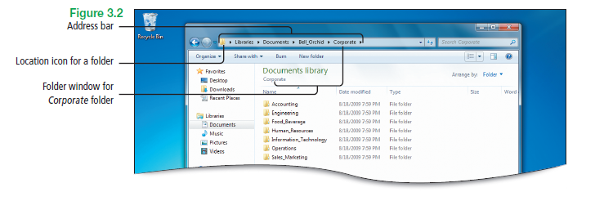
Navigate by Using the
Address Bar
Notes:
Figure 3.2

Slide 8
Navigate by Using the
Address Bar
Recent Pages button – displays a list of recently accessed locations
  The current location is indicated by a check mark
  Quick movement to a recently accessed location is accomplished by clicking an item

Slide 9
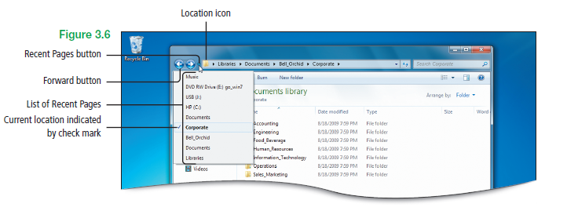
Navigate by Using the
Address Bar
Notes:
Figure 3.6

Slide 10
Navigate by Using the
Address Bar
Base locations
  Locations frequently need to access to manage a computer
  Includes Libraries, Homegroup, personal folder, Computer, Network, Control Panel, and Recycle Bin

Slide 11
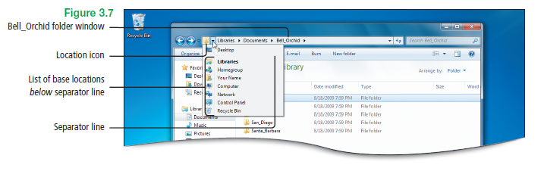
Navigate by Using the
Address Bar
Notes:
Figure 3.7

Slide 12
Create and Navigate Favorites
Favorites
  Display in the navigation pane of a folder window and in the two common dialog boxes
    Save As dialog box
    Open dialog box
  List are customizable for each user account

Slide 13
Create and Navigate Favorites
Virtual folder – folder that does not represent a physical location but contains the result of a search
Saved searches – an example of a virtual folder
Favorites area – provides a way to navigate quickly

Slide 14
Personalize the Display of Folders and Files
Personalize – using tools in Windows 7 allow changes in
  The way files and folders function
  How the content in folders displays

Slide 15
Personalize the Display of Folders and Files
Subfolders Created by Windows 7 in each User Account’s Personal Folder
  Contacts
  Desktop
  Downloads
  Favorites
  Links
  My Documents
  My Music
  My Pictures
  My Videos
  Saved Games
  Searches

Slide 16
Personalize the Display of Folders and Files
Folder Options dialog box – three significant changes
  Browse folders – choose to open every new folder in its own folder window
  Click items as follows – change the behavior of clicking items to open them
  Navigation pane – choose to show all folders and automatically expand to the current folder

Slide 17
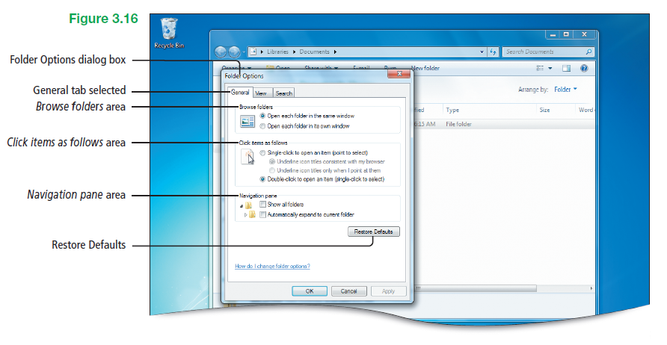
Personalize the Display of Folders and Files
Notes:
Figure 3.16

Slide 18
Personalize the Display of Folders and Files
Check box feature – when you point to a file or folder, a check box displays in the upper left corner

Slide 19
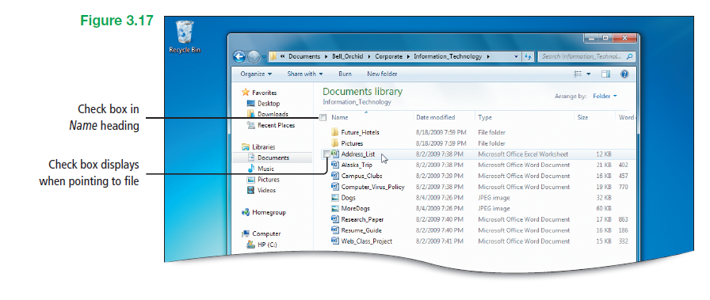
Personalize the Display of Folders and Files
Notes:
Figure 3.17

Slide 20
Personalize the Display of Folders and Files
Arrange by – feature that enables you to arrange the items by Folder, Author, Date modified, Tag, Type, or Name
  Folder is the default arrangement

Slide 21
Recognizing File Types and Associating Files with Programs
Split button – when pointed to, two parts display
  First, the arrow that displays a menu
  Second, the part of the button with the command name, which performs the command
  Open button – an example of a split button

Slide 22
Recognizing File Types and Associating Files with Programs
File association – Windows 7 keeps track of which file is associated with which program
  Changing the file name extension might cause the file to stop working properly

Slide 23
Filter Searches in the
Search Box
File properties – display information about files (i.e., name of author and date file was last modified)
Metadata – data that describes other data (i.e., title, subject, author, and file size)

Slide 24
Filter Searches in the
Search Box
Index – collection of detailed information about files on your computer
Tag – property you create and add to a file
  Help find and organize files
  Can be used in searches

Slide 25
Filter Searches in the
Search Box
Indexed locations – includes all of the folders in user’s personal folder
Searches of indexed locations –include both file names and contents
Partial matching – matching to part of a word or phrase rather than to whole words

Slide 26
Filter Searches in the
Search Box
Narrowing a search – to narrow a search, type the name of the property followed by a colon and then type the search term
  Examples: name:beach, camera:canon

Slide 27
Filter Searches in the
Search Box
Boolean operators – AND, OR, and NOT
  Must be typed in all uppercase letters
  Express a condition that is either true or false, when used in a statement
  Examples:
    shareholders NOT orlando
    type:pptx AND name:safety

Slide 28
Filter Searches in the
Search Box
Boolean operators – AND, OR, and NOT
  AND – finds files that contain both search terms, even if those terms are not next to each other
  NOT – finds files that contain the first search term but do not contain the second search term
  OR – finds files that contain either search term

Slide 29
Filter Searches in the
Search Box
Natural language – feature that allows a simpler search, without using colons and without the need for Boolean operators

Slide 30
Filter Searches in the
Search Box
Quotes filter – finds files that contain the exact phrase placed within the quotes
  Example: “Windows 7 updates”

Slide 31
Search by Using the
Search Folder
Search folder – conducts a search in the entire set of indexed locations
  Includes personal folder with all of its libraries and any offline files
  Allows the ability to look in many locations at once
  Allows a search in two or more folders

Slide 32
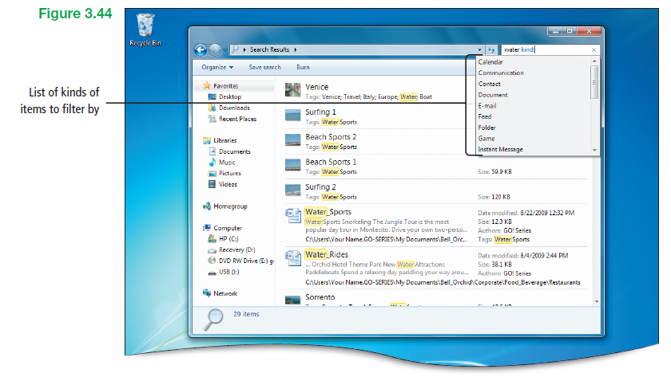
Search by Using the
Search Folder
Notes:
Figure 3.44

Slide 33
Search by Using the
Search Folder
Custom search – use custom search to define a specific scope (range of locations) for a search
  Using the Custom button – at the bottom of the search results, under Search again in, click Custom, to display the Search Location dialog box

Slide 34
Search by Using the
Search Folder
Faster search results – indexing an external hard drive attached to a computer results in a fast search result

Slide 35
Save a Search, Manage Search Behavior, and Manage the Index
Saved searches – the criteria is saved, not the current results
Rerunning saved searches – each time the Search folder is reopened, Windows 7 reruns the search with the most current results

Slide 36
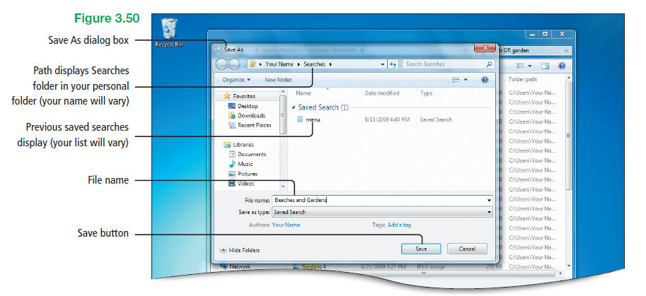
Save a Search, Manage Search Behavior, and Manage the Index
Notes:
Figure 3.50

Slide 37
Covered Objectives
Navigate by Using the Address Bar
Create and Navigate Favorites
Personalize the Display of Files and Folders
Recognize File Types and Associate Files with Programs

Slide 38
Covered Objectives
Filter Searches in the Search Box
Search by Using the Search Folder
Save a Search, Manage Search Behavior, and Manage the Index

Slide 39
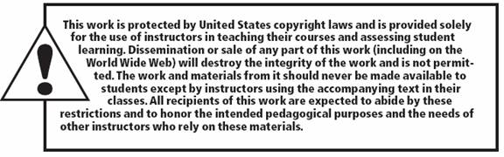
All rights reserved. No part of this publication may be reproduced, stored in a retrieval system, or transmitted, in any form or by any means, electronic, mechanical, photocopying, recording, or otherwise, without the prior written permission of the publisher. Printed in the United States of America.

