Slide 1

PowerPoint Presentation to Accompany
GO! with Windows 7 Comprehensive
Chapter 1
Windows 7

Slide 2
Objectives
Create a New Folder and Save a File on a Removable Storage Device
Identify the Functions of an Operating System
Use the Getting Started Information and Windows Help and Support
Log Off, Turn Off Your Computer, and View Power Options

Slide 3
Objectives
Manage User Accounts
Display Libraries, Folders and Files in a Window
Start Programs and Open Data Files
Manage the Display of Individual and Multiple Windows

Slide 4
Create a New Folder and Save a File on a Removable Storage Device
Program – set of instructions that a computer uses to accomplish a task
File – collection of information stored on computer under single name
Folder – container in which files are stored

Slide 5
Create a New Folder and Save a File on a Removable Storage Device
Windows 7
  An operating system developed by Microsoft Corporation
  Manages all the other programs on your computer
  Stores files in an organized manner
  Allows you to use software programs
  Coordinates the use of computer hardware

Slide 6
Create a New Folder and Save a File on a Removable Storage Device
Turning On Your computer
  Booting the computer
  BIOS (Basic Input/Output System) program
Logging On to a Windows 7 User account
  The Windows 7 screen displays and indicates the names and pictures associated with all active user accounts

Slide 7
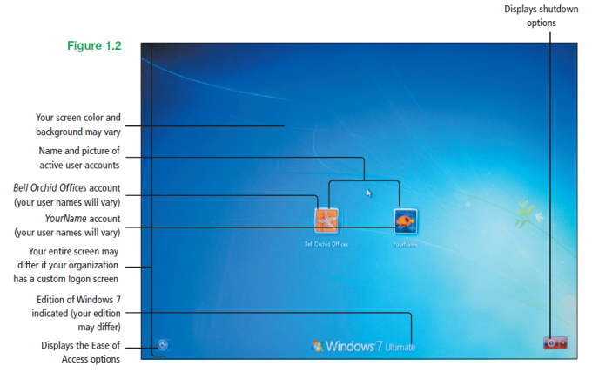
Create a New Folder and Save a File on a Removable Storage Device
Notes:
Figure 1.2

Slide 8
Create a New Folder and Save a File on a Removable Storage Device
Parts of the Windows 7 Desktop
  Desktop
  Notification area
  Recycle Bin
  Show desktop button
  Start button
  Taskbar

Slide 9
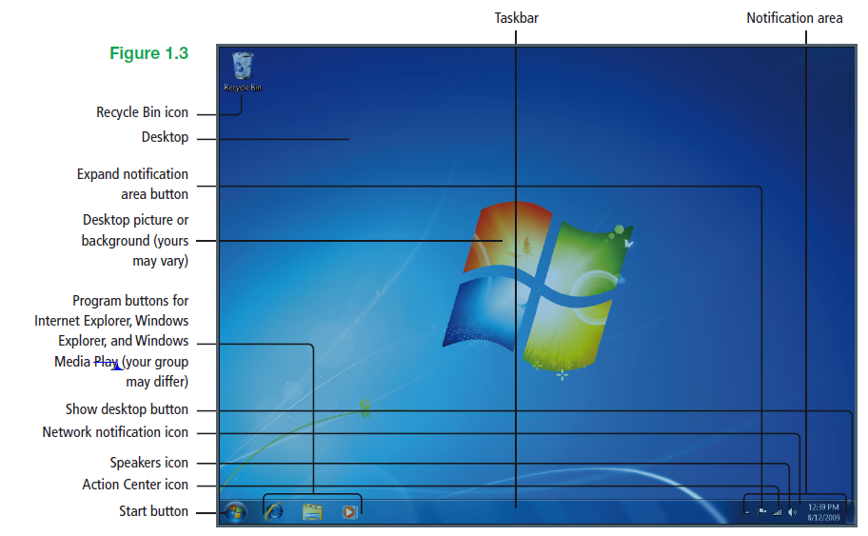
Create a New Folder and Save a File on a Removable Storage Device
Notes:
Figure 1.3

Slide 10
Create a New Folder and Save a File on a Removable Storage Device
Parts of the Start Menu
  All Programs
  Computer
  Control Panel
  Default Programs
  Devices and Printers
  Games
  Help and Support
  Personal folders
  Pinned programs
  Search box
  Shut down button and arrow

Slide 11
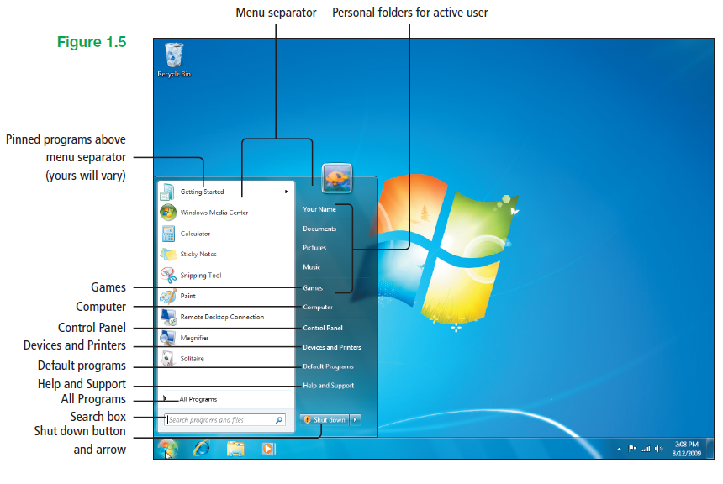
Create a New Folder and Save a File on a Removable Storage Device
Notes:
Figure 1.5

Slide 12
Create a New Folder and Save a File on a Removable Storage Device
Removable storage device – commonly used to transfer information from one computer to another
Drive – area of storage
  Formatted with file system compatible with operating system
  Identified by drive letter

Slide 13
Create a New Folder and Save a File on a Removable Storage Device
Hard disk drive – primary storage device located inside computer
  Where most files and programs are typically stored
  Usually designated as drive C

Slide 14
Create a New Folder and Save a File on a Removable Storage Device
AutoPlay - lets you choose which program to use to start different kinds of media
Folder window
  Displays the contents of the current folder, library, or device
  Contains helpful parts so that you can navigate—explore within the organizing structure of Windows

Slide 15
Create a New Folder and Save a File on a Removable Storage Device
Library – a collection of items, such as files and folders, assembled from various locations
Location – any disk drive, folder, or other place in which you can store files and folders
To add folder
  On the toolbar, click New folder

Slide 16
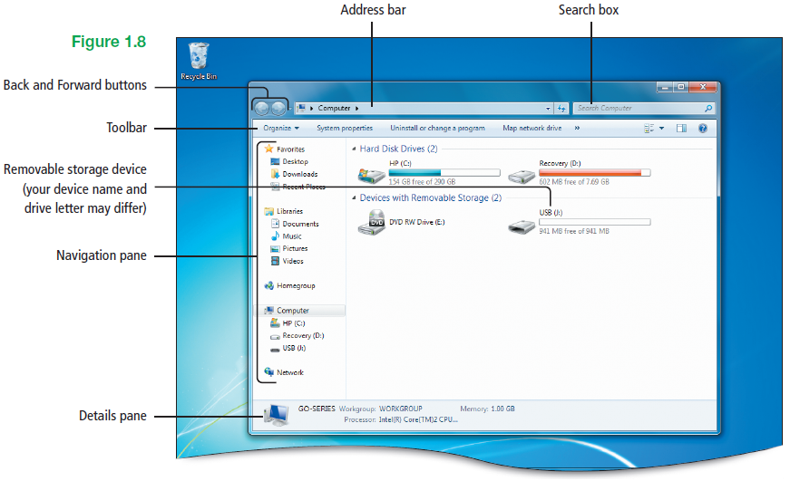
Create a New Folder and Save a File on a Removable Storage Device
Notes:
Figure 1.8

Slide 17
Create a New Folder and Save a File on a Removable Storage Device
Snipping Tool – program that captures an image of a computer screen
Snip – captured image that can be annotated, saved, copied, or shared via email
  Can be referred to as a screen capture or a screenshot

Slide 18
Create a New Folder and Save a File on a Removable Storage Device
Four types of snips
  Free-form snip – draws irregular line around an area of screen
  Rectangular snip – draws a precise box around area of screen
  Window snip – captures entire displayed window
  Full-screen snip – captures entire screen

Slide 19
Identify the Functions of an Operating System
Graphical user interface (GUI) – graphics clicked to activate item represented
  Pronounced GOO-ee
Pointer – any symbol that displays on your screen in response to moving your mouse and with which you can select objects and commands

Slide 20
Identify the Functions of an Operating System
Icons - small images that represent commands, files, or other windows
Desktop - a simulation of a real desk that represents your work area
Data management – most often function of the operating system, managing your files and folders

Slide 21
Use the Getting Started Information and Windows Help and Support
Windows 7 Getting Started feature - a task-centered grouping of links to tools that can help you get started with and add new features to your computer
Insertion point – a blinking vertical line that indicates where text or graphics will be inserted

Slide 22
Use the Getting Started Information and Windows Help and Support
Use the Control Panel to access the Getting Started information
  Go to online resources or to information about basic tasks
  Click other options to help you learn about Windows 7

Slide 23
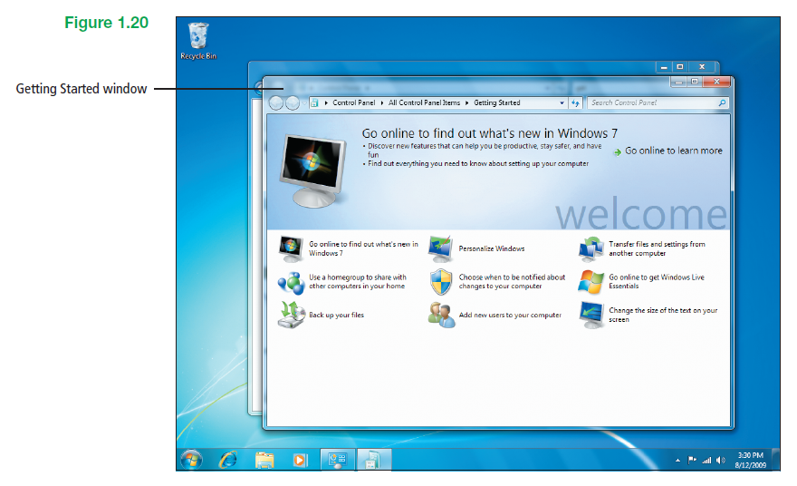
Use the Getting Started Information and Windows Help and Support
Notes:
Figure 1.20

Slide 24
Use the Getting Started Information and Windows Help and Support
Windows Help and Support window -displays a list of basic help topics
Windows Help and Support database - can be searched by typing one or more words in the Search box

Slide 25
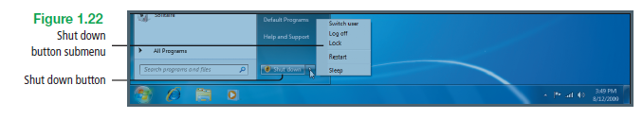
Log Off, Turn Off Your Computer, and
View Power Options
Switch user and Log off
  Logs the active user account off of Windows
  Displays the Windows 7 welcome screen
Notes:
Figure 1.22

Slide 26
Log Off, Turn Off Your Computer, and
View Power Options
Lock
  Locks the computer so that a password is required to log back on to your desktop
Restart
  Restarts the computer and clears the system cache

Slide 27
Log Off, Turn Off Your Computer, and
View Power Options
Sleep – automatically saves work, screen goes dark, fan stops
  Need not close programs
  Next time turn computer on, need only enter password
Hibernate
  An option that displays on some laptop computers and is similar to Sleep
Notes:
Sleep – automatically saves work, screen goes dark, fan stops
Light on computer will blink or turn yellow to indicate sleep mode
Need not close programs
Next time turn computer on, need only enter password
Computer uses small amount of power

Slide 28
Log Off, Turn Off Your Computer, and
View Power Options
Shut down – all open programs and files close, network connections close, hard disk stops
  No power is used
  Only two reasons to shut computer down
    Add or upgrade the hardware inside computer’s case
    Add external hardware, such as printer or monitor not connected by USB cable

Slide 29
Log Off, Turn Off Your Computer, and
View Power Options
Power Options – can change power plan
  Make other changes to manner in which computer uses power
  Options set by manufacturer
    Optimized for best use of power on system
    Consult user manual before adjusting

Slide 30
Manage User Accounts
User account – collection of information that tells Windows 7
  What files and folders account holder can access
  What changes account holder can make to computer system
  Account holder’s personal preferences

Slide 31
Manage User Accounts
User accounts useful - can share computer with other people while maintaining own files and settings
Three types of user accounts
  Administrator
  Standard
  Guest

Slide 32
Manage User Accounts
Administrator account – lets you make changes that will affect other users
  Most powerful of three types of accounts
  Permits most control over computer

Slide 33
Manage User Accounts
Standard user – lets individual use most of the capabilities of computer
  Requires permission from administrator to make changes that affect other users and the security of computer

Slide 34
Manage User Accounts
Guest account – for users who do not have a permanent account
  Permits access to someone who needs only temporary access to computer
  Cannot access files of other users
  Cannot install software or hardware
  Cannot change settings
  Cannot create password

Slide 35
Manage User Accounts
Passwords
  Discuss good practice for each user
  Prevent unauthorized access to computer
  Must be at least 8 characters, not obvious
  Case sensitive – capitalization must match each time characters are typed
  How to create a strong password

Slide 36
Manage User Accounts
Delete User Account
  From Control Panel
  User Accounts and Family Safety
  Option to keep the files and settings of the user

Slide 37
Display Libraries, Folders, and Files in a Window
Hierarchy – an arrangement where items are ranked and where each level is lower in rank than the item above it
Folder structure – the hierarchy of folders

Slide 38
Display Libraries, Folders, and Files in a Window
Library
  Collection of items (i.e., files, folders) assembled from various locations
    Your computer or external hard drive
    Another computer in network
  Does not store items, but provides access point

Slide 39
Display Libraries, Folders, and Files in a Window
ScreenTip – displays useful information when you perform various mouse actions, such as pointing to screen elements
Personal folder – always located at top of Start menu, may contain a number of subfolders for convenience

Slide 40
Display Libraries, Folders, and Files in a Window
Windows Explorer – program that displays contents of libraries, folders, and files on computer enabling performance of tasks
Opening a folder window
  Click the Window Explorer button to display the Libraries window

Slide 41
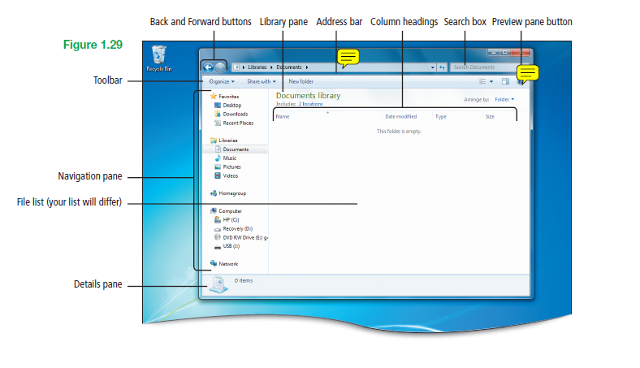
Display Libraries, Folders, and Files in a Window
Notes:
Figure 1.29

Slide 42
Display Libraries, Folders, and Files in a Window
Address bar – displays current location in the file structure
Back and Forward buttons – provides the ability to navigate to other folders already opened
Column headings – identify the columns information
Notes:
Back and Forward buttons
Provides the ability to navigate to other folders already opened without closing current folder window
Work with address bar

Slide 43
Display Libraries, Folders, and Files in a Window
Details pane – displays most common
File list – displays contents of current folder or library
Library pane – enables you to customize library or arrange files by different file properties
Notes:
Library pane – enables you to customize library or arrange files by different file properties
File properties – information about files
(i.e., author, date of last change, descriptive tags) added to the file
Tags – a property that you create to help find and organize files

Slide 44
Display Libraries, Folders, and Files in a Window
Navigation pane – displays Favorites, Libraries, Homegroup, and an expandable list of drives and folders
Search box – enables you to search for a file or subfolder stored in current folder
Toolbar – provides buttons with which common tasks can be performed

Slide 45
Display Libraries, Folders, and Files in a Window
Live Icons – display a small picture of actual contents of each file or folder, for some applications without opening them.
  Thumbnails are displayed from the taskbar

Slide 46
Display Libraries, Folders, and Files in a Window
Content view – displays a vertical list that includes program icon, date that the file was last modified, file size, and any other properties
Metadata – data that describes other data, collective group of a file’s properties

Slide 47
Display Libraries, Folders, and Files in a Window
Filtered – listed files that meet a certain criteria
Type – file property used for filtering contents of a folder by file type

Slide 48
Start Programs and Open
Data Files
Start a program
  From Start menu
  From Desktop, via shortcut to program
Open data file
  From within program
  From a folder window

Slide 49
Start Programs and Open
Data Files
All Programs – list of all programs available on your computer
Paint – program you can create and edit drawings and display and edit stored photos

Slide 50
Start Programs and Open
Data Files
Dialog Box Elements
  Address bar
  File list
  File name box
  File type button
  Navigation pane
  Search box
  Toolbar

Slide 51
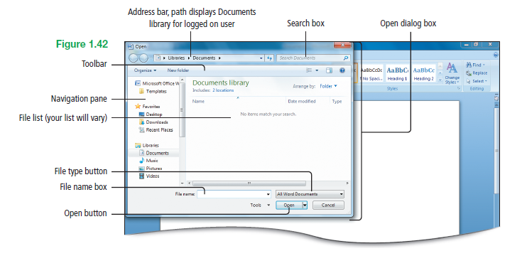
Start Programs and Open
Data Files
Notes:
Figure 1.42

Slide 52
Start Programs and Open
Data Files
Shortcuts – desktop icons that link to any item accessible on your computer or on a network
  Allows for easy access to commonly used files or folders
  Default icon is the Recycle Bin
  Many programs automatically create a desktop icon shortcut when installed

Slide 53
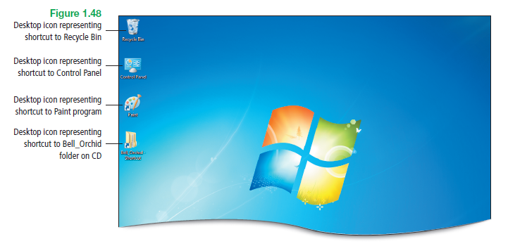
Start Programs and Open
Data Files
Notes:
Figure 1.48

Slide 54
Start Programs and Open
Data Files
If a shortcut is deleted from the desktop, only the shortcut icon will be deleted
  Actual programs and files associated with icon are not deleted
If you save a file or folder directly to the desktop, deleting it from the desktop will delete the folder or file

Slide 55
Start Programs and Open
Data Files
Recycle Bin – stores anything that you delete from your computer
  Anything stored can be retrieved, until contents are permanently deleted by the Empty Recycle Bin command

Slide 56
Manage the Display of Individual and Multiple Windows
Window – screen element you work with most often in Windows 7
  Can move, resize, maximize, minimize, and close
  Can freely arrange and overlap multiple open windows on screen

Slide 57
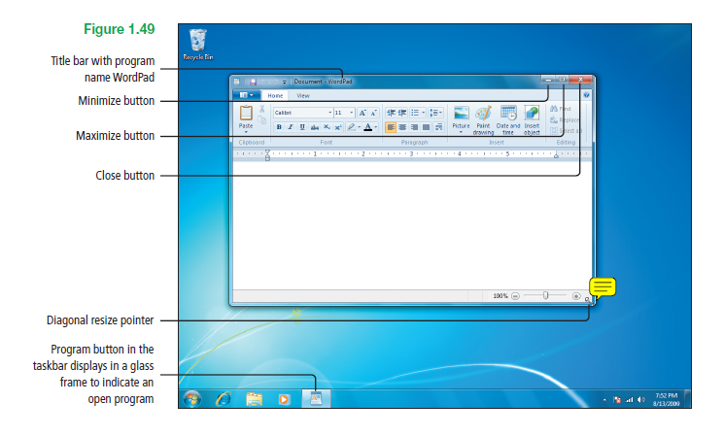
Manage the Display of Individual and Multiple Windows
Notes:
Figure 1.49

Slide 58
Manage the Display of Individual and Multiple Windows
All open programs display an icon on the taskbar with a glass frame
  The active program has the brightest frame
  Minimizing a window allows the window to remain open, visible only as a button on the taskbar

Slide 59
Manage the Display of Individual and Multiple Windows
Thumbnail – reduced image of a graphic
Jump List – displays destinations and tasks from a program’s taskbar button

Slide 60
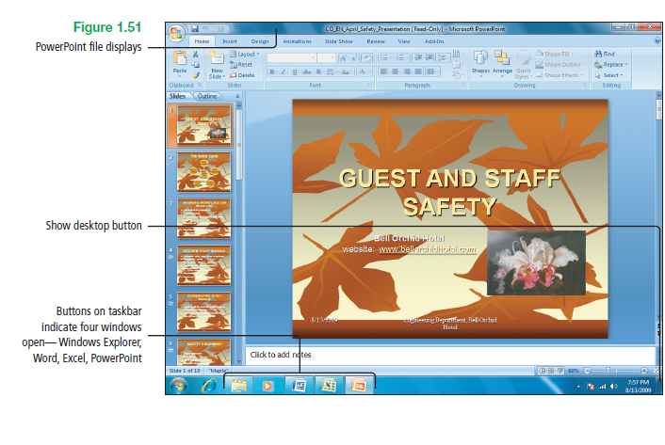
Manage the Display of Individual and Multiple Windows
Notes:
Figure 1.51

Slide 61
Manage the Display of Individual and Multiple Windows
Aero Peek – technology that assists when multiple windows are open
  Preview Desktop – “peeking” at desktop behind open windows
  Full-Screen Window Preview – “peeking” at a window hidden from view by other windows

Slide 62
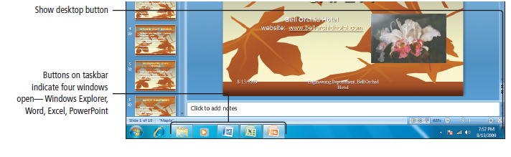
Manage the Display of Individual and Multiple Windows
Show desktop button – “peeking” at desktop behind all the open windows
  A glass rectangle at the lower right corner of screen, extreme right edge of taskbar
Notes:
Figure 1.51

Slide 63
Manage the Display of Individual and Multiple Windows
Cascade – arrangement of windows in a single stack, fanned out so that each title bar is visible
Stacked – arrangement of windows where three open windows display across the width of the screen in a vertical stack

Slide 64
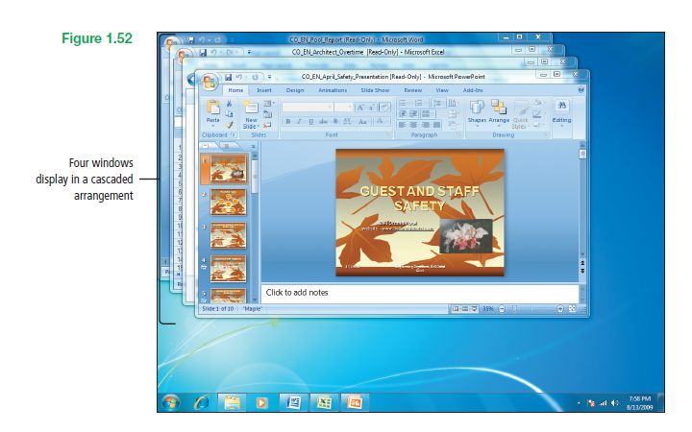
Manage the Display of Individual and Multiple Windows
Notes:
Figure 1.52

Slide 65
Manage the Display of Individual and Multiple Windows
Side by side – arrangement of windows displayed side by side
  Can work in any of the files
  Clicking in a window makes it the active window until another window is clicked

Slide 66
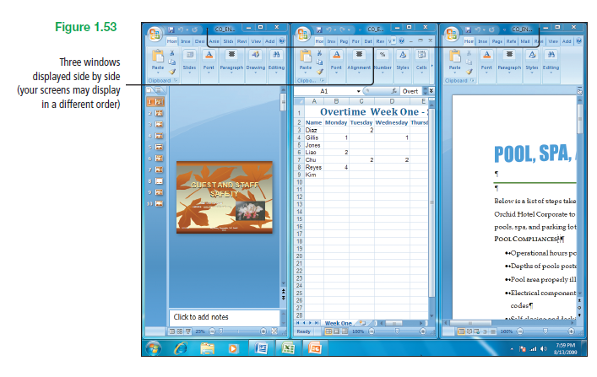
Manage the Display of Individual and Multiple Windows
Notes:
Figure 1.53

Slide 67
Manage the Display of Individual and Multiple Windows
Aero Flip 3D – arranges open windows in a three-dimensional stack, quickly flipped through without having to click on taskbar
  Hold down the Windows key on the keyboard and press the Tab key repeatedly to flip through the open windows
Notes:
Aero Flip 3D is available in Windows 7 Home Premium, Professional, Ultimate, and Enterprise editions.

Slide 68
Manage the Display of Individual and Multiple Windows
Snap – feature that automatically resizes windows when you move (snap) them to the edge of the screen
  Arrange windows side by side, expand windows vertically, or maximize a window
  Compare two documents
  Copy or move files between two windows
  Expand long documents to reduce scrolling

Slide 69
Manage the Display of Individual and Multiple Windows
Aero Shake –used to focus on a single window without minimizing all other open windows individually
  Point to title bar of active window and hold down left mouse button
  Move mouse back and forth vigorously to minimize all other windows
  Repeat and all windows will be visible

Slide 70
Covered Objectives
Create a New Folder and Save a File on a Removable Storage Device
Identify the Functions of an Operating System
Use the Getting Started Information and Windows Help and Support
Log Off, Turn Off Your Computer, and View Power Options

Slide 71
Covered Objectives
Manage User Accounts
Display Libraries, Folders and Files in a Window
Start Programs and Open Data Files
Manage the Display of Individual and Multiple Windows

Slide 72
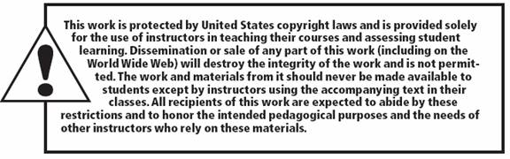
All rights reserved. No part of this publication may be reproduced, stored in a retrieval system, or transmitted, in any form or by any means, electronic, mechanical, photocopying, recording, or otherwise, without the prior written permission of the publisher. Printed in the United States of America.

