Slide 1
Software
Software---what is it.
Notes:
This chapter discusses the kinds of software you can use to perform a variety of tasks, from simple word processing to digital image editing. We’ll also discuss how you can buy software, what the different versions of software mean, how you can legally get free software from the Web, and how you install and uninstall software safely on your system.

Slide 2
Topics
Application vs. system software
Productivity software
Multimedia software
Entertainment software
Educational and reference software
Notes:
Topics in this chapter include:
Application vs. system software
Productivity software
Multimedia software
Entertainment software
Educational and reference software

Slide 3
Chapter Topics (cont.)
Drawing software
Business software
Getting help with software
Acquiring software
Installing and uninstalling software
Notes:
Drawing software
Business software
Getting help with software
Acquiring software
Installing and uninstalling software

Slide 4
Software
A set of instructions that tells the computer what to do
Two main types of software
System software
Application software
Notes:
The term software refers to a set of instructions that tells the computer what to do. These instruction sets, also called programs, provide the means for us to interact with and use the computer.
Your computer uses two basic types of software: system software, which helps run the computer, and application software, which was created for a specific purpose.

Slide 5
System Software vs. Application Software
System Software
Coordinates instructions between software and hardware
Includes
Operating system
Utility programs
Application Software
Programs used to complete tasks
Includes
Productivity software
Specialty software
Entertainment software
Educational and reference software
Personal software
Notes:
System software coordinates instructions between application software and the computer’s hardware devices. System software includes the operating system and utility programs (programs often in the operating system that help manage system resources).
Application software is what you use to do tasks at home, school, and work.

Slide 6
Application Software
Productivity
Word Processing
Spreadsheet
Personal Information Manager
Database
Presentation
Personal Finance
Notes:
Here you see the various types of productivity software available.

Slide 7
Application Software
Media
Image Editing
Audio Editing
Media Management
Video Editing
Notes:
Here you see the various types of media software available.

Slide 8
Application Software
Home Entertainment
Gaming
Education
Drawing
Reference
Notes:
Here you see the various types of home entertainment software available.

Slide 9
Application Software
Business
Home Business
Large Business
Specialized Business
Notes:
Here you see the various types of business software available.

Slide 10
Productivity Software
Programs that enable you to perform tasks required in home, school, and business
Word processing programs
Spreadsheet programs
Presentation programs
Database programs
Personal information manager programs
Notes:
Productivity software includes programs that enable you to perform various tasks generally required in home, school, and business. This category includes word processing, spreadsheet, presentation, database, and personal information manager (PIM) programs.
You might already be familiar with some productivity software. For example, Microsoft Office consists of a word processing program called Word, a spreadsheet program called Excel, a presentation program called PowerPoint, a database program called Access, and a PIM called Outlook.

Slide 11
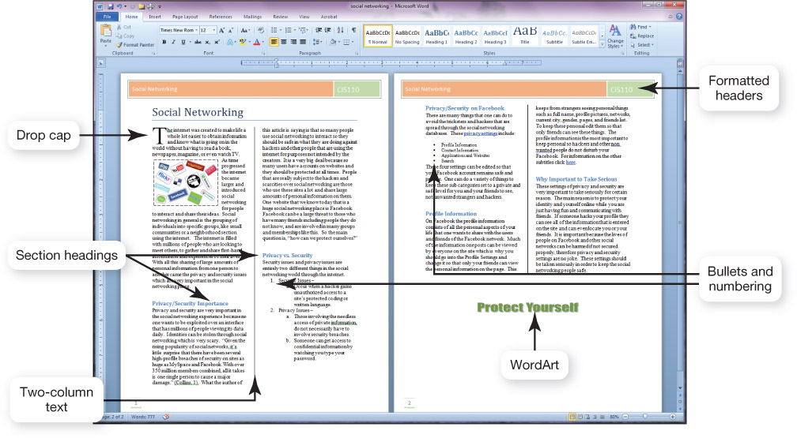
Word Processing Software
Used to create and edit documents
Features include:
Quick and easy editing
Formatting options
Search-and-replace
Translation
Examples
Microsoft Word
Corel WordPerfect
OpenOffice Writer
Notes:
Word processing software was one of the early applications that turned computers into a necessity.
Today’s word processors come with tools that allow you to produce a wide range of professional-looking documents such as research papers, letters, and résumés.

Slide 12
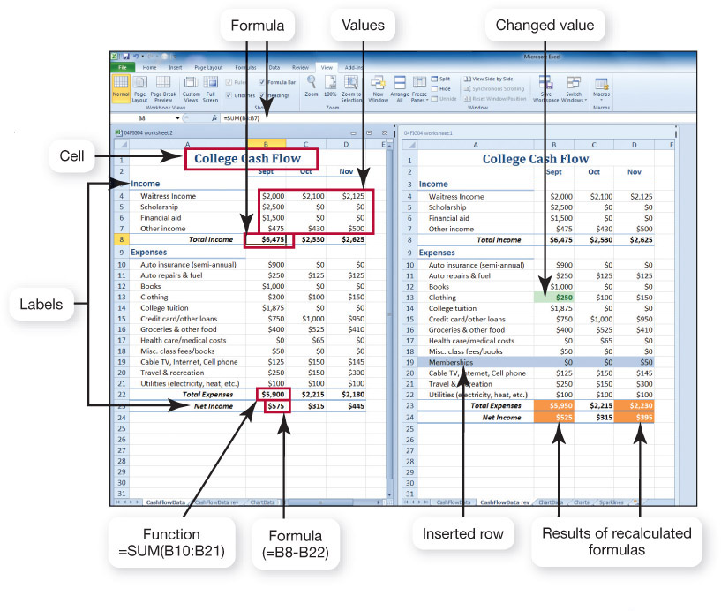
Spreadsheet Software
Used to perform calculations and numerical analyses
Features include:
Worksheets with cells
Text, values, formulas, and functions
Automatic recalculation
Graphs and charts
Examples
Microsoft Excel
OpenOffice Calc
Notes:
Spreadsheet software enables you to do calculations and numerical analyses easily. You can use spreadsheet software to create a budget and to evaluate different scenarios such as planning a loan payment strategy.
The basic element in a spreadsheet program is the worksheet, columns and rows of which form boxes called cells. There are several types of data you can enter into a cell:
-Text is letters, numbers, and symbols used as labels to identify the contents of the worksheet.
-Values are numeric data entered either directly or as a result of a calculation.
-Formulas are equations that you build yourself.
-Functions are formulas that are preprogrammed into the spreadsheet software.
The primary benefit of spreadsheet software is what-if analysis—the ability to test different assumptions.
You can display numbers in a graphical format.

Slide 13
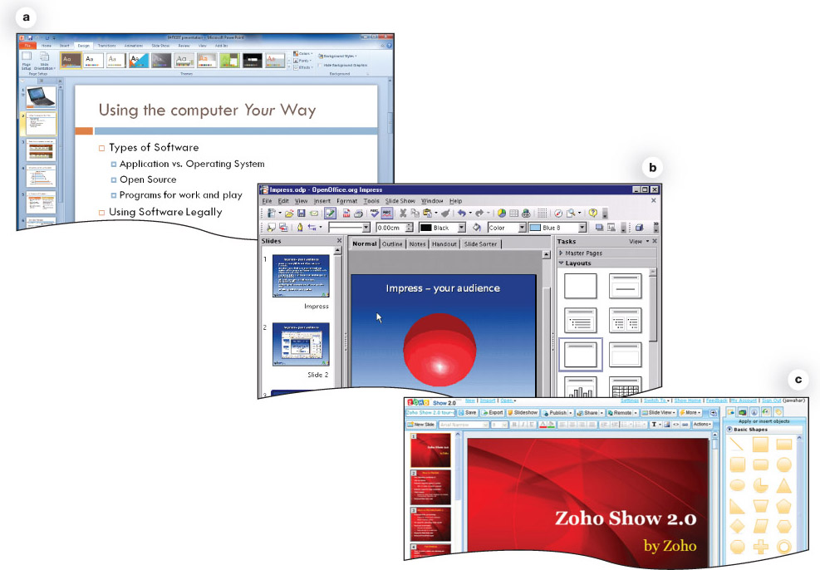
Presentation Software
Used to create slide shows
Features include:
Templates and layouts
Animations
Transitions
Examples
Microsoft PowerPoint
OpenOffice Impress
Zoho Show
Notes:
You use presentation software to create presentations, such as the one shown here.
Basic features include a variety of slide layouts and design templates.
You can use animation effects to control how and when text and other objects enter and exit each slide. Similarly, slide transitions add different effects as you move from one slide to the next during the presentation.
With some of the new capabilities in PowerPoint 2010, you can embed online videos, as well as change the color, add effects, and even trim video clips without the need for a separate video editing program.

Slide 14
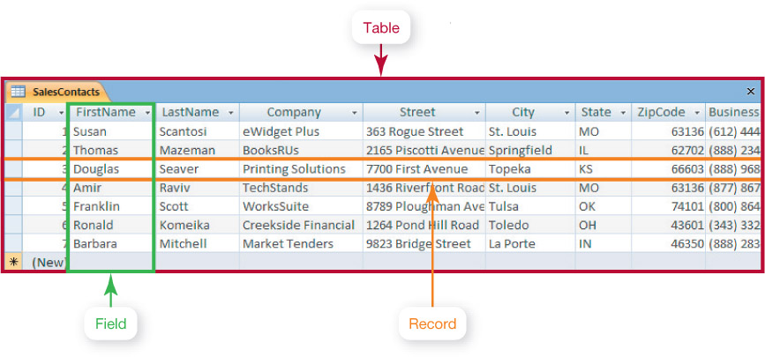
Database Software
Used to store and organize data
Features include:
Ability to group, sort, and filter data and generate reports
Organized into fields, records, and tables
Examples
Oracle
MySQL
Notes:
Database software programs are powerful applications that allow you to store and organize data that can be used to track clients, invoices, and personnel information.
Spreadsheet applications include many database features and are easy to use for simple database tasks such as sorting, filtering, and organizing data. However, you need a more full-featured database application to manage larger and more complicated groups of data that contain more than one table or when you need to group, sort, and retrieve data and generate reports.
Traditional databases are organized into fields, records, and tables. A field is a data category such as “First Name.” A record is a collection of related fields. A table groups related records together.

Slide 15
Note Taking Software
Microsoft OneNote
Allows students who have Tablet PCs to write their notes directly onto the tablet, using it as an electronic notebook
Can be used with a notebook or desktop computer, typing the information onto the sheets, and then the pieces of text can be easily moved around the page
Has co-authoring and version tracking capabilities
Notes:
Free note taking software examples:
Evernote allows you to take notes via the Web, your phone, or your computer and then sync your notes between the Web, your phone, and any computer. You can save text, audio, and images, as well as screen captures, Web pages, and photos.
StickyNotes are digital equivalents of paper sticky notes. These notes can be customized, saved, and shared via e-mail, and they even have reminders.

Slide 16
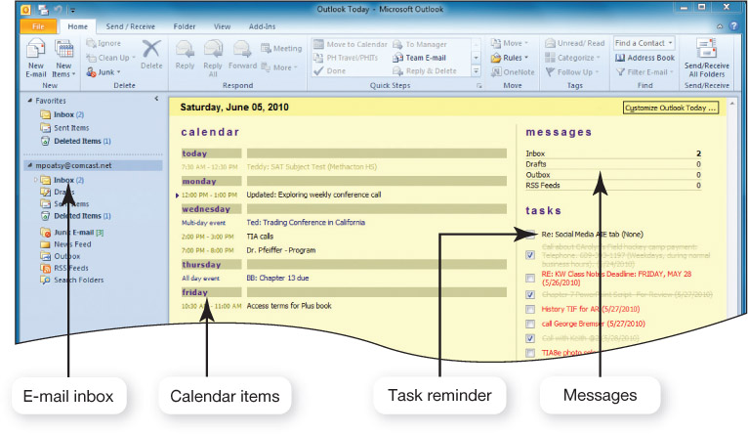
Personal Information Manager Software
Used to replace the management tools found on a traditional desk
Features include:
Calendar, address book, notepad, to-do list
Some contain e-mail management features
Examples
Microsoft Outlook
Lotus Organizer
Notes:
Most productivity software suites contain some form of personal information manager (PIM) software. These programs strive to replace the management tools found on a traditional desk, such as a calendar, address book, notepad, and to-do list.
Some PIMs contain e-mail management features so that you can receive and send e-mail messages, and also organize them into various folders, prioritize them, and coordinate them with other activities in your calendar.

Slide 17
Productivity Software Tools
Wizards
Step-by-step guides that help you complete a task
Templates
Predesigned forms included with software
Macros
Small programs that group a series of commands to run as a single command
Notes:
Whether you are working on a word processing document, spreadsheet, database, or slide presentation, there are several tools you can use to increase your efficiency:
Wizards are step-by-step guides that walk you through the necessary steps to complete a complicated task. At each step, the wizard asks you questions. Based on your responses, the wizard helps you complete that portion of the task.
Templates are forms included in many productivity applications that provide the basic structure for a particular kind of document, spreadsheet, or presentation.
Macros are small programs that group a series of commands to run as a single command. Macros are best used to automate a routine task or a complex series of commands that must be run frequently.

Slide 18
Integrated Software Applications vs. Software Suites
Integrated Software Application
Single program that incorporates many software programs
Complex features are not included
Less expensive
Example: Microsoft Works
Software Suite
Collection of stand-alone software programs packaged together
Share common menus and toolbars
Integrate well
Developers: Microsoft, Corel, and Lotus
Notes:
An integrated software application incorporates the most commonly used tools of many productivity software programs into one integrated stand-alone program. They don’t include many of the more complex features of the stand-alone productivity software applications and cost less than individual programs.
Microsoft Works is an example of an integrated software application that includes word processing, spreadsheet, and database functionality.
A software suite is a group of software programs bundled together as a package. Because the programs come from the same developer, they work well together and share common features.
Microsoft Office is one example of the many types of software suites on the market today. You can also buy different versions of the same suite, the difference among them being the combination of software applications included in each version.

Slide 19
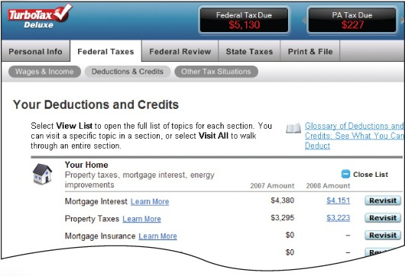
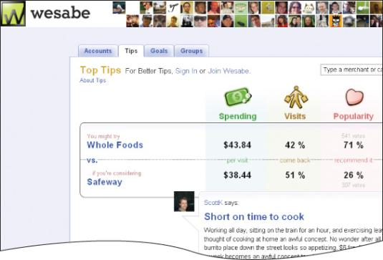
Personal Financial Software
Used for:
Tax preparation
Intuit TurboTax
H&R Block At Home
Financial planning
Intuit Quicken
Microsoft Money
Web-based programs (e.g., Mint.com, Wesabe.com)
Notes:
Tax preparation software enables you to prepare your taxes on your own rather than hiring a professional. Each program offers a complete set of tax forms and instructions as well as expert advice on how to complete each form. TurboTax and H & R Block At Home software also have Web-based versions.
Financial planning software helps you manage your daily finances. These programs include electronic checkbook registers and automatic bill payment tools. With these features, you can print checks from your computer or make your regular monthly payments with automatically scheduled online payments. Web-based programs are also gaining in popularity. These can also be accessed from smartphones.

Slide 20
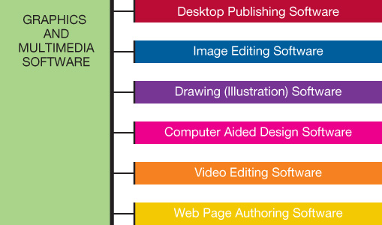
Media Software for Home
Notes:
Next we look at several popular types of multimedia software.

Slide 21
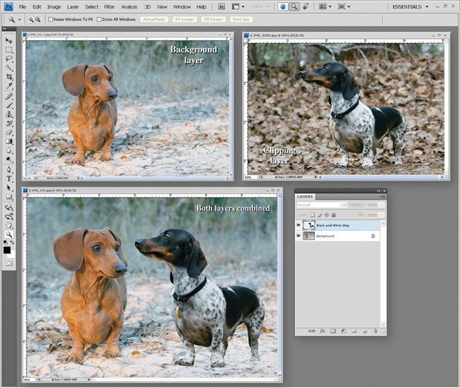
Digital Image Editing Software
Used to edit photographs and other images
Remove red-eye
Modify contrast
Fix scratches
Examples
Adobe Photoshop
Microsoft Photo Story
Google Picasa
Notes:
Image editing software (sometimes called photo editing software) enables you to edit photographs and other images.
Image editing software includes tools for basic modifications to digital images such as removing red-eye, modifying color hues, and removing scratches or rips from scanned images of old photos.
Many of these software packages now also include an extensive set of painting tools such as brushes, pens, and artistic-type mediums that allow you to create realistic-looking images as well.
Adobe Photoshop is a full-featured image editing software application. Other image editing programs are geared toward the casual home user and are included with digital cameras.
Other photo software makes it easy to use digital images in new ways. In Microsoft’s Photo Story, you can add text, music, and camera movement to create full-featured slide shows. Using Google’s Picasa, you can create posters or collages. Both products are free.

Slide 22
Digital Audio Software
Used to edit audio files in formats such as MP3, WAV, WMA, and AIFF
Most popular is MP3: Compresses audio file size
Hundreds of applications allow you to rip, play, and organize MP3s
Features include recording, editing, adding special effects, and format conversion
Notes:
You might have a variety of audio files on your hard drive from subscriptions to podcasts, digitizing CDs, or your own compositions.
MP3, short for MPEG-1 Audio Layer 3, is an audio compression format that reduces the file size of traditional digital audio files so more files take up less storage capacity.
Because of the popularity of MP3 files, hundreds of digital audio software applications are available to allow you to copy (or rip), play, edit, and organize your MP3 files.
Audio editing software includes tools that allow you to record and edit audio files as well as add special sound effects and convert between different audio file formats.
Examples include Audacity and Sony Sound Forge Audio Studio.

Slide 23
Digital Video Editing Software
Used to create and edit Windows Media Player, Apple QuickTime, or RealPlayer video files
Examples
Adobe Premiere Pro
Microsoft Live Movie Maker
Apple iMovie HD
Buy the application that supports your file format
Many portable devices play MP4 format
Notes:
Create and edit videos with digital video editing software.
Different video editing software programs support only a few types of video formats, so choose the one that lists the types of video files you want to edit.
One popular format is MP4, which is similar to the MP3 format in that it compresses audio and video content into more manageable file sizes. This format can be watched on an iPod, for instance.

Slide 24
Media Management Software
Software to organize media files
Sort, filter, and search by artist, album, or category
Examples
Windows Media Player
Nullsoft Winamp
Apple iTunes
Manage tracks and generate playlists
Burn songs to CDs and print liner notes
Notes:
Many people add hundreds or even thousands of media files to their hard disk drive. Media management software helps them find what they're looking for.
Software such as Windows Media Player, Nullsoft Winamp, or Apple iTunes organizes audio and video files so you can sort, filter, and search your music collection by artist, album, or category.
You can manage individual tracks, generate playlists, and even export the files to a database or spreadsheet application.
You can burn songs to a CD, and the program will print liner notes that you can place inside the CD case.

Slide 25
Online Photo Management
Web-based sites allow easy management and sharing of digital photos
Allow creation of photo albums
Offer professional printing services
Examples
Snapfish.com
Kodak.com
Shutterfly.com
Flickr.com
Notes:
Web-based sites like Snapfish.com, Kodak.com, and Shutterfly.com allow you to edit, store, and share digital photos.
You can create personalized online photo albums and have pictures or entire albums printed professionally.
Google Picasa and Flickr.com offer additional photo sharing applications.

Slide 26
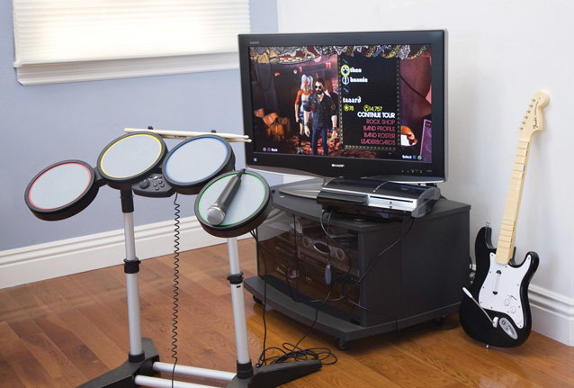
Software Fun for Home
Computer games require appropriate:
Processing power
Memory (RAM)
Hard disk capacity
Sound card
Video card
Speakers
Monitor
CD or DVD drive
Specialized controllers
Notes:
Computer games make up the vast majority of entertainment software.
As with any computer software, you need to make sure your system has enough processing power, memory (RAM), and hard disk capacity to run the program. Because games often push the limit of sound and video quality, you need to ensure your system has the appropriate sound cards, video cards, speakers, monitor, and CD or DVD drives as well.
Some software might require a special controller to play the game. The controllers for Rock Band are pictured here.

Slide 27
Game Rating System
The Entertainment Software Rating Board (ESRB) provides:
Rating symbols
Everyone (E)
Teens (T)
Mature (M)
Adult Only (AO)
Content descriptors
Notes:
The Entertainment Software Rating Board (ESRB) was established in 1994 by the Entertainment Software Association.
The ESRB’s rating system has two parts: rating symbols that suggest age appropriateness, and content descriptors that point out elements that triggered the rating.

Slide 28
Educational and Reference Software
Educational Software
Provides instruction
Types include:
K–12 education
Skill development
Test preparation
Brain training
Simulations
Online courses
Notes:
Educational software refers to the variety of software applications on the market that offer some form of instruction or training.
Electronic reference software such as encyclopedias, atlases, and dictionaries are available on CDs and DVDs as well as online.

Slide 29
Drawing Software
Used to create and edit
Two-dimensional drawings
Technical diagrams
Animations
Geometric shapes
Examples
Adobe Illustrator
Microsoft Visio
Notes:
Drawing software (or illustration software) lets you create or edit two-dimensional, line-based drawings such as technical diagrams or original nonphotographic drawings, animations, and illustrations using standard drawing and painting tools such as pens, pencils, and paintbrushes.
Software applications such as Adobe Illustrator include tools that let you create professional-quality illustrations.
Microsoft Visio is a program used to create technical drawings, maps, basic block diagrams, networking and engineering flowcharts, and project schedules.

Slide 30
Business Software for Home and Office
Programs for home business
Accounting software
Desktop publishing software
Web page authoring software
Notes:
If you run a business from your home, there are several helpful programs to consider. We look at each of the programs listed and the functions they perform over the next few slides.

Slide 31
Accounting Software
Helps small-business owners efficiently manage their finances
Provides tools for tracking accounts receivable and accounts payable
Includes templates for invoices, statements, and financial reports
Examples
Intuit QuickBooks
Peachtree by Sage
Notes:
A number of software packages are designed to organize and help with the day-to-day operations of a typical business.
Accounting software helps small-business owners manage their finances more efficiently by providing tools for tracking accounts receivable and accounts payable.
In addition, these applications offer inventory management plus payroll and billing tools.
Examples of accounting software applications include Intuit QuickBooks and Peachtree by Sage. Both programs include templates for invoices, statements, and financial reports so that small-business owners can create common forms and reports.

Slide 32
Desktop Publishing Software
Used to arrange text and graphics for publications
Features include:
Text formatting
File importing
Graphics tools
Web publishing
Examples
QuarkXPress
Adobe InDesign
Notes:
Desktop publishing (DTP) software allows you to incorporate and arrange graphics and text in your documents in creative ways.
DTP programs offer a variety of tools with which you can format text and graphics. You can easily change the font, size, and style of your text as well as arrange text on the page in different columns, shapes, and patterns. You can import files into your documents from other sources and manipulate graphics. DTP programs also include features that allow you to publish to the Web.

Slide 33
Web Page Authoring Software
Knowledge of HTML is not necessary
Features include:
Wizards and templates
Reference materials
Interactive content
Examples
Microsoft Expression Web
Adobe Dreamweaver
Office applications can save a document as a Web page
Notes:
Web page authoring software allows even the novice user to design interesting and interactive Web pages without knowing any HTML code.
Web page authoring applications often include wizards, templates, and reference materials to help you easily complete most Web page authoring tasks.
Most Microsoft Office programs, such as Word, have options to convert your file to a Web page.

Slide 34
Large Business Software
Used across a variety of industries
Includes:
Business and marketing plan software
Project management software
Customer relationship management (CRM) software
Enterprise resource planning (ERP) systems
E-commerce solutions
Notes:
There are specialized programs for a number of important business tasks, like writing business and marketing plans.
Project management software, such as Microsoft Project, helps project managers easily create and modify scheduling charts so they can plan and track specific project tasks and coordinate personnel resources.
Customer relationship management (CRM) software is used to store sales and client contact information in one central database. Sales professionals use CRM programs to get in touch and follow up with their clients. GoldMine from FrontRange Solutions is an example of a CRM program.
Enterprise resource planning (ERP) systems are used to control many back-office operations and processing functions such as billing, production, inventory management, and human resources. ERP systems are implemented by third-party vendors and matched directly to the specific needs of a company.
E-commerce software offers bundled Web site creation and hosting services, shopping cart setup, and credit card processing services. For larger businesses, specialized software to handle each aspect of e-commerce is available; alternatively, a large business might develop proprietary software tailored to its specific needs.

Slide 35
Mapping Software
Provides nationwide street maps and directions
Supplies geographic data for decision making
Available versions
Online
PC
Smartphone
GPS devices
Notes:
Mapping programs, such as DeLorme Street Atlas USA and Microsoft Streets & Trips, are perfect for businesses that require a lot of travel.
Online mapping services such as MapQuest and Yahoo! Maps are accessible from anywhere with Internet access.
Mapping software is also available for smartphones and cars.
Google Earth and Google Maps are examples of a geographic information system (GIS), which provides data for complex business decisions.

Slide 36
Specialized Business Software
Vertical market software: Tailored to the needs of a particular industry
Examples
Estimating software
Property management software
Scheduling and dispatching software
Proprietary software can be custom developed for a company
Notes:
Some software applications are tailored to the needs of a particular industry and are called vertical market software.
For example, the construction industry uses software such as Sage Master Builder, which features estimating tools to help construction companies bid on jobs. Other examples of vertical market software include property management software for real estate professionals and scheduling and dispatching software for emergency services.
In addition to specific business software applications that companies can buy off the shelf, programs can also be custom developed to address the specific needs of a particular company. These custom applications are often referred to as proprietary software because they are owned and controlled by the company that uses them.

Slide 37
Computer-Aided Design Software
Used to create 3D models
Applications for architecture, automotive, aerospace, and medical engineering industries
Example: Autodesk’s AutoCAD
Notes:
Computer-aided design (CAD) programs are a form of 3D modeling that engineers use to create automated designs, technical drawings, and model visualizations.
Specialized CAD software is used in the architecture, automotive, aerospace, and medical engineering industries, among others.
With CAD software, architects can build virtual models of their plans and readily visualize all aspects of the design before actual construction.
Full-featured packages are available, as well as simpler open source programs and Web-based versions.

Slide 38
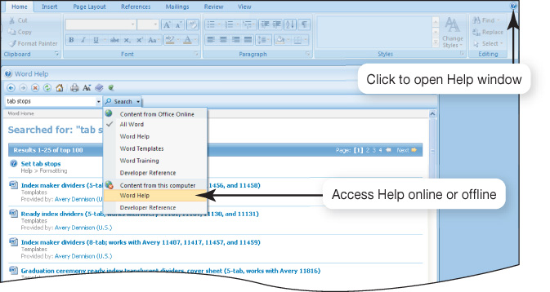
Getting Help with Software
Types of help
Frequently asked questions (FAQs)
Online help and support
ScreenTips
MS Office integrated help
Notes:
If you need help while working with software, there are several resources you can access to find answers to your questions.
For general help or information about the product, many Web sites offer frequently asked questions (FAQs), which include answers to the most common questions.
Some programs also offer online help and support. Sometimes, online help also allows you to chat with a member of an online support team.
Some applications are context-sensitive and offer help based on the task you’re doing or ScreenTips to explain where your cursor is resting.
In Microsoft Office applications, on the far, top right of the screen, you’ll find a question mark icon. This takes you to the main Help interface. Integrated help means that the documentation is built directly into the program. You type a question, search for a term, or browse the help topics.
There is a Help menu on the menu bar of most applications where you can choose to search an index or content outline to find out the nature of almost any feature.
There are also many online sites, such as MalekTips.com, that provide a vast array of multimedia help files and tutorials.

Slide 39
Software Licenses
You buy a license, not the software itself
Check license for:
Ultimate owner of software
Number of installations allowed per license
Per computer, per user, or per family (Apple)?
Warranties
Multiuser licenses available
Per-seat
Concurrent
Notes:
Unlike other products, when buying software you are usually buying a license for one installation instance of the software and not the software itself.
You need to check the license to find answers to the following questions:
Who is the ultimate owner of the software?
How many installations are allowed per license?
Is the license for use per computer or per user?
What warranties, if any, are offered?
Family or multiuser licenses might also be available. Some multiuser licenses are per-seat and limit users to a specific number, whereas concurrent licenses limit the number of users accessing the software at the same time.

Slide 40
Acquiring Software
Software can be purchased
Through retail stores
Online
By mail order
Preinstalled software
Web-based application software
Hosted on a Web site
Requires no installation on your computer
Discounted software
Custom-developed software
Notes:
You can find software in almost any retail environment. Additionally, you can purchase software online, through mail order companies, or on auction sites such as eBay.
Virtually every new computer comes with some form of application software installed, although the applications depend on the hardware manufacturer and the computer model. You can usually count on your computer having some form of productivity software preinstalled.
Web-based application software is a program hosted on a Web site and does not require installation on your computer.
If you’re a student or an educator, you can purchase software that is no different from regularly priced software at prices sometimes substantially lower than general consumer prices.
You can also buy software that is custom developed to your specific needs. A company such as Ascentix Corporation acts as the intermediary between you, the user, and the software developer.

Slide 41
Freeware and Shareware
Freeware: Copyrighted software you can use for free
Beta versions: Programs still under development
Shareware: Software that allows users to run it for a limited time for free
Open source: Free to use
Notes:
Freeware is any copyrighted software you can use for free.
Some software developers offer beta versions of their software free of charge. Beta versions are still under development. By distributing free beta versions, developers hope to have users report errors or bugs they find in the program. This helps them correct any errors before they launch the software on the market at retail prices.
Software that allows users to test software (run it for a limited time free of charge) is referred to as shareware. Shareware is not freeware. If you use the software after the initial trial period is over, you will be breaking the software license agreement.
Open source software is free to use on the condition that any changes you make to improve the source code also must be distributed for free.

Slide 42
Software Versions
Numbers are used to represent major and minor upgrades
Major upgrade: Version 2.0
Minor upgrade: Version 2.1
Years (Microsoft Office 2010) and letters (WordPerfect Office X3) are also used
When an upgrade is released, consider if it is cost-effective to purchase it
Notes:
Software developers sometimes change their software programs to repair problems (or bugs) or to add new or upgraded features. Generally, they keep the software program’s name but add a number to indicate it is a different version.
Originally, developers used only numbers to indicate different software versions (major upgrades) and releases (minor upgrades). Today, however, software developers also use years (such as Office 2007) and letters (such as WordPerfect Office X3) to represent version upgrades.
Unless the upgrade adds features that are important to you, it might be best to wait before rushing out to buy the latest version.

Slide 43
System Requirements
Minimum standards for the operating system, processor, RAM, and hard drive capacity
Specifications for video card, monitor, CD drive, and other peripherals
Need sufficient storage, memory capacity, and processing capabilities
Notes:
Every software program has a set of system requirements that specify the minimum recommended standards for the operating system, processor, primary memory (RAM), and hard drive capacity. Sometimes there are other specifications, such as for the video card, monitor, CD drive, and other peripherals. These requirements are generally printed on the software packaging or viewable on the publisher’s Web site.
Before installing software on your computer, ensure that your system setup meets the minimum requirements by having sufficient storage, memory capacity, and processing capabilities.

Slide 44
Installing/Uninstalling Software
Installing software from CD or DVD
Installation wizard
Choose full or custom installation
Downloading software from the Web
Unzip files
Launch setup program
Uninstalling software
Software uninstall utility
Notes:
When you buy software, you insert the CD or DVD that contains the program files, and for most programs being installed on a PC, an installation wizard automatically opens. By simply following the steps indicated by the wizard, you can install the software application on your system.
If, for some reason, the wizard doesn’t open automatically, the best way to install the software is to go to the Programs and Features icon located in the Control Panel on the Start menu. This feature locates and launches the installation wizard.
One of the first steps in the installation wizard is deciding between a full installation and a custom installation. A full installation copies all the files and programs from the CD to your hard drive. By selecting a custom installation, on the other hand, you can decide which features you want installed on the hard drive.
When you download software from the Internet, everything you need is contained in one zipped file. For the most part, these downloaded files unzip themselves and launch the setup program.
Uninstalling software in Windows requires using the uninstall utility. Most software programs load a series of files into different system locations to support their operation. When uninstalling, all of these files need to be removed, and the only good way to do this is through the uninstall utility.

