Slide 1
Ray Tracing

Slide 2
How does Ray-Tracing work?
Modeling
  Build a 3D model of the world
    Geometric primitives
    Light sources
    Material properties
  Simulate the bouncing of light rays
    Trace ray from eye through image pixel to see what it hits
    From there, bounce ray in reflection direction, towards light source, etc.
    Thus, model physics of emission, reflection, transmission, etc. (backwards)

Slide 3
Modeling the World
camera {
location <0, 5, -5>
look_at <0, 0, 0>
angle 58
}
light_source { <-20, 30, -25>
color red 0.6 green 0.6 blue 0.6 }
blob {
threshold 0.5
sphere { <-2, 0, 0>, 1, 2 }
cylinder { <-2, 0, 0>, <2, 0, 0>, 0.5, 1 }
cylinder { <0, 0, -2>, <0, 0, 2>, 0.5, 1 }
cylinder { <0, -2, 0>, <0, 2, 0>, 0.5, 1 }
pigment { color red 1 green 0 blue 0 }
finish { ambient 0.2 diffuse 0.8 phong 1 }
rotate <0, 20, 0>
}
Notes:
To make a complex scene, you'd use a modeling program to generate this stuff, but let's do it by hand for this assignment. You can keep your scene simple.

Slide 4
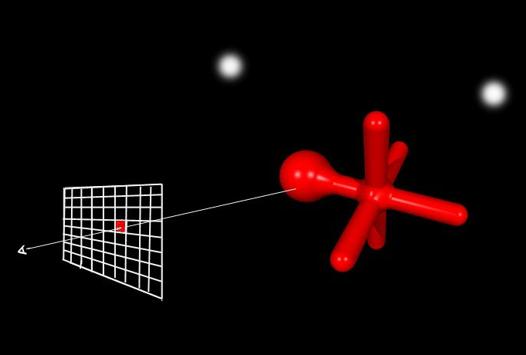
Ray thru pixel
With Ray Tracing

Slide 5

Flat blob
No Ray Tracing

Slide 6
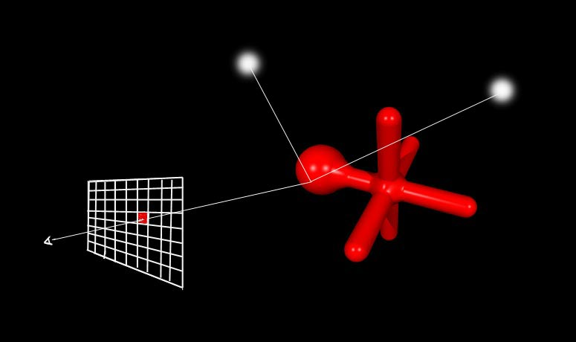
Bounce toward lights
Notes:
How would you know what color to use for each pixel of the image? The basic idea is to "shoot a ray" from the eye, through the pixel of the image, and see what part of the world model it hits first. If it hits a red object, we color that pixel red.
What would you get using this approach, do you think?

Slide 7
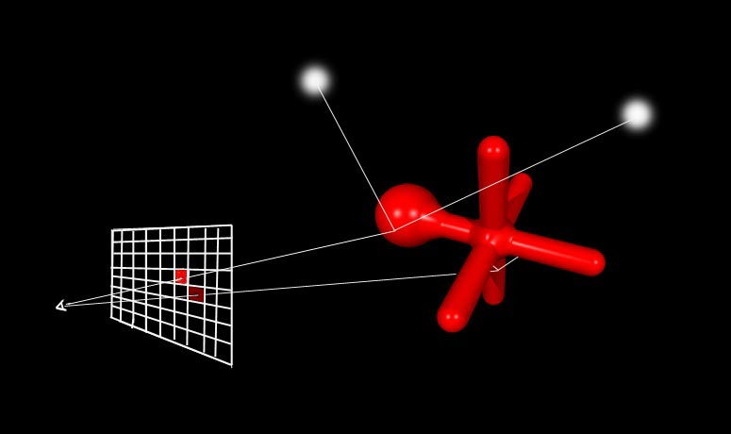
Shadows

Slide 8
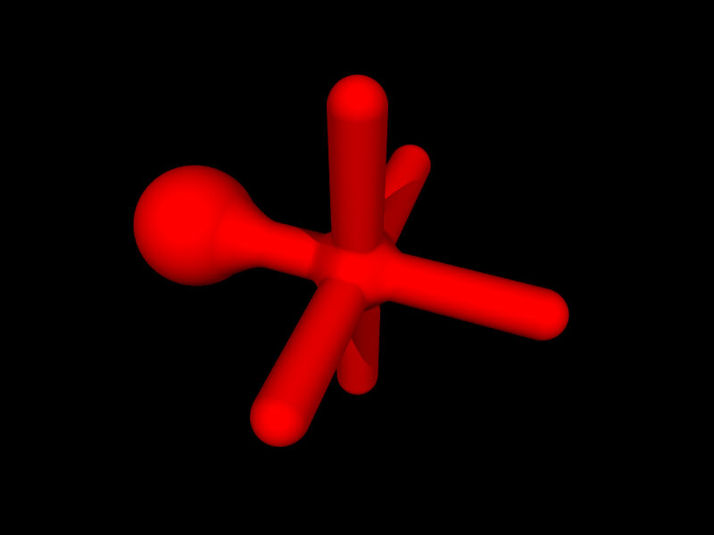
Shaded blob

Slide 9
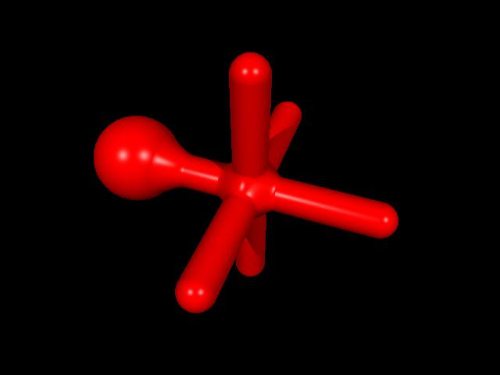
Blob with Highlights

Slide 10
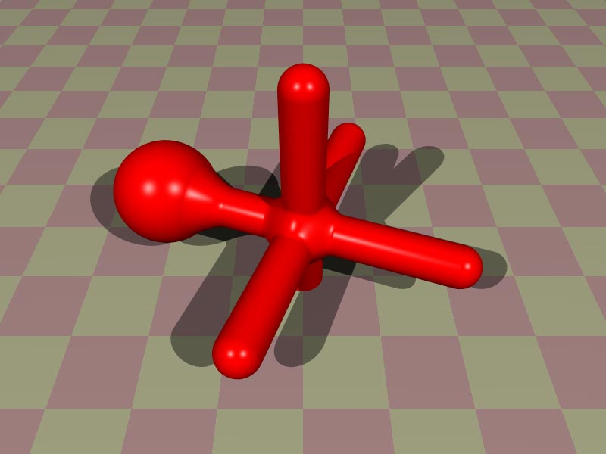
Blob with ground plane

Slide 11
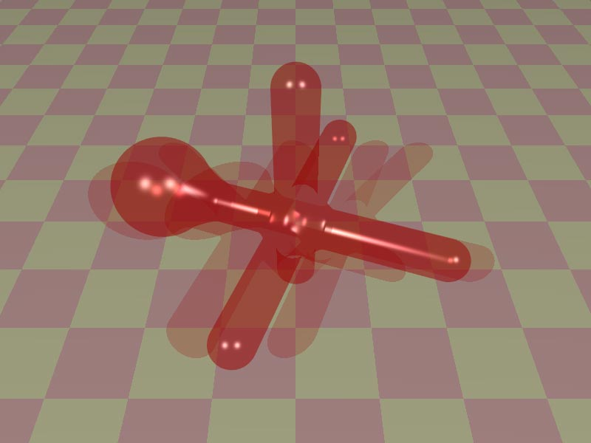
Blob with transparency

Slide 12
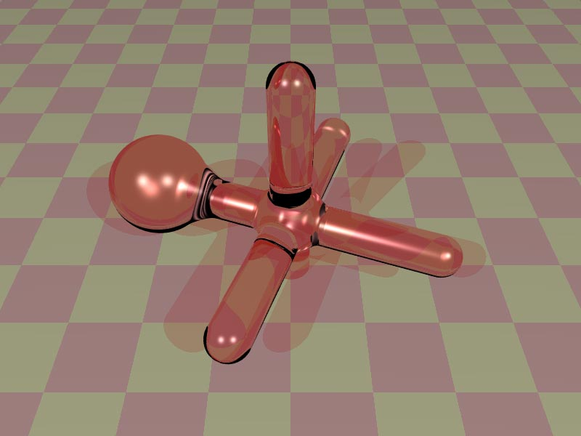
Blob with refraction

Slide 13
Types of illumination
Ambient – "light soup" that affects every point equally
Diffuse – shading that depends on the angle of the surface to the light source
Specular – 'highlights.' Falls off sharply away from the reflection direction

Slide 14
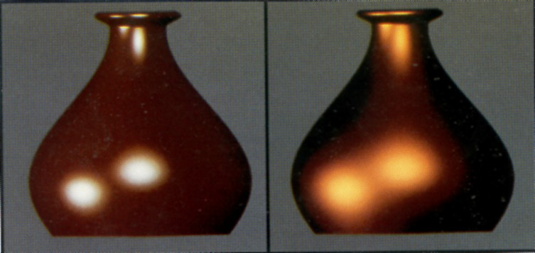
What are these made of?

Slide 15
Material types
Dielectrics (non-conductors):
  In body reflection, light penetrates the surface and is affected by material pigment
  Highlights are the color of the light source
  Examples: paint, plastic, wood, …
Conductors (metals)
  No light penetrates the surface
  Highlight and "body" reflection are affected equally by the material
  Same color for diffuse and specular reflection

Slide 16
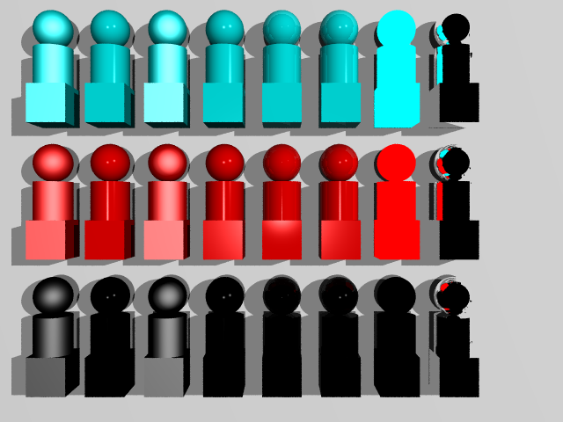
Finishes

Slide 17
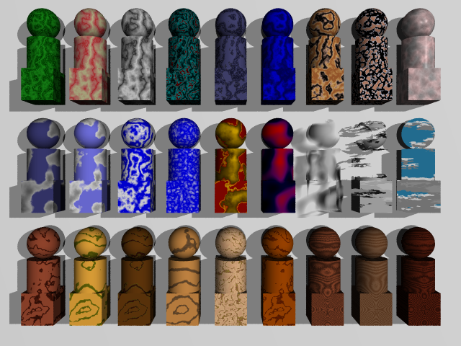
Textures

Slide 18
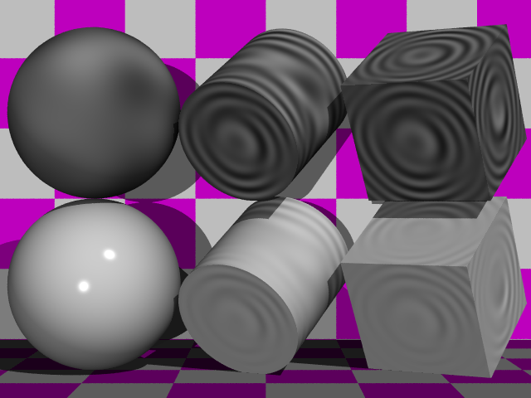
Surface (Ripples)

Slide 19
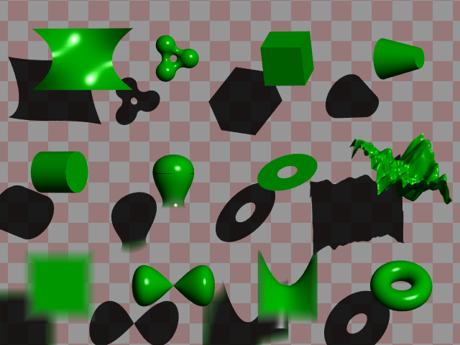
POV-Ray Primitives

Slide 20
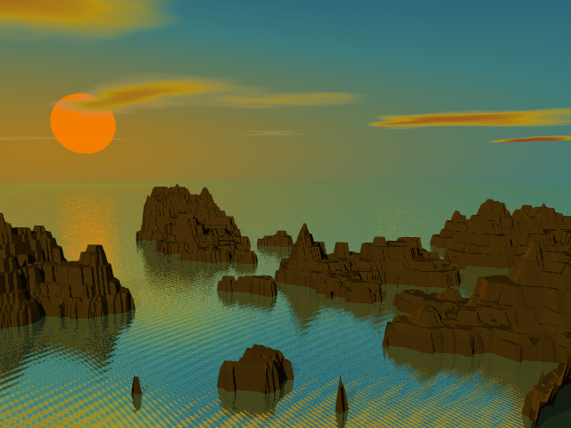
Sunsethf

Slide 21
How to ray-trace…
Transparency?
Refraction?
Reflection?
Fog?
Anti-aliasing?

Slide 22
Drawbacks of ray tracing?
Time: many rays are needed per pixel…
  Up to 25 rays through each pixel
  Each ray may bounce and split many times
  Each ray tested for intersection with many objects
  Need to be able to compute intersection with shape and ray, bounce angles, etc.
Shape limitations
Hard lighting
  No soft shadows, inter-object diffusion, etc

Slide 23
Beyond Ray Tracing
Problems with ray tracing:
  hard shadows
  no color bleeding
  Slow
  How else could you generate realistic-looking images – without the hard shadows and aliasing? Color bleed?

Slide 24
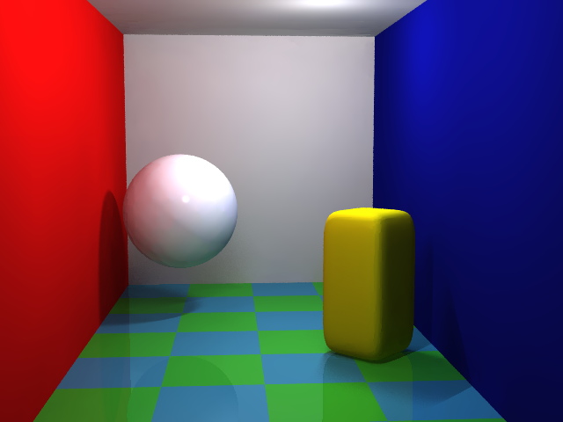
Radiosity in POV-Ray

Slide 25
Radiosity
Treat each patch as reflector and emitter of light
Each patch affects every other patch depending on distance, orientation, occlusion etc.
Let light "bounce around" for a few iterations to compute the amount of light reaching a patch

Slide 26
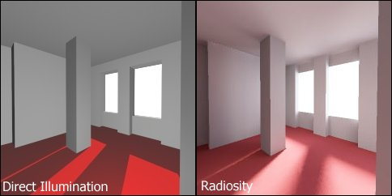
Image: Wikipedia

Slide 27
Form factors
We need to know the percentage of the light leaving one patch that reaches another (form factor).
How to compute?

Slide 28
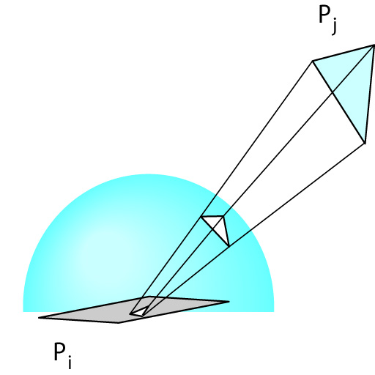
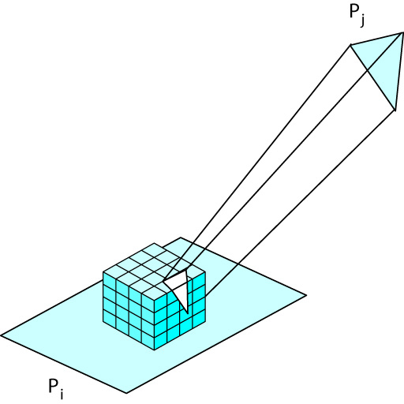
Hemicube algorithm
Form factor computation:
  Put a hemicube around patch reference point
  Render an image in each of five directions
  Count pixels…

Slide 29
Radiosity summary
Radiosity gives wonderful soft shading
But even slower than ray tracing…
Can't do reflection, refraction, specular highlights with radiosity
Can combine ray tracing and radiosity for best of both worlds (and twice the time)

Slide 30
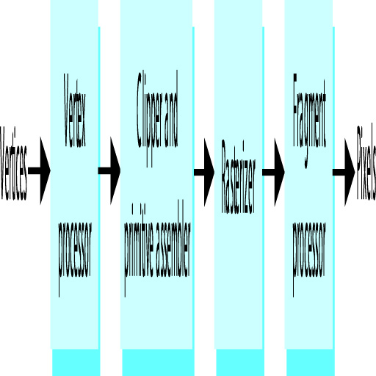
Rendering pipeline
Where does lighting happen? Shading? Reflections? Resizing and moving objects? Textures? Bump mapping? Displacement mapping? Hidden surface removal?
Notes:
This all happens in the “graphics pipeline”

Slide 31
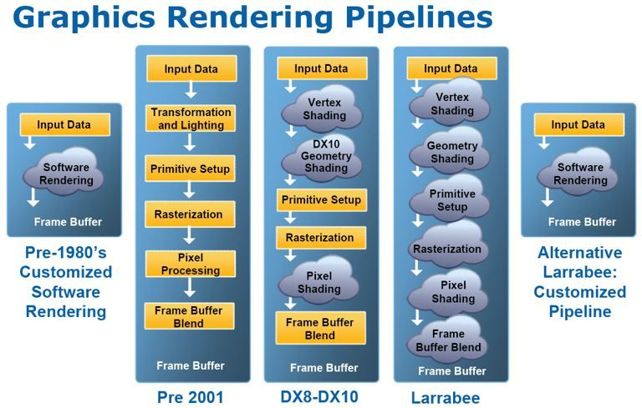
History of Interactive Graphics
http://www.geeks3d.com/20080810/graphics-rendering-pipelines/
Notes:
Here's Intel's vision of computer graphics hardware history
Intel's Larrabee – many cores, fully programmable, can be used for graphics
(or other things)
Released Dec. 09 – hasn't really caught on.
Graphics is data parallel. (Same processing on each pixel – ideal for parallelization.) Except not as much as Intel thought. Many different kinds of parallelism to exploit.
Intel was also shocked to find out that it can take longer to implement something in software on multi-core CPUs than in custom hardware. The were slow to the plate.
Also, hardware is more efficient for performance and cost/energy
(This take draws from a paper by Andrew Richards, "Why Intel Larrabee really stumbled: developer analysis")

Slide 32
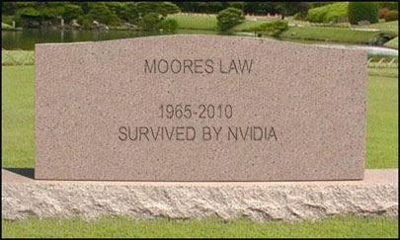
Nvidia: Moore's Law is Dead,
Multi-core Not Future
According to NVidia, the future is not a few cores optimized for serial performance speed, it's many smaller processors optimized for power consumption.

